Slide 1


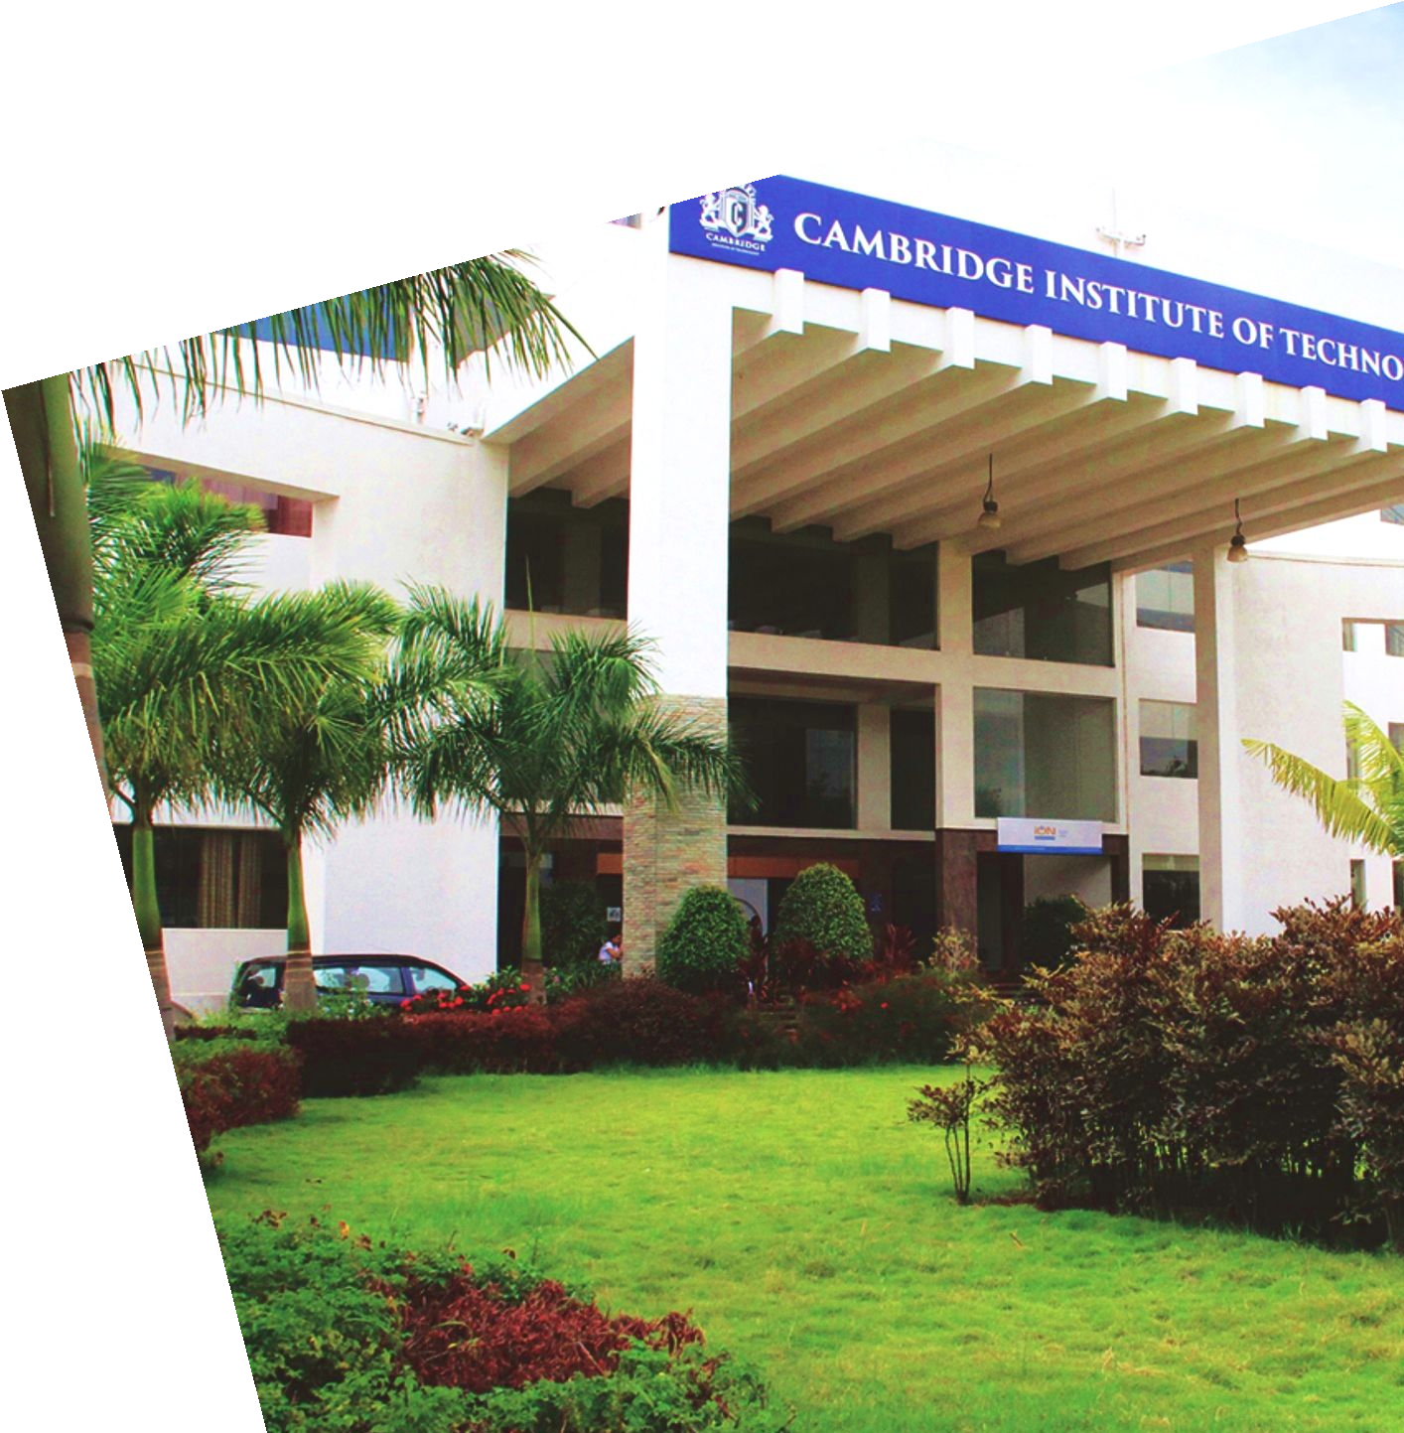
Project Presentation Phase I - Part II
By:
Shivanna 1CD21IS145
Utkarsh Kumar 1CD21IS171
Raviteja G K 1CD21IS133
Shaik Mohammad Afraz 1CD21IS139
Department of Information Science and Engineering
www.cambridge.edu.in

Slide 2

Objective
To propose an AI-based LSTM-CNN model for predicting stock market behavior to assist investors in making more informed decisions.
To evaluate the prediction accuracy of the LSTM-CNN model in comparison to other existing prediction models.
To explore how AI models like Long Short-Term Memory (LSTM) and Convolutional Neural Networks (CNN) can enhance risk management and portfolio diversification strategies for investors.
To improve investors' decision-making processes by leveraging reliable AI-based stock market forecasting techniques with high prediction accuracy.
Department of Information Science And Engineering
www.cambridge.edu.in

Slide 3
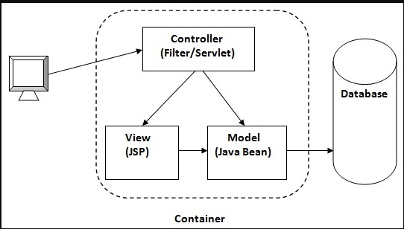
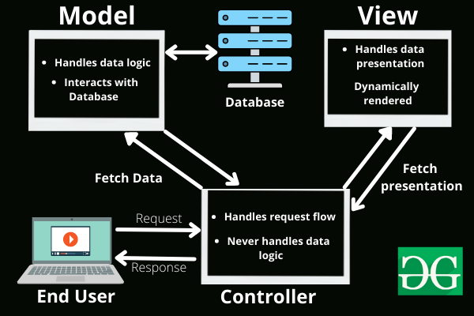

Architecture Diagram
Data Set
Data visualization
Train
Model
Department of Information Science And Engineering
www.cambridge.edu.in

Slide 4
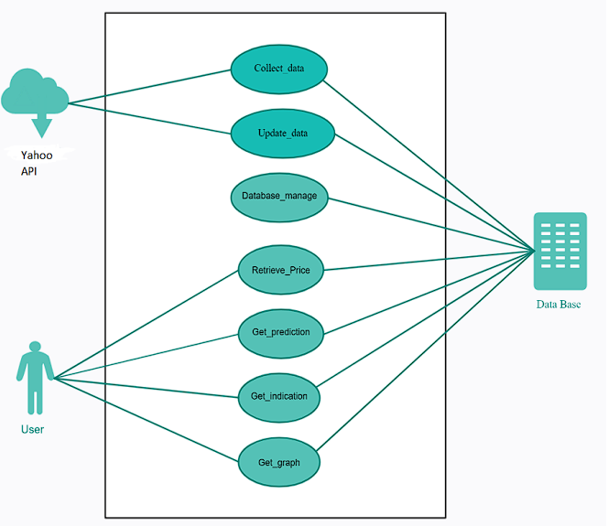
Use case diagram
Trusted Source
Predicted Data
User
Department of Information Science And Engineering
www.cambridge.edu.in

Slide 5
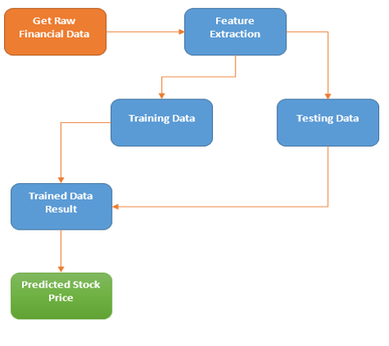
Flow chart
Department of Information Science And Engineering
www.cambridge.edu.in

Slide 6
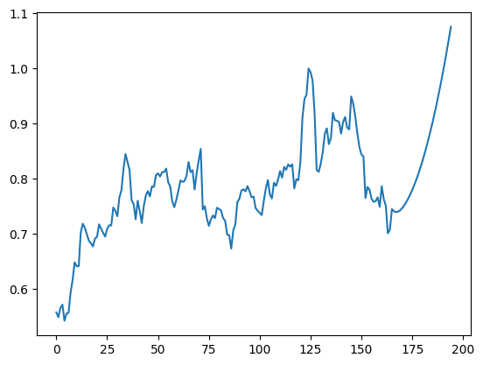
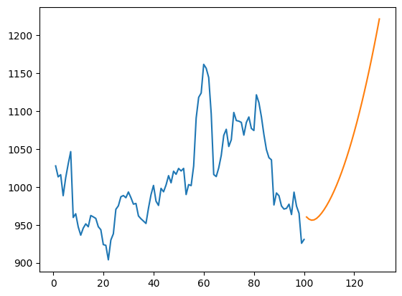
Stock Prediction - code output
Day One: [0.812 0.816 0.781 0.81 0.833 0.854 0.744 0.75 0.728 0.714 0.726 0.733
0.729 0.747 0.745 0.742 0.729 0.724 0.699 0.697 0.673 0.706 0.717 0.758
0.764 0.779 0.781 0.777 0.787 0.777 0.766 0.767 0.747 0.742 0.738 0.734
0.76 0.782 0.798 0.771 0.764 0.793 0.787 0.798 0.814 0.802 0.821 0.816
0.826 0.822 0.826 0.782 0.799 0.797 0.83 0.91 0.945 0.952 1. 0.993
0.978 0.917 0.816 0.812 0.827 0.848 0.881 0.891 0.863 0.874 0.92 0.906
0.905 0.903 0.882 0.903 0.912 0.893 0.889 0.949 0.936 0.912 0.883 0.858
0.844 0.84 0.765 0.785 0.78 0.763 0.758 0.759 0.766 0.749 0.786 0.763
0.751 0.701 0.707 0.745]
Till Specified date
Department of Information Science And Engineering
www.cambridge.edu.in

Slide 7
Thank you

