Slide 1
Digital Portfolio
STUDENT NAME: SAKTHI.M
REGISTER NO AND NMID: asanm212anm212bca022
DEPARTMENT: BCA Bachelor of Computer Application
COLLEGE: COLLEGE/ UNIVERSITY: Siddhar Sivagnaani arts and Science College

Slide 2
PROJECT TITLE: INTERACTIVE STUDENT PORTFOLIO WEBSITE

Slide 3


AGENDA
Problem Statement
Project Overview
End Users
Tools and Technologies
Portfolio design and Layout
Features and Functionality
Results and Screenshots
Conclusion
Github Link
3/21/2024 Annual Review

Slide 4

PROBLEM STATEMENT: Traditional resumes lack design, interactivity and easy access.Students need a digital portfolio to showcase the skills, projects and achievements.

Slide 5

PROJECT OVERVIEW An interactive Portfolio Website using HTML, CSS, JS. Includes section like Home, About, Skills, Project and Contact. Features are Animation, Theme Changer, Project Models, Responsive design.

Slide 6

WHO ARE THE END USERS? Students Teachers Employers Friends

Slide 7

TOOLS AND TECHNIQUES Languages are HTML for structure, CSS for design and JS for interactivity Webpage. Techniques are Local storage, CSS Animation.

Slide 8
Interactive Student Portfolio Website
Interactive Student Portfolio Website: This dynamic online portfolio showcases a student's academic journey, skills, and projects. Designed for easy navigation, it highlights achievements and personal growth. The site is interactive, allowing visitors to explore multimedia content. Regularly updated, it reflects the student's latest accomplishments. Perfect for sharing with educators, peers, or future employers.

Slide 9
POTFOLIO DESIGN AND LAYOUT
Portfolio Design and Layout: The layout features a clean, modern design with a blue gradient background for visual appeal. Sections are clearly divided for easy access to different content areas. Responsive design ensures compatibility across devices. Intuitive navigation enhances user experience. Customizable elements allow for personal branding.
9

Slide 10
FEATURES AND FUNCTIONALITY
Features and Functionality: Includes a gallery for project showcases with images and descriptions. Interactive resume section with downloadable PDF option. Contact form for direct communication. Embedded video or audio clips to demonstrate skills. Social media integration for broader reach.

Slide 11

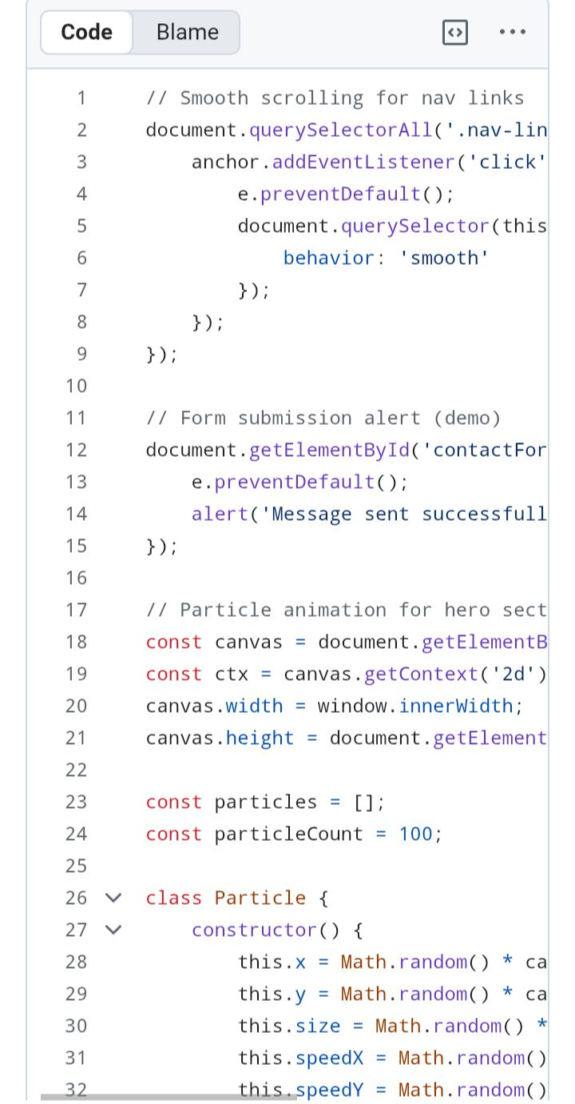
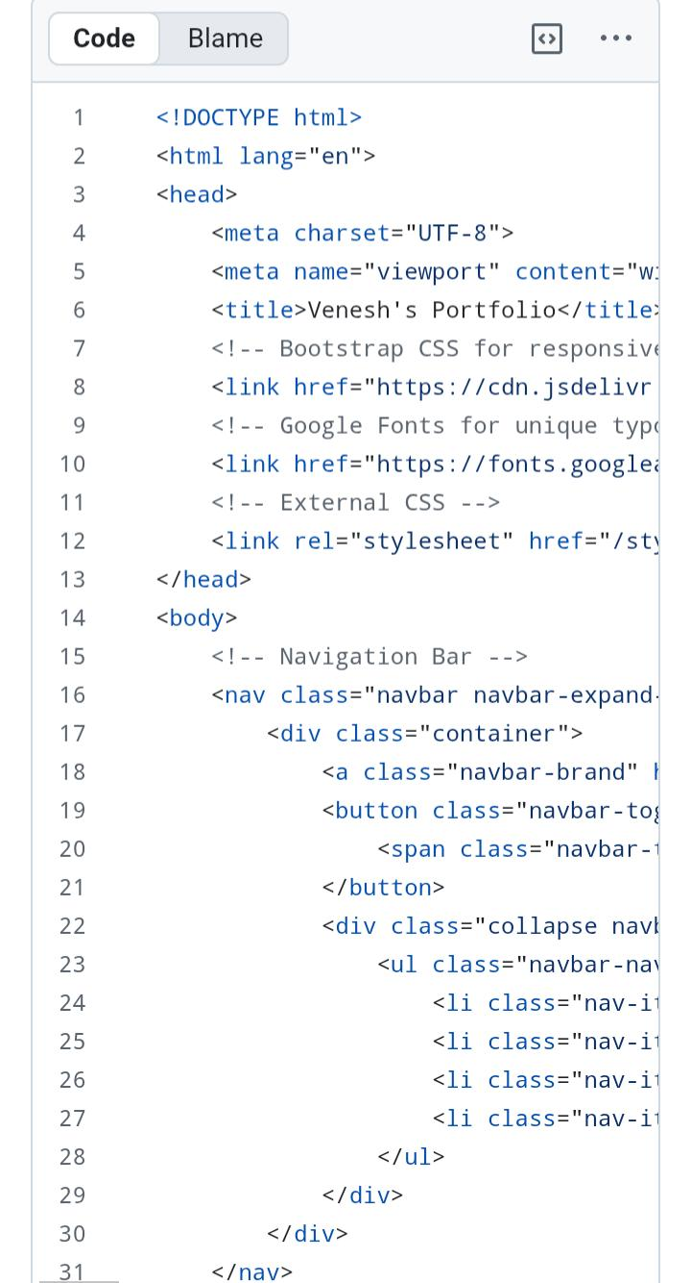
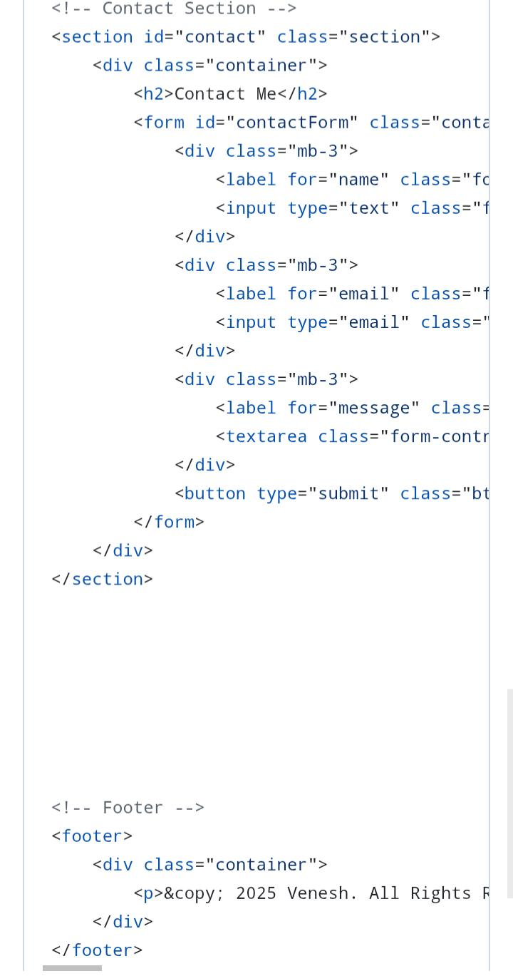
RESULTS AND SCREENSHOTS
3/21/2024 Annual Review
11

Slide 12
CONCLUSION
This portfolio represents my journey of learning and self-improvement.It highlights my key projects and the skills I have developed.I am committed to applying my knowledge in future endeavors.This experience has strengthened my confidence and creativity.I am excited to pursue new challenges and continue growing.Let me know if you'd like to adjust or expand this, or if you'd like help editing the image!
12

