Slide 1



CardioShield AI
AI-Powered Early Cardiovascular Risk Detection
PYTHON
SCIKIT-LEARN
FLASK
XGBOOST
LIGHTGBM
NEURAL NETWORKS
ENSEMBLE
Notes:
1

Slide 2
The Critical Need: Addressing Cardiovascular Diseases
Global Mortality Crisis
Early Detection Saves Lives
Cardiovascular diseases remain the leading cause of death worldwide, demanding urgent solutions.
Timely prediction of risk factors can significantly reduce mortality rates and improve patient outcomes.
Limitations of Current Methods
AI for Low-Cost Stratification
Traditional screening methods are often expensive, resource-intensive, and reactive, missing crucial early indicators.
There's a pressing need for a low-cost, proactive AI-based system for accurate risk stratification.
Notes:
2

Slide 3
CardioShield Dataset: Unveiling Health Indicators
Our predictive model is built upon a robust, real-world structured medical dataset, specifically curated to capture key cardiovascular health parameters.
Key Features
Target Variable
  Age, Height, Weight, Gender
  Blood Pressure (Systolic & Diastolic)
  Cholesterol Levels
  Glucose Levels
  Lifestyle Factors (Smoke, Alcohol, Physical Activity)
  Cardio (0 = No Disease , 1 = Disease): Our clear objective is to accurately predict the presence or absence of cardiovascular disease.
Notes:
3

Slide 4

Data Engineering: Sculpting Insights from Raw Data
Data Processing
Feature Engineering
Encode Categorical
Normalize & Split
Rigorous data preprocessing is the foundation of our robust AI model, transforming raw clinical data into a refined format suitable for machine learning.
Notes:
4

Slide 5




Model Development: A Multi-faced Approach
XGBoost
LightGBM
A high-performance gradient boosting framework known for its speed and accuracy.
Another efficient gradient boosting framework, optimized for large datasets and parallel processing.
Neural Networks
Ensemble/Stacking
Deep learning architectures capable of learning complex non-linear relationships in data.
Combining the strengths of multiple models to achieve superior predictive power and robustness.
Our approach involves training and rigorously comparing a diverse set of machine learning models to identify the most effective solution for cardiovascular risk prediction.
Notes:
5

Slide 6
Model Performance Results: Comparative Analysis
Model
Accuracy
Recall
Precision
ROC AUC
PR-AUC
XGBoost
0.89
0.90
0.88
0.97
0.97
LightGBM
0.87
0.88
0.86
0.96
0.96
Neural Network
0.89
0.90
0.87
0.96
0.96
Stacking
0.89
0.91
0.88
0.97
0.97
All four models demonstrate comparable high performance, with Stacking model showing slightly higher recall (0.91), making it an excellent choices for identifying cardiovascular disease cases where missing a positive case is critical.
Notes:
6

Slide 7
Risk Classification Framework
CardioShield AI categorizes users into distinct risk profiles, enabling personalized interventions and proactive healthcare management based on individual model predictions and health data.
🟢 Low Risk
🟠 Medium Risk
🔴 High Risk
Model Prediction Probability: 0-42%
Model Prediction Probability: 42-65%
Model Prediction Probability: 65-100%
Characteristics: Healthy vital signs, normal cholesterol, and positive lifestyle factors.
Characteristics: Presence of some elevated markers, borderline values, or mixed lifestyle factors.
Characteristics: Multiple elevated markers, concerning vital signs, or detrimental lifestyle factors.
Recommendation: Maintain healthy habits and adhere to routine check-ups for continued wellness.
Recommendation: Implement targeted lifestyle modifications, regular monitoring, and consult a healthcare provider for guidance.
Recommendation: Seek immediate medical consultation, engage in intensive monitoring, and consider preventive treatment options.
Notes:
7

Slide 8
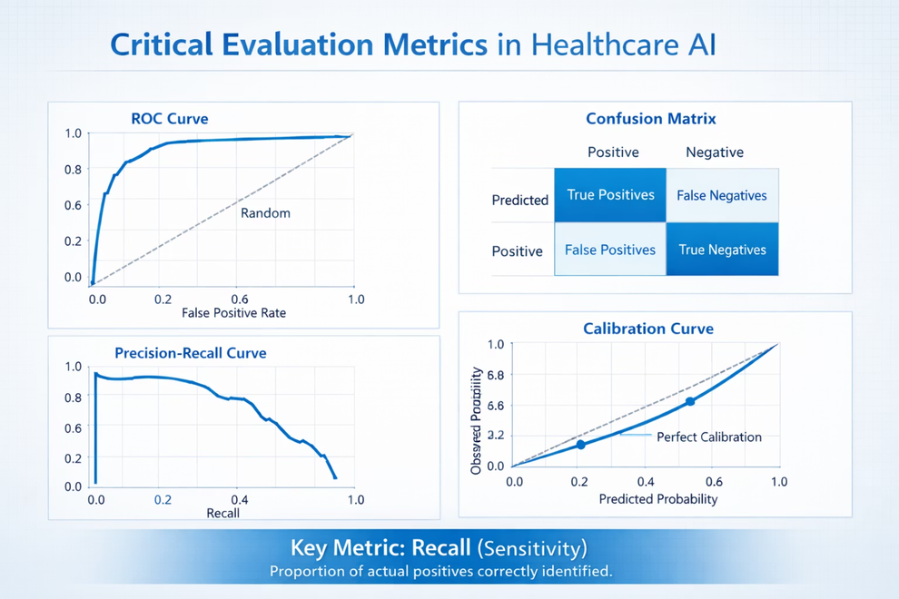
Critical Evaluation Metrics in Healthcare ML
Why Recall is Paramount in Healthcare: In medical diagnoses, missing a true positive (False Negative) can have life-threatening consequences. High recall ensures that as many disease cases as possible are identified, even if it means a few false alarms (False Positives).
Accuracy
Precision
Recall (Sensitivity)
ROC-AUC Score
Overall correctness of the model's predictions.
Proportion of positive identifications that were actually correct.
Proportion of actual positives that were identified correctly.
Measures the ability of the model to distinguish between classes.
Notes:
8

Slide 9
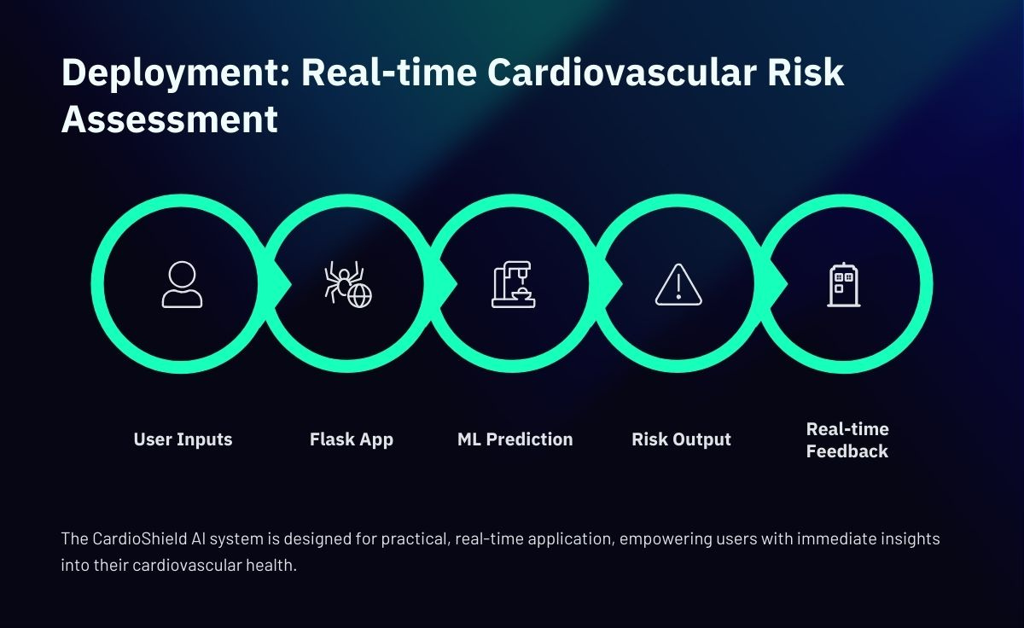

Slide 10






CardioShield AI: Innovation, Impact & Future Horizons
Immediate Impact & Benefits
Future Enhancements
Hospital API Integration
Seamless data exchange with existing electronic health record systems.
Low-Cost Screening
Preventive Healthcare
Democratizes early detection, making it accessible to a broader population.
Empowers individuals and clinicians with proactive risk assessment.
Wearable Device Integration
Leveraging continuous data streams from smartwatches and fitness trackers.
Mobile App Version
Providing a user-friendly interface for on-the-go risk assessment.
Scalability
Designed for deployment in diverse settings, including underserved rural areas.
Notes:
10

Slide 11
Thank You
CardioShield AI – Early Detection. Smarter Prevention. Healthier Lives.
Hackathon: NavKalpana AI Innovation Challenge
Team Name: NavKalpana-RICR-NK-0046
Presented By:Shivansh Dhakad (Team Lead & Backend)
Aman Kumar Pandey (Data Analysis & Preprocessing)
Sonu Yadav (Model Building & Shap Analysis)
Tanishka Sharma (Frontend & Real Word Analysis)
Notes:
11

