Slide 1

Seasonal Agriculture Performance Analysis
Shivansh Mishra
Feroze Gandhi Institute of Engineering and Technology
AICTE STU ID : STU682f5470736fd1747932272

Slide 2

PROBLEM STATEMENT
(
Raw agricultural data contains environmental, farming, resource, production and economic information, but seasonal differences are not immediately clear.
The project analyzes seasonal variation in crop yield, production, environment, resource use, water efficiency, profit and disease/pest risk.

Slide 3
Project Description
This project focuses on analyzing agricultural performance across different seasons, crops, and geographical regions using data visualization and statistical analysis.
The analysis examines important factors such as crop yield, production, rainfall, temperature, soil conditions, irrigation, fertilizer usage, water efficiency, disease/pest risk, revenue, cost, and profit.
The project identifies seasonal patterns, crop-wise variations, relationships between environmental and agricultural factors, and unusual observations. The insights obtained from the analysis can help in better crop planning, resource management, and improving agricultural productivity and profitability.

Slide 4

WHO ARE THE END USERS?
• Farmers – seasonal crop and resource planning
• Agricultural planners – evidence-based decisions
• Farm managers – yield, cost and water monitoring
• Researchers/analysts – pattern discovery
• Policy/advisory teams – regional planning

Slide 5

Technology Used
Python
• Pandas – data cleaning and aggregation
• NumPy – numerical operations
• Matplotlib – visualization
• Seaborn – statistical plots
• SciPy – statistical tests
• Jupyter Notebook – analysis and documentation

Slide 6
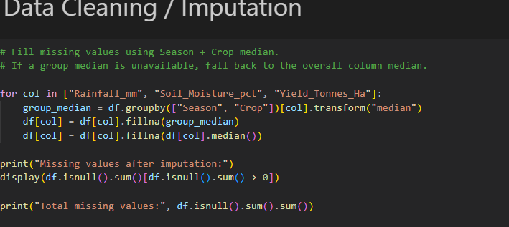
RESULTS

Slide 7
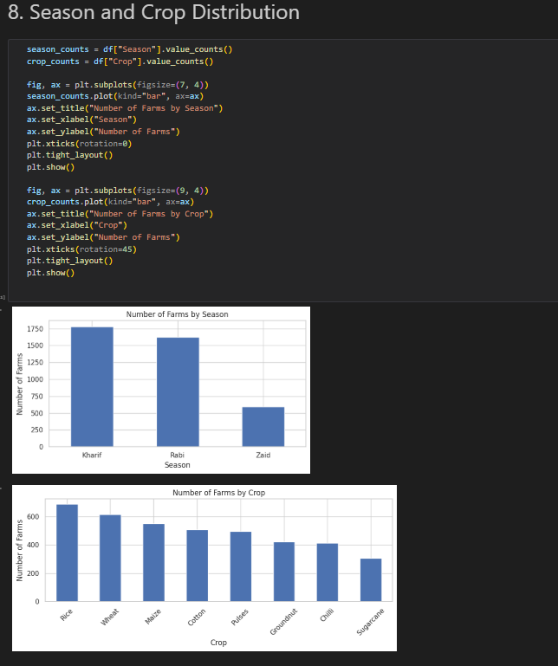
RESULTS :

Slide 8
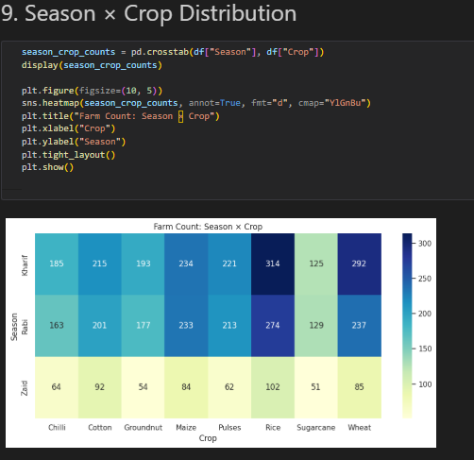
RESULTS
[Add screen shots of your code ]

Slide 9
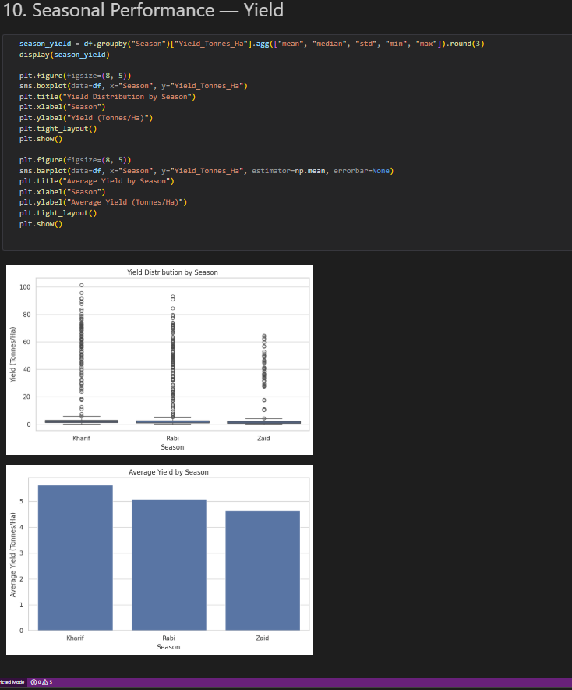
RESULTS

Slide 10
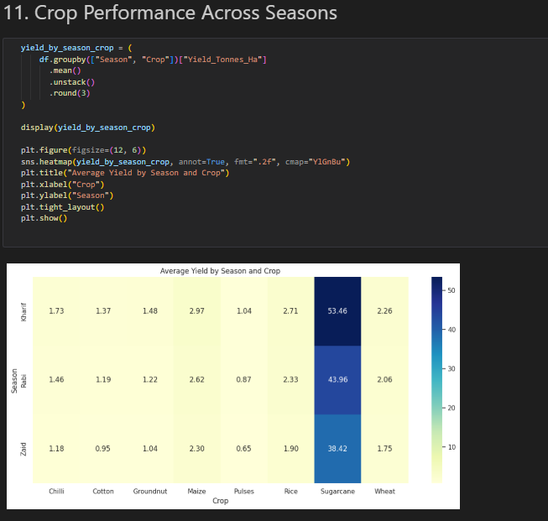
RESULTS
[Add screen shots of your code ]

Slide 11
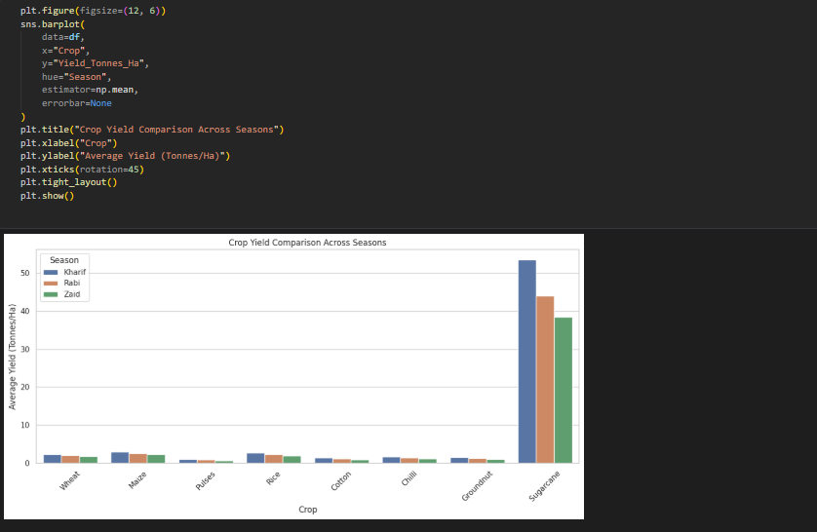
RESULTS

Slide 12
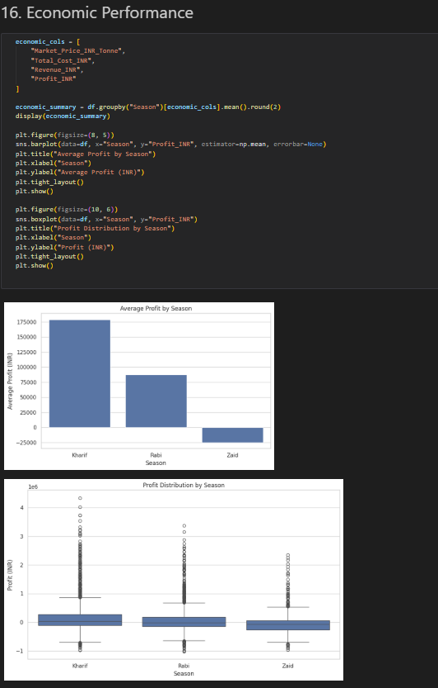
RESULTS

Slide 13
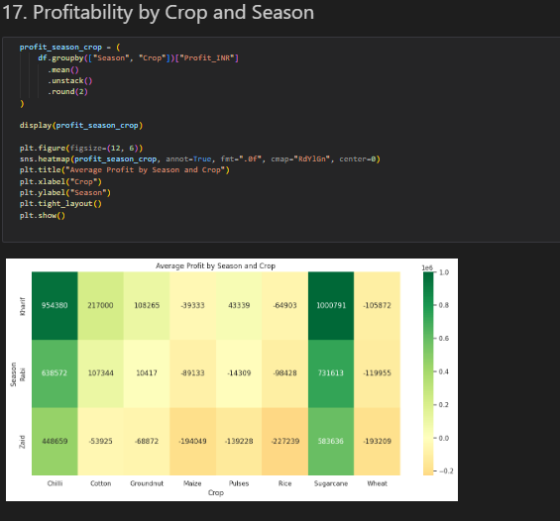
RESULTS

Slide 14
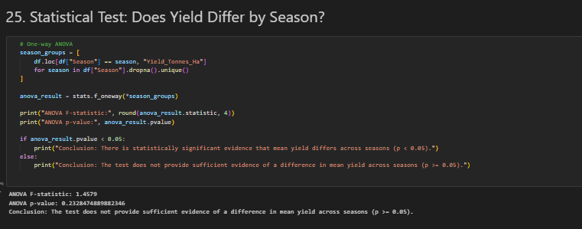
RESULTS

Slide 15
Future scope
• Machine-learning models for yield and profit prediction
• Multi-year weather and market-price integration
• Farmer-facing dashboard
• Location-specific crop recommendations
• Irrigation and disease/pest forecasting
• Model comparison using suitable evaluation metrics

Slide 16
GitHub Link: https://github.com/shivansh0052/Seasonal-Agriculture-Performance-Analysis

Slide 17

VOIS Course completion certificate -
Course name- Data Visualization

Slide 18
Thank You
.
.

