Slide 1


Slide 2


Slide 3


Slide 4


Slide 5
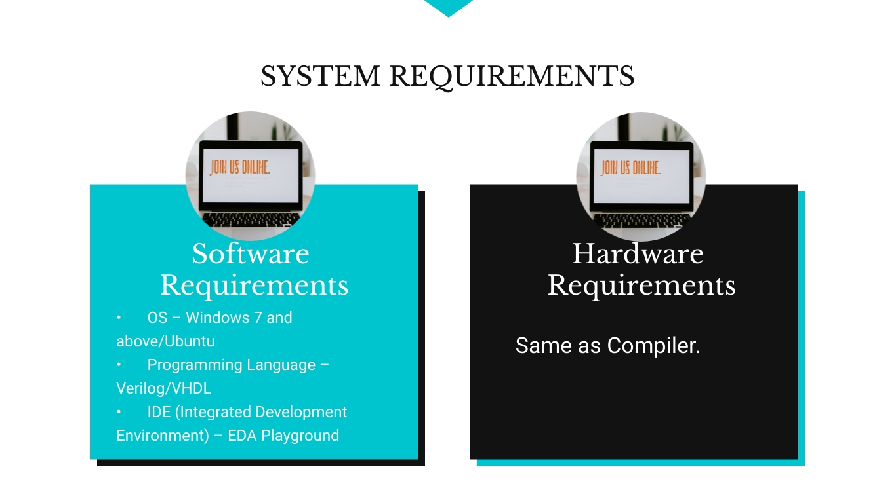

Slide 6
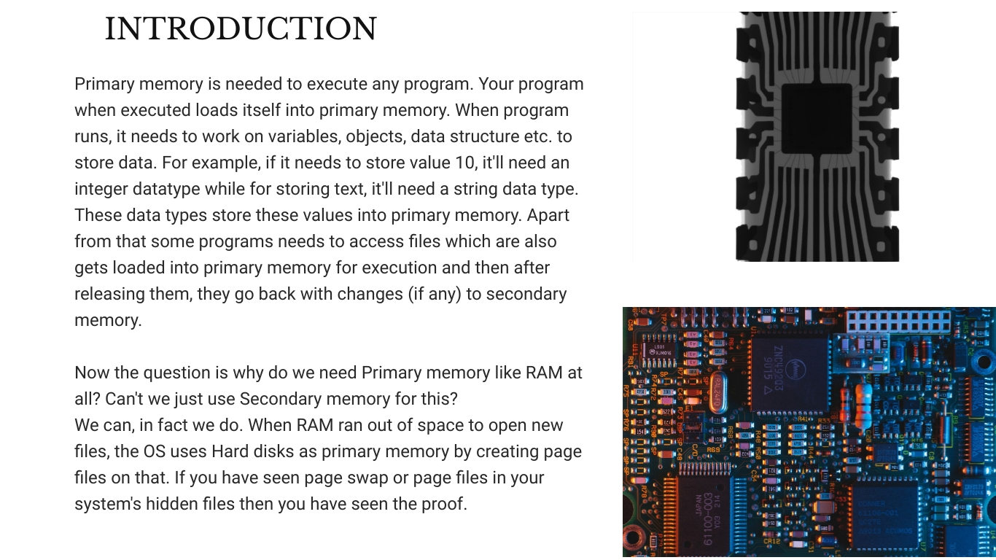

Slide 7
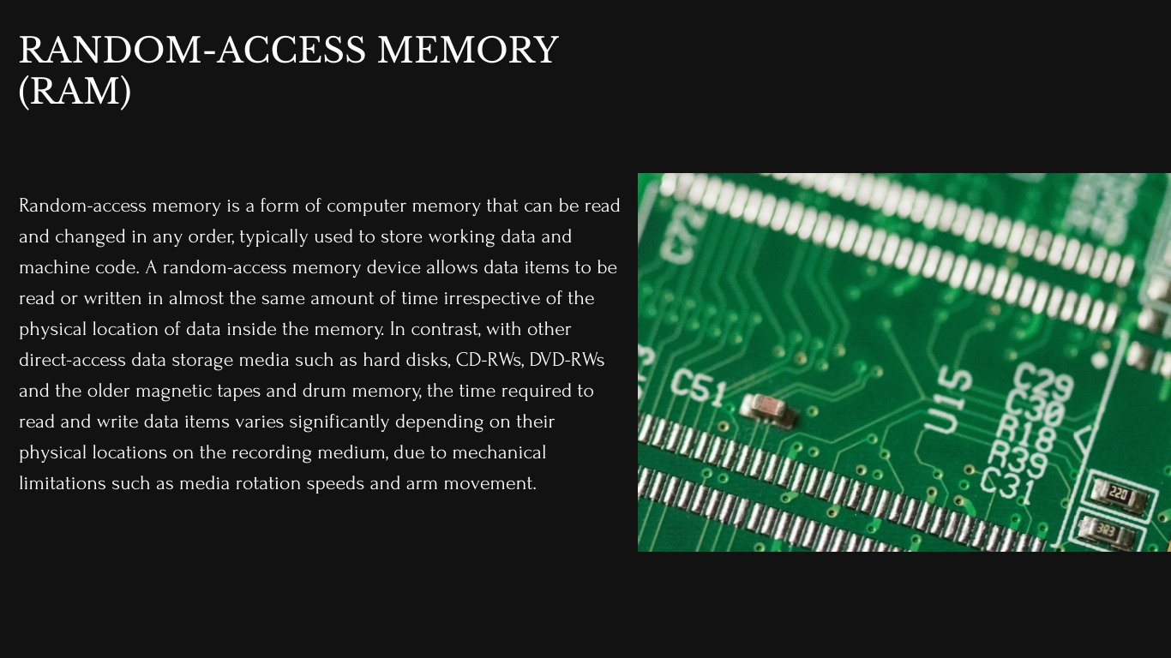

Slide 8
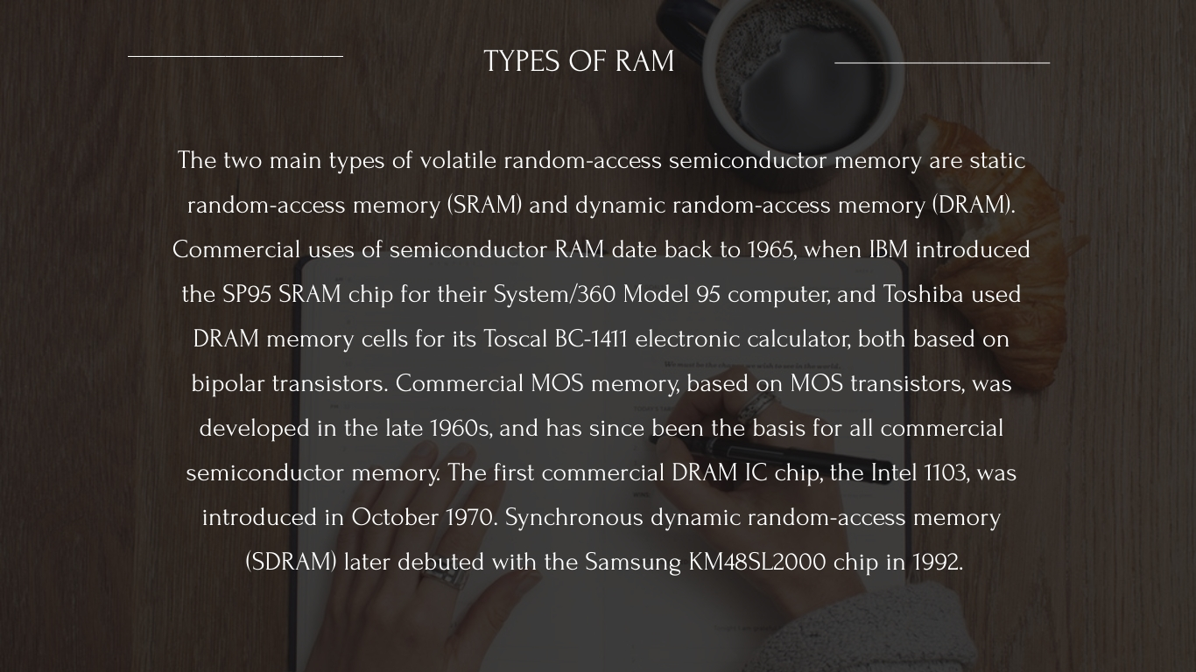

Slide 9
CODE IMPLEMENTATION OF RAM
Design Code:
module single_port_ram(
input [7:0] data,
input [5:0] addr,
input we,clk,
output [7:0] q
);
reg [7:0] ram [63:0];
reg [7:0] addr_reg;
always @ (posedge clk)
begin
if(we)
ram[addr]<=data;
else
addr_reg<=addr;
end
assign q = ram[addr_reg];
endmodule

Slide 10
CODE IMPLEMENTATION OF RAM
Test Bench Code:
module single_port_ram_tb();
reg [7:0] data;
reg [5:0] addr;
reg we;
reg clk;
wire [7:0] q;
single_port_ram single_port_ram(
.data(data),
.addr(addr),
.we(we),
.clk(clk),
.q(q)
);
initial begin
clk = 1'b1;
forever #50 clk = ~clk;
end
initial begin
$dumpfile("dump.vcd");
$dumpvars(1);
data = 8'h01;
addr = 5'd0;
we = 1'b1;
#100;
data = 8'h02;
addr = 5'd01;
#100;
data = 8'h03;

Slide 11
CODE IMPLEMENTATION OF RAM
Test Bench Code:
addr = 5'd02;
#100;
addr = 5'd0;
we = 1'b0;
#100;
addr = 5'd1;
#100;
addr = 5'd2;
#100 $finish;
end
endmodule

Slide 12
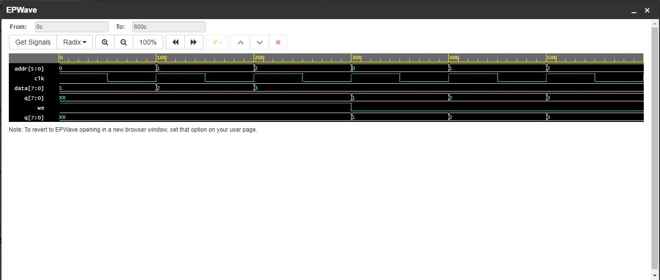
OUTPUT OF RAM

Slide 13
CODE IMPLEMENTATION OF ROM
Design Code:
module simple_rom(
input [1:0] addr,
output reg [7:0] data
);
always @(*)
begin
case (addr)
0: data = 8'd05;
1: data = 8'd10;
2: data = 8'd15;
3: data = 8'd20;
endcase
end
endmodule

Slide 14
CODE IMPLEMENTATION OF ROM
Test Bench Code:
module simple_rom_tb();
reg [1:0] addr;
wire [7:0] data;
simple_rom simple_rom(
.addr(addr),
.data(data)
);
initial begin
$dumpfile("dump.vcd");
$dumpvars;
addr = 2'd3;
#10;
addr = 2'd2;
#10;
addr = 2'd1;
#10;
addr = 2'd0;
#10;
end
endmodule

Slide 15
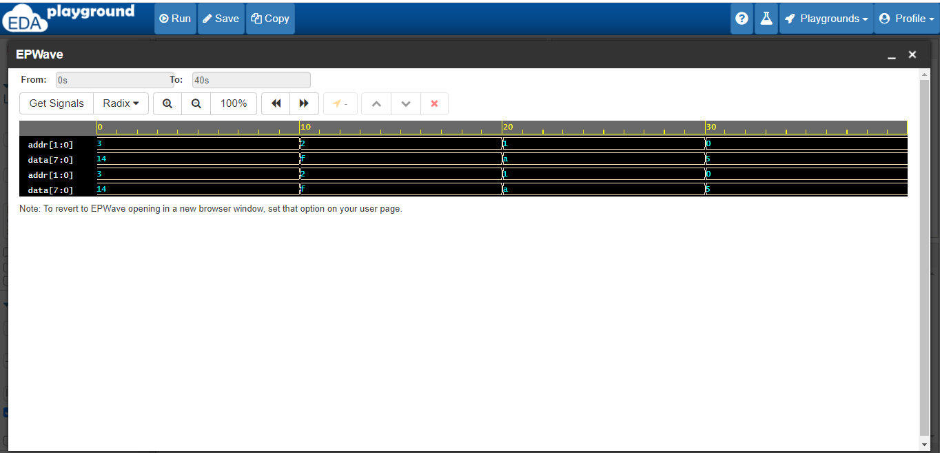
OUTPUT OF ROM

Slide 16
THANK YOU

