Slide 1

SMART INDIA HACKATHON 2026
TITLE PAGE
Problem Statement ID – SIH26160
Problem Statement Title- AI-Powered IPsec VPN Protocol Analyzer & Security Assessment Framework
Theme- [Enter theme from PS portal]
PS Category- Software
Team ID- [Enter Team ID]
Team Name- VaultScope

Slide 2
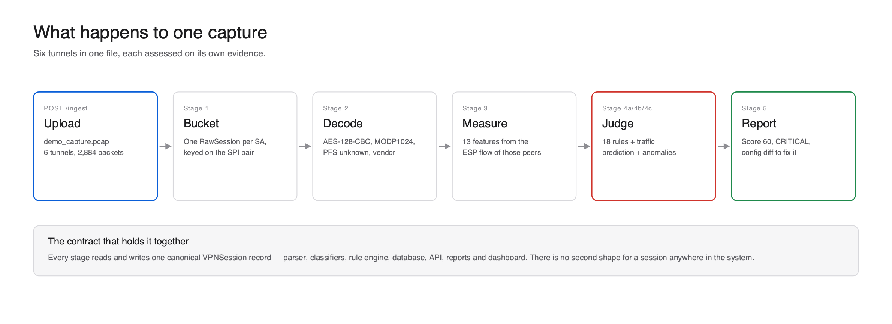
VAULTSCOPE
VaultScope
Passive-first platform: decodes every IKE handshake in cleartext, infers what's inside the encrypted ESP tunnel via ML, and scores each session against a CVE-linked rule engine — one capture in, an assessed and scored session record out:

Slide 3
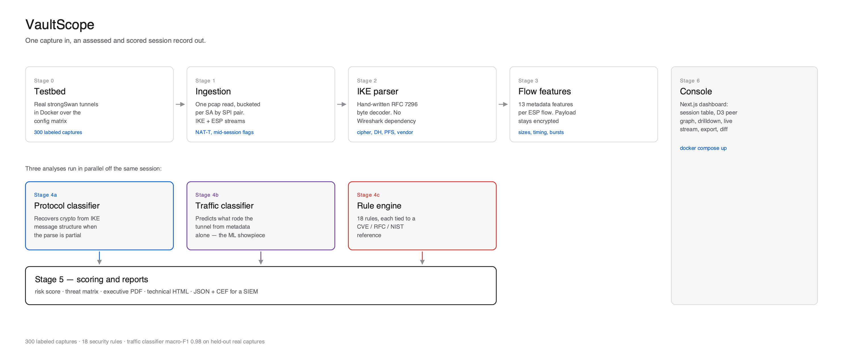
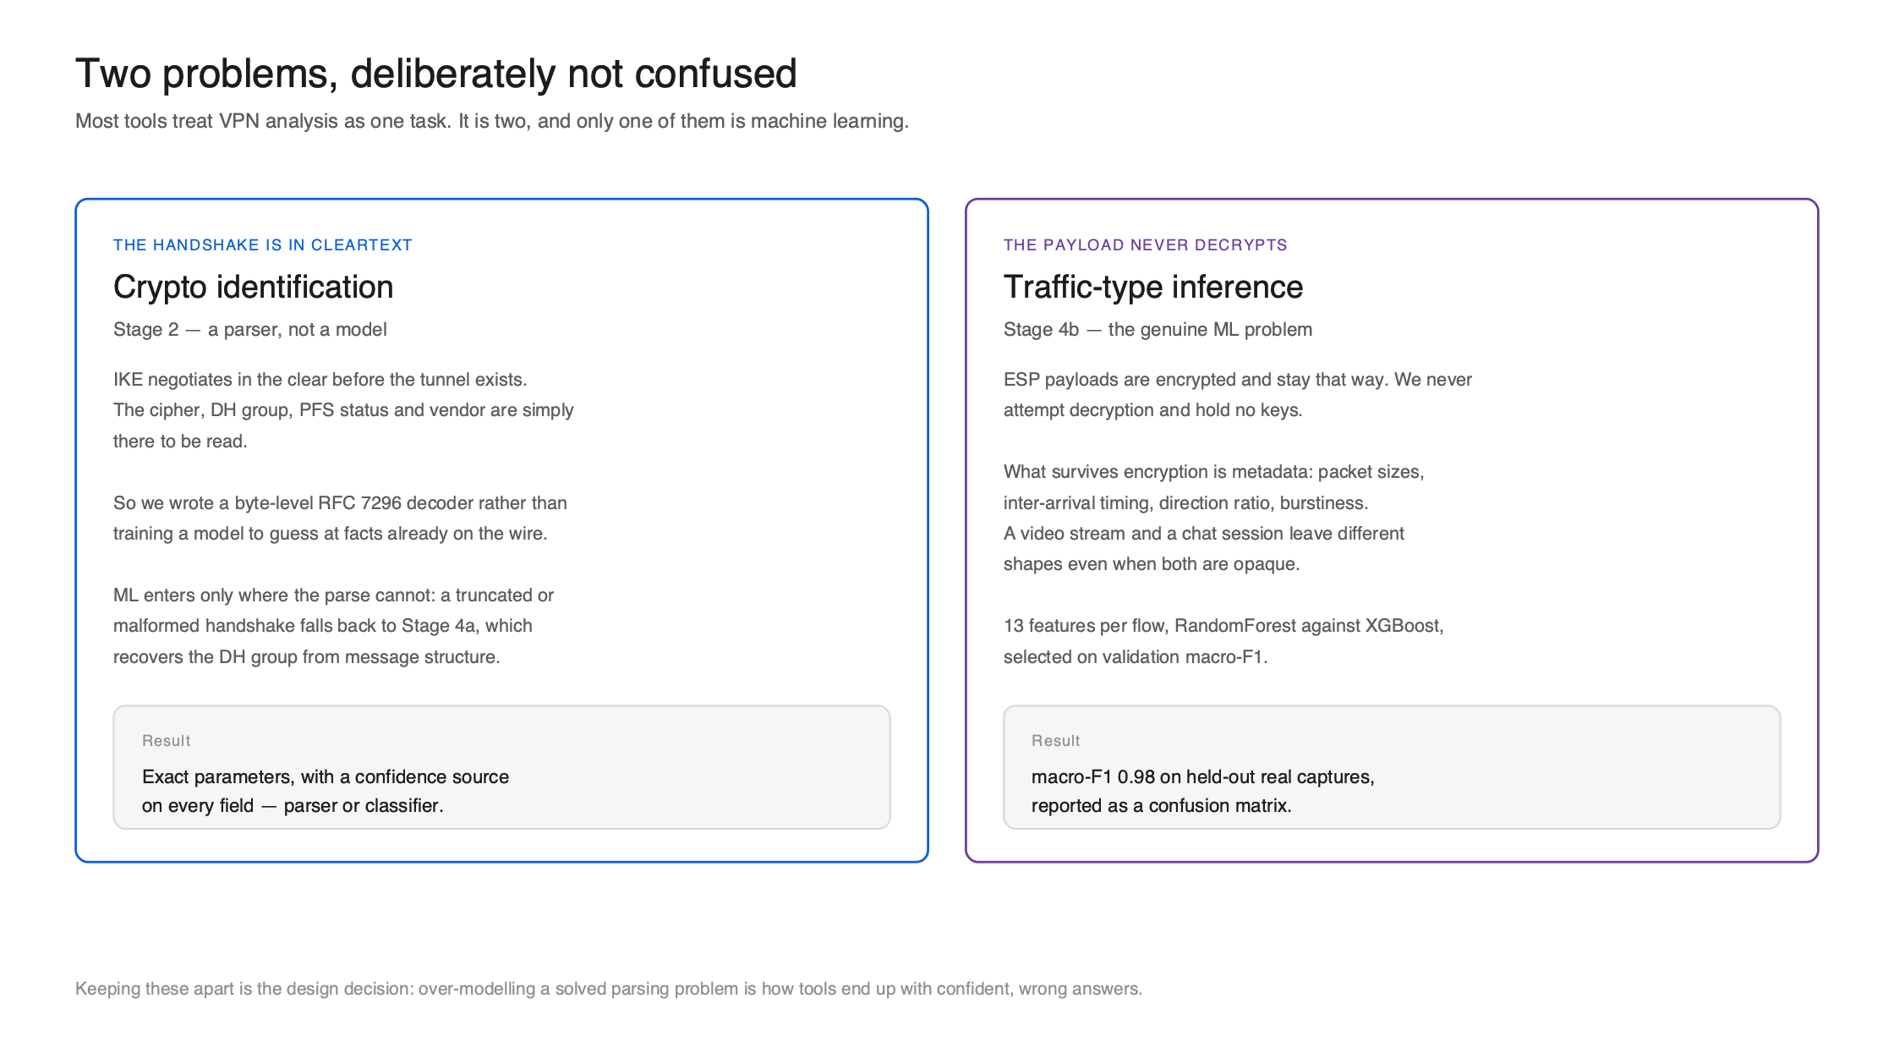
TECHNICAL APPROACH
VaultScope
Architecture and methodology — Python/FastAPI, scikit-learn + XGBoost, strongSwan/Docker testbed, React + D3 dashboard, every stage sharing one canonical session record:

Slide 4
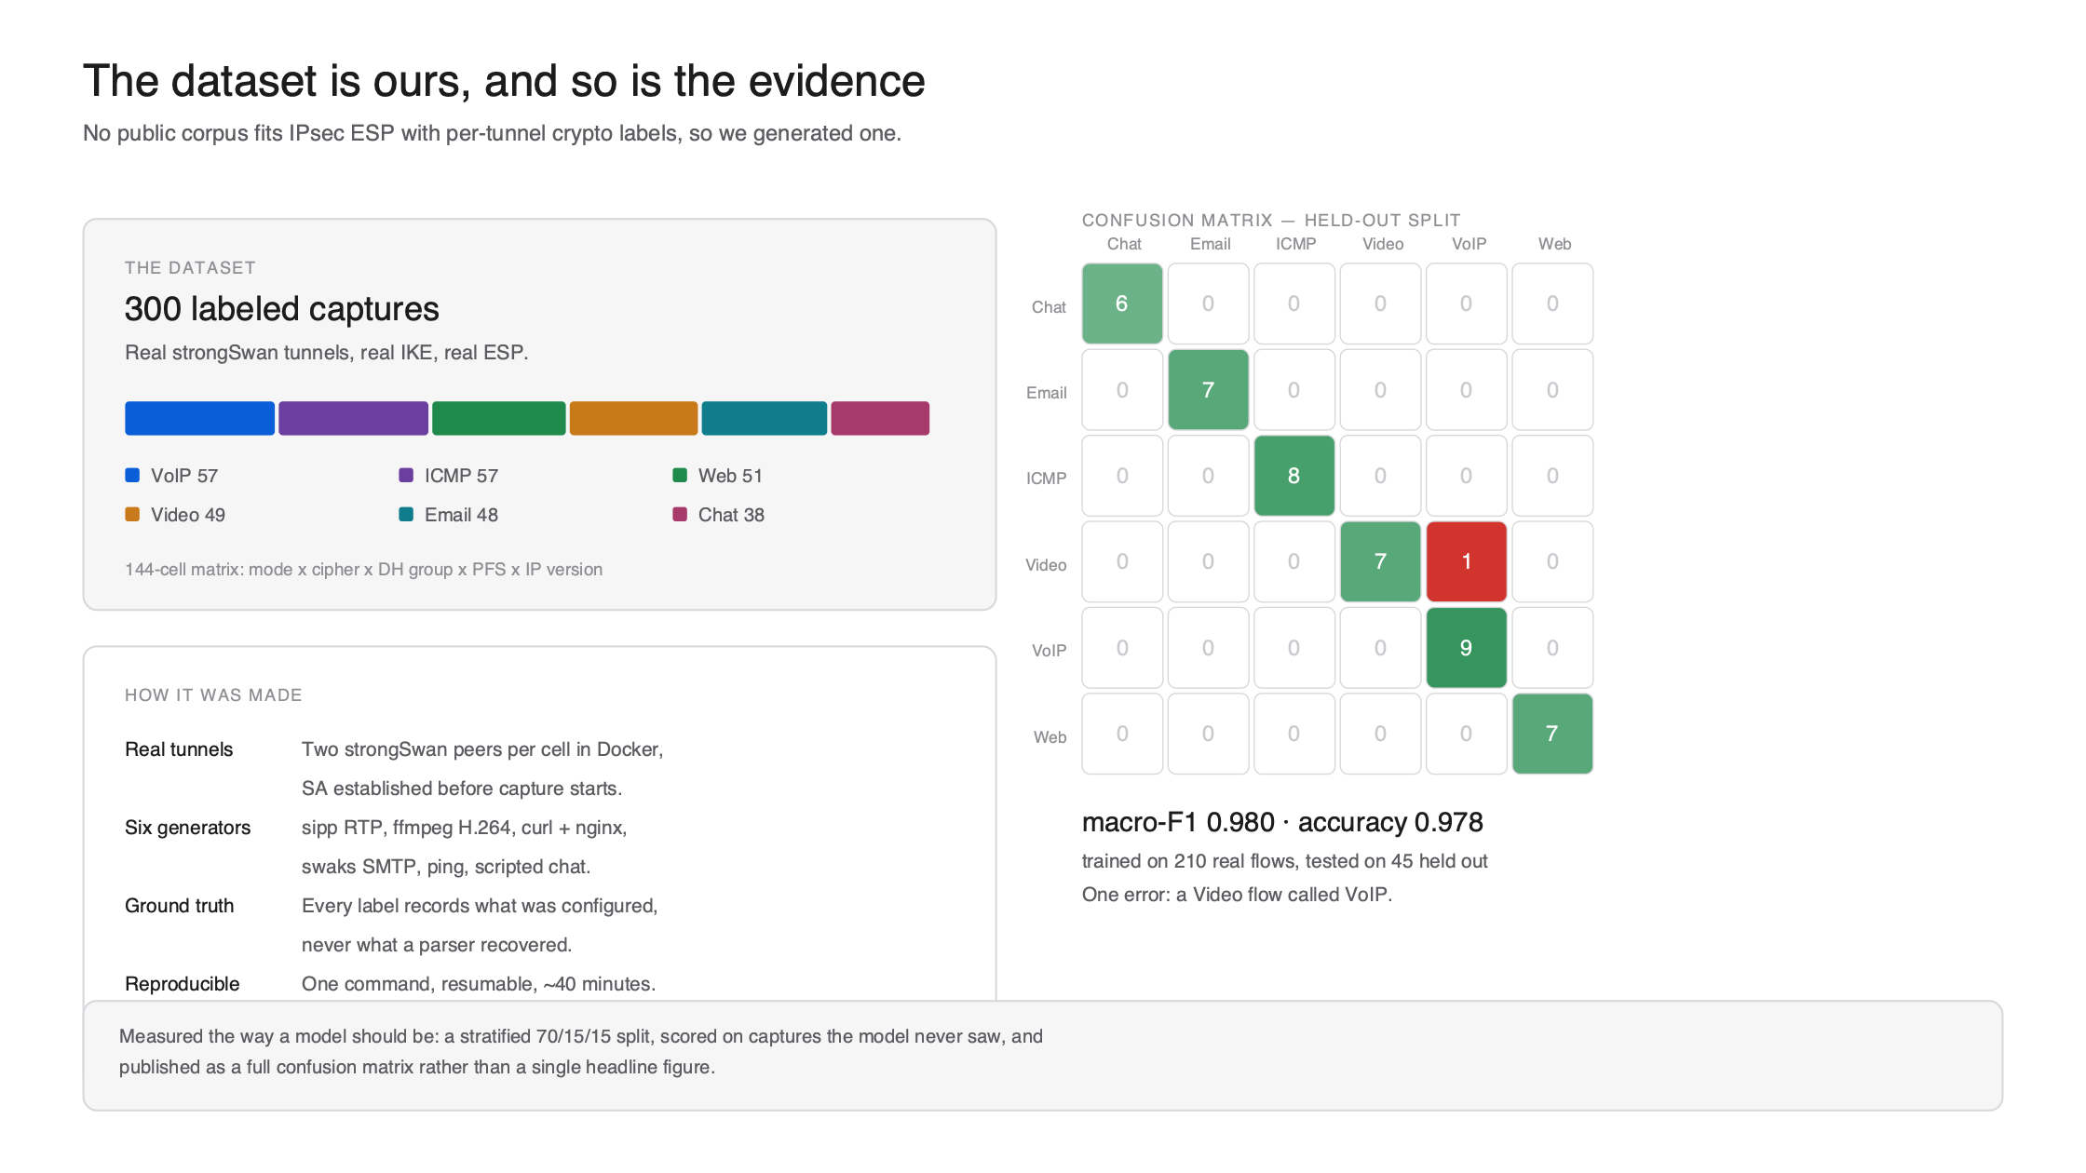
FEASIBILITY AND VIABILITY
VaultScope
Feasible today: a working end-to-end prototype runs with a single docker compose up, built on a real, self-generated dataset — not synthetic filler:

Slide 5
IMPACT AND BENEFITS
VaultScope
Gives operators of large-scale VPN infrastructure continuous, real-time visibility into actual cryptographic posture instead of periodic manual audits — surfacing configuration drift, such as legacy IKEv1/DES/DH-group-2 devices sitting beside modern IKEv2 deployments, before it is exploited
Security teams get a plain-English executive PDF score for leadership, a deep technical report with CVE links and vendor-specific config diffs for engineers, and SIEM-ready JSON/CEF exports — cutting remediation time and manual pentest effort
Passive-by-default operation means zero disruption to live traffic; strengthens the security posture of sensitive government and enterprise networks at a fraction of the cost of recurring manual assessments

Slide 6
RESEARCH AND REFERENCES
VaultScope
Standards: RFC 8247 (IKEv2 cryptographic algorithm recommendations), RFC 7296 (IKEv2), RFC 2409 (IKEv1), RFC 4303 (ESP anti-replay), NIST SP 800-77 (IPsec VPN guide), CNSSP-15
Vulnerabilities referenced: CVE-2016-2183 (SWEET32 / 3DES), CVE-2016-1287 (Cisco ASA IKE fragmentation), plus the LOGJAM and SLOTH weaknesses covered by the rule engine
Prior art reviewed and compared: ike-scan, ikeforce, iker.py, IKEv3Analytica, Wireshark, Tufin/AlgoSec, Cisco SecureX/Stealthwatch, Nessus IPsec plugins
Full technical specification and source: github.com/shivansh193/vaultscope

