Slide 1

SMART INDIA HACKATHON 2026
TITLE PAGE
Problem Statement ID – SIH26160
Problem Statement Title- AI-Powered IPsec VPN Protocol Analyzer & Security Assessment Framework
Theme- Blockchain & Cybersecurity
PS Category- Software
Team ID- 183631
Team Name- frontend-backend-tragedy

Slide 2
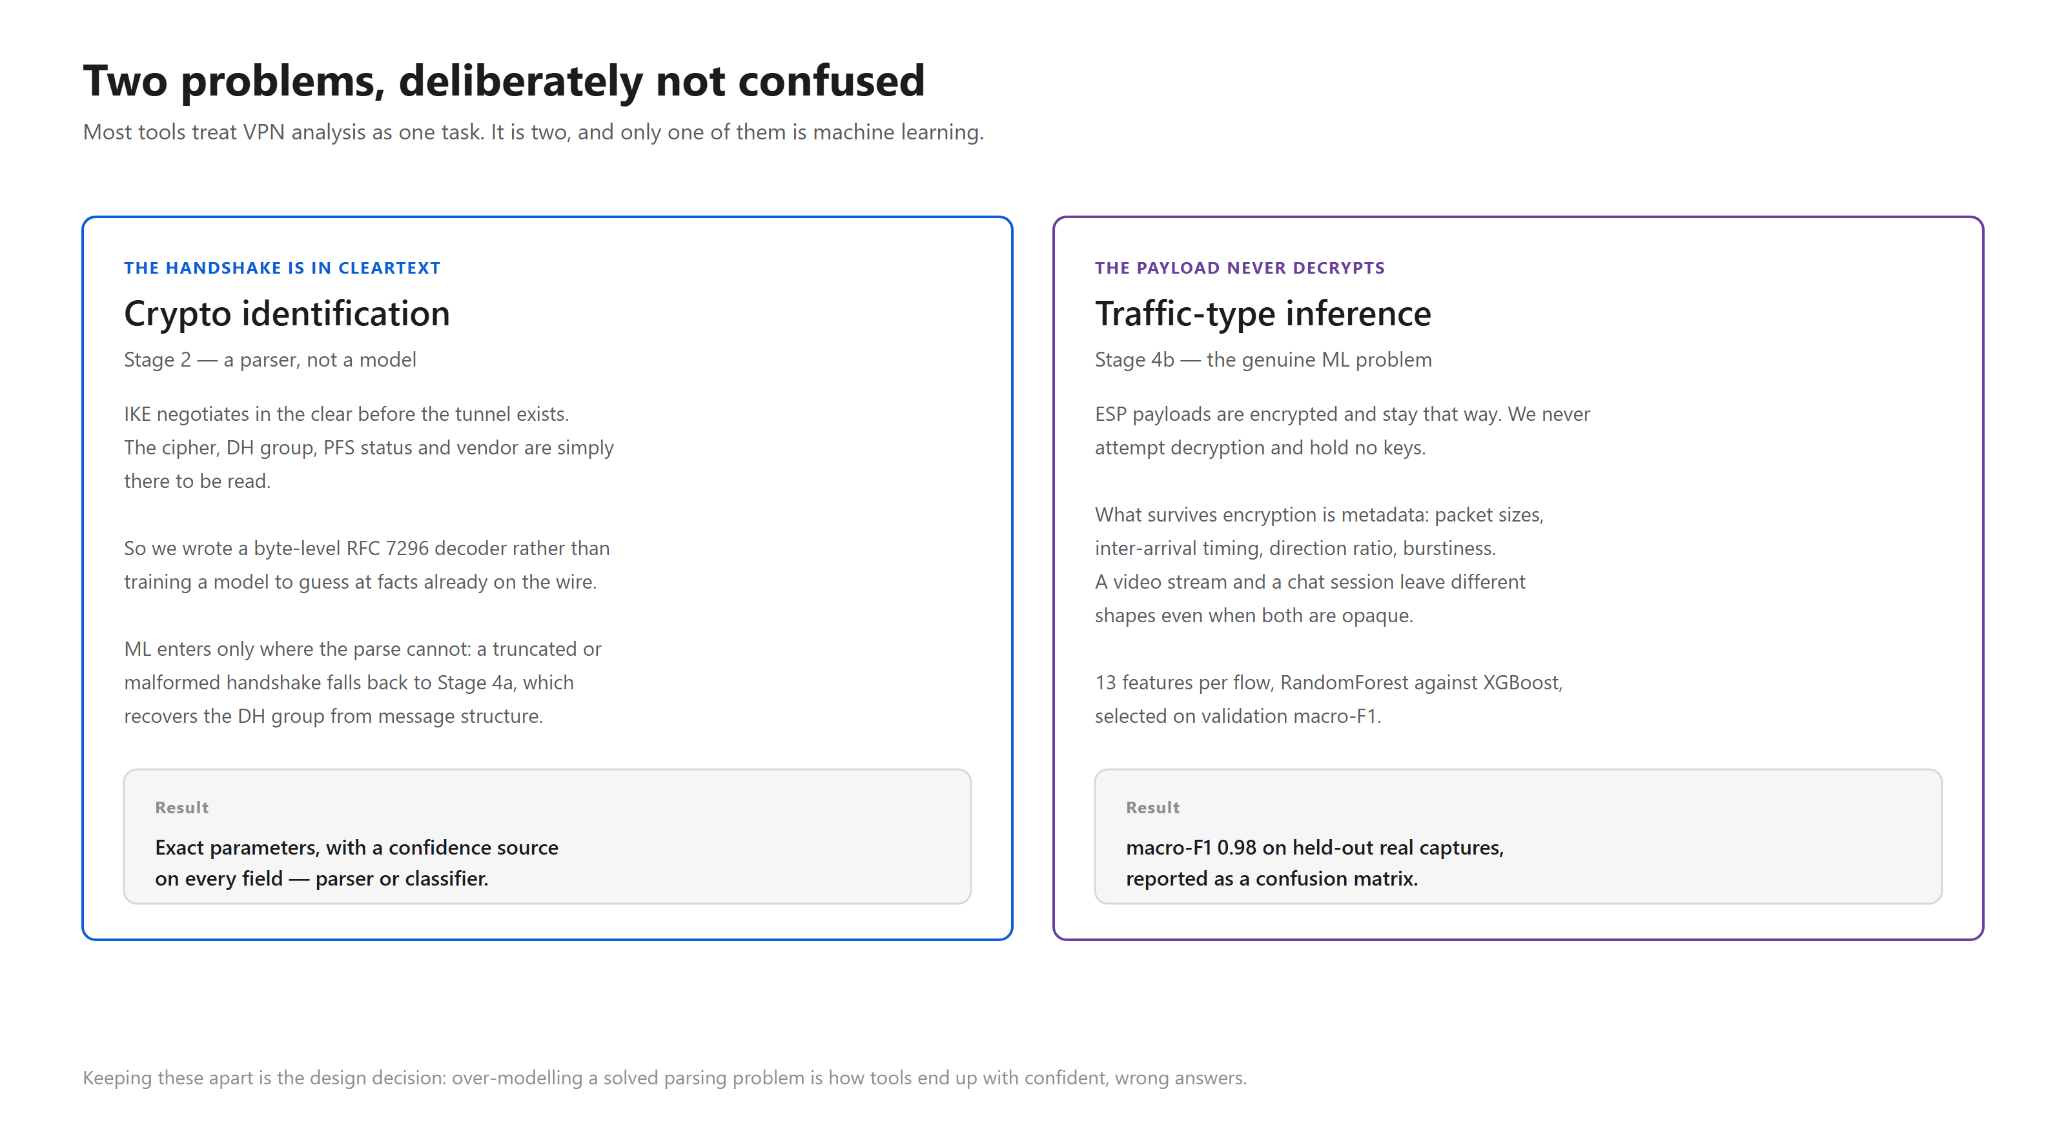
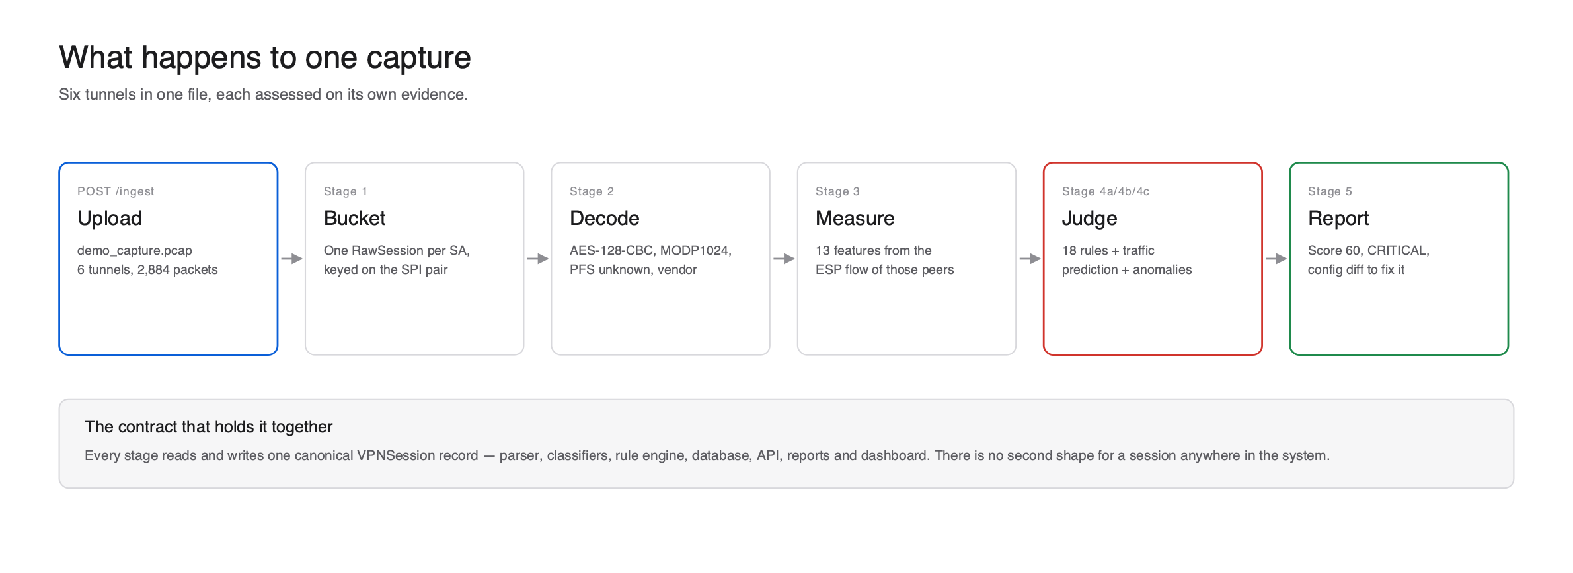
PROPOSED SOLUTION
VaultScope
One capture in, a scored assessment out. VaultScope reads an IPsec PCAP or live stream and tells an analyst how strong the VPN is, with no manual packet inspection.
Two AI problems, kept separate. Crypto identification is a cleartext parser, because IKE negotiates in the clear. Traffic type inside ESP is ML on packet-size and timing metadata.
Full assessment. 21 CVE and RFC-linked rules, 5 compliance baselines, a metadata-exposure score, post-quantum readiness and attack detection that cites exact pcap frames.
Every output the brief asks for. Risk score, threat matrix, AI confidence score, executive and technical reports, live dashboard, JSON/CEF export.
What is unique. A hand-written RFC 7296 / 2408 decoder and a first-party labeled dataset from real strongSwan tunnels.
Covers every item in the brief
(a) testbed (b) capture (c) protocol and traffic identification
(d) security assessment (e) scores and reports

Slide 3
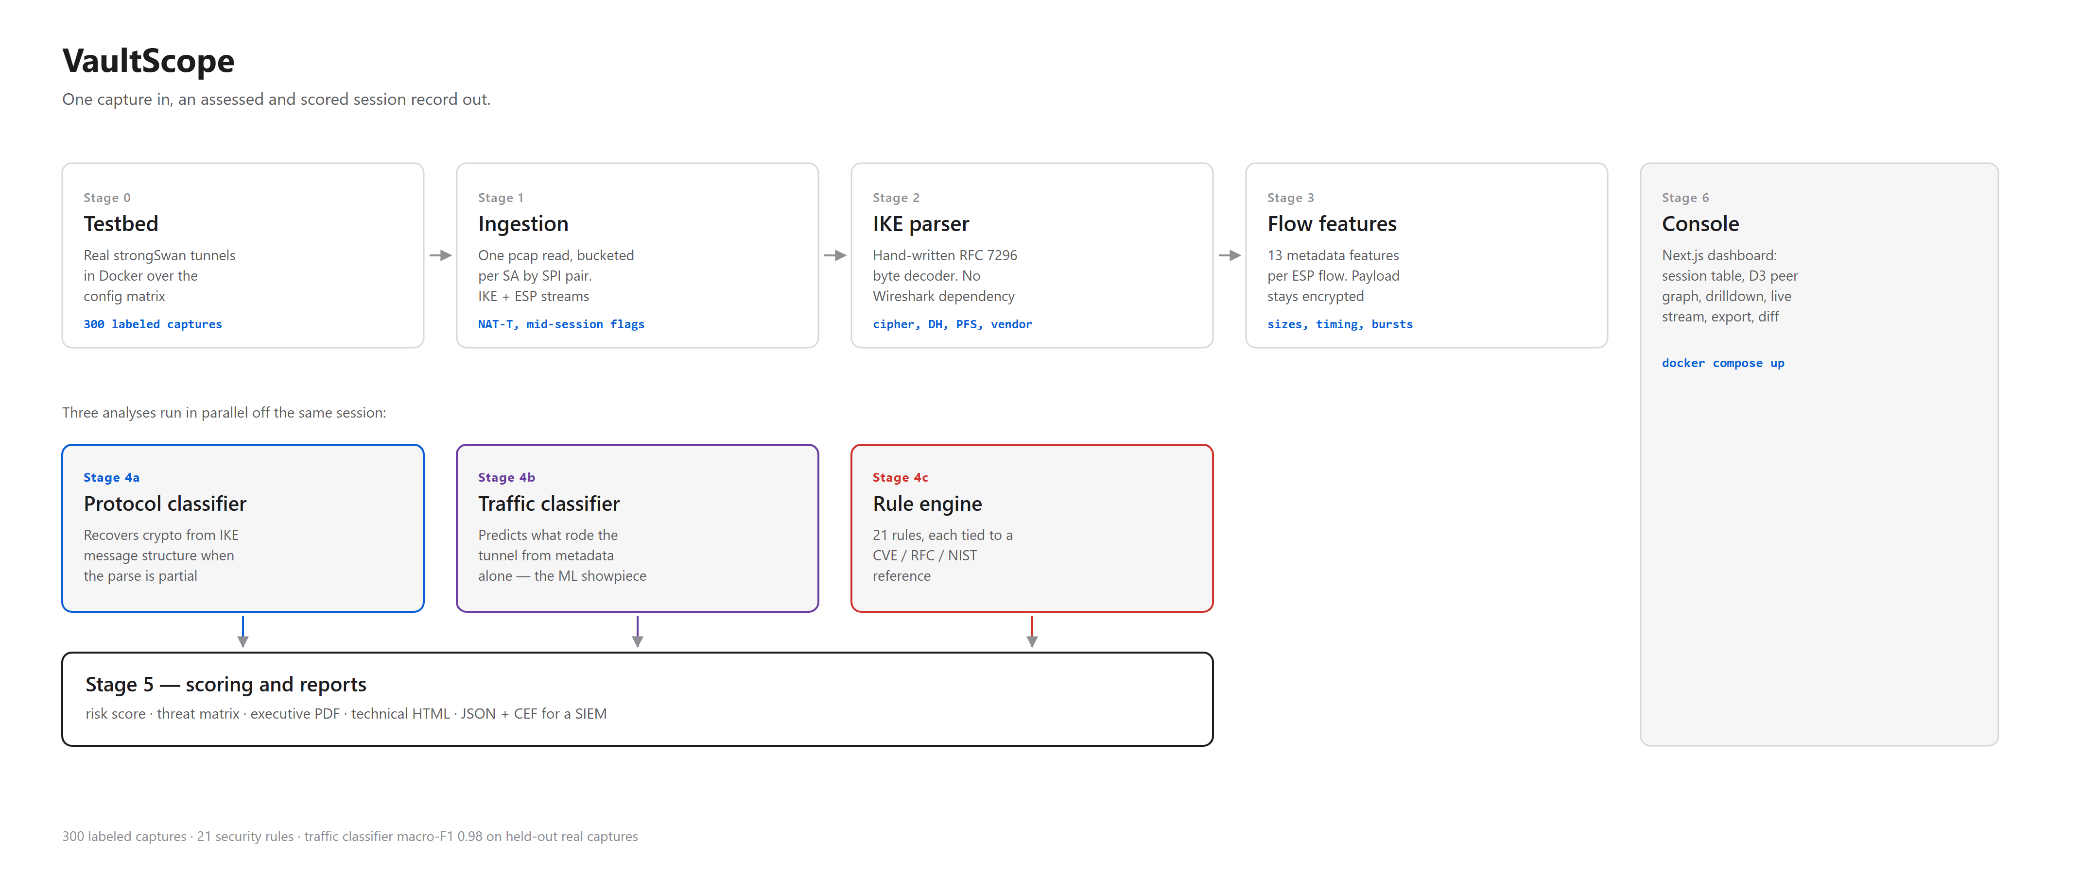
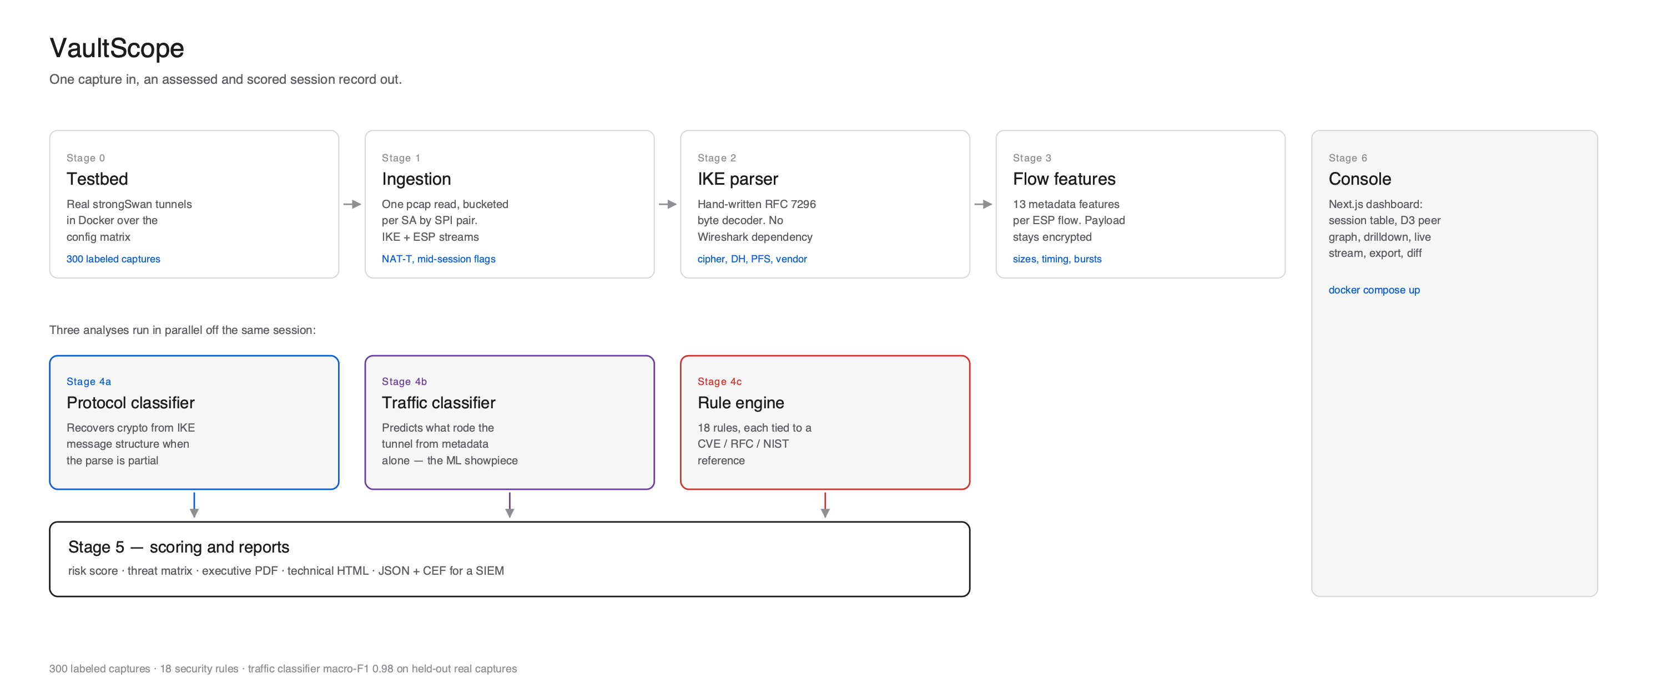
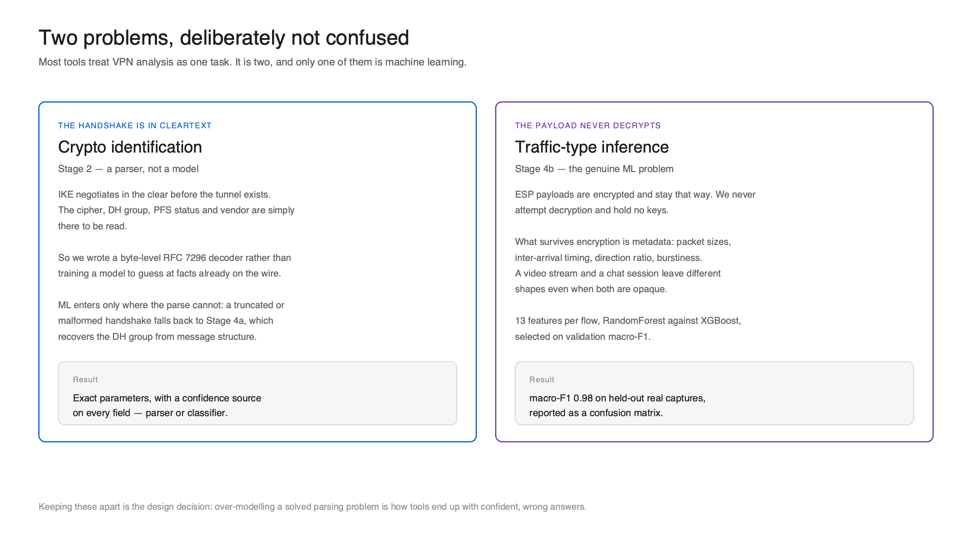
TECHNICAL APPROACH
VaultScope
Stack
Python 3.11, scapy, FastAPI, SQLite
scikit-learn RandomForest and XGBoost, picked by macro-F1
strongSwan in Docker; tcpdump / dumpcap capture
Jinja2 + WeasyPrint reports
Next.js, Tailwind, Recharts, D3
One docker compose command
IKE parser: pure-struct decoder. Aggressive Mode comes from the ID payload in message 1, not message count; PFS only from a real second DH exchange.
Traffic model: 13 metadata features per ESP flow, trained on 300 real captures, with per-prediction explanations and an abstain threshold.
Assessment: 21 YAML rules. Fields hidden by encryption read 'unknown' or 'inferred', never a guess; imported swanctl / ip xfrm state can fill them.

Slide 4
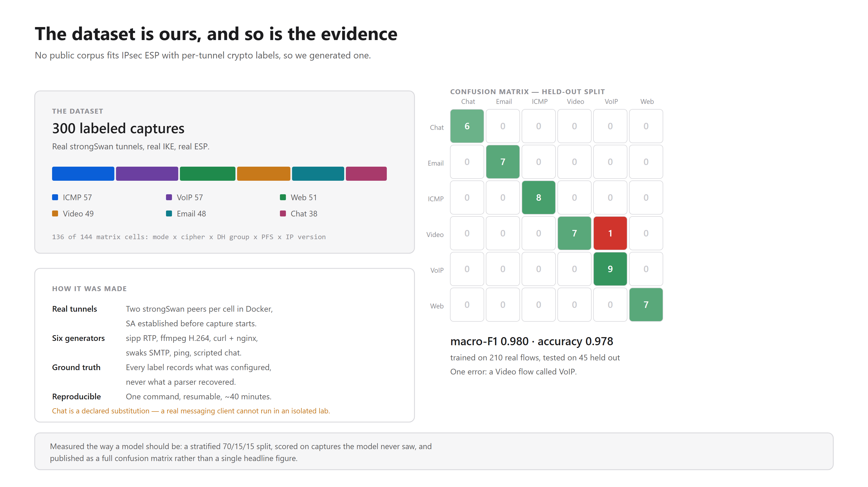
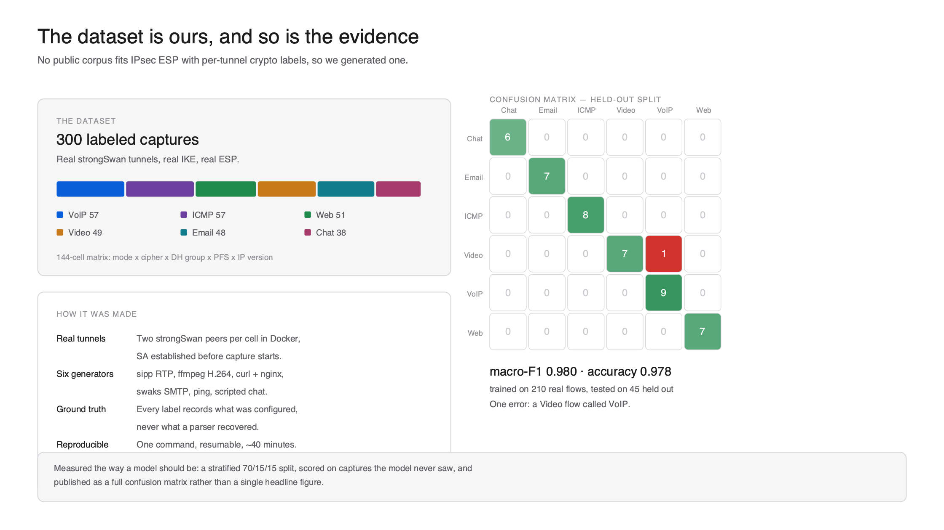
FEASIBILITY AND VIABILITY
VaultScope
Built and tested
Runs today: one docker compose command; 380 Python, 57 unit and 23 end-to-end tests in CI
Real data: 300 captures, 136 of 144 matrix cells, tunnel and transport, IPv4 and IPv6, PFS on and off
Fast: about 1 s warm for a 2,884-packet, six-tunnel capture
Honest accuracy: macro-F1 0.98 on 45 held-out flows is an upper bound, not a field number
Constraints and mitigations
Encrypted payload: metadata only, with a confidence score and an abstain threshold
Mode, PFS and auth sit in encrypted IKE_AUTH: reported 'unknown' or 'inferred', or filled from gateway state
Lab-clean, one class per capture: disclosed; held-out runs by cipher and DH group are scripted
(a) Testbed
done
(b) Capture
done
(c) Identify
done
(d) Assess
done
(e) Reports
done

Slide 5
IMPACT AND BENEFITS
VaultScope
TODAY: manual, expert-only
Capture traffic
Open in Wireshark
Work out the configuration by hand
Judge crypto and compliance
Write the report
WITH VAULTSCOPE: about 1 s per 2,884-packet capture, warm
Upload a PCAP or capture live
Automatic protocol and traffic identification
21 rules, 5 baselines, exposure score
Risk score and threat matrix
Executive and technical reports
Analysts: a scored, referenced verdict on any IPsec capture without reading packets. Every finding names the CVE or RFC behind it and a vendor-specific configuration fix.
Auditors and leadership: compliance mapped to NIST, BSI, CNSA 2.0, CERT-In and TEC ITSAR, a plain-English executive PDF, and SIEM-ready JSON/CEF export.
The ecosystem: the testbed and the 300-capture labeled dataset are reproducible, so others can extend and benchmark the work. Passive by default, so live traffic is never disrupted.

Slide 6
RESEARCH AND REFERENCES
VaultScope
Standards: RFC 7296 (IKEv2), RFC 2408 and 2409 (ISAKMP, IKEv1), RFC 4301 and 4303 (IPsec architecture, ESP anti-replay), RFC 3947 (NAT-T), RFC 7427, RFC 8247 (IKEv2 algorithm guidance), RFC 9370 (multiple key exchanges, post-quantum hybrid).
Guidance: NIST SP 800-77r1, NIST SP 800-131A, NIST IR 8547, BSI TR-02102-3, NSA CNSA 2.0 and CNSSP-15, CERT-In and TEC ITSAR (indicative mappings).
Vulnerabilities: CVE-2016-2183 (SWEET32, 3DES), CVE-2016-1287 (Cisco ASA IKE fragmentation), plus LOGJAM and SLOTH, all covered by the rule engine.
Prior art compared: ike-scan, ikeforce, iker.py, Wireshark, Tufin and AlgoSec, Nessus IPsec plugins. These decode or scan configuration; none pairs runtime attack detection with traffic-type inference inside ESP.
Method: encrypted-traffic classification from packet-size and timing side channels (RandomForest, XGBoost); strongSwan documentation.
Source and data: github.com/shivansh193/vaultscope (README, design document, data/DATASHEET.md).

