Slide 1
IBM University Engagement Project Submission
“Exploring the Power of Agentic AI with IBM Granite and LangFlow”

Slide 2

Project Tile – Research Agent
Domain of Project – Education
Student Name | Recent Passport Photo | Email ID | Mobile number [WhatsApp]
Shivansh Awasthi |  | shivansh21awasthi@gmail.com | 6390496811

Slide 3
Problem Statement -
Problem Statement : Research Agent
The Challenge
Academic researchers spend enormous time manually searching literature, reading papers, extracting insights, managing citations, and writing reports. There is no single AI-powered tool that automates this end-to-end research workflow. Researchers often miss relevant papers, struggle with citation formatting, and spend weeks on tasks that could be done in minutes with intelligent automation.
The Objective
Build an AI-powered Research Agent that autonomously handles the complete academic research workflow. The solution should:
Autonomous Literature Search – Search arXiv and Semantic Scholar for relevant papers on any research topic
Paper Summarisation – Generate concise AI summaries of each paper using IBM Granite
Literature Synthesis – Produce a coherent multi-paper narrative synthesis
Hypothesis Generation – Propose novel, testable research hypotheses from the literature
Citation Management – Export references in BibTeX, APA, and JSON formats automatically
Report Generation – Produce full Markdown and PDF research reports in one click

Slide 4
Proposed Solution -
The proposed solution is an end-to-end AI-powered Research Agent built using IBM watsonx.ai and IBM Granite models to automate the complete academic research workflow. The system takes a natural language research question and autonomously executes a 5-step pipeline.
The agent uses IBM Granite (ibm/granite-4-h-small) for all AI generation tasks — summarisation, synthesis, hypothesis generation, and section drafting — via the IBM watsonx.ai inference API on IBM Cloud Lite tier.
The system consists of five specialised modules:
LiteratureSearcher – Retrieves papers from arXiv and Semantic Scholar. Returns structured Paper objects with title, authors, year, abstract, URL, and citation count.
Summarizer – Generates per-paper summaries from abstracts using IBM Granite, and produces a multi-paper narrative synthesis across all retrieved papers.
ReferenceManager – Manages citations and exports in three formats: BibTeX (.bib), APA plain text (.txt), and machine-readable JSON.
ReportGenerator – Creates a full Markdown research report and optional PDF, including executive summary, paper summaries, synthesis, and hypotheses.
GraniteClient – Thin wrapper around IBM watsonx.ai ModelInference, handling authentication, generation parameters, and all LLM calls.
The solution includes two interfaces: a CLI (main.py using Click + Rich) and a browser-based web app (app_streamlit.py using Streamlit) deployed on Streamlit Community Cloud.

Slide 5
Technology Used
IBM watsonx.ai – LLM inference platform used to host and call IBM Granite models. Provides the REST API for text generation and embeddings on IBM Cloud.
IBM Granite (ibm/granite-4-h-small) – Core generation model for summarisation, multi-paper synthesis, hypothesis generation, research section drafting, and key findings extraction.
IBM Granite Embeddings (ibm/granite-embedding-278m-multilingual) – Embedding model for semantic text similarity and vector-based paper relevance ranking.
IBM Cloud Lite – Free-tier IBM Cloud account used for watsonx.ai service instance and IAM API key authentication. No paid plan required.
Python ibm-watsonx-ai SDK (v1.9.0) – Official IBM SDK for programmatic access to watsonx.ai ModelInference and Embeddings APIs.
arXiv SDK – Python library for querying the arXiv preprint repository for academic papers.
Scholarly – Python library for Semantic Scholar paper metadata retrieval.
ReportLab + PyPDF2 – PDF generation and parsing for research report output.
Streamlit – Python web framework for the browser-based UI, deployed on Streamlit Community Cloud.
Click + Rich – CLI framework and terminal formatting for the command-line interface.
python-dotenv – Secure .env-based credential management for local development.

Slide 6
IBM Granite Components Used -
1. IBM watsonx.ai ModelInference – Core inference class used for text generation. Configured with model ID, credentials, project ID, and generation parameters (MAX_NEW_TOKENS=800, TEMPERATURE=0.3, TOP_P=0.9).
2. IBM Granite Model – ibm/granite-4-h-small – Primary generation model used for: paper summarisation from abstracts, multi-paper literature synthesis, testable hypothesis generation, research paper section drafting, executive summary writing, and key findings extraction.
3. IBM Granite Embeddings – ibm/granite-embedding-278m-multilingual – Used via the IBM watsonx.ai Embeddings class for semantic text similarity scoring and paper relevance ranking.
4. IBM Cloud IAM Authentication – API key-based authentication using the ibm-cloud-sdk-core library. Credentials loaded from .env (local) or Streamlit secrets (deployed).
5. IBM watsonx.ai Credentials Object – Wraps the IBM Cloud API key and regional URL (https://us-south.ml.cloud.ibm.com) for all SDK calls.
6. Generation Parameters – Controlled via GenTextParamsMetaNames: MAX_NEW_TOKENS (800), TEMPERATURE (0.3), TOP_P (0.9), STOP_SEQUENCES. Tuned for factual, concise academic output.

Slide 7
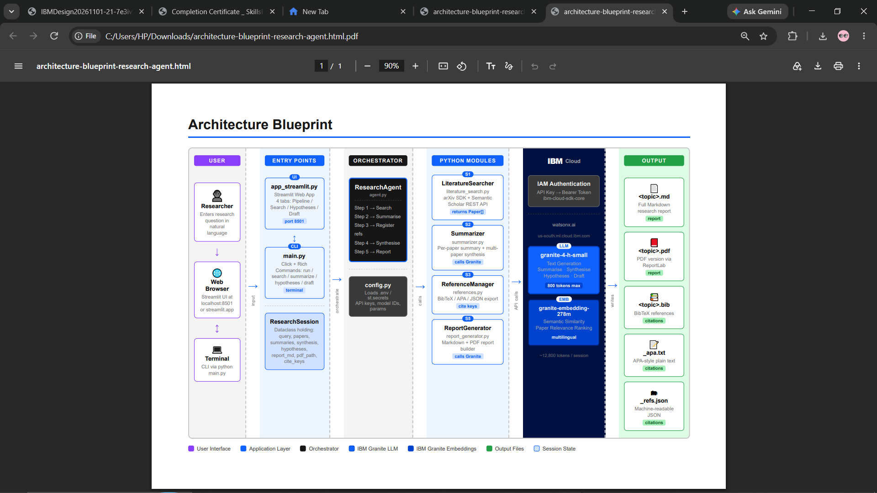
Architecture blueprint

Slide 8

Role of Agentic AI in the solution
Agentic AI enables the Research Agent to function as an intelligent, autonomous system rather than a simple chatbot. Using IBM watsonx.ai and IBM Granite models, it executes a multi-step research workflow without human intervention at each step.
Autonomous Action – The agent takes a single research question and independently decides what to search, what to summarise, and how to synthesise findings. No human instructions required between steps.
Context Awareness – IBM Granite understands the full context of multiple papers simultaneously. During synthesis, it reads all abstracts together and produces a coherent narrative capturing relationships, gaps, and trends across the literature.
Goal-Driven Output – Every action the agent takes is directed toward the final goal: a complete research report. The agent maintains state across all 5 pipeline steps via the ResearchSession dataclass.
Multi-Step Reasoning – IBM Granite performs different reasoning tasks at different stages: extractive summarisation (Step 2), abstractive synthesis (Step 4), creative hypothesis generation (Step 4), and structured report writing (Step 5).
Adaptive Generation – Generation parameters (temperature, top-p, max tokens) are tuned per task type to balance creativity and factual accuracy.
Overall, Agentic AI makes the system proactive, autonomous, and goal-driven — acting like a smart digital research assistant that completes hours of work in under 2 minutes.

Slide 9
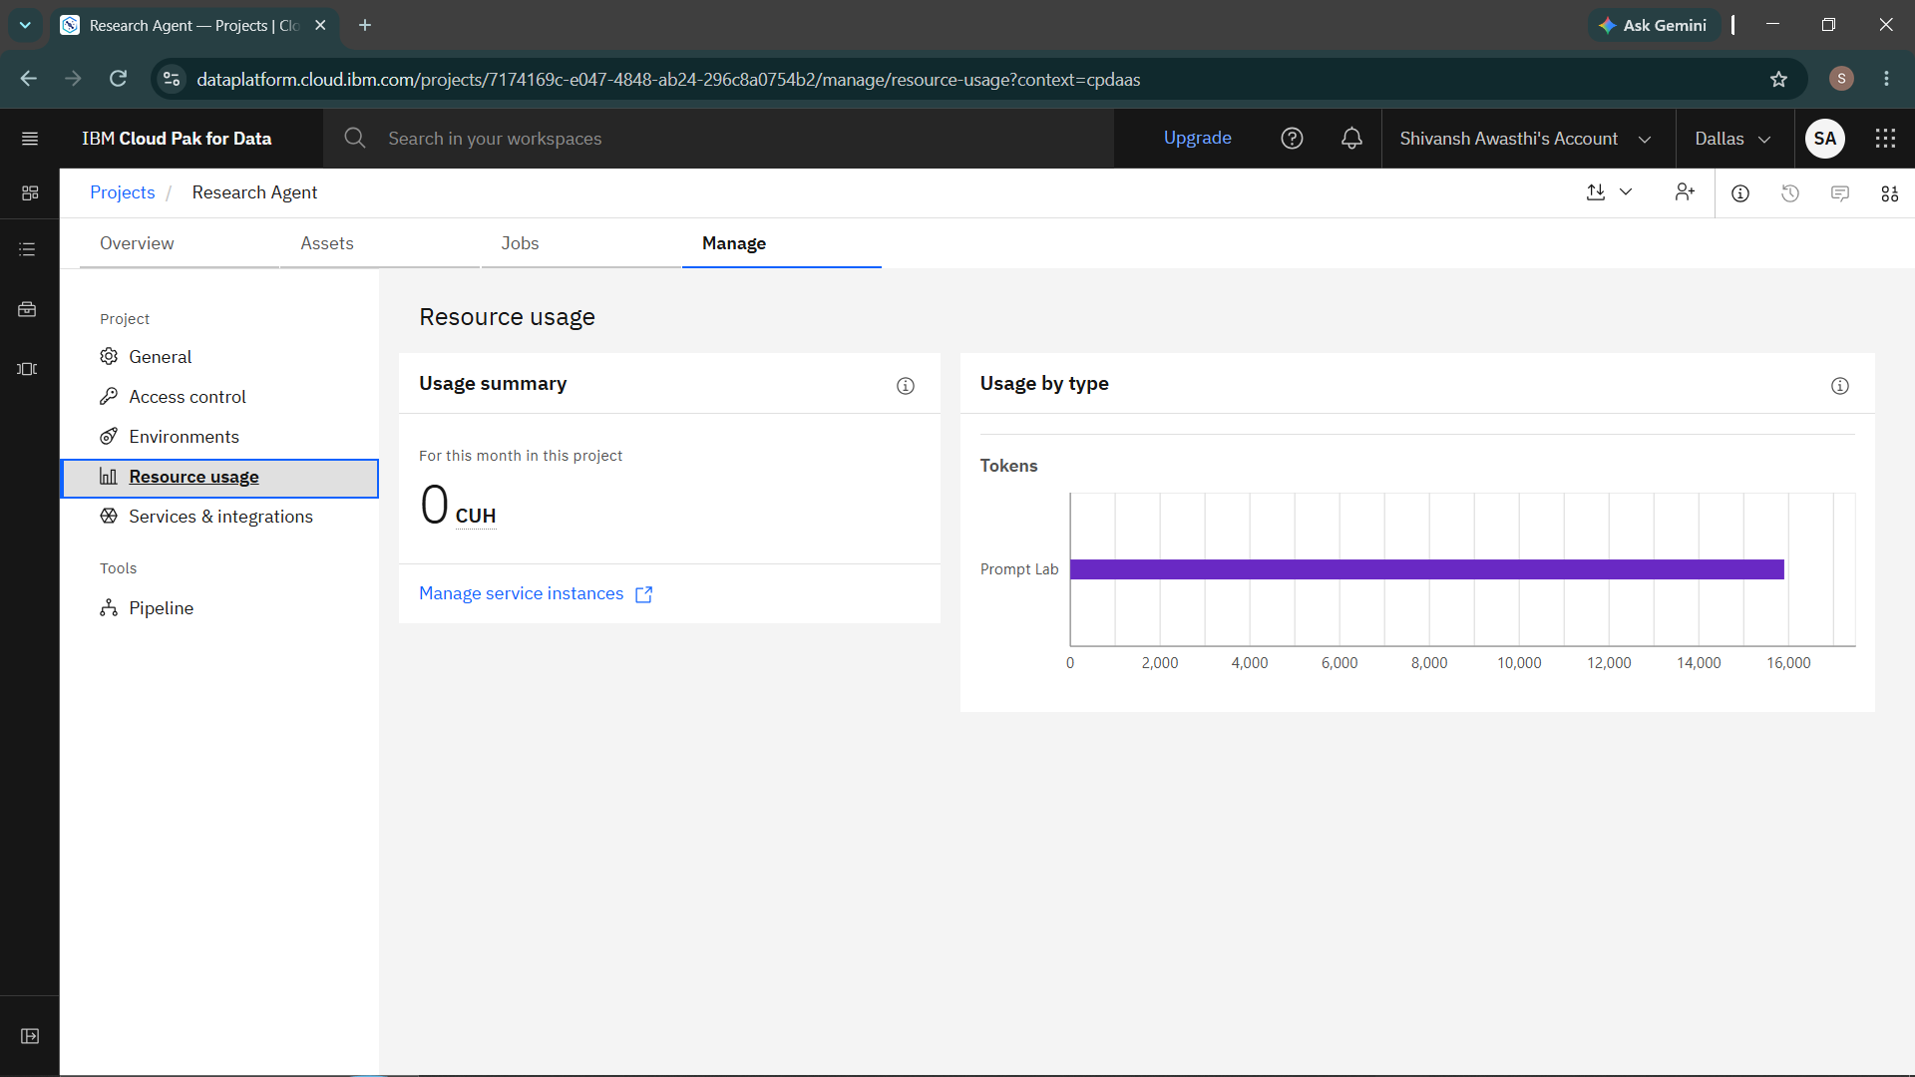
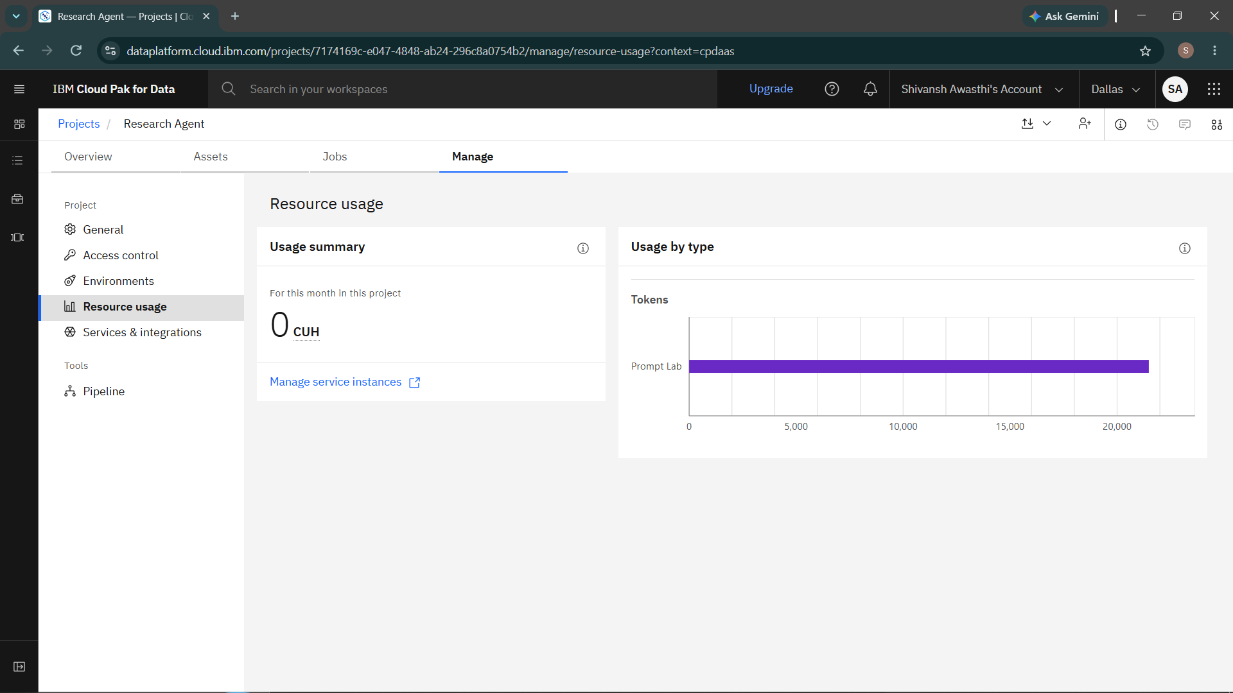
Token Usage
5000 token are used
Before Prompt
After the Prompt
·
·
·

Slide 10
Novelty and Uniqueness
The Research Agent stands out through the combination of complete automation, IBM Granite AI, and multiple output formats in a single deployable system.
Complete End-to-End Automation – Unlike tools that handle only one task (search OR summarise OR cite), this agent handles the full pipeline: Search → Summarise → Synthesise → Hypothesise → Report — triggered by a single command or button click.
Exclusively IBM Granite Powered – All AI generation uses IBM Granite models on IBM watsonx.ai. No OpenAI, no Anthropic — fully compliant with IBM Cloud Lite tier requirements.
Multiple Output Formats Simultaneously – A single run produces: Markdown report, PDF report, BibTeX file, APA plain-text file, and JSON reference file — all automatically.
Dual Interface – Both a CLI tool (main.py) and a browser web app (app_streamlit.py) are built from the same agent codebase, serving both developers and non-technical users.
Free IBM Cloud Lite Compatible – The entire system runs on the free IBM Cloud Lite tier. No paid subscription required for evaluation or submission.
Deployable Web Application – The Streamlit interface is deployed on Streamlit Community Cloud, giving a permanent public URL that evaluators can access without any local setup.
Research-Grade Quality – Outputs include proper academic citations, BibTeX keys, and synthesis language suitable for direct use in research papers.

Slide 11
Git Hub Link
Github URL – https://github.com/shivansh21awasthi/AICTE---Research-Agent
·
·
·

Slide 12
Future Scope
Multi-Source Literature Search – Expand beyond arXiv to include PubMed (biomedical), IEEE Xplore (engineering), Springer, ACM Digital Library, and SSRN for coverage across all academic disciplines.
RAG-Based Paper Retrieval – Integrate a vector database (FAISS or Chroma) with IBM Granite embeddings to enable semantic search over full paper PDFs, not just abstracts. Allows the agent to answer specific questions from within papers.
Multi-Agent Architecture with LangFlow – Refactor the pipeline into specialised agents orchestrated via LangFlow: a Search Agent, Summarisation Agent, Synthesis Agent, and Report Agent — enabling parallel processing and complex workflows.
IBM Watson Discovery Integration – Activate the Watson Discovery module already scaffolded in literature_search.py for enterprise-grade literature search with curated institutional databases.
Voice and Multilingual Support – Add voice input for research queries and multilingual report generation, making the tool accessible to researchers worldwide regardless of language background.
Collaborative Research Sessions – Allow multiple researchers to share a session, annotate papers collaboratively, and export joint reports with shared citation libraries.
LaTeX and Word Export – Add export formats for LaTeX (.tex) and Microsoft Word (.docx) to integrate directly with academic writing workflows.
·
·
·

Slide 13
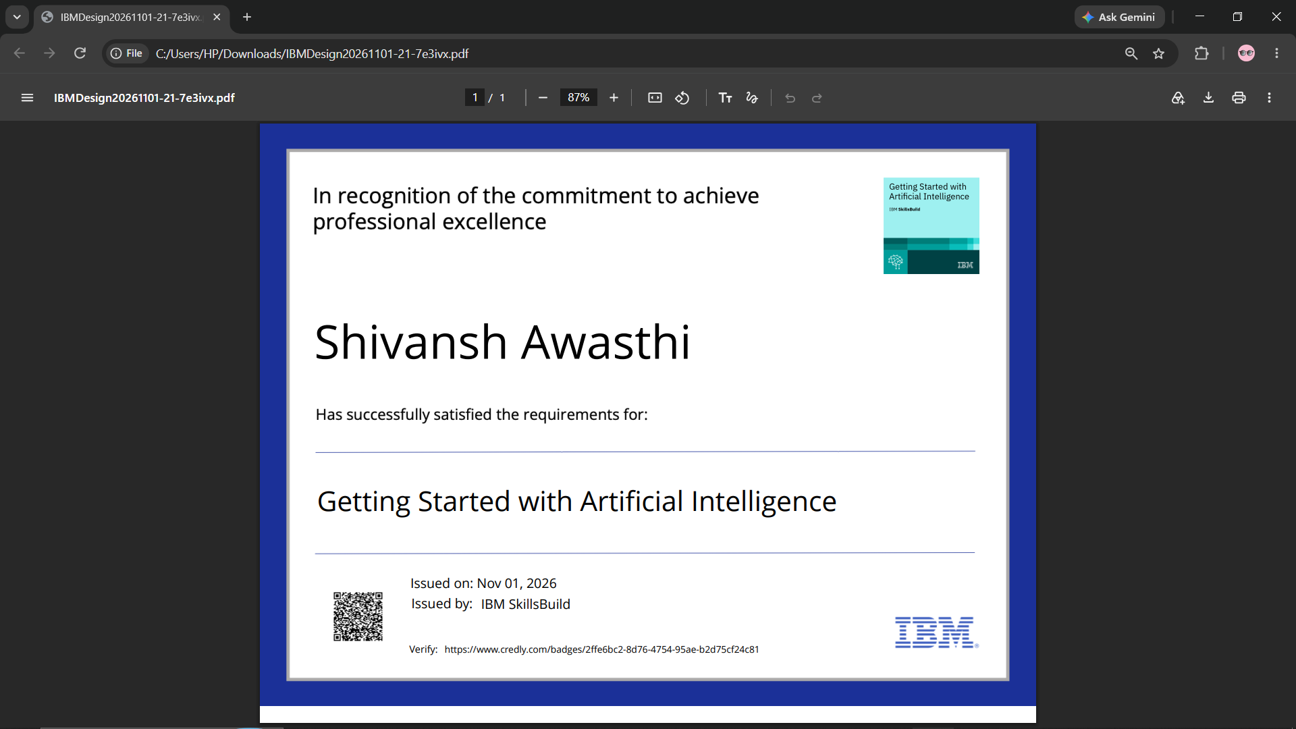
Certificates Earned:

Slide 14
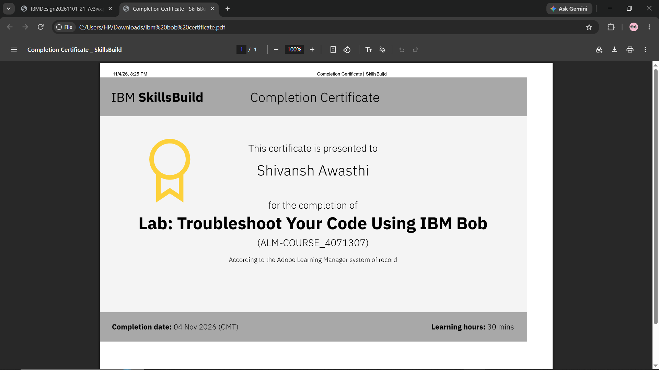
Certificates Earned:​

Slide 15


