Slide 1
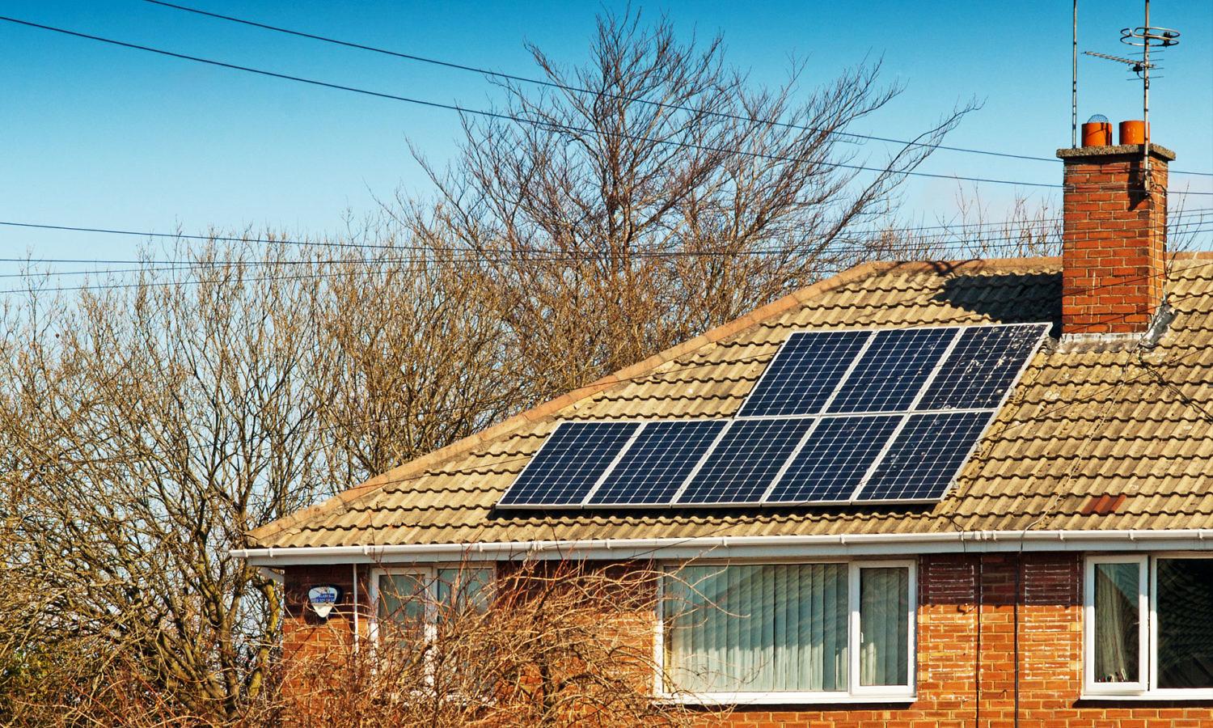
Solar tracking device
Project Guide:
Prof. Ashok Ranade
Jaina Mehta, Lecturer
Parth Shah, Staff Engineer
Project members:
Aman Dave(1741003)
Aditya Shah(1741007)
Shivansh Nautiyal(1741037)
Param Shah(1741019)
Source: http://www.which.co.uk/news/2017/07/do-solar-panels-affect-the-value-of-your-home/

Slide 2

Target Users
House Owners
To reduce Electricity Cost
Architectures/Builders
To increase the value of Property
To showcase as an Extra luxury amenity while selling the house
Land Owners
To sell Electricity
To sell carbon emission allowance/credits
Electricity Companies
Comply with government regulations
Increase their profits

Slide 3
Empathy
NEEDS
To reduce the electricity bill: Average Saving of $44 to $187 per month
It is good for the environment.
As an investment:
In countries like USA, you can earn tax credits (30%). A study by Lawrence Berkeley lab in California showed that house buyers were willing to pay extra $15000 for a home with average sized solar panel system.
FEARS
Solar energy only during day: This is a myth. The truth is most of the providers of solar energy will get you connected to the grid so you don’t risk power outrage at night.
Toxicity of solar panels causing cancer. Example: a town in USA blocked construction of solar farm due to fear of draining the sun and causing cancer.
People tend to resist big investments on a long time return.

Slide 4
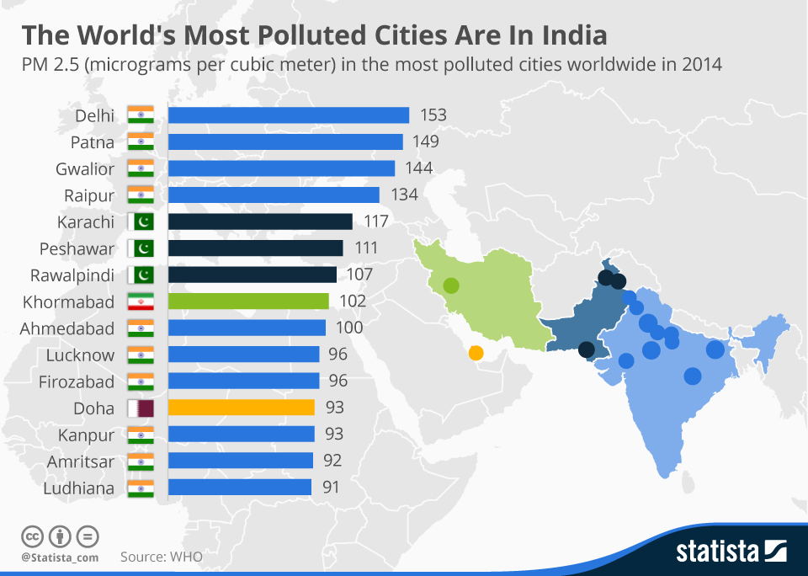
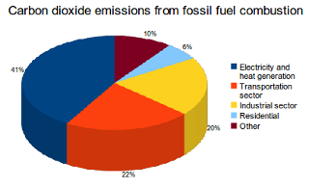
Problem Statement
Source: CO2 Emissions from Fuel Combustion (2012), International Energy Agency.
Source: https://www.statista.com/chart/3670/the-worlds-most-polluted-cities-are-in-india/
The above pie chart shows the major factors of pollution.
We can clearly make out that electricity is the main reason behind it
The above graph clearly depict the amount of pollution currently in India. And if we do not try to stop it , we all are doomed.

Slide 5
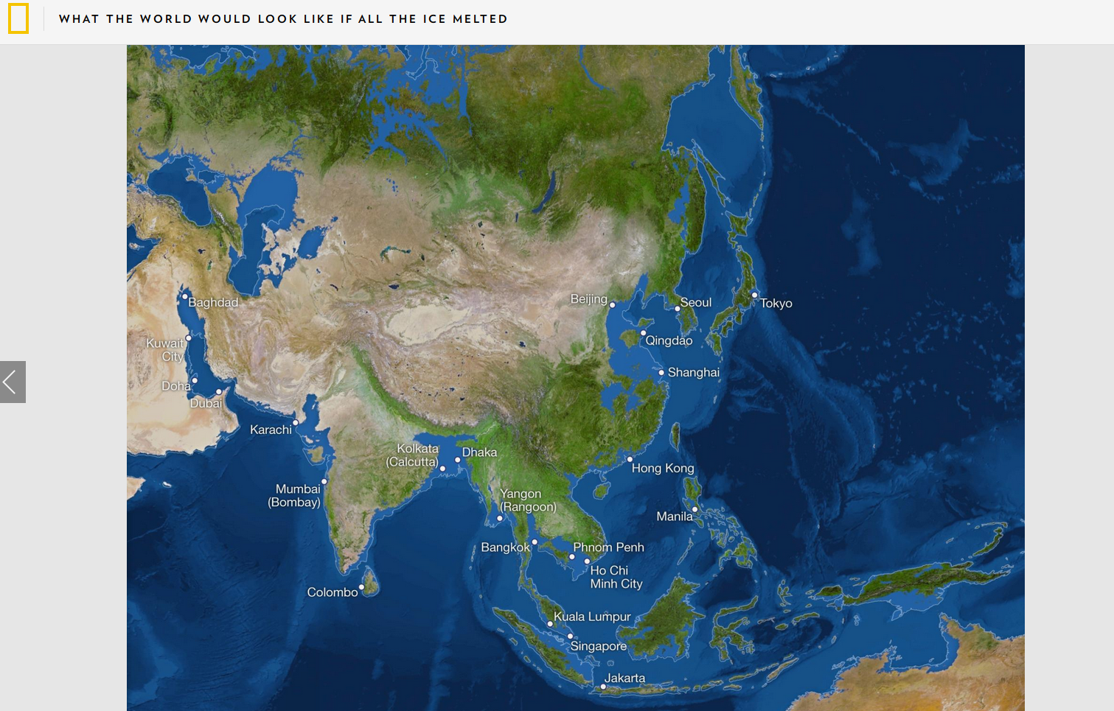
What if carbon emission does not stop and all the ice melts ?
Source: http://www.nationalgeographic.com/magazine/2013/09/rising-seas-ice-melt-new-shoreline-maps/

Slide 6






Ideation
COLOUR OF HAT | DETAILS
WHITE | We collected various data regarding pollution and its effect and why it is necessary to save electricity
RED | We discovered the after effects of pollution
YELLOW | We tried to look at the ways to stop and reduce the pollution
BLACK | We thought of various limitations regarding the usage of Arduino board
GREEN | We thought of various ideas in which Arduino board could be used to save electricity
BLUE | We discussed whether our solution was proper and what could be added

Slide 7
Introduction to the Prototype
We are going to make a Solar Panel Tracker using Arduino, in which we will use two LDRs (Light dependent resistor) to sense the light and a servo motor to automatically rotate the solar panel in the direction of the sun light.
Advantage of this project is that Solar panel will always follow the sun light will always face towards the sun to get charge all the time and can provide the supply the maximum power.

Slide 8
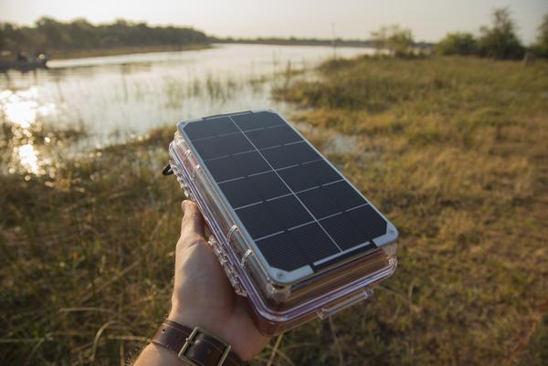
Wont look like this though…
SOURCE: www.portablesolarpower.biz (This is not the prototype)

Slide 9
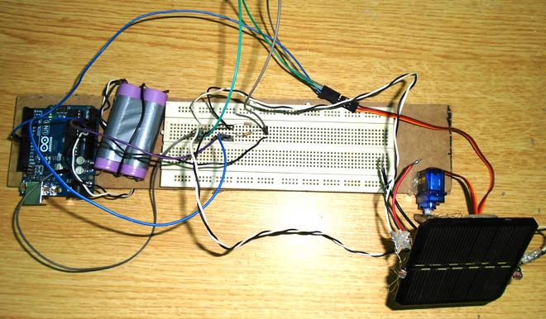
Probably like this….
SOURCE: https://circuitdigest.com/microcontroller-projects/arduino-solar-panel-tracker

Slide 10
System Requirements
Servo Motor X 2 (sg90)
Solar panel
Arduino Uno
LDR’s X 4 (Light Dependent Resistor)
10K resistors X 4
Battery (6 to 12V)

Slide 11
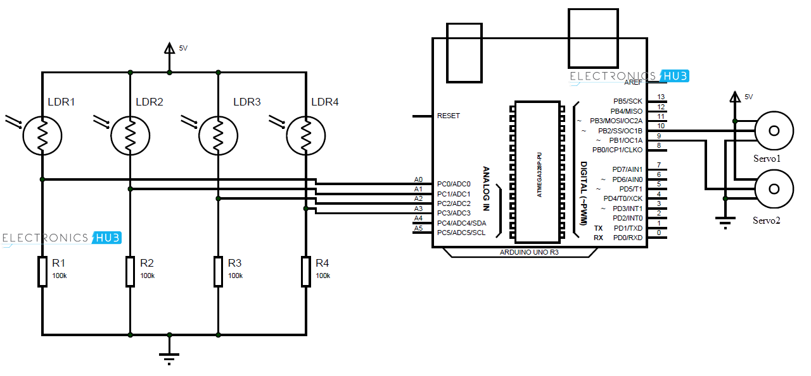
Block Diagram
SOURCE:
http://www.electronicshub.org/wp-content/uploads/2016/02/Solar-Tracker-Arduino.png

Slide 12
START
FLOWCHART
SUNLIGHT FALLS ON LIGHT DEPENDENT RESISTORS
IF DIFFERENCE IS EQUAL TO ZERO
PROGRAM CALCULATES DIFFERENCE BETWEEN THE SUNLIGHT ON THE FOUR RESISTORS (TWO AT A TIME)
SERVO MOTORS WILL ROTATE ACCORDINGLY
NO
STOP
YES

Slide 13
Budget Analysis
ITEM NAME | MODEL NUMBER | PRICE RANGE (IN ₹ )
SERVO MOTOR | SG 90 | ₹140 - ₹190
SOLAR PANEL | - | ₹120- ₹300
ARDUINO BOARD | ARDUINO UNO | ₹350 - ₹700
LIGHT DEPENDENT RESISTOR | - | ₹ 145 (6 PCS)
RESISTORS | - | ₹2- ₹5
9V BATTERY | - | ₹125(5 PCS)

Slide 14
REFERENCES
For circuit diagrams and block diagrams:
https://circuitdigest.com/microcontroller-projects/arduino-solar-panel-tracker
http://www.electronicshub.org/arduino-solar-tracker/#Project_Code
For price analysis:
amazon.in
ebay.in
Every image has its source written below it

