Slide 1
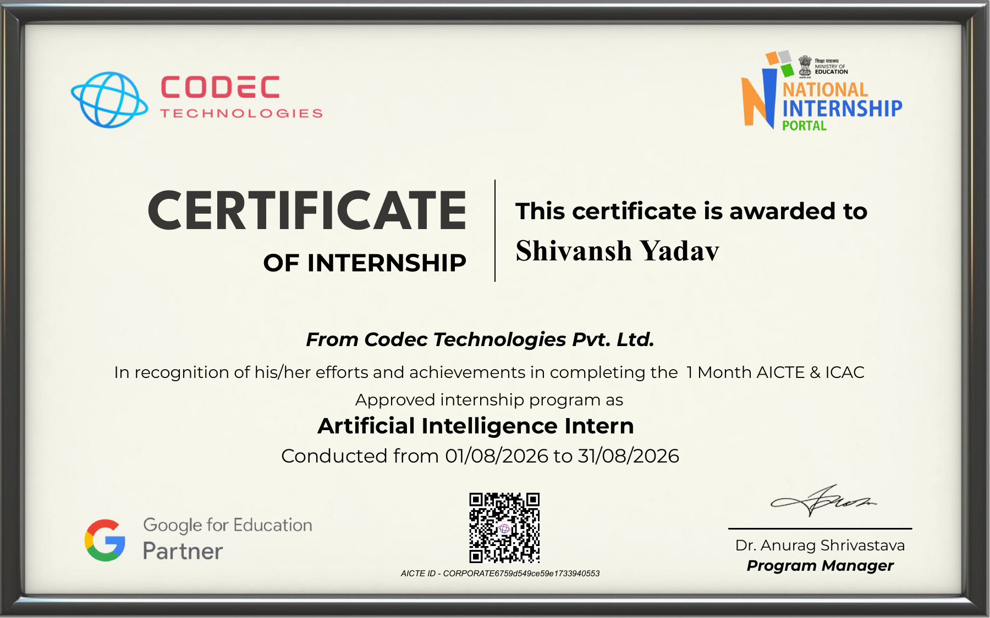
ARTIFICIAL INTELLIGENCE
INTERNSHIP REPORT
Submitted by: Shivansh Yadav
B.Tech – Computer Science & Engineering
IILM University, Greater Noida
Internship Organization: Codec Technologies Pvt. Ltd.
Duration: 01 August 2026 – 31 August 2026
Internship report
Certificate attached as the verified internship record
Notes:
Source: Internship Certificate issued by Codec Technologies Pvt. Ltd. The certificate confirms the organization, program type, role, and dates. General/proposed sections do not claim undocumented activities.

Slide 2
Objectives of the Internship
02
The certificate confirms the internship role and duration. The objectives below describe suitable learning aims for an AI internship; they do not document individual tasks.
LEARNING AIM
PRACTICE AIM
PROFESSIONAL AIM
Artificial intelligence foundations
Applied technical exposure
Workplace readiness
Build a structured understanding of core Artificial Intelligence concepts and how they support real-world problem solving.
Develop familiarity with the stages commonly involved in AI work, from understanding a problem to reviewing an output.
Strengthen communication, documentation, and responsible use of technology in a professional setting.
Certificate-supported internship context: Artificial Intelligence Intern, Codec Technologies Pvt. Ltd., 01 August 2026 - 31 August 2026.
Notes:
Source: Internship Certificate issued by Codec Technologies Pvt. Ltd. The certificate confirms the organization, program type, role, and dates. General/proposed sections do not claim undocumented activities.

Slide 3
Technologies and Tools
03
No specific software, programming languages, platforms, or tools are listed on the certificate.
CERTIFICATE RECORD
GENERAL LEARNING AREA
REPORTING NOTE
Verified information
AI workflow concepts
Evidence-based scope
The certificate identifies an AICTE & ICAC Approved internship program and the role of Artificial Intelligence Intern.
Typical AI learning may involve data, models, evaluation, and ethical considerations. This deck does not attribute particular tools to the internship.
Any tool names or technical implementations should be added only when supported by personal work records, mentor guidance, or project documentation.
Certificate-supported internship context: Artificial Intelligence Intern, Codec Technologies Pvt. Ltd., 01 August 2026 - 31 August 2026.
Notes:
Source: Internship Certificate issued by Codec Technologies Pvt. Ltd. The certificate confirms the organization, program type, role, and dates. General/proposed sections do not claim undocumented activities.

Slide 4
Learning and Development Activities
04
The following are general learning areas appropriate to an Artificial Intelligence internship. They are not presented as a record of completed activities.
CONCEPTUAL
ANALYTICAL
PROFESSIONAL
AI concepts
Problem analysis
Communication
Review core ideas such as problem formulation, data quality, model behaviour, and responsible technology use.
Practice breaking a broad problem into inputs, expected outputs, constraints, and ways to assess results.
Develop clear technical writing and the ability to explain an AI approach to different audiences.
Certificate-supported internship context: Artificial Intelligence Intern, Codec Technologies Pvt. Ltd., 01 August 2026 - 31 August 2026.
Notes:
Source: Internship Certificate issued by Codec Technologies Pvt. Ltd. The certificate confirms the organization, program type, role, and dates. General/proposed sections do not claim undocumented activities.

Slide 5
Project Work
05
The certificate does not name a project, deliverable, or result. This page preserves that boundary.
DOCUMENTED STATUS
SUGGESTED REPORT ENTRY
ACADEMIC INTEGRITY
No project title recorded
Add verified evidence
No unsupported claims
The official certificate verifies completion of the internship program but does not identify an individual project.
If a project report, code repository, brief, or mentor-approved summary exists, it can be inserted here as supporting documentation.
The presentation intentionally avoids inventing a project scope, methodology, tools, metrics, or outcome.
Certificate-supported internship context: Artificial Intelligence Intern, Codec Technologies Pvt. Ltd., 01 August 2026 - 31 August 2026.
Notes:
Source: Internship Certificate issued by Codec Technologies Pvt. Ltd. The certificate confirms the organization, program type, role, and dates. General/proposed sections do not claim undocumented activities.

Slide 6
Challenges and Solutions
06
The certificate contains no account of particular challenges. The examples below are general considerations for AI learning, not claims about this internship.
GENERAL CONSIDERATION
GENERAL CONSIDERATION
GENERAL CONSIDERATION
Translating concepts
Assessing outputs
Communicating work
A common learning challenge involves connecting theoretical AI ideas with an actual problem statement. Structured notes and review can help clarify the connection.
AI outputs require careful checking for relevance, reliability, and limitations. Clear evaluation criteria support responsible review.
Technical work benefits from concise documentation that states assumptions, sources, and what remains unverified.
Certificate-supported internship context: Artificial Intelligence Intern, Codec Technologies Pvt. Ltd., 01 August 2026 - 31 August 2026.
Notes:
Source: Internship Certificate issued by Codec Technologies Pvt. Ltd. The certificate confirms the organization, program type, role, and dates. General/proposed sections do not claim undocumented activities.

Slide 7
Skills Gained
07
The certificate establishes successful completion of a one-month Artificial Intelligence internship program. It does not list assessed competencies.
ROLE-RELEVANT AREA
TRANSFERABLE AREA
PROFESSIONAL AREA
AI awareness
Analytical thinking
Academic reporting
Completion supports exposure to the Artificial Intelligence internship domain. Specific proficiency levels are not stated on the certificate.
Problem framing, evidence review, and careful communication are relevant learning areas for AI-focused study.
Preparing an evidence-based internship report helps distinguish verified experience from broader learning reflections.
Certificate-supported internship context: Artificial Intelligence Intern, Codec Technologies Pvt. Ltd., 01 August 2026 - 31 August 2026.
Notes:
Source: Internship Certificate issued by Codec Technologies Pvt. Ltd. The certificate confirms the organization, program type, role, and dates. General/proposed sections do not claim undocumented activities.

Slide 8
Outcome of the Internship
08
Verified outcome from the certificate
COMPLETION
ROLE
PERIOD
Program completed
Artificial Intelligence Intern
01/08/2026 to 31/08/2026
Shivansh Yadav completed a 1 Month AICTE & ICAC Approved internship program.
The certificate identifies the internship role as Artificial Intelligence Intern at Codec Technologies Pvt. Ltd.
The certificate states that the program was conducted from 01/08/2026 to 31/08/2026.
Certificate-supported internship context: Artificial Intelligence Intern, Codec Technologies Pvt. Ltd., 01 August 2026 - 31 August 2026.
Notes:
Source: Internship Certificate issued by Codec Technologies Pvt. Ltd. The certificate confirms the organization, program type, role, and dates. General/proposed sections do not claim undocumented activities.

Slide 9
Conclusion
09
This report records only what the supplied certificate supports and distinguishes general academic content from verified internship facts.
VERIFIED RECORD
SUBMISSION STANDARD
NEXT STEP
Internship completion
Accurate representation
Optional evidence addition
The certificate confirms successful completion of a one-month Artificial Intelligence internship program at Codec Technologies Pvt. Ltd.
The deck avoids unsupported details about tools, projects, metrics, and individual tasks.
A fuller academic report can include verified project records or mentor-approved reflections, if available.
Certificate-supported internship context: Artificial Intelligence Intern, Codec Technologies Pvt. Ltd., 01 August 2026 - 31 August 2026.
Notes:
Source: Internship Certificate issued by Codec Technologies Pvt. Ltd. The certificate confirms the organization, program type, role, and dates. General/proposed sections do not claim undocumented activities.

Slide 10
Certificate of Internship
Original certificate reproduced for reference
Notes:
Source: Internship Certificate issued by Codec Technologies Pvt. Ltd. The certificate confirms the organization, program type, role, and dates. General/proposed sections do not claim undocumented activities.

