Slide 1

NurseSync – Voice-enabled handoffs for smarter, seamless nursing care
Speak. Sync. Care.
Team
Shivansh Sharma 1024030732
Ishaan Bhalla 1024030950
Pushp Batheja 1024030941

Slide 2


Why we started?
Healthcare is personal
We all have grandparents, parents, or loved ones who may need frequent medical care.
Seeing them navigate hospitals, we noticed how easily important information can be lost or misunderstood between nurse, shifts, and departments.
The Joint Commission identifies hand-off communication as an important safety requirement and notes that inadequate handoffs can contribute to adverse events
This motivated us to create a solution that helps nurses capture handoffs naturally through voice while making important information easier to understand, organize and access
“Because better documentation isn’t just about efficiency - it’s about safer, more connected care for the people we love.”

Slide 3




Problem
Documentation :
Burden
Nurses spend up to 35% of their shifts on manual charting, detracting from direct patient interaction and contributing to burnout.
Incomplete or misinterpreted information during nurse-to-nurse handoffs is a leading cause of preventable medical errors and missed critical patient details.
Handoff Errors :
Communication gaps between providers and patients who speak different languages increase nurses' cognitive load and introduce significant risks.
Language Barriers :
Accountability : Gaps
The absence of reliable, time-stamped records creates accountability gaps, making it difficult to reconstruct patient care events accurately.

Slide 4
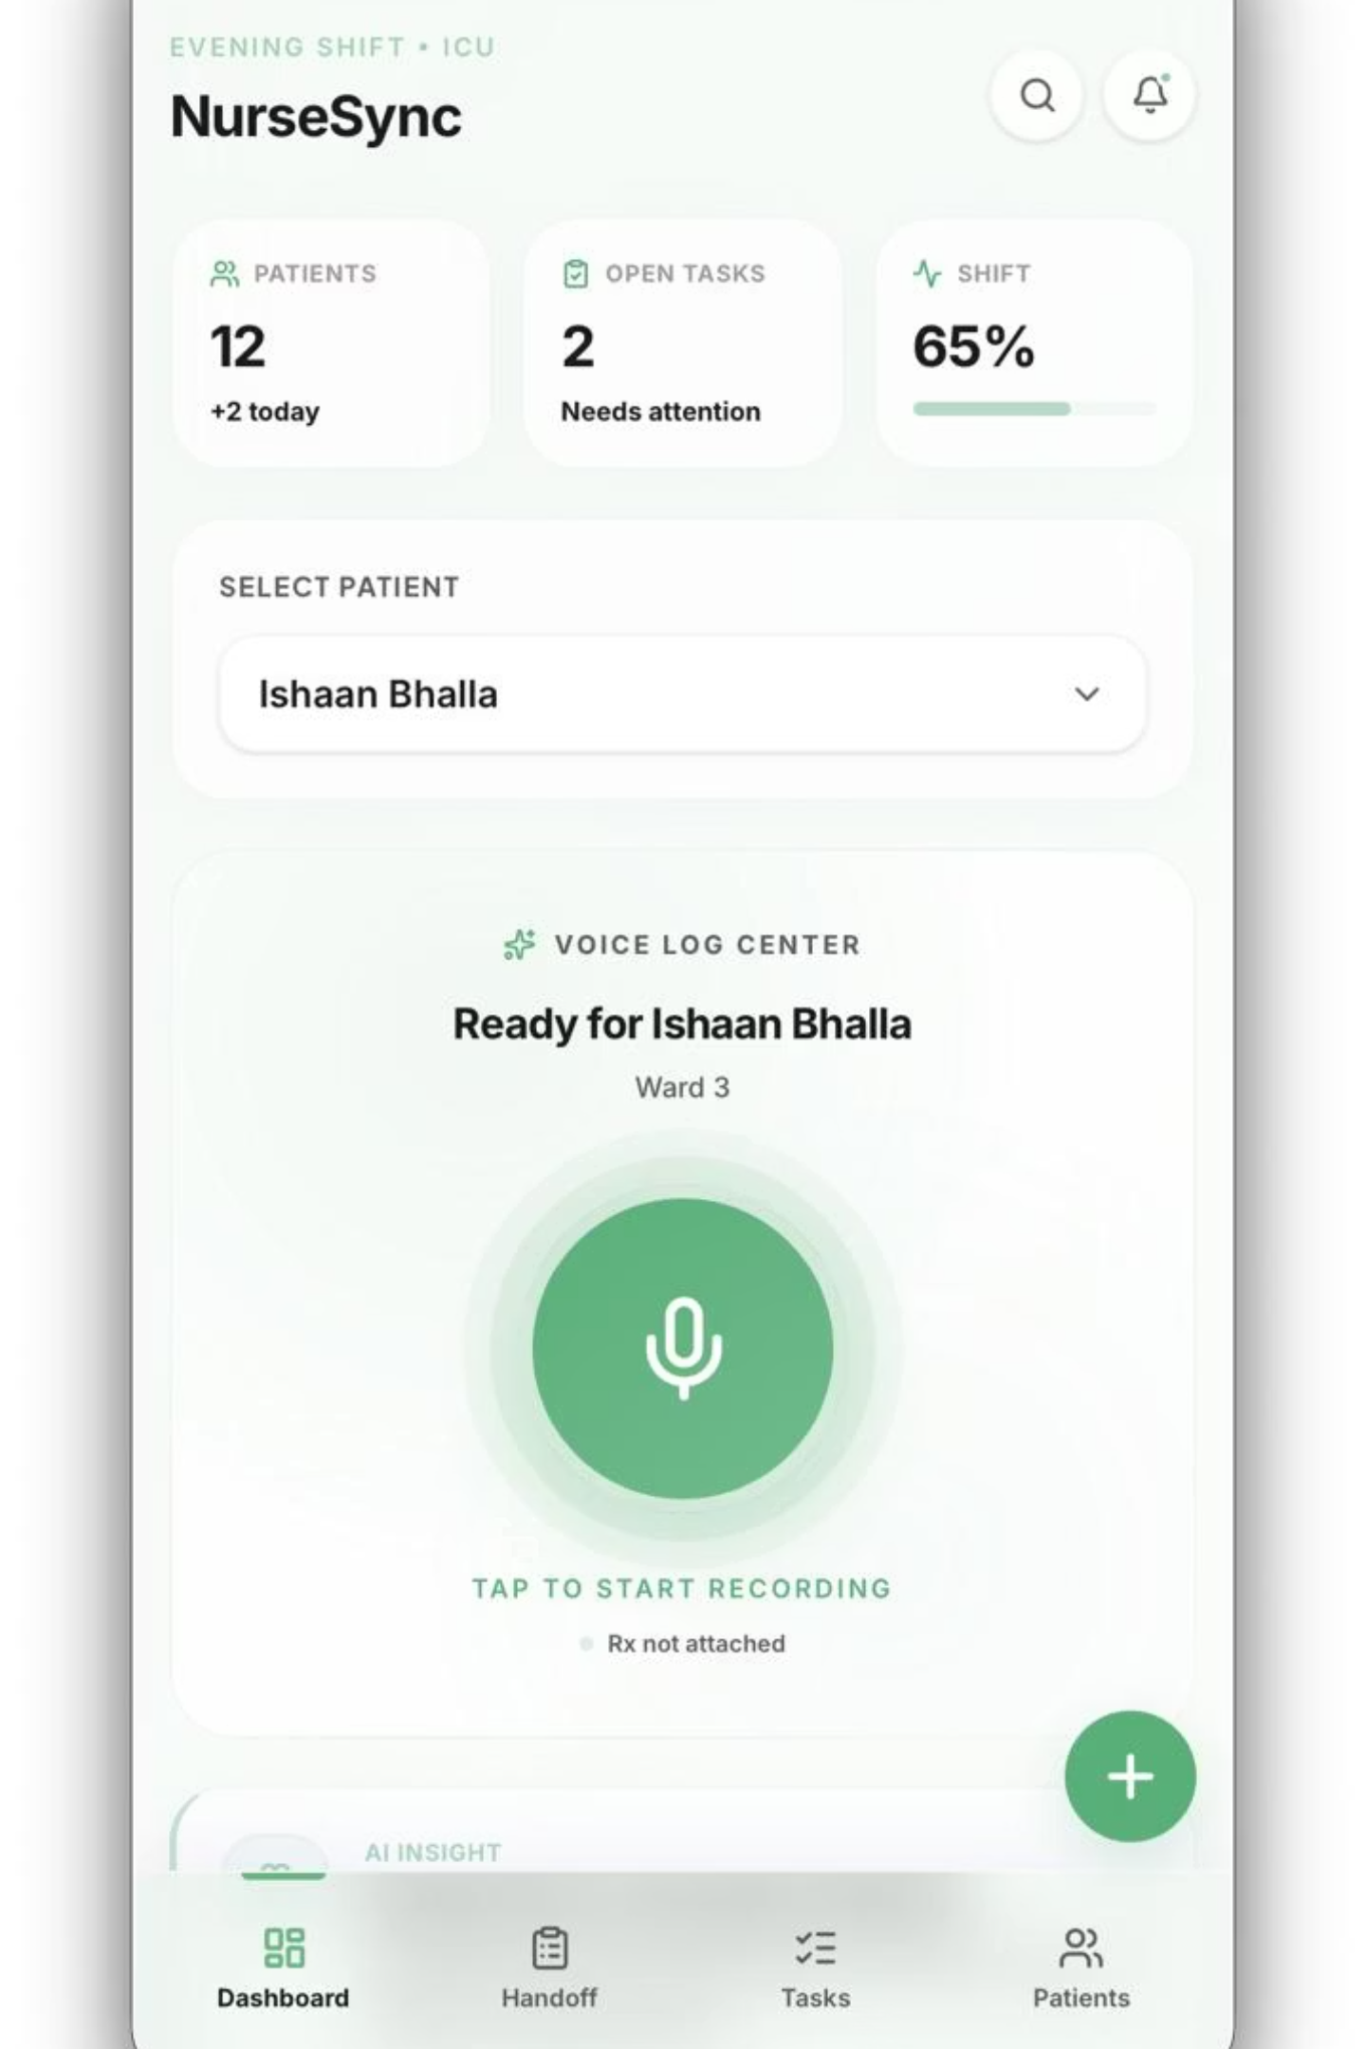
Solution
NurseSync converts spoken nursing updates into structured, time-stamped clinical records — in multiple languages — and produces intelligent shift handoffs with risk detection and accountability.
Voice Logging
Quick bedside notes captured hands-free on mobile or workstation.
AI Structuring
Extracts vitals, meds, tasks, and care plans into EMR-ready fields.
Accountability Stamps
Time + clinician identity for every action — audit-ready logs.
Automated Handoffs
Shift summaries prioritizing risks, pending tasks, and prescriptions.

