Slide 1

NurseSync AI — Prototype Progress Report
Speak. Sync. Care. · Work completed 3 Aug – 14 Sep 2026
Team
Shivansh Sharma 1024030732
Ishaan Bhalla 1024030950
Pushp Batheja 1024030941

Slide 2
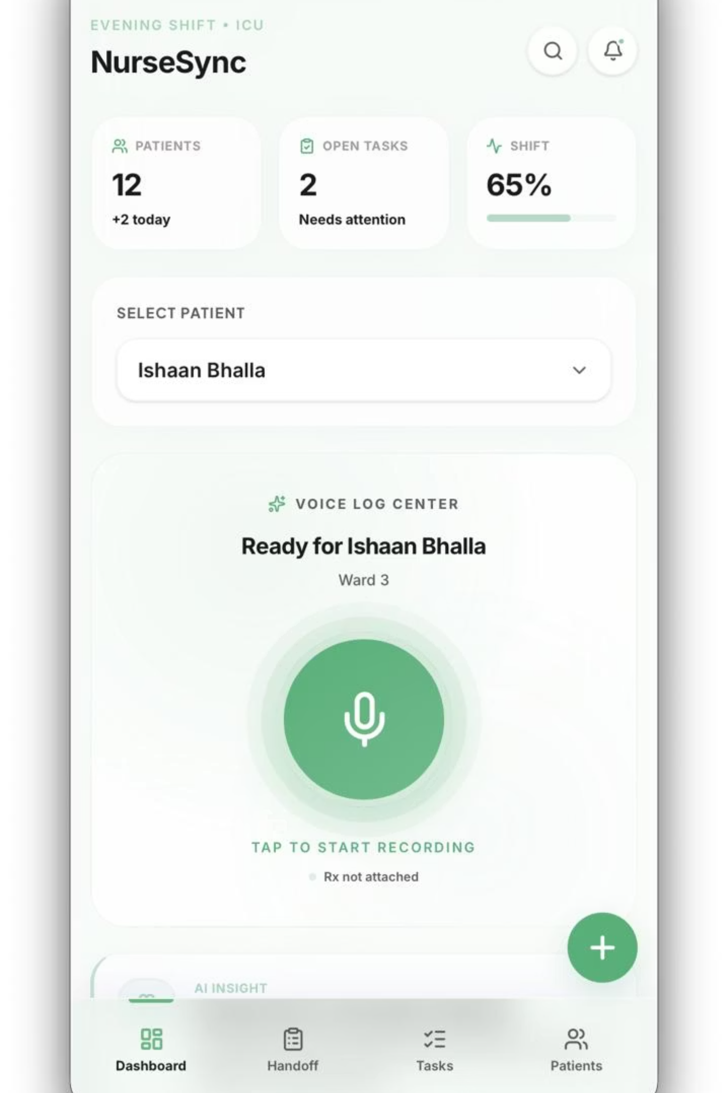
What We Built
A working speech-to-text handoff pipeline. A nurse speaks at the bedside, the audio is transcribed on our own server, and the transcript comes back for review before it is saved.
Voice Capture
Browser MediaRecorder captures the spoken handoff hands-free.
On-Premise Transcription
Runs locally on CPU — audio never leaves the institution.
Multilingual Input
English, Hindi, Punjabi, Tamil, Telugu and Bengali — auto-detected.
Nurse-in-the-Loop Review
Every transcript returns editable, so the nurse corrects before saving.

Slide 3




Phase 1 & 2
Inception :
Team formed, the clinical problem researched, and the NurseSync AI concept and scope finalised. (3 – 9 Aug)
GitHub repository restructured to the course-required layout; Git workflow and commit conventions agreed. (10 – 16 Aug)
Setup :
Proposal content drafted in LaTeX, then formatted and finalised into the submitted document. (17 – 23 Aug)
Proposal :
Modelling :
UML use case diagram, Level 0 and Level 1 data flow diagrams, and the activity diagram completed. (21 – 31 Aug)

Slide 4
Phase 3 & 4
Backend :
FastAPI application set up and the faster-whisper model integrated for local, offline transcription. (31 Aug – 6 Sep)
POST /transcribe built — multipart audio upload, model invocation, and JSON carrying transcript, language and confidence. (2 – 6 Sep)
Endpoint :
Demo page built with microphone capture, live Recording and Transcribing states, transcript display and history. (31 Aug – 11 Sep)
Frontend :
Testing :
Full pipeline verified end to end across multiple languages, returning successful responses. (9 – 13 Sep)

Slide 5
Architecture
NurseSync AI separates capture, recognition and persistence across four layers — three implemented, one modelled and scheduled for the next phase.
Presentation Layer
Capture, language selector, live states, editable transcript.
API Layer
Multipart upload, optional language parameter, structured JSON.
Recognition Engine
faster-whisper on CPU. Model cached in memory, not per request.
Data Layer (modelled)
Seven entities in the ER diagram. PostgreSQL is the next step.

Slide 6
Deliverables
Proposal :
Problem formulation, objectives, methodology and expected outcomes, authored in LaTeX and submitted.
Level 0 context diagram and Level 1 process decomposition, balanced so inputs and outputs match across levels.
DFDs :
Eight entities with key, multi-valued and derived attributes, relationship attributes and cardinality constraints.
ER Diagram :
UML :
Use case diagram with include dependencies, and an activity diagram with swimlanes, fork/join and decision nodes.

Slide 7


Key Decisions
Why we run the model locally
A nurse handoff contains protected patient health information. Sending that audio to a third-party cloud API would create a privacy exposure no hospital could reasonably accept.
We therefore run faster-whisper locally on CPU, so the audio never leaves the institution’s own infrastructure.
The same decision removes the API key, the per-request cost and the dependency on connectivity — once cached, transcription works offline.
The model is loaded once and held in memory rather than per request, turning a 10–20 second cost on every call into a one-time startup cost.
“Privacy was not a constraint we worked around — it decided the architecture.”

Slide 8
Status
Working :
Record, transcribe and display verified end to end, with successful responses across multiple languages.
Documentation site and demo published to GitHub Pages via GitHub Actions; local HTTPS configured with mkcert.
Deployed :
Persistence to PostgreSQL — the schema is modelled, but handoffs currently live in browser storage.
Pending :
Remaining :
SBAR auto-summarisation, deterioration risk flagging, and authentication with role-based access.

Slide 9
Contributions
Shivansh :
Proposal finalisation, ER diagram, the /transcribe endpoint, repository restructuring, GitHub Pages deployment and local HTTPS.
Initial proposal content, Level 0 and Level 1 DFDs, the project README, FastAPI setup with model integration, end-to-end testing.
Ishaan :
UML and activity diagrams, and the speech-to-text frontend — microphone capture, live states and transcript display.
Pushp :

Slide 10
Next Steps
Persistence :
Wire the modelled seven-entity schema to PostgreSQL so handoffs survive beyond the browser session.
Structure each transcript automatically into Situation, Background, Assessment and Recommendation.
SBAR :
Surface deteriorating patients to the incoming nurse from the vitals captured in each handoff.
Risk Model :
Evaluation :
Benchmark word error rate on annotated clinical speech, and add authentication with role-based access.

