Slide 1
Diagnosing Type Of The Breast Cancer Tumor
ML Problem Statement Report
Creator: Shivansh Srivastav
Institute: Jain (Deemed-to-be-University)

Slide 2
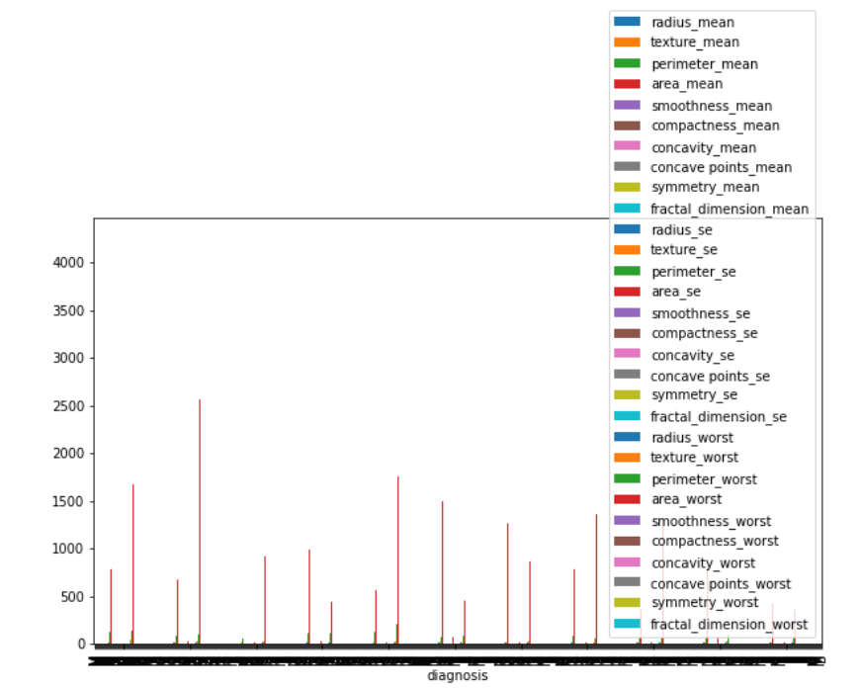
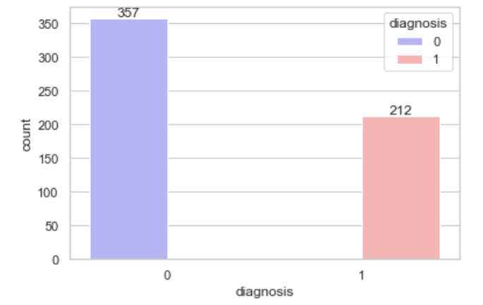
Plotting's Made
Class distribution
0: 357 Benign,
1: 212 Malignant
The mean, standard error and "worst" or largest (mean of the three largest values) of these features were computed for each image, resulting in 30 features.

Slide 3
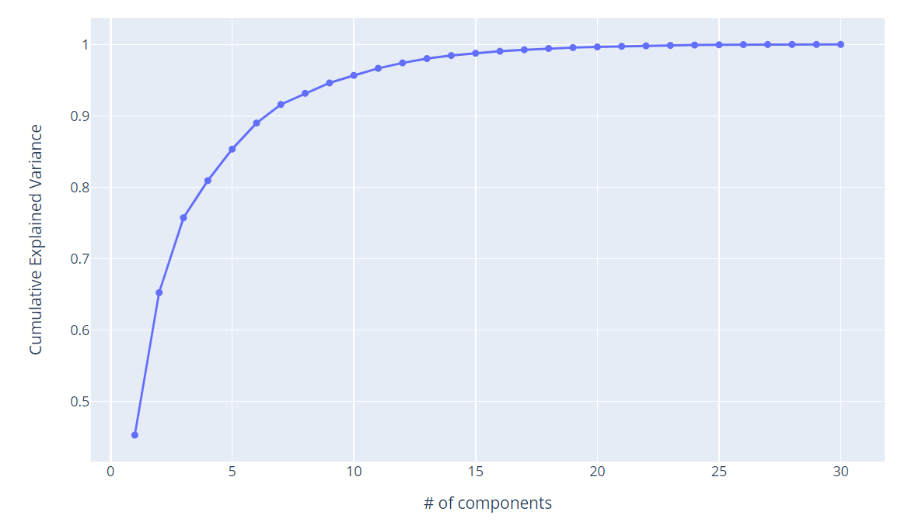
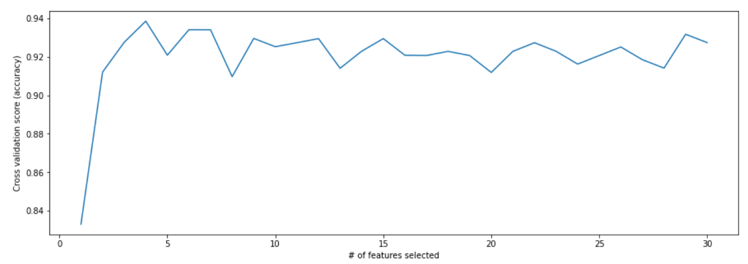
There is an elbow after the seventh component, and 91% of the total variance is explained by the first seventh components. If keeping the first 10 or 17 principal components, we can preserve about 95 % or even more than 99% of the total variance.
We can visualize how the model’s performance changes when the number of features increases by plotting the number of features used in the model versus the model accuracy. So, more features isn’t always better. The accuracy value has reached the highest when the first # important features are used in the model.

Slide 4
Attributes Used
1) ID number 2) Diagnosis (M = malignant, B = benign)
Ten real-valued features are computed for each cell nucleus:
a) radius (mean of distances from center to points on the perimeter) b) texture (standard deviation of gray-scale values) c) perimeter d) area e) smoothness (local variation in radius lengths) f) compactness (perimeter^2 / area - 1.0) g) concavity (severity of concave portions of the contour) h) concave points (number of concave portions of the contour) i) symmetry j) fractal dimension ("coastline approximation" - 1)

Slide 5
Models Used
Assumptions Used
Logistic Regression
Logistic Regression with PCA
Random Forest with PCA
Random Forest with RFE
SVC
It was required to diagnose breast tissue (M = malignant, B = benign) using the computed 30 features, and make a prediction based on the models we selected to perform the training and evaluating of cancerous and non-cancerous tissues.
Features are computed from a digitized image of a fine needle aspirate (FNA) of a breast mass. They describe characteristics of the cell nuclei present in the image.

Slide 6
The effectiveness of dimensionality reduction highly depends on the algorithm to be applied later and type of the data to be passed into the methodology.
We used AUC-ROC curve with False positive rate (1-specifically), True positive rate (Recall) and Precision recall curve for trace 0 and 1.
The main concern was to choosing the right threshold value. In this case, we may be far more concerned with having high true positive rate (or low false negative) than high true negative rate (or low false positive). A high true positive rate means that patients would get the early treatment as much as possible. Sometimes, we also need a relative lower false positive value for a balance, because incorrectly identifying benign tumor as malignant will cause patients' excessive mental stress.
In this breast cancer dataset, the classification performance in logistic regression method is obviously improved after using PCA. In the meanwhile, we also noticed that when we use random forest technique as a classifier, the classification metrics are no overall improvement either with PCA or RFE as dimension reduction method, although the training time is decreased as the number of used features reduced.
Results: After using all the Models, we plotted Model performance plot, and the final graph shows we have a prediction accuracy of 99.1% with Logistic Regression classifier.

