Slide 1
ML Problem Statement Report – Predicting Cloud CPU Utilization Using Deep Learning
Creator: Shivansh Srivastav
Institute: Jain (Deemed-to-be-University)

Slide 2
Objective Of The Project
Nowadays companies are utilizing the cloud for the day-to-day activities. Many big cloud service providers like AWS, Microsoft Azure have been successfully serving the needs of its customers. A brief understanding of the characteristics of production virtual machine (VM) workloads of large cloud providers can inform the providers resource management systems, e.g., VM scheduler, power manager, server health manager.
In this project we are going to analyzing Microsoft Azure’s VM CPU utilization dataset released in October 2017. We will predict the VM workload from the CPU usage pattern like minimum, maximum and average usage from the Azure dataset. Different techniques among Deep learning are used for the prediction by considering the history of the workload.
Proactively allocating VMs can increase usage efficiency of underlying resources. If a computing cluster predicts the future resource usage of a user service will increase, it can preemptively scale up to accommodate a higher load. If it predicts that usage will decrease, it can deallocate VMs and save computing resources.
We can arrive at a conclusion that cloud service providers can use their workloads’ characteristics and machine learning techniques to enhance resource management greatly.

Slide 3
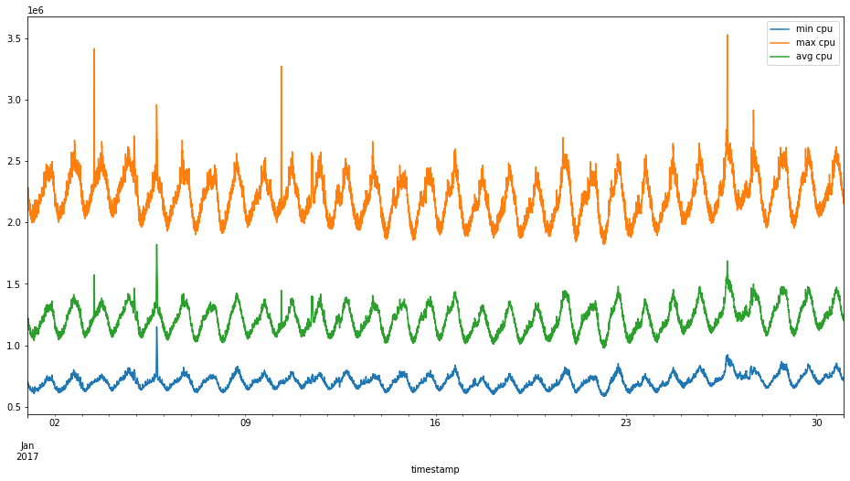
Attributes Used
The Dataset contains the CPU Usage data of Microsoft Azure, which is a cloud service, sampled every 5 minutes. The data has three attributes:
Max (maximum) CPU Utilization
Avg (average) CPU Utilization
Min (minimum) CPU Utilization

Slide 4
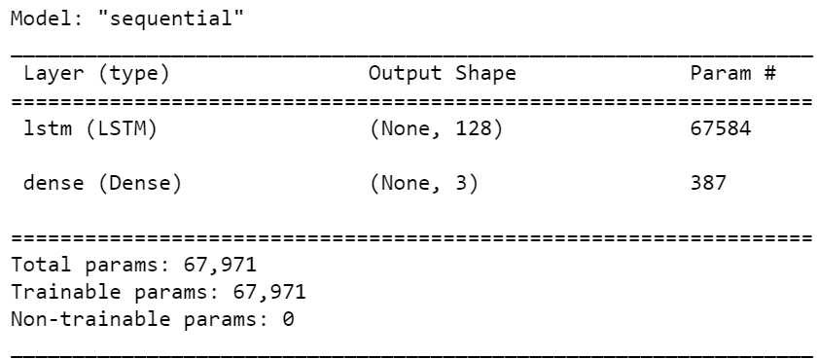
Model Used
LSTM Model ( 2 layers of 512 units each and a dense layer at the top)
The Model was evaluated using rolling window forecasting method. The Root Mean Squared Error (RMSE) , Mean Absolute Error (MAE) and the Mean Average Percentage Error (MAPE) were chosen as evaluation metrices.
Model Performance:
Test Score: 23987.87 RMSE
Test Score: 123.022565 MAE
Test Score: 1.004987 MAPE
Adam optimizer model summary – Training parameters

Slide 5
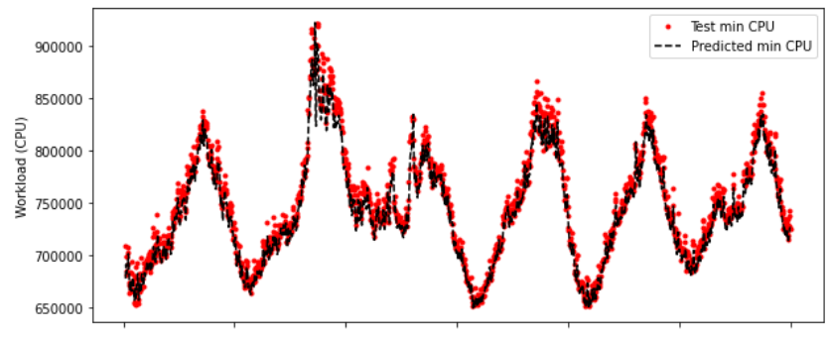
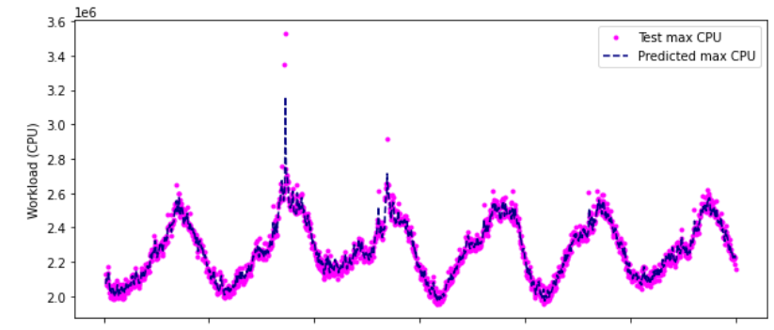
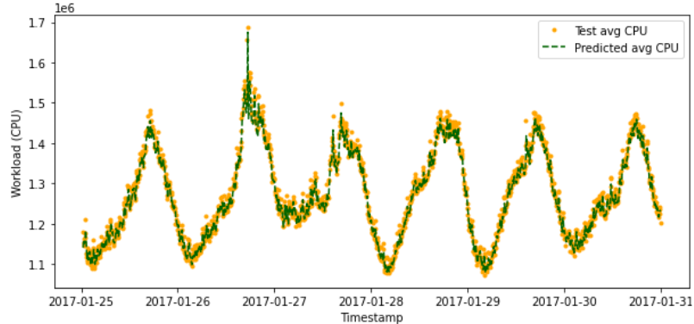
Final Results
Min CPU Utilization Graph
Max CPU Utilization Graph
Avg CPU Utilization Graph

