Slide 1
Exploratory Data Analysis &
Feature Engineering–
On Zomato Dataset Modules
Creator: Shivansh Srivastav
Institute: Jain (Deemed-to-be-University)

Slide 2
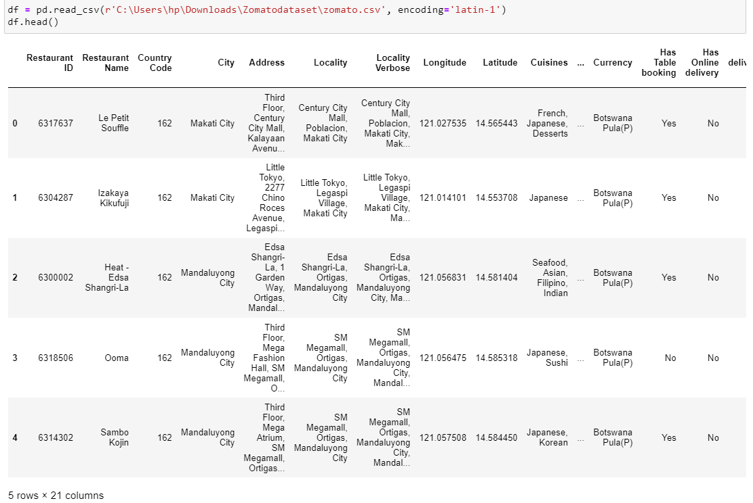
Dataset Description
There are total 21 modules to perform EDA & Feature Engineering, we will see how we should handle missing values, null values and corelate the features to find the optimal solution.

Slide 3
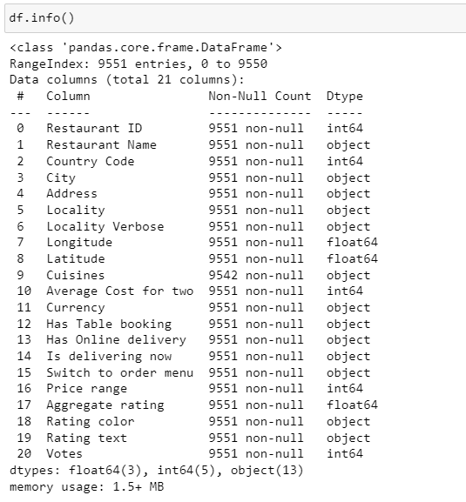
There are total 21 modules to perform EDA & Feature Engineering.
Let’s see what will be the operations to perform on the Feature Engineering dataset.
First we will handle the null values (if any)
Second we will find and handle missing values in the dataset, missing values can impact the process data analysis and model performance.
Explore about Categorical variables.
Explore about Numerical variables.
We will se the relationship between features.
Correlation features.

Slide 4
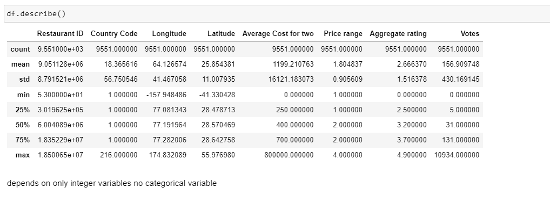
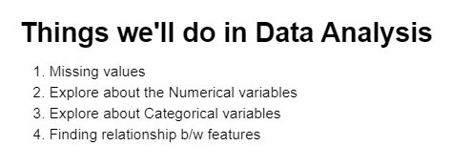
Description of the dataset shows count of all the important features especially ‘price range’ and, ‘aggregate rating’ in this dataset to plot graphs and make predictions.
There are many features to consider in EDA we will see some of it performing in this dataset.
Some questions to perform correlation of features.

Slide 5
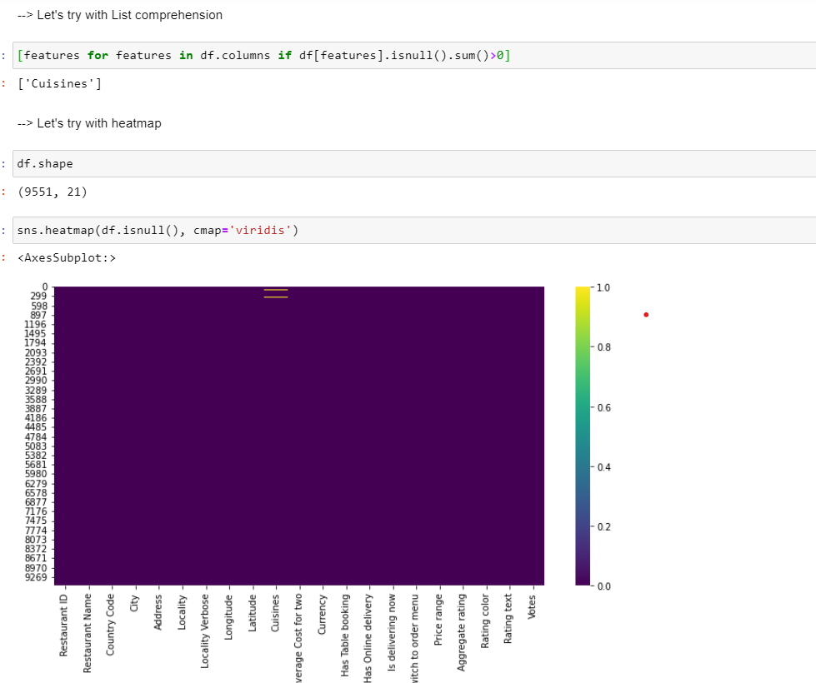
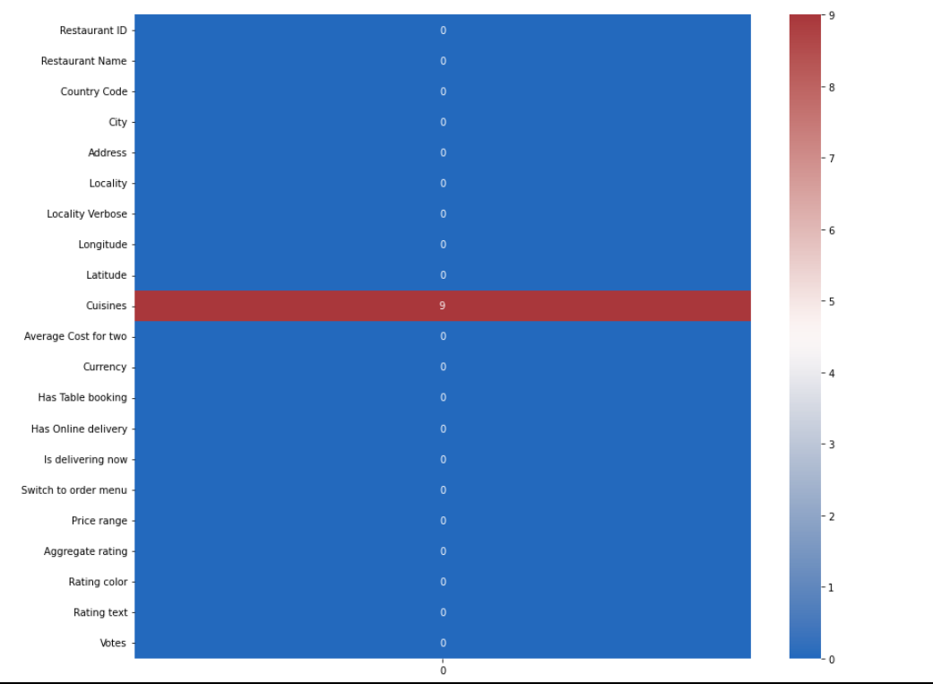
Handling Missing Values
List comprehension shows features which has missing values.
Below heatmap shows where those missing values lies.
Exact number of missing values will show in the heatmap, whether it is one feature or many.

Slide 6
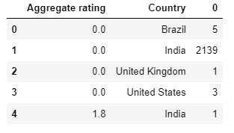
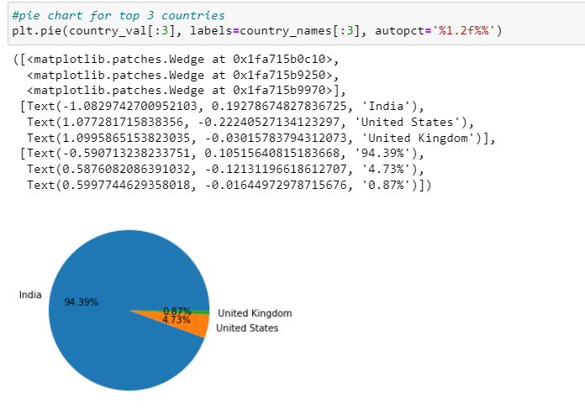
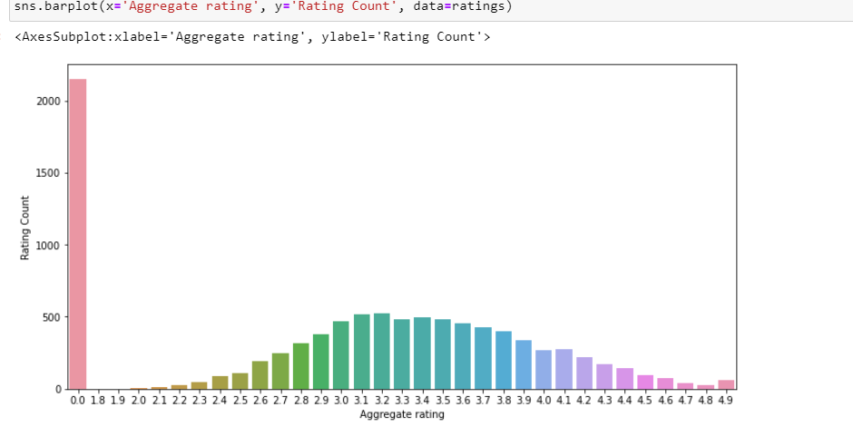
Country Code dataset Feature Performance
We have plotted top 3 countries from the Zomato dataset that has topmost orders.
Below graph shows aggregate rating and, no rating at all given by zomato users of a country dataset.
countries with no rating
average rating point

