Slide 1
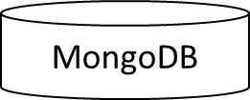
Eureka Science Discovery
(8761)
Owner Service
8081
MongoDB
API
Gateway
[Zuul]
8181
Swagger
API
Manager Service
8082
MongoDB
Spring
Security
Receptionist Service
8083
UI
Framework
(Angular)
MongoDB
USER
Room Service
8084

