Slide 1


Noida Institute of Engineering and Technology, Greater Noida
Spring MVC & Spring Boot
Unit: 4
Advanced Java Programming
(ACSAI0612/ACSE0601/ACSEH0601/AMICSE0601)
Raviraj Singh
Assistant Professor
Department: CSE(DS)
6th Semester
(CSE M.Tech Int./B.Tech)

Slide 2
Faculty Profile
Name | Raviraj Singh
Qualification | M. Tech. (Computer Science & Engineering)
Designation | Assistant Professor
Department | Computer Science & Engineering
Total Experience | 7 years
NIET Experience | 3.5 years
Subject Taught | C-Programming, Python and Advance Python, Java Programming, Advanced Java, Python with Django, Web Technology DAA, Data Structure, DBMS, Operating System, COA, TOC, Compiler Design.

Slide 3
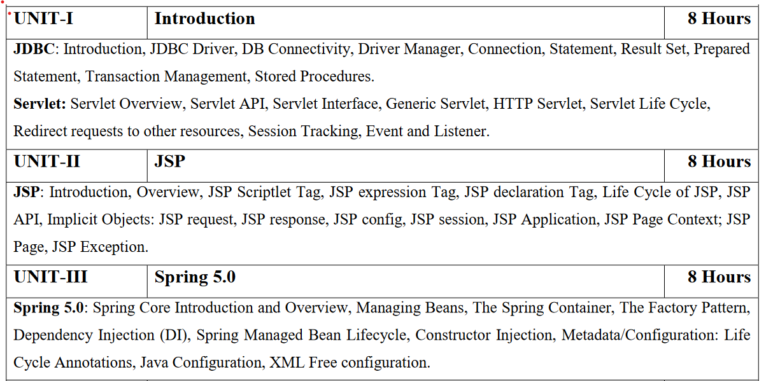
Syllabus

Slide 4
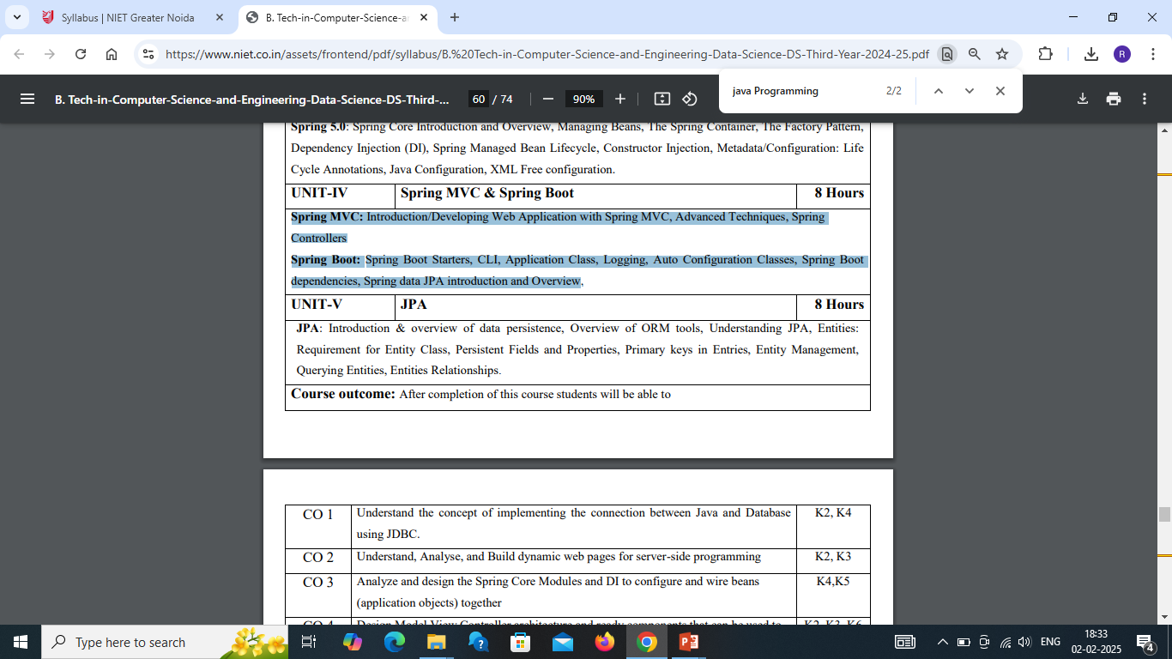
Syllabus

Slide 5
Branch Wise Application
Desktop GUI Applications
Mobile Applications
Artificial intelligence
Web applications
Big Data technology
Gaming applications
Business applications
Embedded systems
Cloud applications
Scientific applications

Slide 6
Course Objectives
Understanding the Model-View-Controller Pattern:
Learn the basics of the MVC pattern and how it’s applied in web development with Spring.
2) Creating a Web Application using Spring MVC:
Develop and deploy a web application using Spring MVC framework.
Configure Spring DispatcherServlet and map it to various controllers.
3) Understand the purpose and advantages of Spring Boot in simplifying the configuration and setup of Spring applications.
4) Set up and create a basic Spring Boot application using Spring Initializr and IDEs like IntelliJ or Eclipse.
5) Learn how Spring Boot’s autoconfiguration works and how to use Spring Boot starters to easily integrate various dependencies.
6) Develop REST APIs using Spring Boot, working with controllers, request mappings, and response formats like JSON and XML.
Develop error-free, well-documented Java programs; develop and test Java network, search engine, and web framework programs. Learn how to write, test, and debug advanced-level Object-Oriented programs using Java. Develop error-free, well-documented Java programs; develop and test Java network, search engine, and web framework programs. Learn how to write, test, and debug advanced-levDevelop error-free, well-documented Java programs; develop and test Java network, search engine, and web framework programs. Learn how to write, test, and debug advanced-level Object-Oriented programs using Java.el Object-Oriented programs using Java.

Slide 7
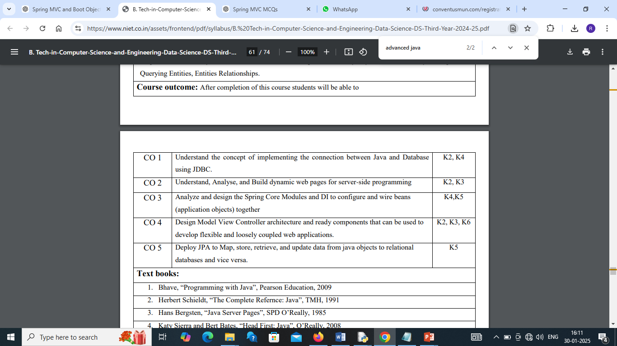
Course Outcomes

Slide 8
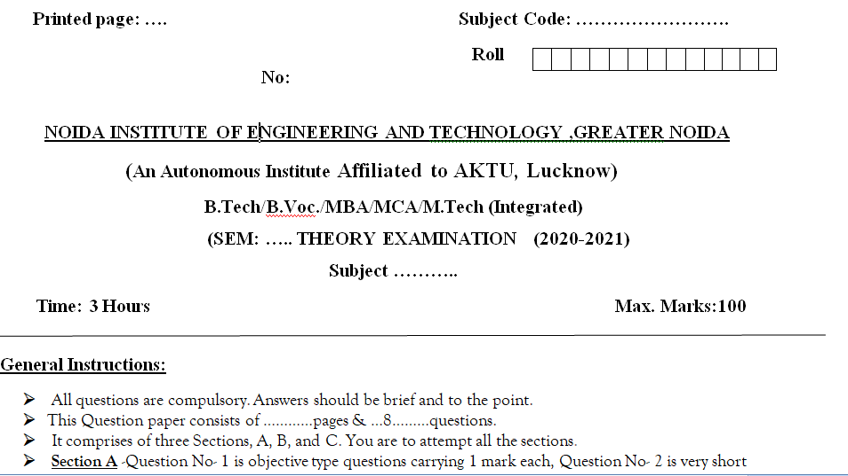
End Semester Question Paper Templates (Offline Pattern/Online Pattern

Slide 9
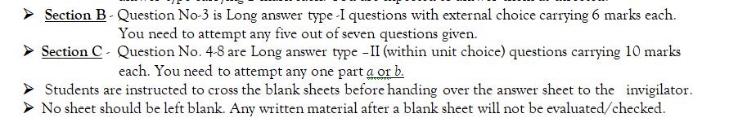
End Semester Question Paper Templates (Offline Pattern/Online Pattern

Slide 10
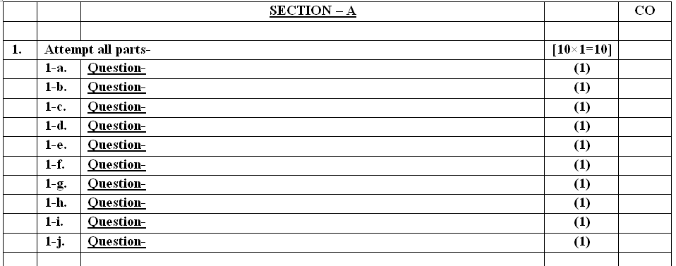
End Semester Question Paper Templates (Offline Pattern/Online Pattern

Slide 11
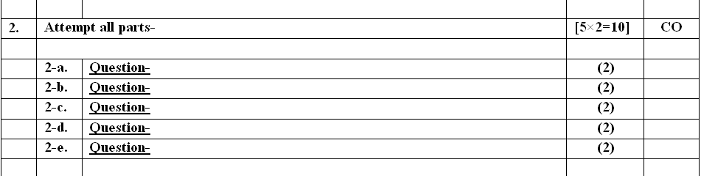
End Semester Question Paper Templates (Offline Pattern/Online Pattern

Slide 12
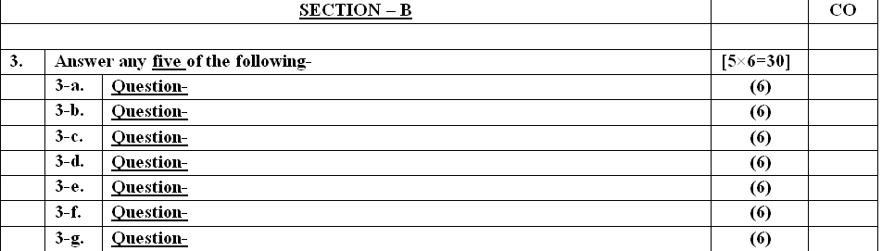
End Semester Question Paper Templates (Offline Pattern/Online Pattern

Slide 13
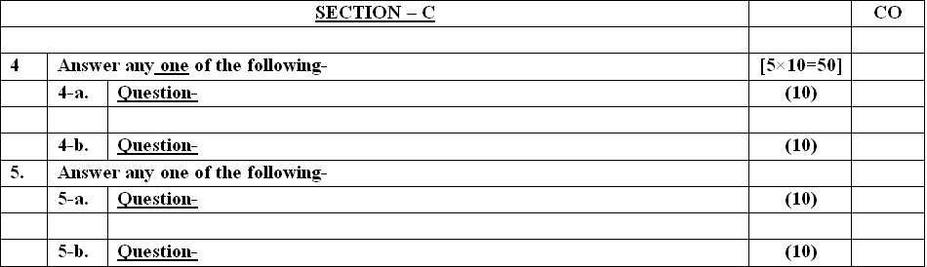
End Semester Question Paper Templates (Offline Pattern/Online Pattern

Slide 14
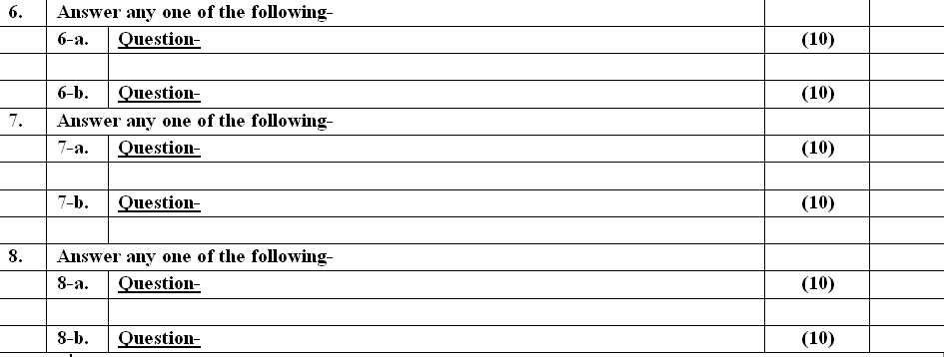
End Semester Question Paper Templates (Offline Pattern/Online Pattern

Slide 15
Prerequisite
Student must know at least the basics of Java programming ,able to start coding on any IDE.
Knowledge of object oriented techniques using Java concepts, as covered in ‘Programming Basic” course is necessary.

Slide 16
Recap
1) Inversion of Control (IoC): Spring's most important concept, where the control of object creation and dependencies is handed over to the Spring container (rather than manually managing them in code). This is also known as Dependency Injection (DI).
DI Types: There are mainly three types of DI in Spring:
Constructor Injection: Dependencies are injected via the constructor.
Setter Injection: Dependencies are injected via setter methods.
Field Injection: Dependencies are injected directly into fields (less common due to reduced testability).
2) Spring Beans: These are objects managed by the Spring IoC container. Beans can be defined in two primary ways:
XML configuration: Beans are defined and wired in an XML file.
Annotation-based configuration: Beans are defined using @Component, @Service, @Repository, or @Controller, and Spring will automatically detect them through classpath scanning.

Slide 17
Recap
3) ApplicationContext: This is the Spring container responsible for managing the beans and their lifecycle. There are different types of ApplicationContext implementations, such as ClassPathXmlApplicationContext, AnnotationConfigApplicationContext, etc.
4) Scope: The scope of a Spring bean defines its lifespan. The common scopes are:
Singleton: A single instance for the entire application context.
Prototype: A new instance is created every time the bean is requested.
Request: One instance per HTTP request (for web applications).
Session: One instance per HTTP session (for web applications).
Application: One instance per ServletContext.
5) Autowiring: Spring can automatically inject dependencies based on matching bean names or types. Autowiring can be done using annotations like @Autowired, @Qualifier, or XML configuration.

Slide 18
About the Subject with Videos
Unit-4 refers to languages that uses objects in programming.
Unit-4 aims to implement real-world entities like inheritance, hiding, polymorphism etc in programming.
The main aim of Unit-4 is to bind together the data and the functions that operate on them so that no other part of the code can access this data except that function
Unit1
https://youtu.be/96xF9phMsWA
https://youtu.be/Zopo5C79m2k
Unit 2 https://youtu.be/vHmUVQKXlVo
https://youtu.be/qz0aGYrrlhU
Unit 3 https://youtu.be/GBOK1-nvdU4
https://youtu.be/YpsFT50mths?list=PLd3UqWTnYXOlc93disyBjyFv-r1Vq-5zh
Unit 4 https://youtu.be/-qfEOE4vtxE
https://youtu.be/PkZNo7MFNFg
Unit 5 https://youtu.be/_GMEqhUyyFM
https://youtu.be/ImtZ5yENzgE

Slide 19
UNIT OBJECTIVE
This course gives the fundamental knowledge of Spring Model View Controller and Spring Boots
The unit will help the students to understand how the approaches of threads help in solving real life problems.
Basic understanding of Java Framework like Spring and Spring Boots used.
Overview of creating custom annotations and using them in programs.

Slide 20
UNIT CONTENT
Spring MVC
Introduction/Developing Web Application with Spring MVC
Advanced Techniques
Spring Controllers
Spring Boot
Spring Boot Starters
CLI
Application Class
Logging
Auto Configuration Classes
Spring Boot Dependencies
Spring data JPA introduction and Overview

Slide 21
Spring MVC: Introduction
Spring MVC framework is an open-source Java platform that provides comprehensive infrastructure support for developing robust Java-based Web applications very easily and very rapidly.
Spring framework was initially written by Rod Johnson and was first released under the Apache 2.0 license in June 2003.
It follows the Model-View-Controller design pattern. It implements all the basic features of a core spring framework like Inversion of Control, and Dependency Injection.
A Spring MVC provides an elegant solution to use MVC in spring framework with the help of DispatcherServlet.
DispatcherServlet is a class that receives the incoming request and maps it to the right resource such as controllers, models, and views.

Slide 22
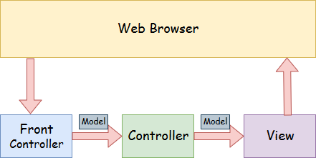
Spring Web Model-View-Controller
(MVC)

Slide 23
MVC
Model - A model contains the data of the application. A data can be a single object or a collection of objects. The Model encapsulates the application data and in general, they will consist of POJO.
View - A view represents the provided information in a particular format. Generally, JSP+JSTL is used to create a view page. Although spring also supports other view technologies such as Apache Velocity, Thymeleaf and FreeMarker. The View is responsible for rendering the model data and in general, it generates HTML output that the client's browser can interpret.
Controller - A controller contains the business logic of an application. Here, the @Controller annotation is used to mark the class as the controller. The Controller is responsible for processing User Requests and Building Appropriate Model and passes it to the view for rendering.
Front Controller - In Spring Web MVC, the DispatcherServlet class works as the front controller. It is responsible to manage the flow of the Spring MVC application.

Slide 24
Working of MVC Framework
Spring MVC Framework works as follows:
All the incoming requests are intercepted by the DispatcherServlet that works as the front controller.
The DispatcherServlet then gets an entry of handler mapping from the XML file and forwards the request to the controller.
The object of ModelAndView is returned by the controller.
The DispatcherServlet checks the entry of the view resolver in the XML file and invokes the appropriate view component.

Slide 25
Advantages of Spring MVC Framework
The container is used for the development and deployment of applications and uses a lightweight servlet.
It enables rapid and parallel development.
Development of the application becomes fast.
Easy for multiple developers to work together.
Easier to Update the application.
It is Easier to Debug because we have multiple levels in the application.

Slide 26
Disadvantages of Spring MVC Framework
It has high complexity to develop the applications using this pattern.
It is not suitable for small applications which affect the application’s performance and design.

Slide 27
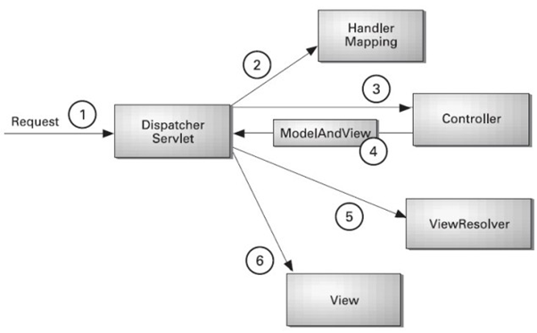
Understanding the flow of Spring Web MVC

Slide 28
Cont…
As displayed in the figure, all the incoming request is intercepted by the DispatcherServlet that works as the front controller.
The DispatcherServlet gets an entry of handler mapping from the XML file and forwards the request to the controller.
The controller returns an object of ModelAndView.
The DispatcherServlet checks the entry of view resolver in the XML file and invokes the specified view component.

Slide 29
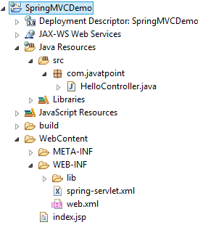
Directory Structure of Spring MVC

Slide 30
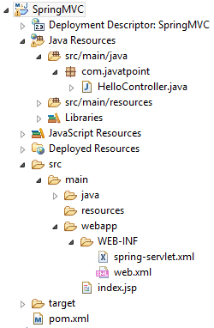
Directory Structure of Spring MVC using Maven

Slide 31
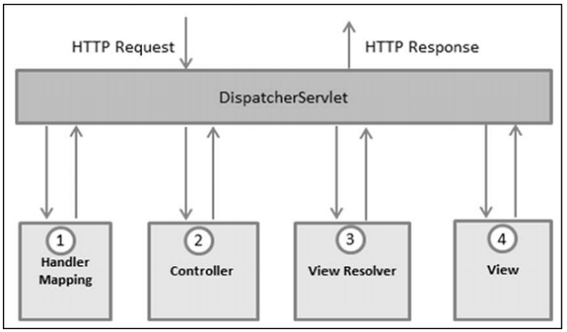
The DispatcherServlet
The Spring Web model-view-controller (MVC) framework is designed around a DispatcherServlet that handles all the HTTP requests and responses. The request processing workflow of the Spring Web MVC DispatcherServlet is shown in the following illustration.

Slide 32
Quiz
1) What is the primary function of the Spring MVC DispatcherServlet?
A) To handle business logic
B) To receive HTTP requests and delegate them to appropriate controllers
C) To connect to the database
D) To generate HTML pages
Answer: B) To receive HTTP requests and delegate them to appropriate controllers
2. Which annotation in Spring MVC is used to mark a class as a controller?
A) @RestController
B) @Service
C) @Controller
D) @Component
Answer: C) @Controller

Slide 33
Quiz
3) Which annotation is used in Spring MVC to map HTTP request methods to specific controller methods?
A) @RequestMapping B) @ResponseBody C) @Autowired D) @RequestParam
Answer: A) @RequestMapping
4) Which Spring MVC annotation is used for mapping HTTP POST requests?
@PostMappingB)
@RequestMappingC)
@PutMapping
D) @GetMappingAnswer:
Answer A) @PostMapping

Slide 34
Quiz
5. How do you configure Spring MVC to use a custom error page?
A) By defining a @ControllerAdvice class B) By defining a web.xml configuration C) By adding error-mapping in the application.properties D) By using the @ExceptionHandler annotation in controllers
Answer: C) By adding error-mapping in the application.properties
6. Which of the following annotations is used to bind an HTTP request header to a method parameter?
@RequestHeader
@RequestParam
@PathVariable
@ModelAttributeAnswer:
Answer: A) @RequestHeader

Slide 35
Quiz
7. What is the role of @ExceptionHandler in Spring MVC?
A) It is used to map an exception to a custom error page. B) It allows handling specific exceptions within a controller method. C) It is used to define a global exception handler. D) It is used for dependency injection of error-handling beans.
Answer: B) It allows handling specific exceptions within a controller method.
8. Which of the following best describes the purpose of the @ResponseBody annotation in Spring MVC?
It indicates that a method’s return value should be directly bound to the HTTP response body.
B) It is used for error handling in controllers.
C) It specifies that a method handles a POST request.
D) It maps a controller to a RESTful web service
.Answer: A) It indicates that a method’s return value should be directly bound to the HTTP response body.

Slide 36
Quiz
9. What is the purpose of the @RequestMapping annotation when used at the method level in Spring MVC?
A) It maps an HTTP request to a method for a particular URL and request method (GET, POST, etc.). B) It maps the controller to the view resolver. C) It binds HTTP headers to method parameters. D) It specifies the type of response to send back.
Answer: A) It maps an HTTP request to a method for a particular URL and request method (GET, POST, etc.).
10. Which Spring MVC feature allows handling validation for user input?
@Valid
B) @ControllerAdvice
C) @PathVariable
D) @Autowired
Answer: A) @Valid

Slide 37
Spring Boot
Spring Boot provides a number of starters that allow us to add jars in the classpath. Spring Boot built-in starters make development easier and rapid. Spring Boot Starters are the dependency descriptors.
In the Spring Boot Framework, all the starters follow a similar naming pattern: spring-boot-starter-*, where * denotes a particular type of application. For example, if we want to use Spring and JPA for database access, we need to include the spring-boot-starter-data-jpa dependency in our pom.xml file of the project.

Slide 38
Create Your First Spring MVC Application
Step 3: Provide the name of the controller in the web.xml file as follows:
DispatcherServlet is the front controller in Spring Web MVC. Incoming requests for the HTML file are forwarded to the DispatcherServlet.
Step 4: We have to define the bean in a separate XML file. We have specified the view components in this file. It is located in the WEB-INF directory.
Step 5: Use JSP to display the message.
Step 6: Start the server and run the project.
Step 0: Setup your project with maven use the required archetype to get the required folders directory and configure the server with your project.
Step 2: Create the Controller Class
.

Slide 39
What is Spring Boot
Spring Boot is a project that is built on the top of the Spring Framework. It provides an easier and faster way to set up, configure, and run both simple and web-based applications.
It is a Spring module that provides the RAD (Rapid Application Development) feature to the Spring Framework. It is used to create a stand-alone Spring-based application that you can just run because it needs minimal Spring configuration.

Slide 40
Cont…
In short, Spring Boot is the combination of Spring Framework and Embedded Servers.
In Spring Boot, there is no requirement for XML configuration (deployment descriptor). It uses convention over configuration software design paradigm that means it decreases the effort of the developer.
We can use Spring STS IDE or Spring Initializr to develop Spring Boot Java applications.

Slide 41
Difference b/w Spring MVC & Spring Boot
S.No. | SPRING MVC | SPRING BOOT
1. | Spring MVC is a Model View, and Controller based web framework widely used to develop web applications. | Spring Boot is built on top of the conventional spring framework, widely used to develop REST APIs.
2. | If we are using Spring MVC, we need to build the configuration manually. | If we are using Spring Boot, there is no need to build the configuration manually.
3. | In the Spring MVC, a deployment descriptor is required. | In the Spring Boot, there is no need for a deployment descriptor.
4. | Spring MVC specifies each dependency separately. | It wraps the dependencies together in a single unit.
6. | . | .
7. | . | .
8. | .

Slide 42
Cont…
SPRING MVC | SPRING BOOT
Spring MVC framework consists of four components : Model, View, Controller, and Front Controller. | There are four main layers in Spring Boot: Presentation Layer, Data Access Layer, Service Layer, and Integration Layer.
It takes more time in development | It reduces development time and increases productivity
Spring MVC do not provide powerful batch processing | Powerful batch processing is provided by Spring Boot
Ready to use feature are provided by it for building web applications | Default configurations are provided by it for building a Spring powered framework.

Slide 43
Spring Boot CLI
The Spring Boot CLI (Command-Line Interface) can be installed manually by using SDKMAN! (the SDK Manager) or by using Homebrew or MacPorts if you are an OSX user.

Slide 44
Spring Boot Architecture
Spring Boot is a module of the Spring Framework. It is used to create stand-alone, production-grade Spring Based Applications with minimum efforts. It is developed on top of the core Spring Framework.
Spring Boot follows a layered architecture in which each layer communicates with the layer directly below or above (hierarchical structure) it.
Before understanding the Spring Boot Architecture, we must know the different layers and classes present in it. There are four layers in Spring Boot are as follows:
Presentation Layer
Business Layer
Persistence Layer
Database Layer

Slide 45
Creating a Spring Boot Project
Following are the steps to create a simple Spring Boot Project.
Step 1: Open the Spring initializer https://start.spring.io.
Step 2: Provide the Group and Artifact name. We have provided Group name com.javatpoint and Artifact spring-boot-example.
Step 3: Now click on the Generate button.

Slide 46
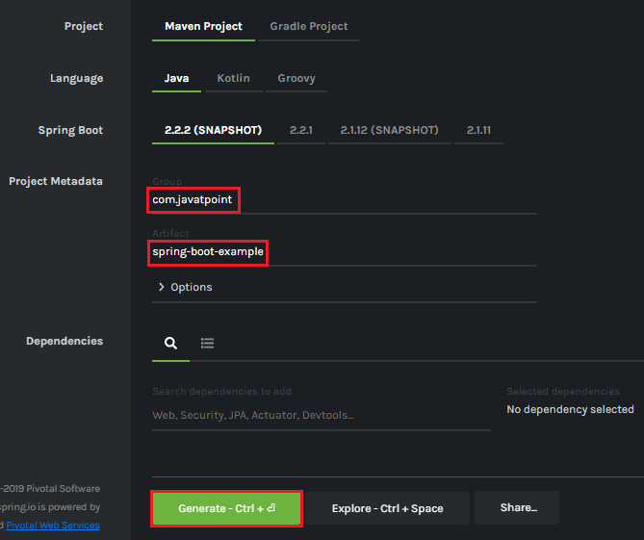
Cont…

Slide 47
Cont…
When we click on the Generate button, it starts packing the project in a .rar file and downloads the project.
Step 4: Extract the RAR file.
Step 5: Import the folder.
File -> Import -> Existing Maven Project -> Next -> Browse -> Select the project -> Finish
It takes some time to import the project. When the project imports successfully, we can see the project directory in the Package Explorer. The following image shows the project directory:

Slide 48
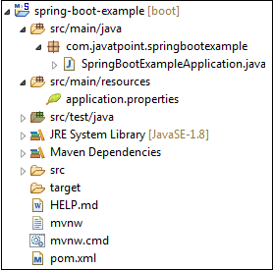
Cont…

Slide 49
SpringBootExampleApplication.java
package com.javatpoint.springbootexample;
import org.springframework.boot.SpringApplication;
import org.springframework.boot.autoconfigure.SpringBootApplication;
@SpringBootApplication
public class SpringBootExampleApplication
{
public static void main(String[] args)
{
SpringApplication.run(SpringBootExampleApplication.class, args);
}
}

Slide 50
Spring Boot Application
Spring Boot Framework comes with a built-in mechanism for application configuration using a file called application.properties. It is located inside the src/main/resources folder, as shown in the following figure.

Slide 51
Spring Boot Auto-configuration Classes
Spring Boot auto-configuration automatically configures the Spring application based on the jar dependencies that we have added.
For example, if the H2 database Jar is present in the classpath and we have not configured any beans related to the database manually, the Spring Boot's auto-configuration feature automatically configures it in the project.
We can enable the auto-configuration feature by using the annotation @EnableAutoConfiguration. But this annotation does not use because it is wrapped inside the @SpringBootApplication annotation. The annotation @SpringBootApplication is the combination of three annotations: @ComponentScan, @EnableAutoConfiguration, and @Configuration. However, we use @SpringBootApplication annotation instead of using @EnableAutoConfiguration.
@SpringBootApplication=@ComponentScan+@EnableAutoConfiguration+@Configuration

Slide 52
Cont…..
When we add the spring-boot-starter-web dependency in the project, Spring Boot auto-configuration looks for the Spring MVC is on the classpath. It auto-configures dispatcherServlet, a default error page, and web jars.
Similarly, when we add the spring-boot-starter-data-jpa dependency, we see that Spring Boot Auto-configuration, auto-configures a datasource and an Entity Manager.
All auto-configuration logic is implemented in spring-boot-autoconfigure.jar, as shown in the following figure.

Slide 53
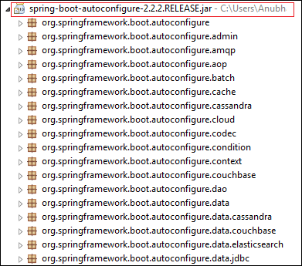
Cont…

Slide 54
Need of auto-configuration
Spring-based application requires a lot of configuration. When we use Spring MVC, we need to configure dispatcher servlet, view resolver, web jars among other things. The following code shows typical configuration of a dispatcher servlet in a web application:
<servlet>
<servlet-name>dispatcher</servlet-name>
<servlet-class>
org.springframework.web.servlet.DispatcherServlet
</servlet-class>
<init-param>
<param-name>contextConfigLocation</param-name>
<param-value>/WEB-INF/todo-servlet.xml</param-value>
</init-param>
<load-on-startup>1</load-on-startup>
</servlet>
<servlet-mapping>
<servlet-name>dispatcher</servlet-name>
<url-pattern>/</url-pattern>
</servlet-mapping>

Slide 55
Configuring Datasource:
<bean id="dataSource" class="com.mchange.v2.c3p0.ComboPooledDataSource"
destroy-method="close">
<property name="driverClass" value="${db.driver}" />
<property name="jdbcUrl" value="${db.url}" />
<property name="user" value="${db.username}" />
<property name="password" value="${db.password}" />
</bean>
<jdbc:initialize-database data-source="dataSource">
<jdbc:script location="classpath:config/schema.sql" />
<jdbc:script location="classpath:config/data.sql" />
</jdbc:initialize-database>

Slide 56
Configuring entity manager factory
<bean
class="org.springframework.orm.jpa.LocalContainerEntityManagerFactoryBean"
id="entityManagerFactory">
<property name="persistenceUnitName" value="hsql_pu" />
<property name="dataSource" ref="dataSource" />
</bean>

Slide 57
Configuration Transaction Manager
<bean id="transactionManager" class="org.springframework.orm.jpa.JpaTransactionManager">
<property name="entityManagerFactory" ref="entityManagerFactory" />
<property name="dataSource" ref="dataSource" />
</bean>
<tx:annotation-driven transaction-manager="transactionManager"/>

Slide 58
Spring Boot Dependencies
In Spring Boot, dependencies are typically managed using Spring Boot Starter dependencies, which are pre-configured libraries that provide the necessary components for various functionalities. Here are some common dependencies you might include in your pom.xml (for Maven) or build.gradle (for Gradle) file when building a Spring Boot application:
1. Spring Boot Starter Web
Used for building web applications, including RESTful services.
Maven:
<dependency>
<groupId>org.springframework.boot</groupId>
<artifactId>spring-boot-starter-web</artifactId>
</dependency>
Gradle:
implementation 'org.springframework.boot:spring-boot-starter-web'

Slide 59
Cont….
2. Spring Boot Starter Data JPAFor working with databases using Java Persistence API (JPA).
Maven:
<dependency>
<groupId>org.springframework.boot</groupId>
<artifactId>spring-boot-starter-data-jpa</artifactId>
</dependency>
Gradle:
implementation 'org.springframework.boot:spring-boot-starter-security'

Slide 60
Cont….
3. Spring Boot Starter Security
For adding authentication and authorization to your application.
Maven:
<dependency>
<groupId>org.springframework.boot</groupId>
<artifactId>spring-boot-starter-security</artifactId>
</dependency>
Gradle:
implementation 'org.springframework.boot:spring-boot-starter-security'

Slide 61
Quiz
1. What is the purpose of a Spring Boot starter?
A) To configure Spring Boot’s auto-configuration features B) To provide default configurations and dependencies for common use cases C) To manage Spring Boot logging properties D) To handle the database configurations in Spring Boot
Answer: B) To provide default configurations and dependencies for common use cases
2. Which Spring Boot starter is used for web application development?
A) spring-boot-starter-web
B) spring-boot-starter-data-jpa
C) spring-boot-starter-security
D) spring-boot-starter-logging
Answer: A) spring-boot-starter-web

Slide 62
Quiz
3. What is the role of the @SpringBootApplication annotation in a Spring Boot application?
A) It is used to configure the application’s logging settings. B) It is used to mark the main class of the Spring Boot application. C) It is used to enable Spring Security configurations. D) It initializes the application context in a Spring Boot application.
Answer: B) It is used to mark the main class of the Spring Boot application
4. What command would you use to run a Spring Boot application from the command
line interface (CLI)?
spring run
B) java -jar application.jar
C) mvn spring-boot:run
D) springboot start
Answer: mvn spring-boot:run

Slide 63
quiz
5. Which logging framework is used by default in Spring Boot?
A) Log4j B) SLF4J with Logback C) Commons Logging D) Java Util Logging
Answer: B) SLF4J with Logback
6. What is auto-configuration in Spring Boot?
A) The process of setting up the Spring Boot application with default configuration options. B) The automatic setup of logging systems in a Spring Boot application. C) The automatic configuration of application-specific beans. D) The process of configuring Spring Boot's data source automatically.
Answer: A) The process of setting up the Spring Boot application with default configuration options.

Slide 64
Quiz
7. Where does Spring Boot look for its auto-configuration classes?
A) In the @Component annotated classes within the src/main/resources folder. B) In the META-INF/spring.factories file. C) In the application.properties file. D) In the src/main/java folder only.
Answer: B) In the META-INF/spring.factories file.
8. Which of the following is NOT a part of Spring Boot’s auto-configuration mechanism?
A) Enabling embedded web servers like Tomcat B) Configuring database connections automatically C) Defining beans for logging systems D) Automatically creating Spring Security configurations
Answer: D) Automatically creating Spring Security configurations

Slide 65
Quiz
9. Which file is typically used to configure logging levels in a Spring Boot application?
A) log4j2.xml B) logback.xml C) application.properties D) logging.properties
Answer: C) application.properties
10. Which command is used to install the Spring Boot CLI on your local system?
brew install springboot
B) curl install springboot-cli
C) sdk install springboot-cli
D) sdk install springboot
Answer: A) brew install springboot

Slide 66
Spring Data JPA
What is JPA?
Spring Boot JPA is a Java specification for managing relational data in Java applications. It allows us to access and persist data between Java object/ class and relational database. JPA follows Object-Relation Mapping (ORM). It is a set of interfaces. It also provides a runtime EntityManager API for processing queries and transactions on the objects against the database. It uses a platform-independent object-oriented query language JPQL (Java Persistent Query Language).
In the context of persistence, it covers three areas:
The Java Persistence API
Object-Relational metadata
The API itself, defined in the persistence package.
JPA is not a framework. It defines a concept that can be implemented by any framework.

Slide 67
Why should we use JPA?
JPA is simpler, cleaner, and less labor-intensive than JDBC, SQL, and hand-written mapping. JPA is suitable for non-performance oriented complex applications. The main advantage of JPA over JDBC is that, in JPA, data is represented by objects and classes while in JDBC data is represented by tables and records. It uses POJO to represent persistent data that simplifies database programming.

Slide 68
Why should we use JPA?
JPA is simpler, cleaner, and less labor-intensive than JDBC, SQL, and hand-written mapping. JPA is suitable for non-performance oriented complex applications. The main advantage of JPA over JDBC is that, in JPA, data is represented by objects and classes while in JDBC data is represented by tables and records. It uses POJO to represent persistent data that simplifies database programming.

Slide 69
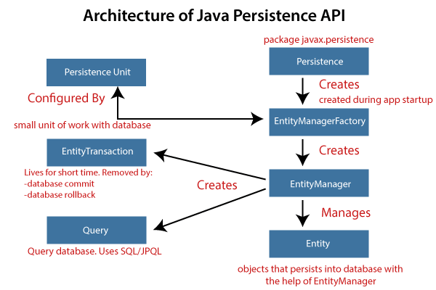
Architecture Of JPA

Slide 70
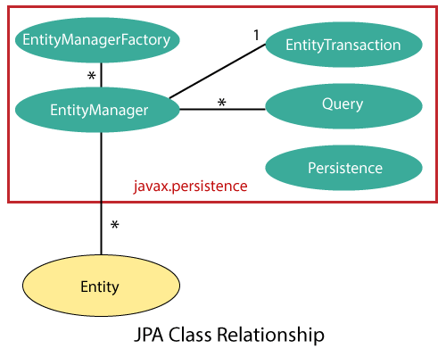
JPA Class Relationships

Slide 71
JPA Implementations
JPA is an open-source API. There is various enterprises vendor such as Eclipse, RedHat, Oracle, etc. that provides new products by adding the JPA in them. There are some popular JPA implementations frameworks such as Hibernate, EclipseLink, DataNucleus, etc. It is also known as Object-Relation Mapping (ORM) tool.

Slide 72
Quiz
1. What is the primary purpose of Spring Data JPA?
A) To simplify the integration of Spring with NoSQL databases B) To simplify database transactions by automating CRUD operations with JPA C) To provide support for SOAP web services in Spring D) To manage logging and exception handling in Spring applications
Answer: B) To simplify database transactions by automating CRUD operations with JPA
2. Which of the following annotations is used to define a repository interface in Spring Data JPA?
@Repository
B) @Entity
C) @JpaRepository
D) @Transactional
Answer: A) @Repository

Slide 73
Quiz
3. Spring Data JPA uses which of the following to simplify data access?
A) XML-based configurations B) A custom implementation of CRUD methods C) The creation of repository interfaces that extend JpaRepository D) Java Reflection API
Answer: C) The creation of repository interfaces that extend JpaRepository
4. Which of the following is automatically provided by Spring Data JPA when using JpaRepository?
Data validation
B) Database migrations
C) CRUD operations (Create, Read, Update, Delete)
D) Entity caching
Answer: C) CRUD operations (Create, Read, Update, Delete)

Slide 74
Quiz
5. In Spring Data JPA, which annotation is used to specify the entity class that maps to a database table?
A) @Table B) @Entity C) @PrimaryKey D) @Id
Answer: B) @Entity

Slide 75
Weekly Assignment
Write difference between spring MVC and spring Boot.
Explain the term auto-configuration with example.
Create a spring MVC application for employee management system, which has database table employee with fields: emp_name, emp_id and salary.
Create a REST API for employee management system, which has database table employee with fields: emp_name, emp_id and salary.
Create a REST API for student management system, which has database table students with fields: stu_name, roll_no and marks.
Write short note on Spring Data JPA.

Slide 76
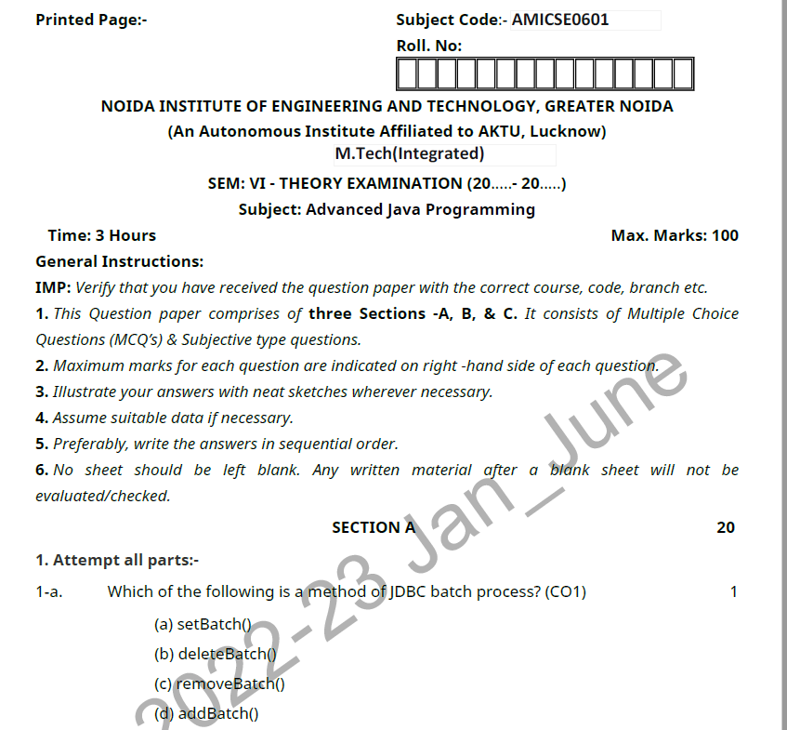
Old Question Papers

Slide 77
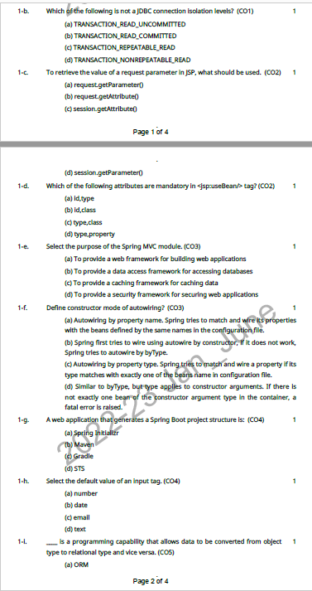
Old Question Papers

Slide 78
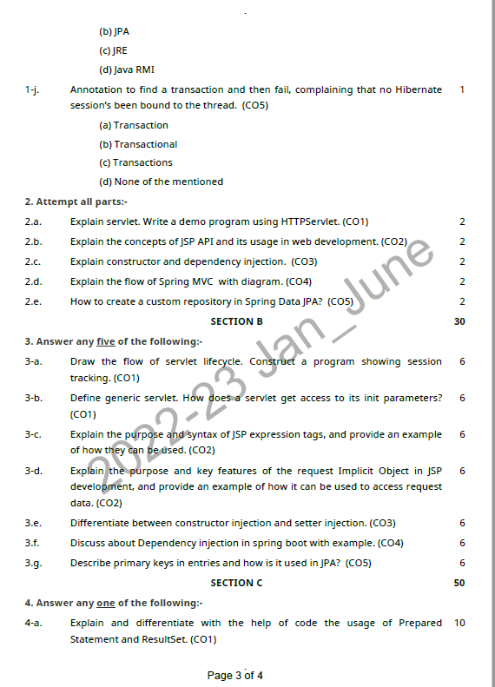
Old Question Papers

Slide 79
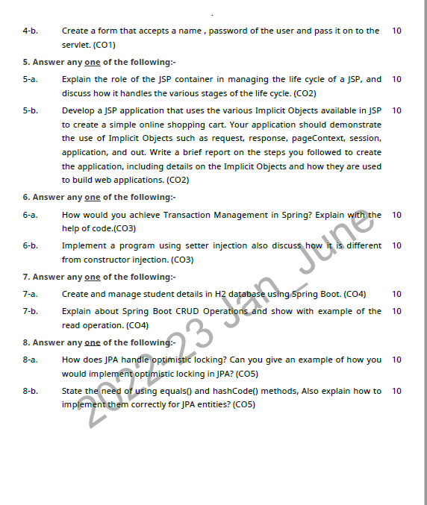
Old Question Papers

Slide 80
Expected Questions
What is Spring?
What are the advantages of spring framework?
What are the modules of spring framework?
What is IOC and DI?
What is the front controller class of Spring MVC?
What does @Controller annotation?
What does @RequestMapping annotation?
Does spring MVC provide validation support?
Create a spring MVC application for employee management system, which has database table employee with fields: emp_name, emp_id and salary.
Create a REST API for employee management system, which has database table employee with fields: emp_name, emp_id and salary.
Create a REST API for student management system, which has database table students with fields: stu_name, roll_no and marks.

Slide 81
Recap of Unit
1. Spring Boot
What it is: A framework built on top of the Spring Framework that simplifies the process of building and deploying Spring-based applications.
Key Features:
Auto-Configuration: Automatically configures your application based on the libraries you include, so you don’t need a lot of XML or Java-based configuration.
Embedded Servers: You can run a Spring Boot application as a stand-alone service with embedded web servers (like Tomcat, Jetty, or Undertow), making deployment easier.
Production-Ready: Built-in features like health checks, metrics, and monitoring through Spring Boot Actuator.
Convention Over Configuration: Simplifies Spring development by setting sensible defaults for most things.
Typical Use Cases: Microservices, RESTful APIs, web applications, batch jobs, etc

Slide 82
Recap of Unit
2. Spring MVC What it is: Part of the Spring Framework that provides a model-view-controller (MVC) architecture for developing web applications.
Key Features:
Model: Represents the application's data and business logic.
View: Represents the presentation layer (e.g., JSP, Thymeleaf, etc.).
Controller: Handles user requests, interacts with the model, and returns a view.
DispatcherServlet: Central component that receives HTTP requests, delegates them to appropriate controllers, and returns the responses.
Annotations: Supports annotations like @Controller, @RequestMapping, @GetMapping, @PostMapping, etc., to define routes and request handling methods.
Typical Use Cases: Web applications where there’s a need to separate concerns (model, view, and controller) and return views (HTML, JSON, XML, etc.) to users.

Slide 83
Thank You

