Slide 1

Moradabad Institute of Technology
Department of Computer Science and Engineering
Project Synopsis / SRS Report
KCS-753
Hunting Extrasolar planets using machine learning
Project Group No :- P36
Ishita Rastogi (1808210069)
Ishvinder Singh (1808210070)
Kartik Tiwari (1808210073)
Sanskriti Agarwal (1808210132)
Shivansh Mathur (1808210139)

Slide 2
Table of Content :-

Slide 3
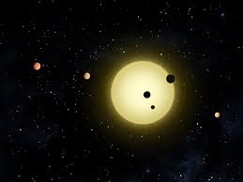
INTRODUCTION
An exoplanet is any planet beyond our Solar System. The detection of such planets can reveal a detailed analysis of planets well beyond our solar system and also help to determine whether there is a chance of detecting some ‘Earth-like’ planet. Several missions are launched for the detection of these extrasolar planets or exoplanets such as Kepler, K2, TESS. Kepler Mission is the most famous among all, it observed about 530,506 stars and discovered 2,662 exoplanets over its lifetime by using Transit method. The shutting down of the Kepler mission led to the launching of a new mission which is much more successful and better than Kepler, named as TESS (Transiting Exoplanet Survey Satellite). It was designed to survey over 85% of the sky to search for planets around nearby stars. Additionally, TESS stars are 30-100 times brighter than those surveyed by the Kepler satellite. Planets detected around these stars are therefore far easier to characterize.

Slide 4
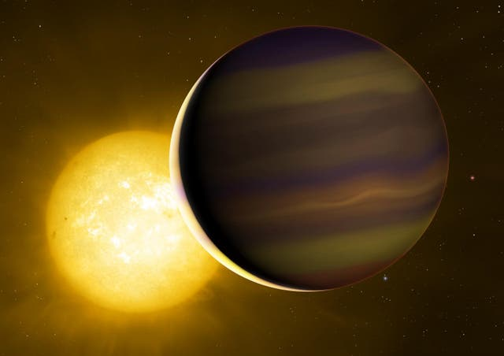
More about the introduction……..
In this project, we are going to continue the process of detection of exoplanets using transit method. In transit method, the exoplanet is detected by measuring a periodic decrease in the flux received from the host star, as a consequence of the exoplanet transiting in front of the host star. The transiting technique is most sensitive to large exoplanets orbiting close to their host stars and provide an accurate determination of the planetary radius relative to host star.

Slide 5
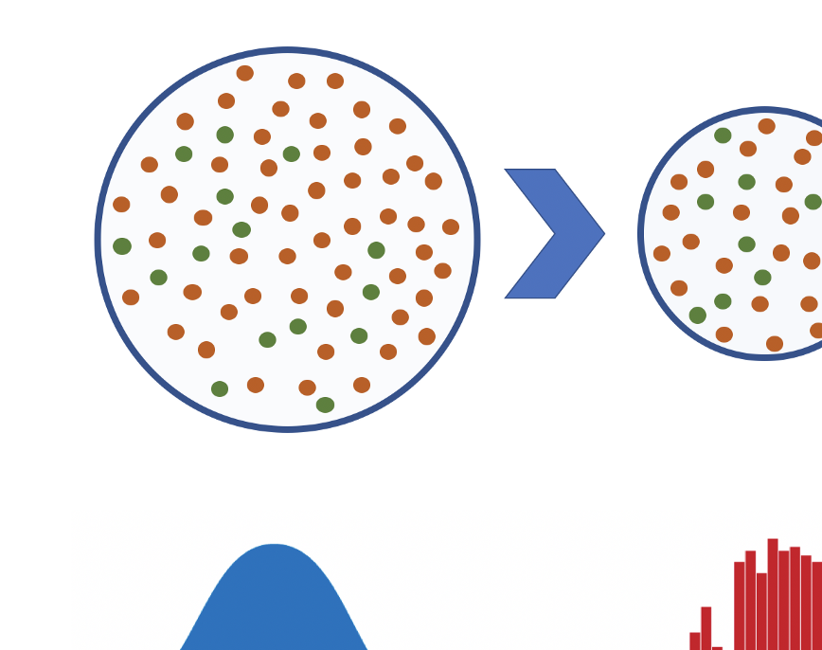
MODULE 1 : Data Selection
In this module, we are dealing with the data that consist of more than 100 columns and every column is not needed as they contain NULL values as well as some inconsiderable values. So basically, we have to neglect values or columns that are of no use and get our required data.

Slide 6

MODULE2 : Data Pre-processing
Data Cleaning:-In this, after removing unnecessary columns we will check for missing values and after that we will convert all the values in the same format so that for further process it will make the model training smooth and to achieve the required result or accuracy.
Data Sampling:-Sampling here means to scale the data, or we can also say it as data scaling.
Splitting the data:-In this we are going to split the finalized data into two parts:
Training – This is going to use 60% of the data.
Testing – This is going to use remaining data that is 40% of the data.

Slide 7

MODULE3 : Data Training
Regression:- Regression is a technique used to model and analyze the relationships between variables and often times how they contribute and are related to producing a particular outcome together.
Classification:- Classification methods aim at identifying the category of a new observation among a set of categories on the basis of a labeled training set.
Clustering:- Clustering or cluster analysis is a machine learning technique, which groups the unlabeled dataset. It can be defined as "A way of grouping the data points into different clusters, consisting of similar data points.
Prediction:- Predictive analytics algorithms try to achieve the lowest error possible by either using boosting or bagging.
Evaluation:- Model Evaluation is the subsidiary part of the model development process. It is the phase that is decided whether the model performs better. Therefore, it is critical to consider the model outcomes according to every possible evaluation method

Slide 8
MODULE 4 : Re-evaluating and improve the world
Stacking- Model stacking is a way to improve model predictions by combining the outputs of multiple models and running them through another machine learning model, which attempts to minimize the weakness and maximize the strengths of every individual model. The result is usually a very robust model that generalizes well on unseen data.
Bagging- It uses a simple approach that shows up in statistical analyses again and again- improve the estimate of one by combining the estimates of many. Bagging constructs n classification trees using bootstrap sampling of the training data and then combines their predictions to produce a final meta-prediction.
Boosting- Boosting is also one of the algorithm that is used to increase the accuracy of the model in the same way as the racers use nitrous boost to increase the speed of car. It uses a base machine learning algorithm to fit the data and decision trees are the most widely used out of all. Like bagging, it also predicts to produce a final meta-prediction.

Slide 9
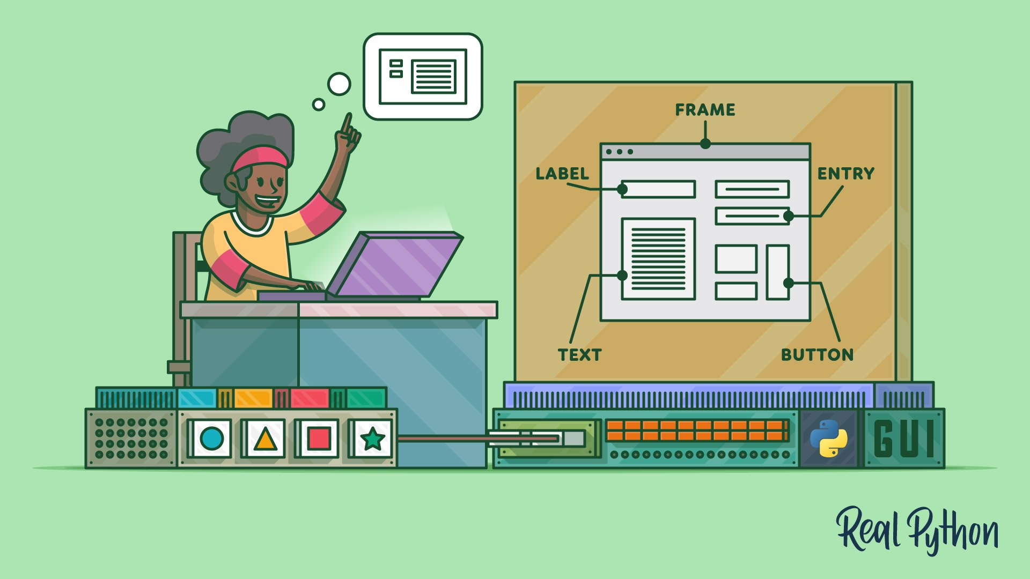
A graphical user interface builder (or GUI builder), also known as GUI designer, is a software development tool that simplifies the creation of GUIs by allowing the designer to arrange graphical control elements (often called widgets) using a drag-and-drop WYSIWYG editor. Without a GUI builder, a GUI must be built by manually specifying each widget's parameters in source-code, with no visual feedback until the program is run.
MODULE 5 : GUI Development

Slide 10
Flow Chart
INPUT
(CSV data format with numerical values )
Data Selection
Data Pre-Processing
Model Training
Re-Evaluating and improve the model
GUI Development
OUTPUT

