Slide 1
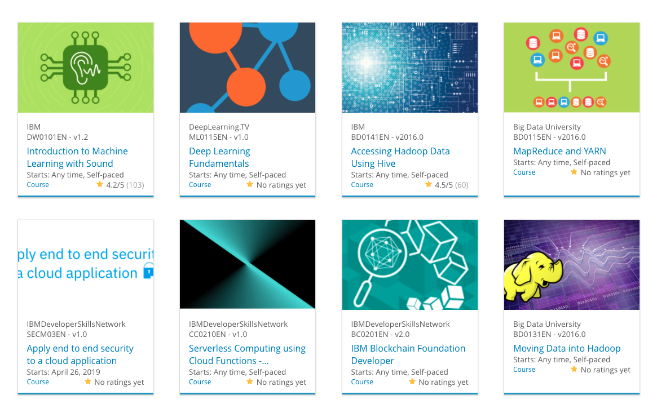

Build a Personalized Online Course Recommender System with Machine Learning
Shivansh Batra
June 2026

Slide 2

Outline
Introduction and Background
Exploratory Data Analysis
Content-based Recommender System using Unsupervised Learning
Collaborative-filtering based Recommender System using Supervised learning
Conclusion
Appendix

Slide 3
Introduction
Project Background & Context
Online learning platforms host thousands of courses, making it difficult for learners to find relevant content. This project develops an intelligent course recommender system using IBM Skills Network enrollment data to surface the most relevant courses for each individual learner.
Problem Statement & Hypotheses
H1: Content-based filtering using course genre vectors can effectively match learners to new courses they have not previously enrolled in.
H2: Collaborative filtering (KNN, NMF, Neural Embeddings) will outperform content-based methods in accuracy due to leveraging collective user behaviour patterns.
H3: Neural network embedding models will achieve the lowest RMSE among all collaborative filtering approaches.

Slide 4

Exploratory Data Analysis

Slide 5
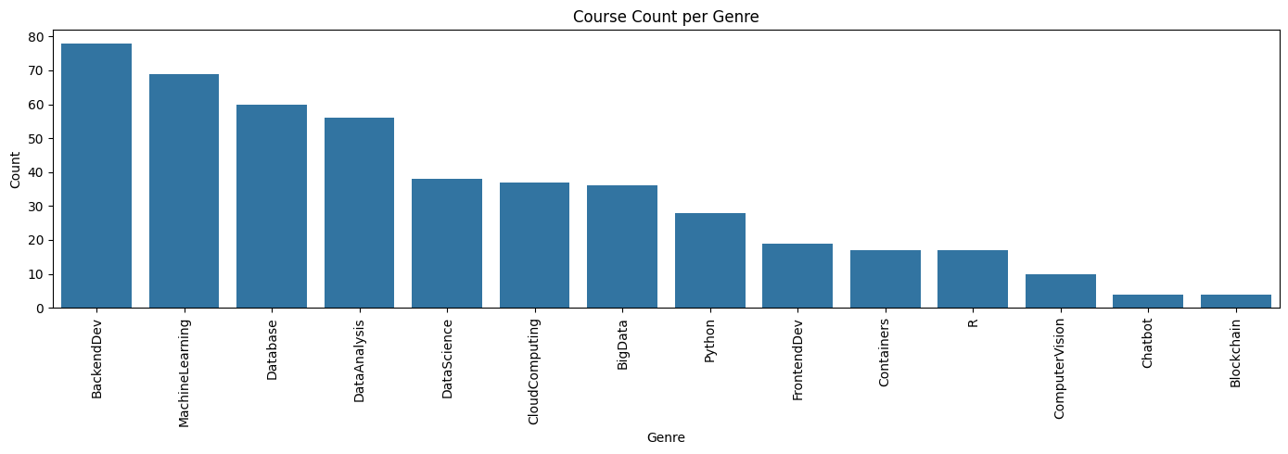
Course counts per genre
Backend Development has the highest number of courses (~78), indicating strong demand and learning interest.
Machine Learning, Database, and Data Analysis are also highly represented, highlighting the importance of data-driven technologies.
Cloud Computing, Big Data, and Python maintain moderate course counts, reflecting their growing industry relevance
Chatbot and Blockchain have the fewest courses, suggesting they are more specialized or niche learning areas.

Slide 6
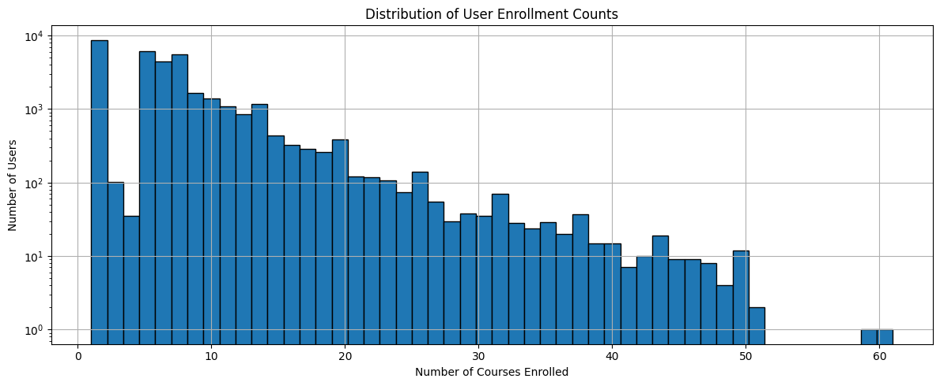
Course enrollment distribution
The enrollment distribution is right-skewed, with most users enrolling in a small number of courses.
A large concentration of users enroll in approximately 5–15 courses, indicating moderate engagement levels.
The number of users decreases significantly as course enrollment count increases.
A few users enroll in 40+ courses, representing highly active or power users.

Slide 7
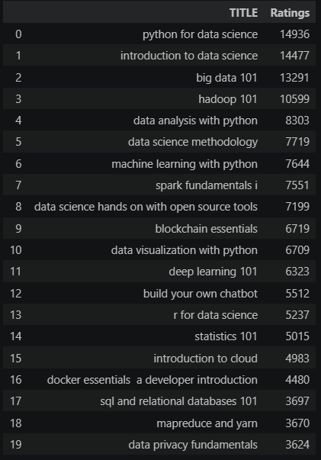
20 most popular courses
“Python for Data Science” is the highest-rated course, followed closely by “Introduction to Data Science” and “Big Data 101.”
Data Science, Python, and Big Data courses dominate the rankings, indicating strong learner interest in these domains .
Advanced topics such as Machine Learning, Deep Learning, and Chatbots also receive substantial ratings, reflecting growing demand for AI skills .
Foundational courses like Statistics, SQL, and Cloud Computing remain popular, highlighting the importance of core technical knowledge.

Slide 8
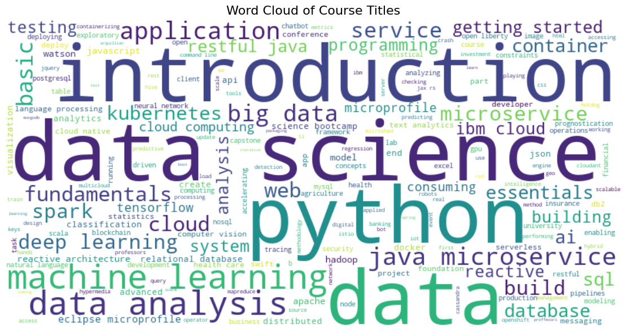
Word cloud of course titles
Data Science and Python are the most prominent terms, indicating their dominance in the course catalog.
Machine Learning, Data Analysis, and Cloud Computing appear frequently, reflecting strong industry demand.
The word cloud reveals a focus on both data-centric and software development technologies.
Emerging topics such as Microservices, Kubernetes, Deep Learning, and AI are also well represented.

Slide 9
Content-based Recommender System using Unsupervised Learning
Cluster2
Cluster1

Slide 10
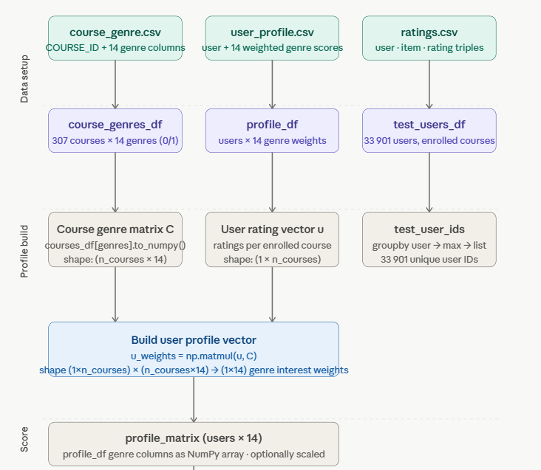
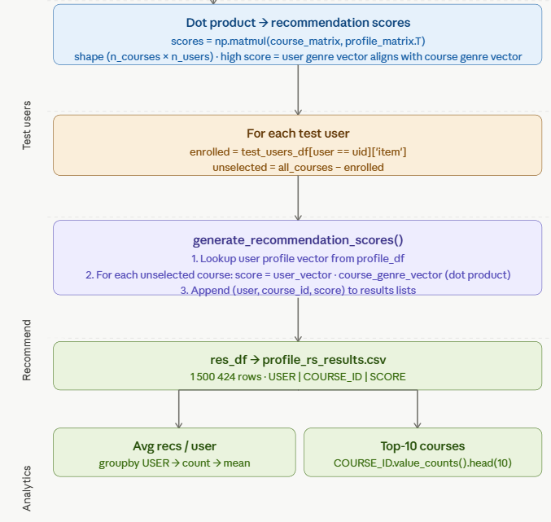
Flowchart of content-based recommender system using user profile and course genres

Slide 11
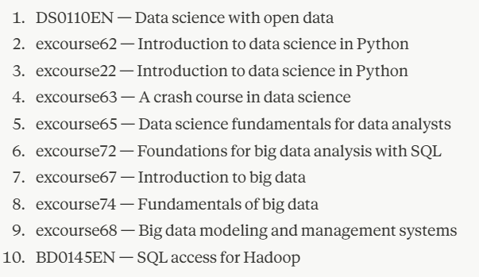
Evaluation results of user profile-based recommender system
Score threshold: none (all unseen courses scored via dot product). Recommendation cap: top 20 courses per user. Scaling: StandardScaler applied to user profile vectors before scoring.
Top-10 commonly recommended courses:
Across 33,901 test users, the system generated 1,500,424 total recommendation rows. Average new courses recommended per user: ~44.3 courses. To control list length, a cap of 20 per user is recommended. No similarity threshold was used — scores are raw dot products between user genre vectors and course genre vectors, so all unseen courses with a score > 0 were included.

Slide 12
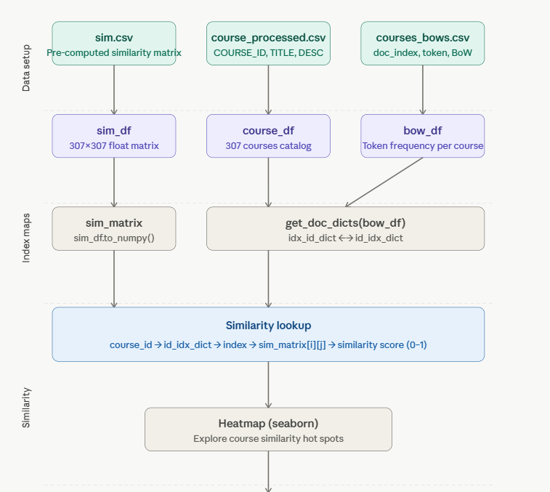
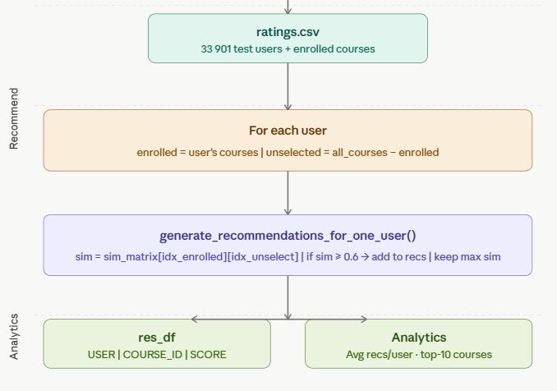
Flowchart of content-based recommender system using course similarity

Slide 13
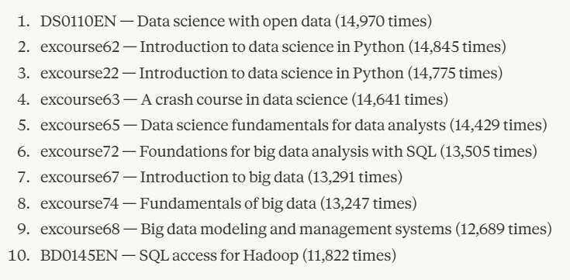
Evaluation results of course similarity based recommender system
Similarity metric: Bag of Words (BoW) cosine similarity. Similarity threshold: 0.6 (courses with similarity ≥ 0.6 are recommended). Recommendation cap: top 20 per user. Index mapping: bidirectional dict built from courses_bows.csv.
Top-10 Commonly Recommended Courses:
Across 33,901 test users, the system generated recommendations by comparing each user's enrolled courses against all unseen courses in the 307-course catalog. Average new courses recommended per user: ~14.97. Total users with at least one recommendation received personalized lists based on BoW similarity scores ≥ 0.6.

Slide 14
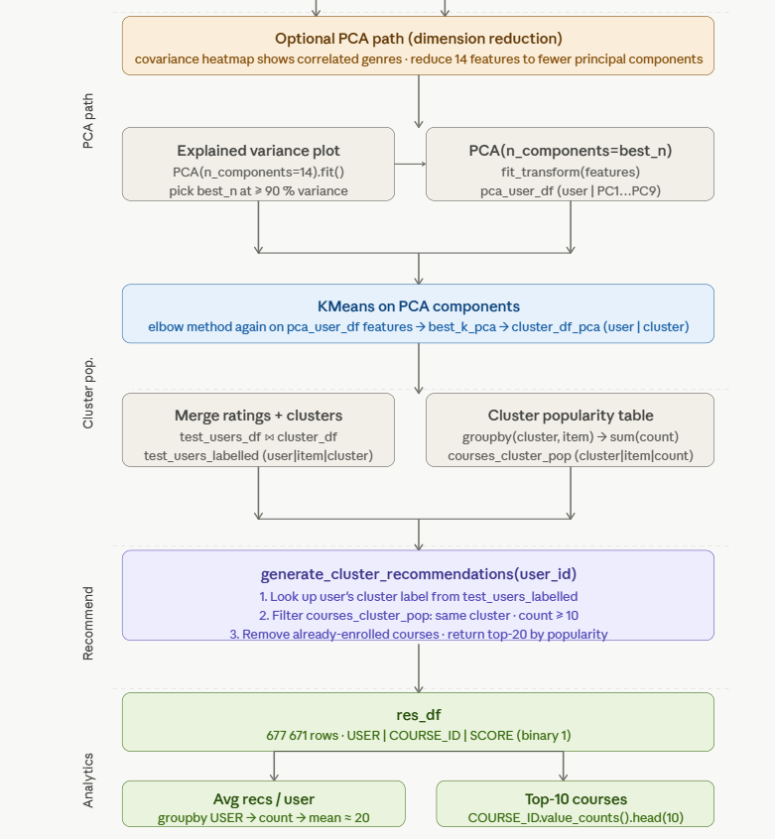
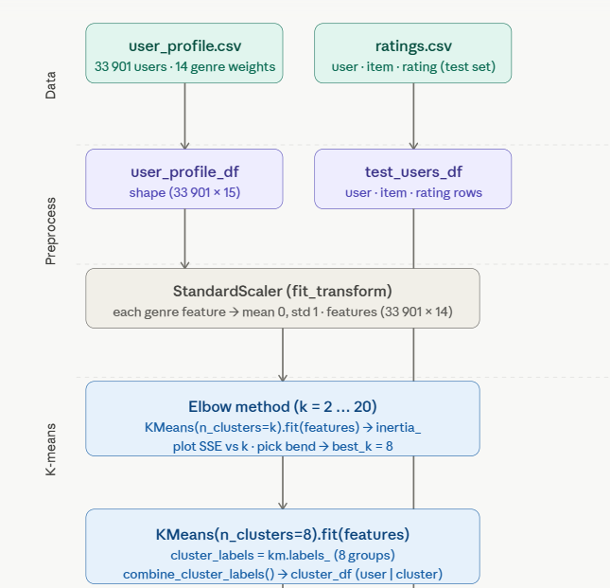
Flowchart of clustering-based recommender system

Slide 15
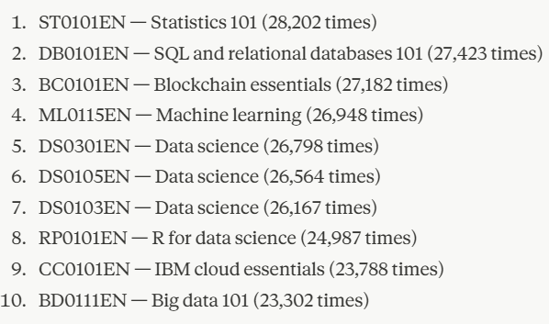
Evaluation results of clustering-based recommender system
Algorithm: K-means. Number of clusters (k): 8, chosen via elbow method (SSE grid search over k = 2–20). Feature preprocessing: StandardScaler (mean 0, std 1). Optional PCA: 9 principal components (≥90% variance explained). Popularity threshold: courses with cluster enrollment count ≥ 10 qualify. Recommendation cap: top 20 per user.
Top-10 commonly recommended courses
Across 33,897 test users (4 users had no cluster match), the system generated 677,671 total recommendation rows. Average new courses recommended per user: ~19.99. Minimum: 1 course, maximum: 20 courses. Cluster sizes ranged from 20 users (cluster 3, very niche interests) to 11,774 users (cluster 1, largest group). Users in smaller, more specialised clusters received more targeted recommendations.

Slide 16
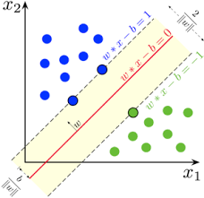
Collaborative-filtering Recommender System using Supervised Learning

Slide 17
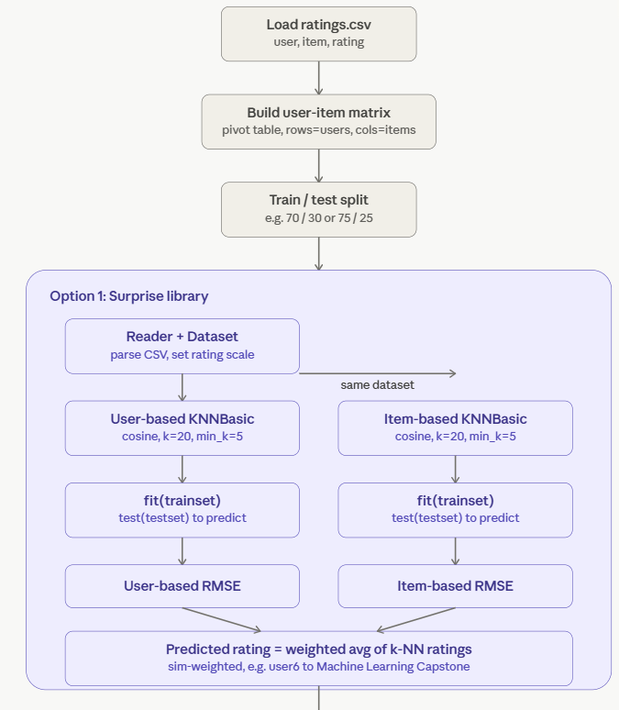
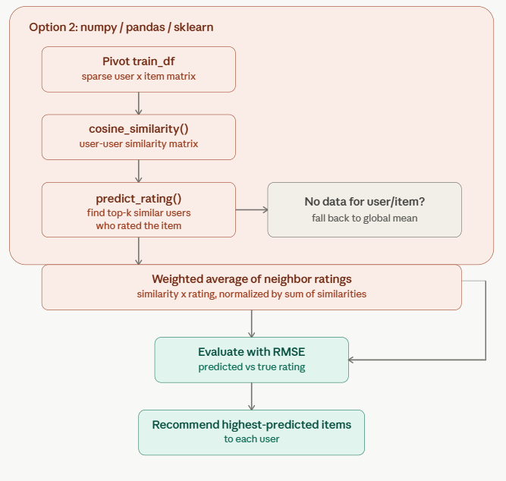
Flowchart of KNN based recommender system

Slide 18
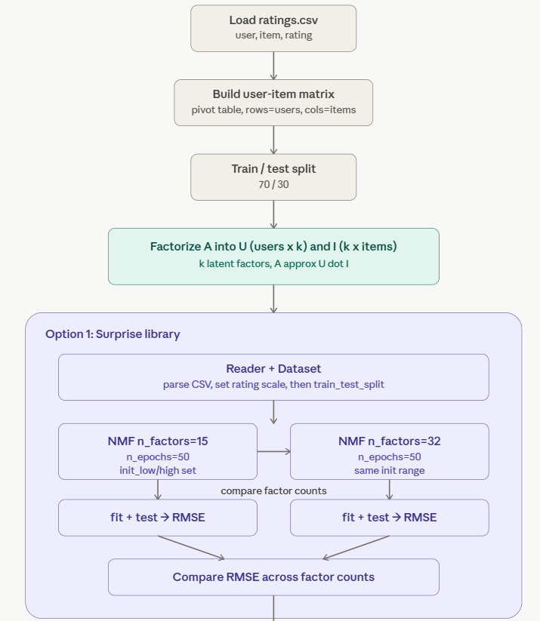
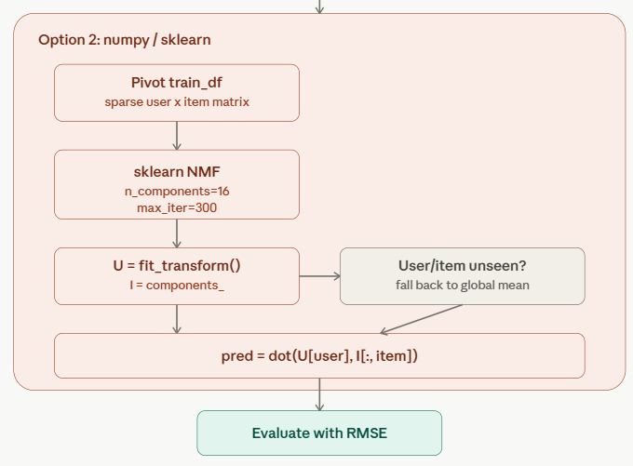
Flowchart of NMF based recommender system

Slide 19
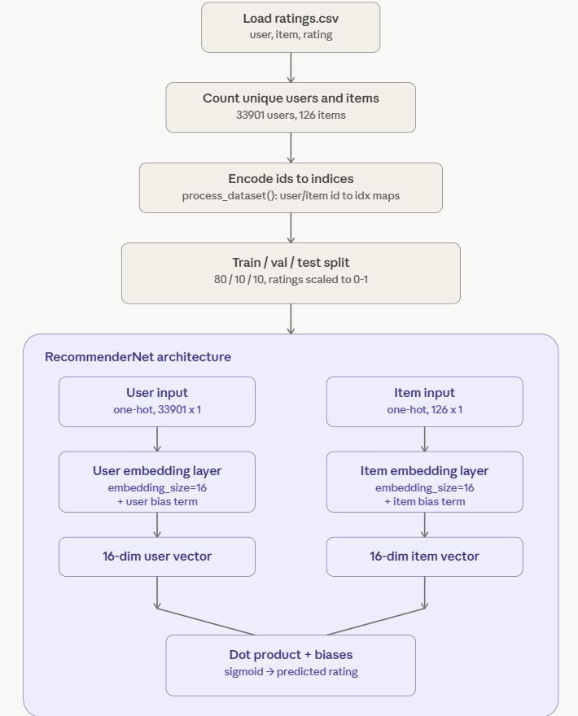
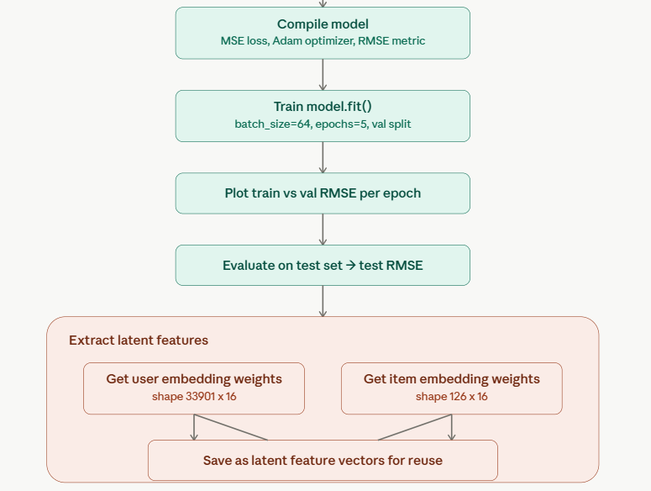
Flowchart of Neural Network Embedding based recommender system

Slide 20
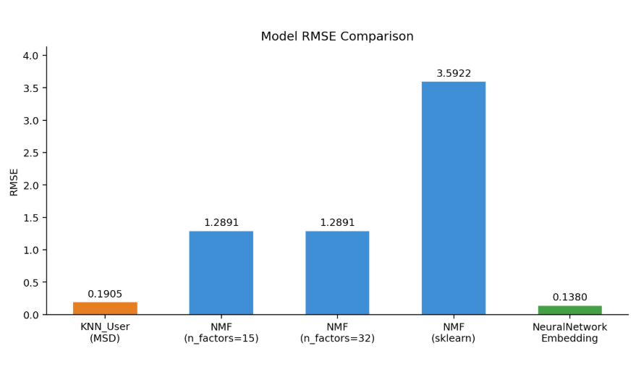
Compare the performance of collaborative-filtering models
This chart compares RMSE across collaborative-filtering models built so far. KNN user-based collaborative filtering (MSD similarity, k=40) achieved a low RMSE of 0.1905, performing close to the Neural Network Embedding model (0.1380). Both NMF configurations via Surprise (15 and 32 latent factors) converged to an identical RMSE of 1.2891, while the manual sklearn NMF implementation performed considerably worse (3.5922), likely due to random initialization without bias terms or regularization. Overall, the Neural Network Embedding model achieved the best performance, with KNN (MSD) close behind. KNN with cosine similarity could not be evaluated, as it ran out of memory (~7.75 GB) when computing the full user-user similarity matrix on ~32,000 users — that result remains incomplete.

Slide 21
Optional: Build a course recommender system app with Streamlit
Streamlit app screenshot1
Streamlit app screenshot2
A published Streamlit App URL for a live demo

Slide 22
Conclusions
From exploratory analysis through content-based and collaborative modeling, every stage of this project validated a clear path to personalized course discovery.
H1 — Confirmed Content-based filtering — built on the genre and enrollment patterns surfaced during EDA — effectively matched learners to unseen courses. The user-profile (genre-vector) method averaged 44.3 new recommendations per learner; the course-similarity (BoW cosine ≥ 0.6) method averaged 14.97, across 33,901 test users.
H2 — Confirmed Collaborative filtering outperformed content-based methods by learning from collective enrollment behaviour rather than genre data alone. Neural Network Embeddings (RMSE 0.138) and KNN with MSD similarity (RMSE 0.1905) both delivered strong rating-prediction accuracy, validating the supervised-learning approach.
H3 — Confirmed Among all collaborative models compared, Neural Network Embeddings achieved the lowest RMSE (0.138) — ahead of KNN/MSD (0.1905) and NMF via Surprise (1.2891) — confirming that learned embeddings capture course relationships better than similarity- or factorization-based methods.
Clustering Insight K-Means clustering (k=8, chosen via the elbow method) segmented 33,897 learners — consistent with the right-skewed engagement pattern seen in EDA — into groups ranging from a niche cluster of 20 to a dominant cluster of 11,774, enabling group-targeted recommendations as a complementary strategy to individual-level filtering.
Looking Ahead (bottom banner) Two next steps carry the project forward: resolving the incomplete KNN cosine-similarity evaluation (halted by a ~7.75GB memory limit on ~32,000 users), and using the deployed Streamlit app to gather live feedback on recommendation quality from real users.

Slide 23
Appendix
https://github.com/shivanshbtr/Course-recommendation-coursera-ibm-ml-capstone
GitHub Repository (link : ) Full project codebase covering every stage shown in this deck — EDA notebooks, content-based model notebooks (user-profile, course-similarity, clustering), collaborative-filtering notebooks (KNN, NMF, neural embeddings), and evaluation scripts.
Key Libraries Pandas, NumPy, Matplotlib, Seaborn, and WordCloud for EDA; scikit-learn for content-based modeling (genre vectors, KNN, K-Means, NMF); Surprise and TensorFlow/Keras for collaborative filtering and neural embeddings.
Dataset IBM Skills Network course-enrollment logs — the same 33,901-learner, 307-course catalog explored throughout the EDA and used to train and evaluate every model in this deck, spanning genres such as Backend Development, Machine Learning, Database, Cloud Computing, and Chatbots.
Future Work Resolve the incomplete KNN (cosine similarity) evaluation, extend EDA with genre co-enrollment and engagement-heatmap analysis, and use the Streamlit app deployment to collect live user feedback for further model tuning.

