Slide 1
BIOMAP BYCULLA · FIELD NOTE
The hidden jungle in
Mumbai's concrete heart
A 53-acre urban refuge, 42 wild species, and one open digital map.

Slide 2
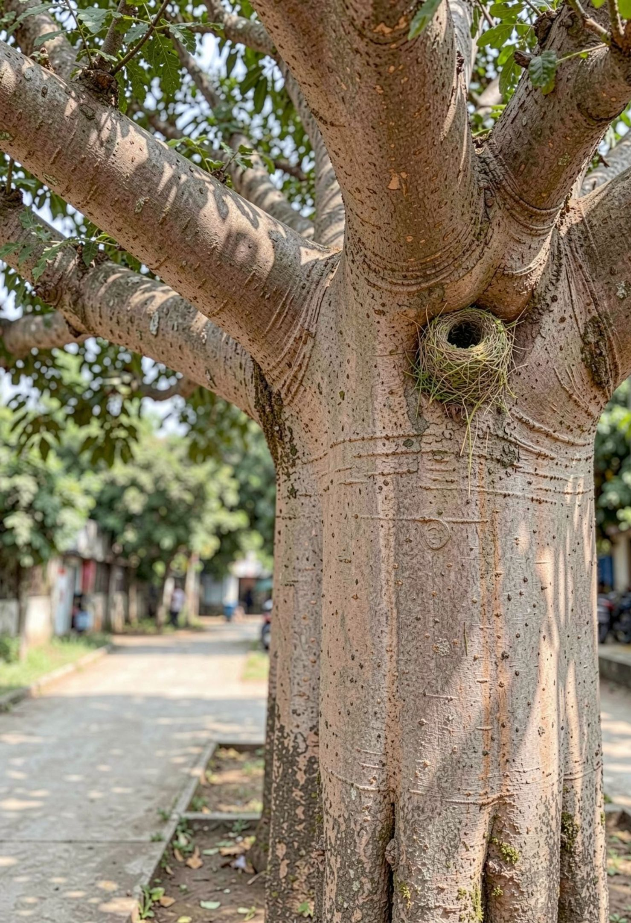
What Mumbai measured — and what it ignored
Tracked
PM2.5, traffic noise, captive animal inventories, pruning schedules
Missed
nesting trees, Blue Mormon breeding sites, heritage Baobabs, active nests before pruning
Cost
pruning can destroy habitat; visitor attention skips living heritage; caretakers' ecological memory can disappear

Slide 3
Two students turned fieldwork into an open map
01
02
03
04
Field effort
Tools
Protocol
Principle
30 hours across four zones
smartphone GNSS, 48 MP camera, Leaflet.js, OpenStreetMap, Python, GeoJSON
fixed-radius point counts, linear belt transects, and three-tier verification
zero backend, zero cost, fully open
BIOMAP BYCULLA · OPEN FIELDWORK

Slide 4
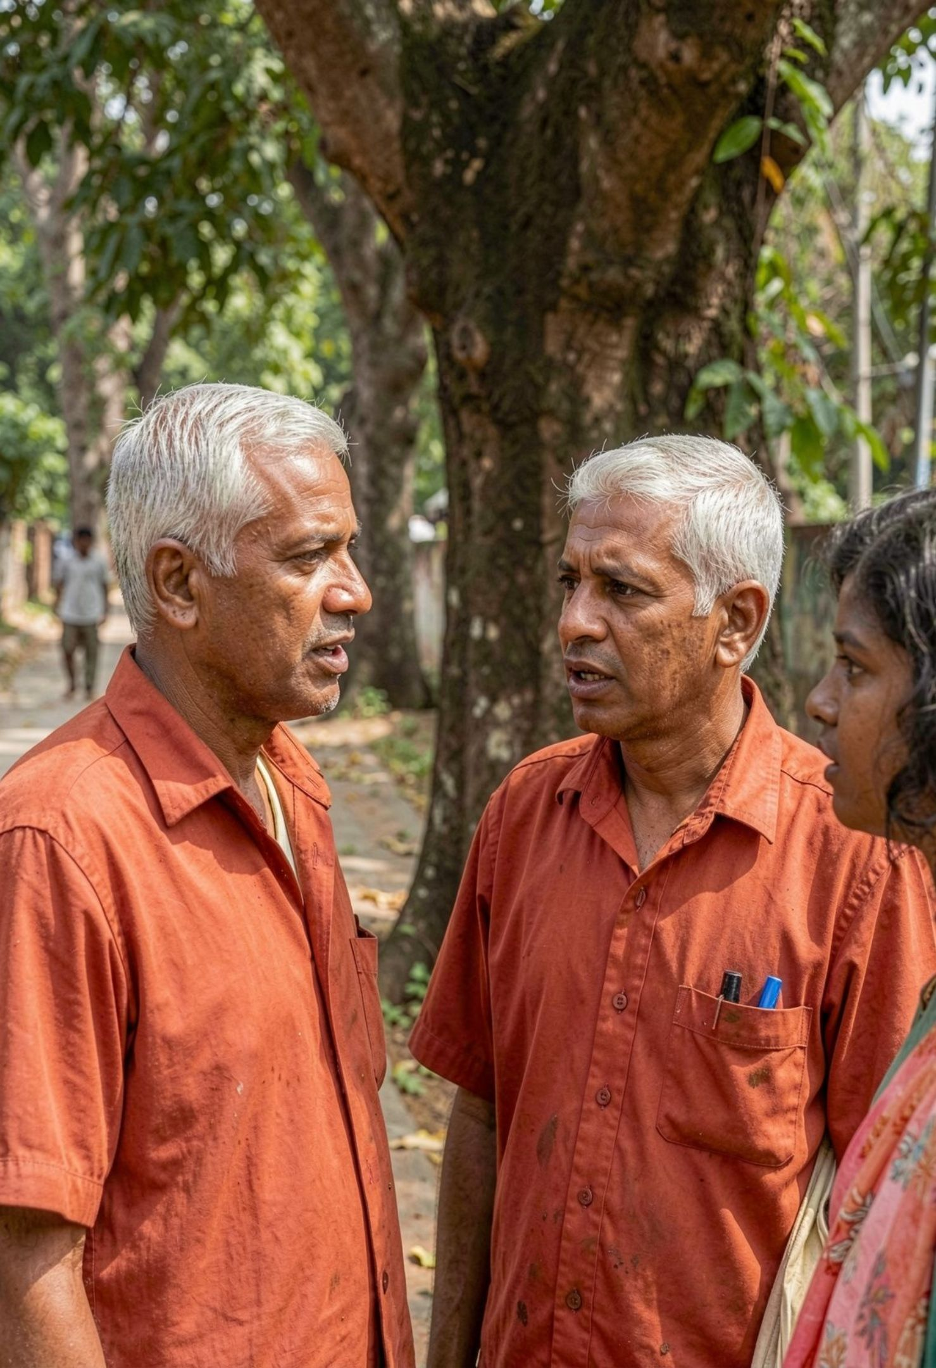
The map started with 84 local voices
malis, walkers, visitors, students, officials, guides, and investigators turned lived ecological knowledge into a shared evidence base.
Maruti Patil
heritage trees and nesting sites need a map before pruning decisions are made
Dr. Anita Rao
traffic and noise have pushed birds toward the botanical center

Slide 5
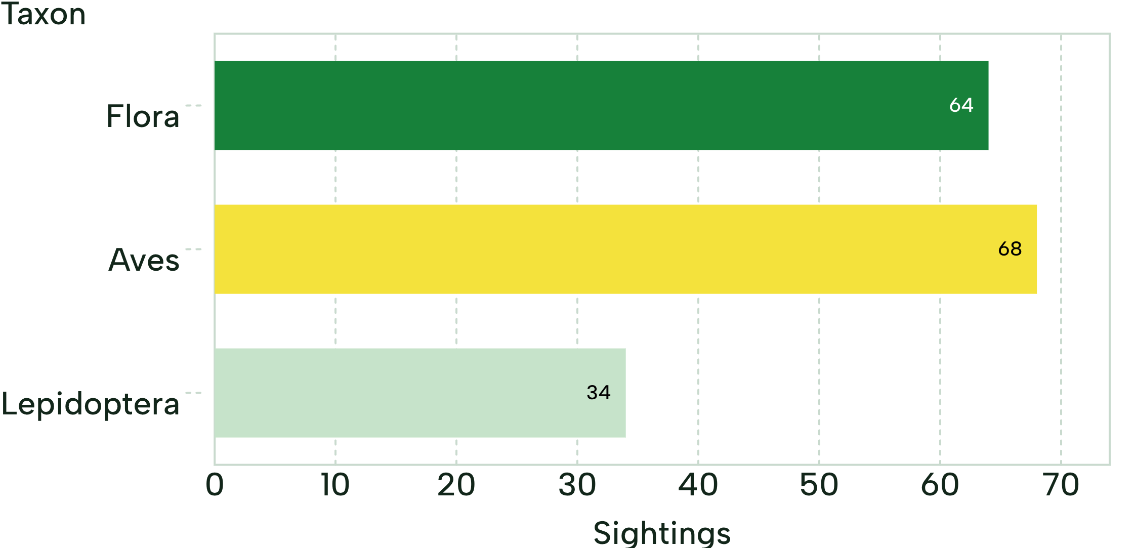
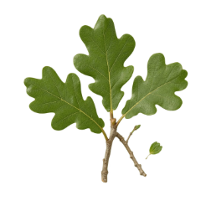

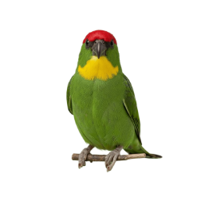
184 sightings revealed 42 species
Flora · 18 species · H' = 2.71
Aves · 14 species · H' = 2.44
Lepidoptera · 7 species · H' = 1.82
Zone 1 holds 54% of all documented species.
Named groups shown. Odonata plus herp/mammal records complete the census.

Slide 6
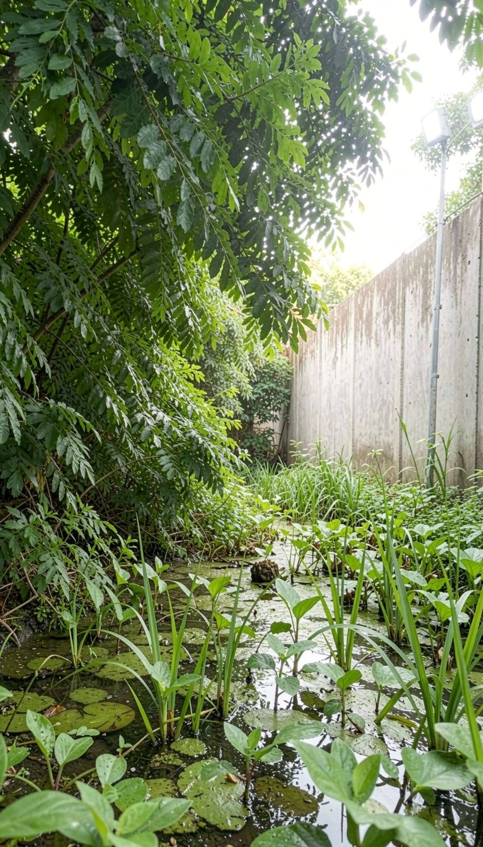
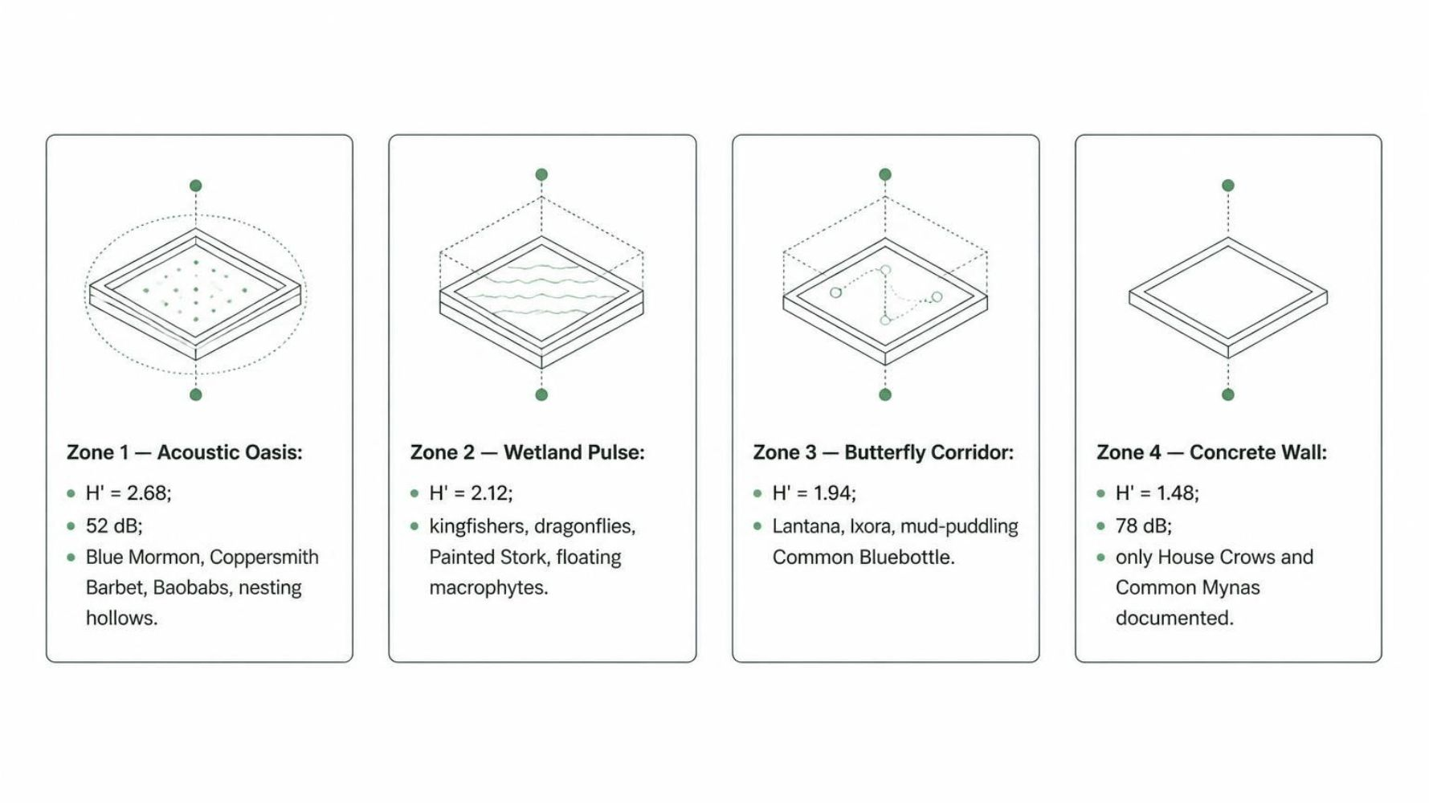
Life clusters where the canopy is thickest

Slide 7
Noise and floodlights draw an ecological boundary
BOTANICAL CORE
AMBEDKAR ROAD EDGE
52 dB
78 dB
Zone 1's quiet canopy holds Blue Mormon, Coppersmith Barbet, Baobabs, and nesting hollows.
Particulate pollution, traffic noise, and night lighting create a barrier for sensitive species.
26 dB quieter
Canopy is not just scenery; it is habitat infrastructure.

Slide 8





BioMap turns observations into a civic tool
Explore: color-coded vector markers by flora, aves, and insecta
Filter: taxon and habitat zone in real time
BIOMAP BYCULLA · OPEN MAP
Inspect: photos, GPS telemetry, and IUCN badges in responsive detail cards
flora
aves
insecta
Share: one-click GeoJSON and CSV export with no login or paywall
Color-coded vector markers · taxon and habitat zone in real time
Include: WCAG 2.1 AA accessibility, high-contrast mode, and ARIA landmarks

Slide 9
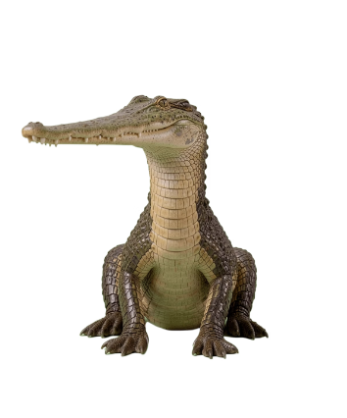
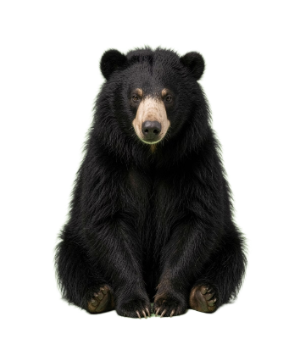
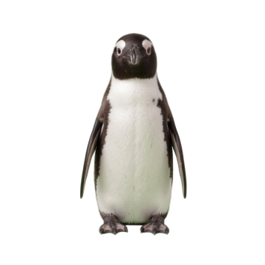
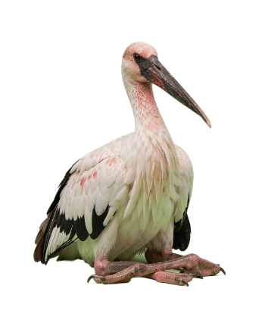

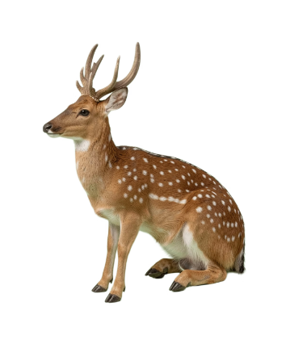
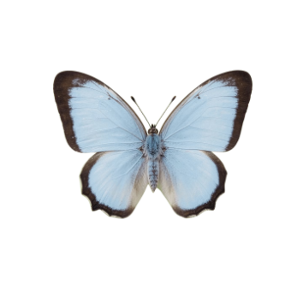
Species become stories, not just records
Humboldt Penguin
Common Bluebottle
Gharial
Sloth Bear
Painted Stork
Blue Mormon
Spotted Deer
Recognizable field portraits give biodiversity data a face, a habitat, and a reason to care.

Slide 10
BIOMAP BYCULLA · LIVE PORTAL
Three tiers can move the map into practice
THE HANDOFF
Tier 1 stops the bleeding.
Now | QR placards on 25 heritage trees and a pre-monsoon nest check before pruning
Next | native larval host plants in Zone 3 and floating reed beds at the lake edge
Later | connect BioMap GeoJSON to the Mumbai Urban Biodiversity Index and add a citizen-science kiosk
Tier 2 heals the wounds.
Tier 3 builds the immune system.

