Slide 1
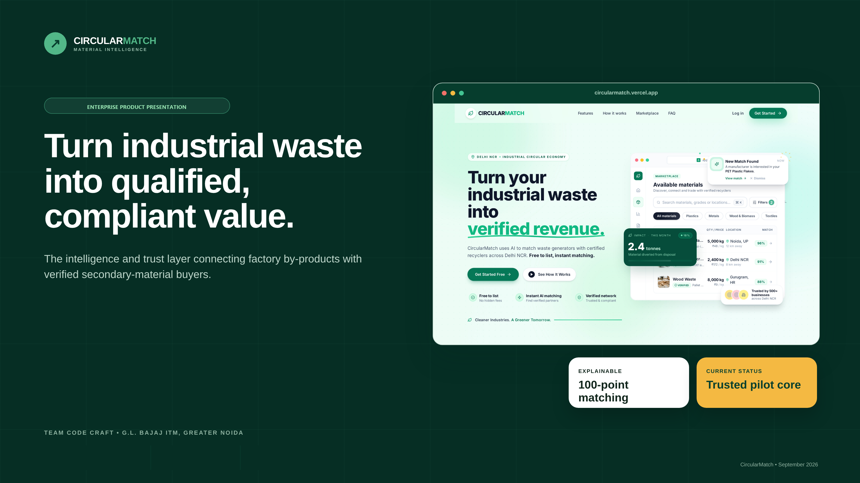
CircularMatch — Turn industrial waste into qualified, compliant value.

Slide 2
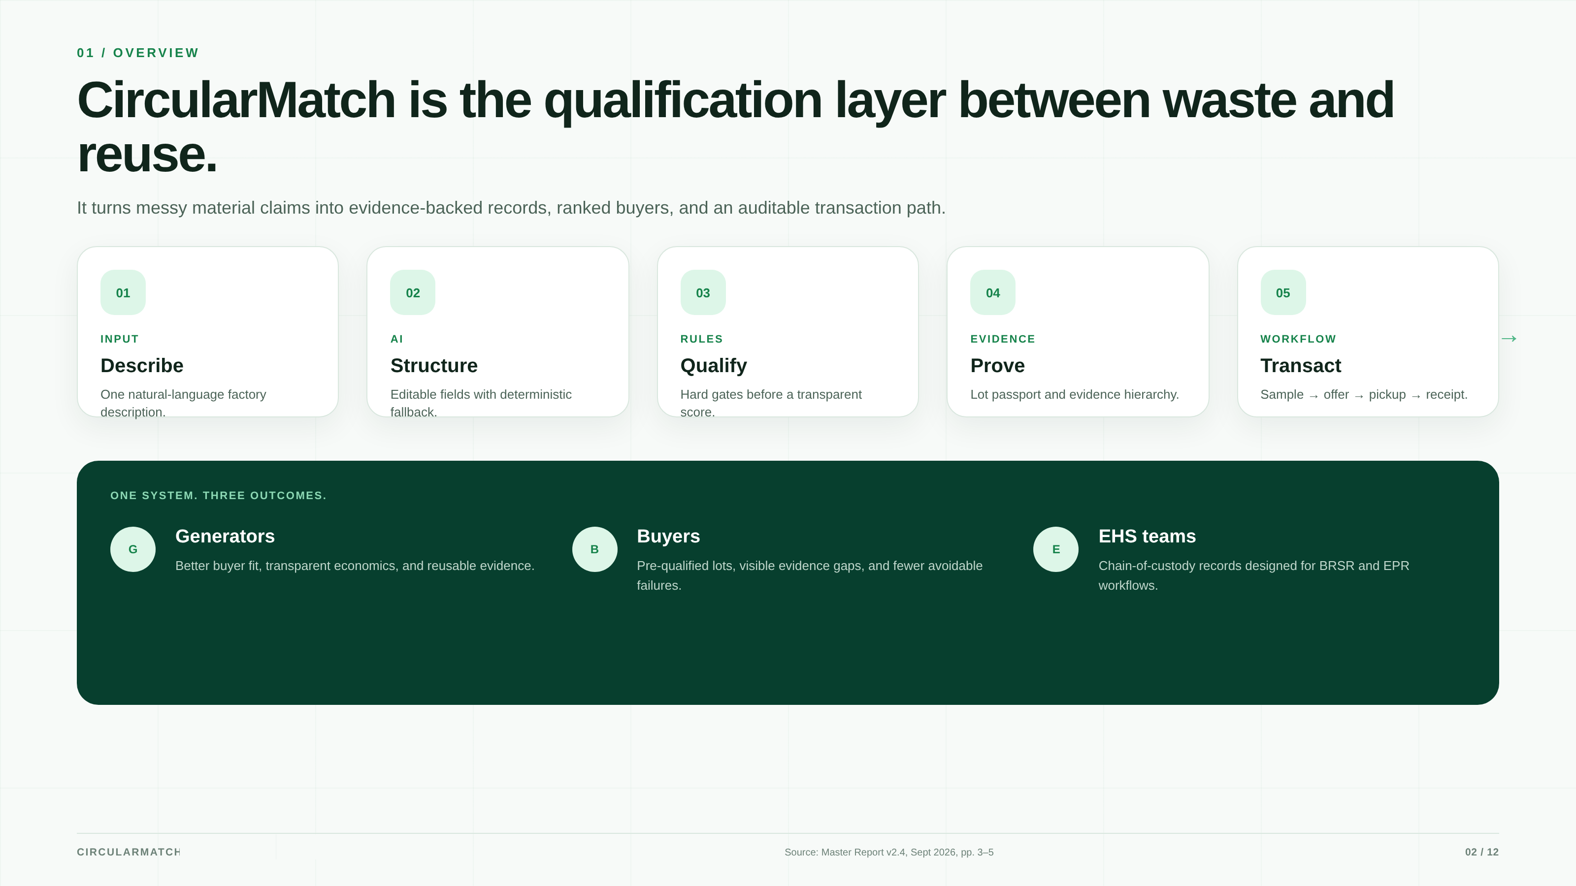
Overview — Qualification layer between waste and reuse.

Slide 3
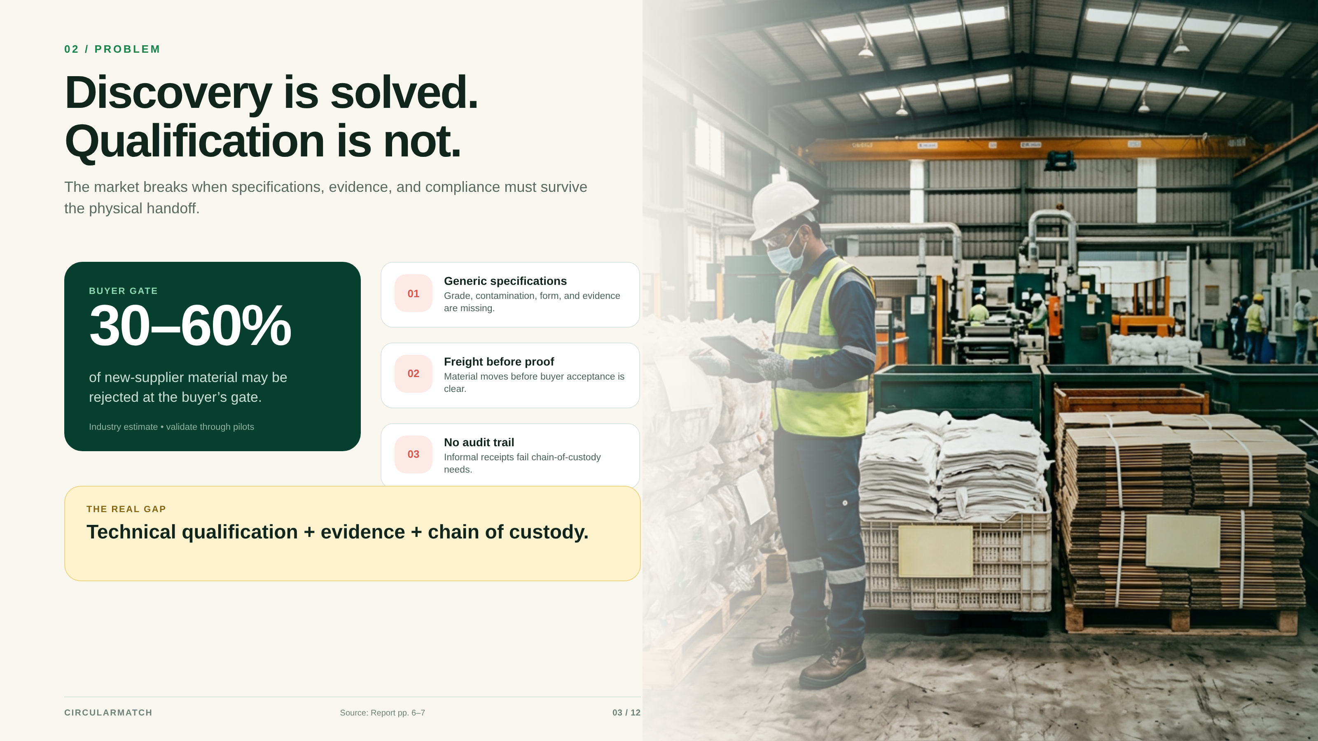
Problem — Discovery is solved. Qualification is not.

Slide 4
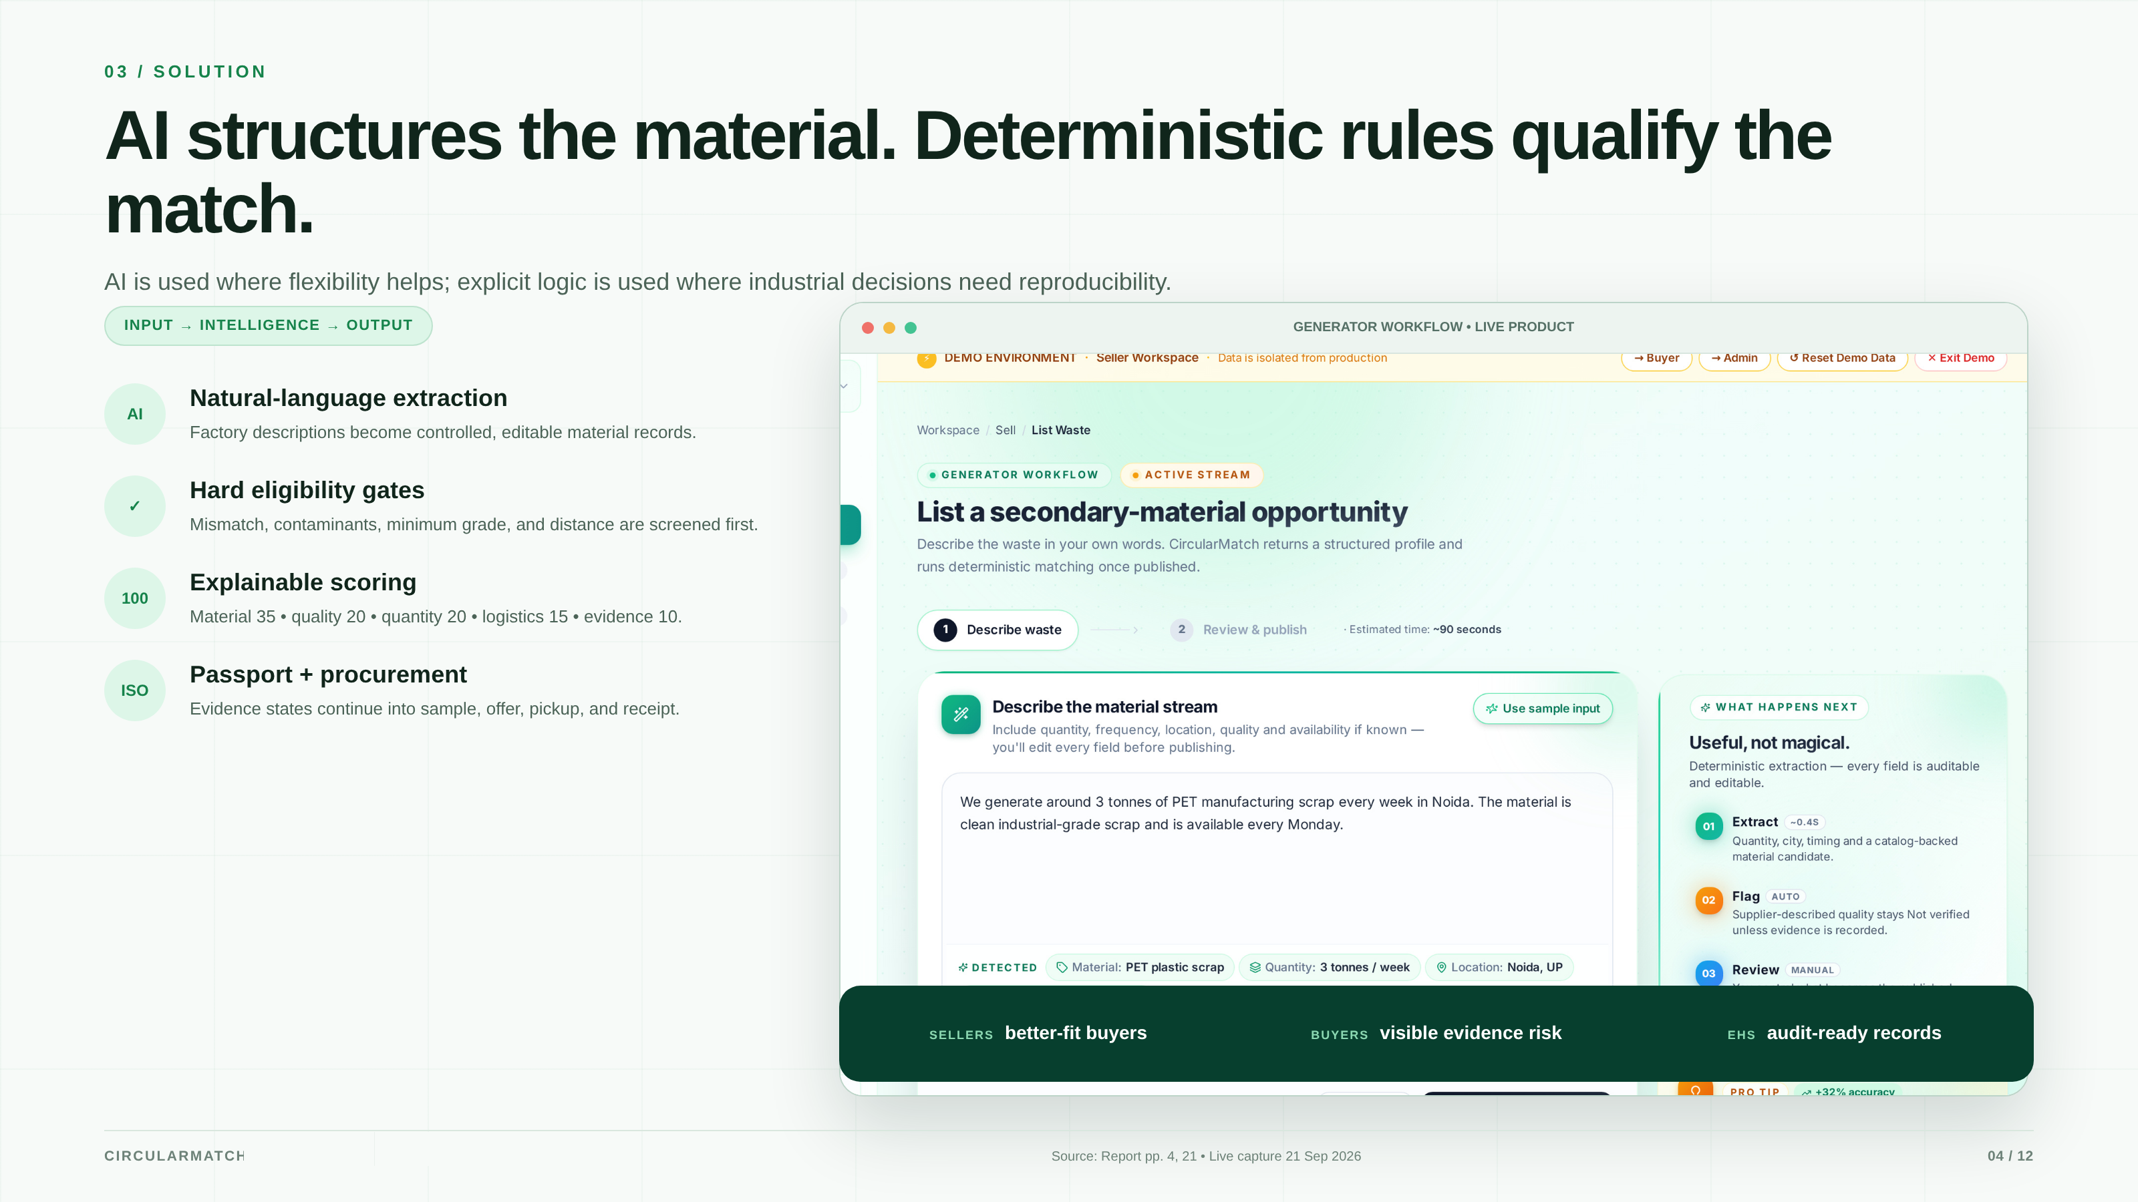
Solution — AI structures the material. Deterministic rules qualify the match.

Slide 5
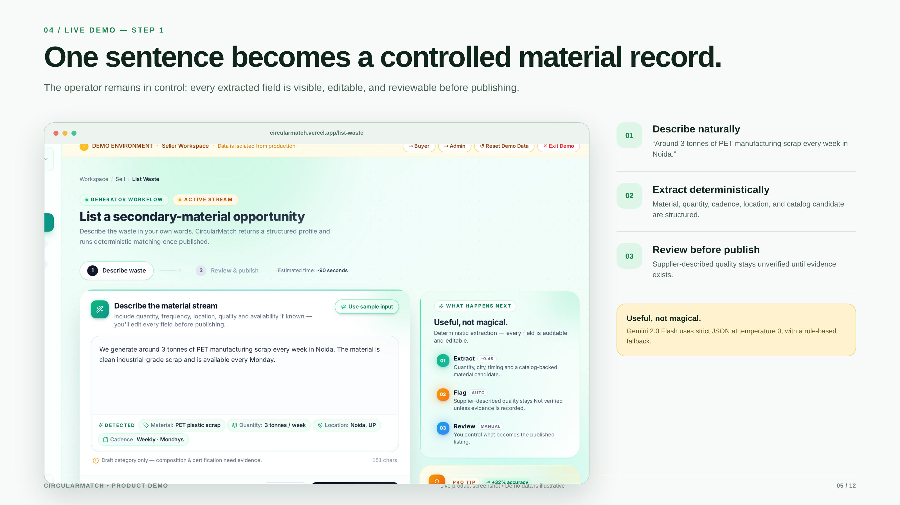
Demo Step 1 — One sentence becomes a controlled material record.

Slide 6
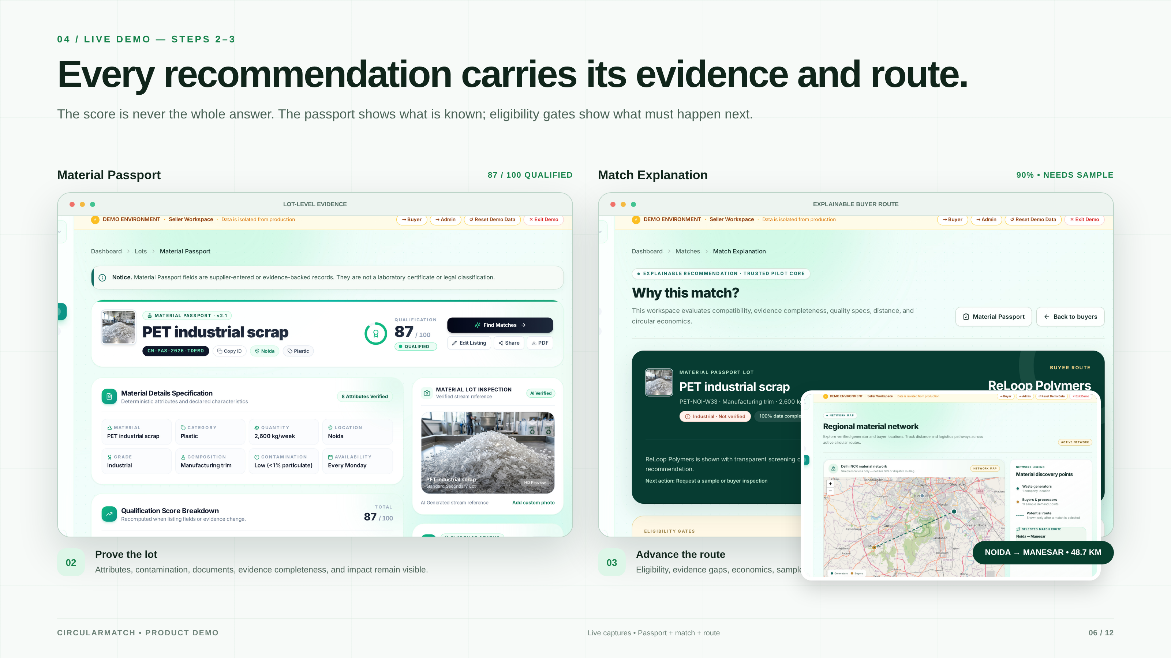
Demo Steps 2–3 — Every recommendation carries its evidence and route.

Slide 7
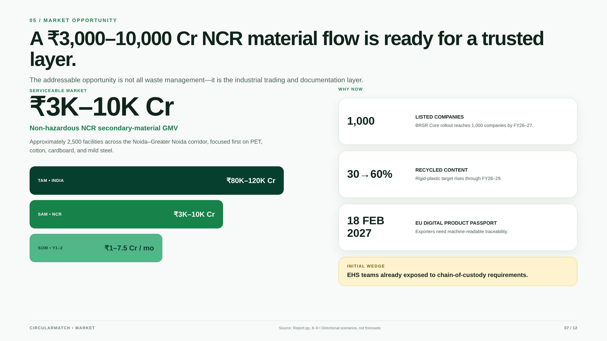
Market Opportunity — ₹3K–10K Cr NCR material flow ready for qualification.

Slide 8
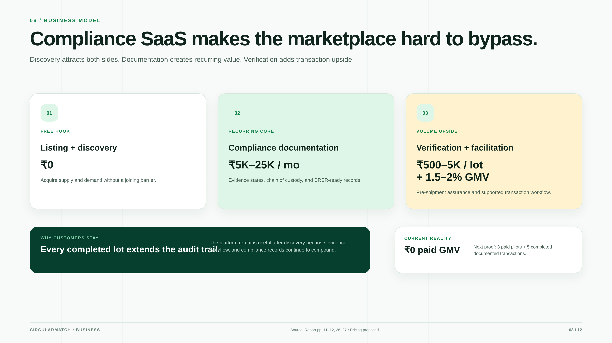
Business Model — Compliance SaaS makes the marketplace hard to bypass.

Slide 9
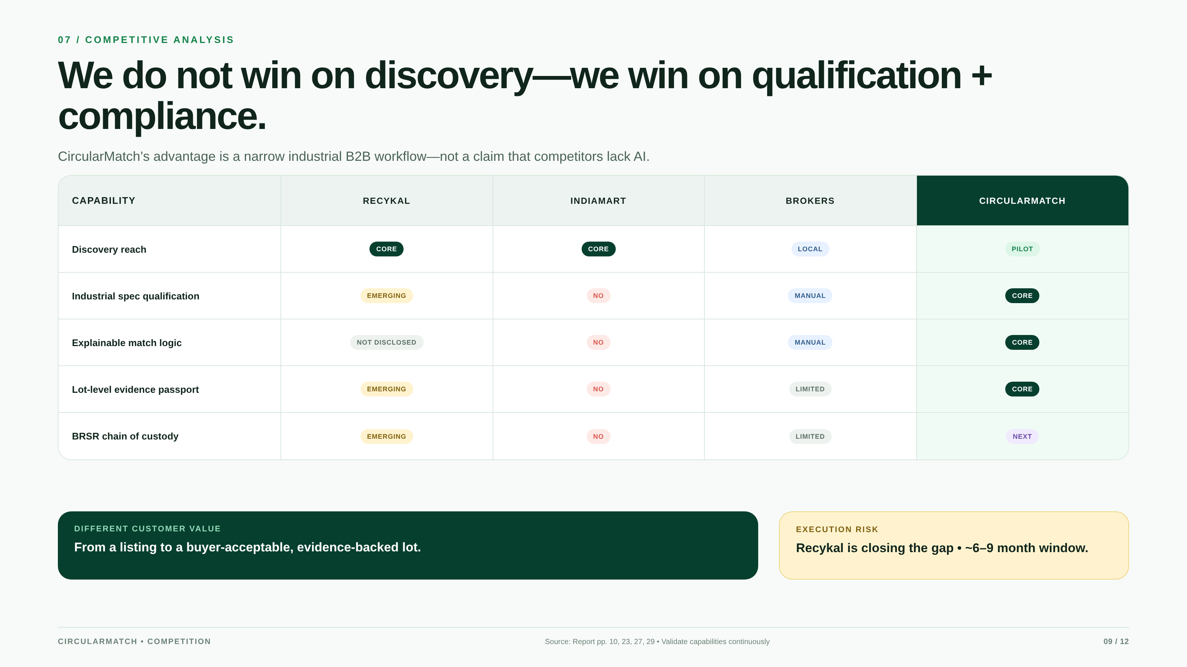
Competitive Matrix — We win on qualification and compliance.

Slide 10
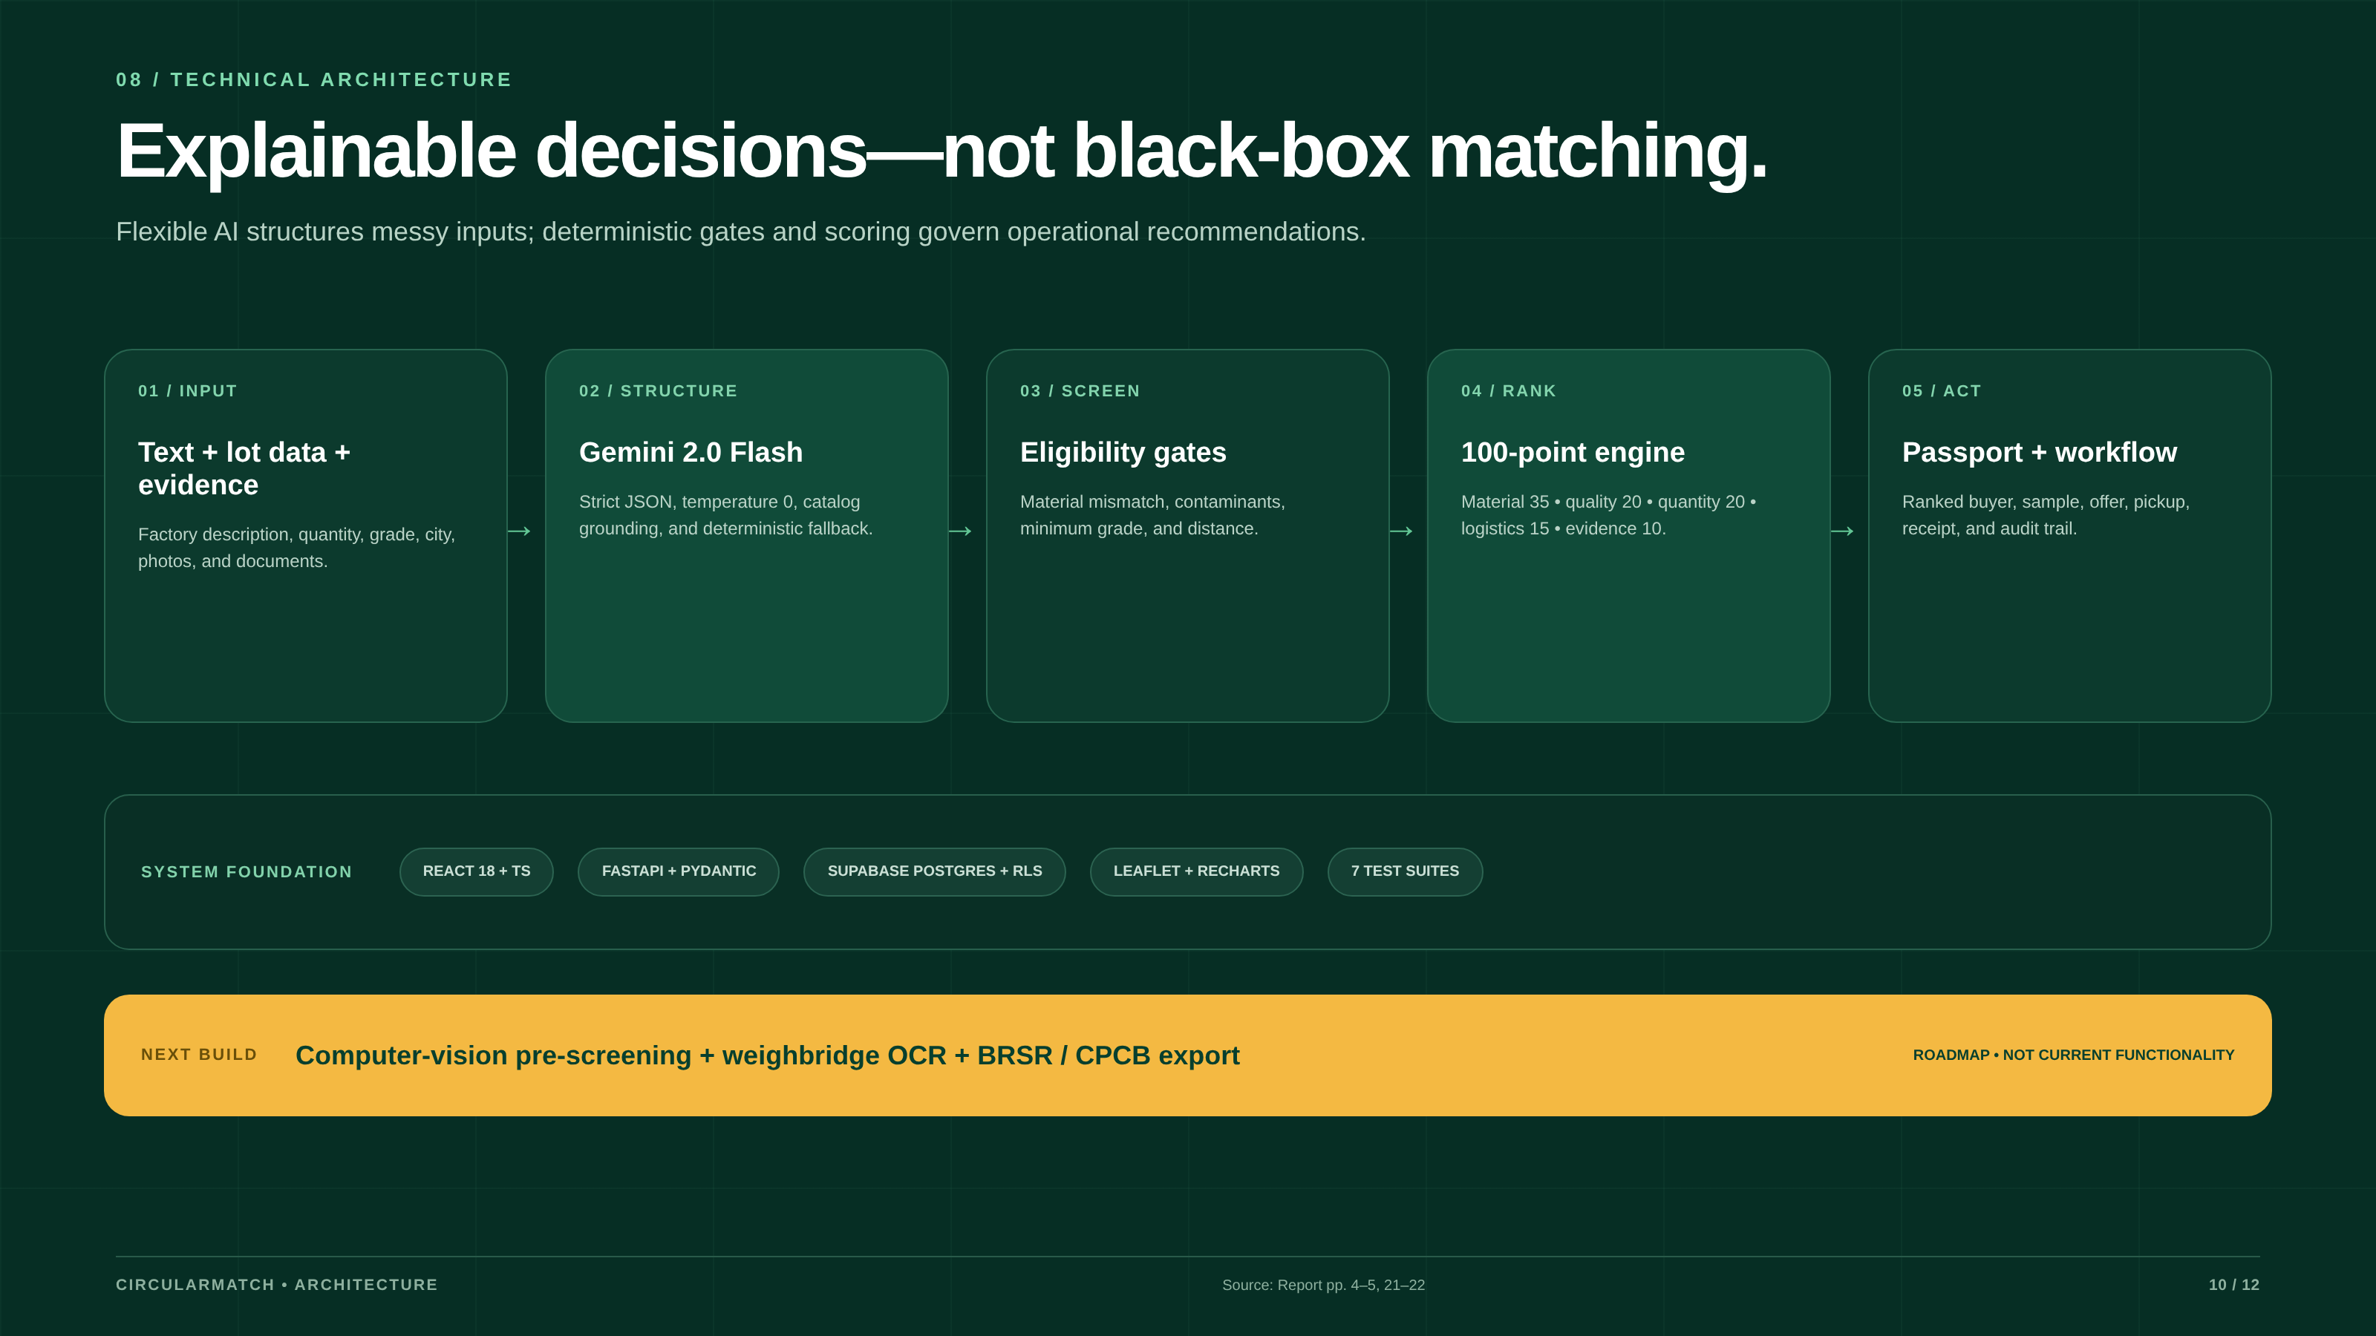
Technical Architecture — Explainable decisions over structured passports.

Slide 11
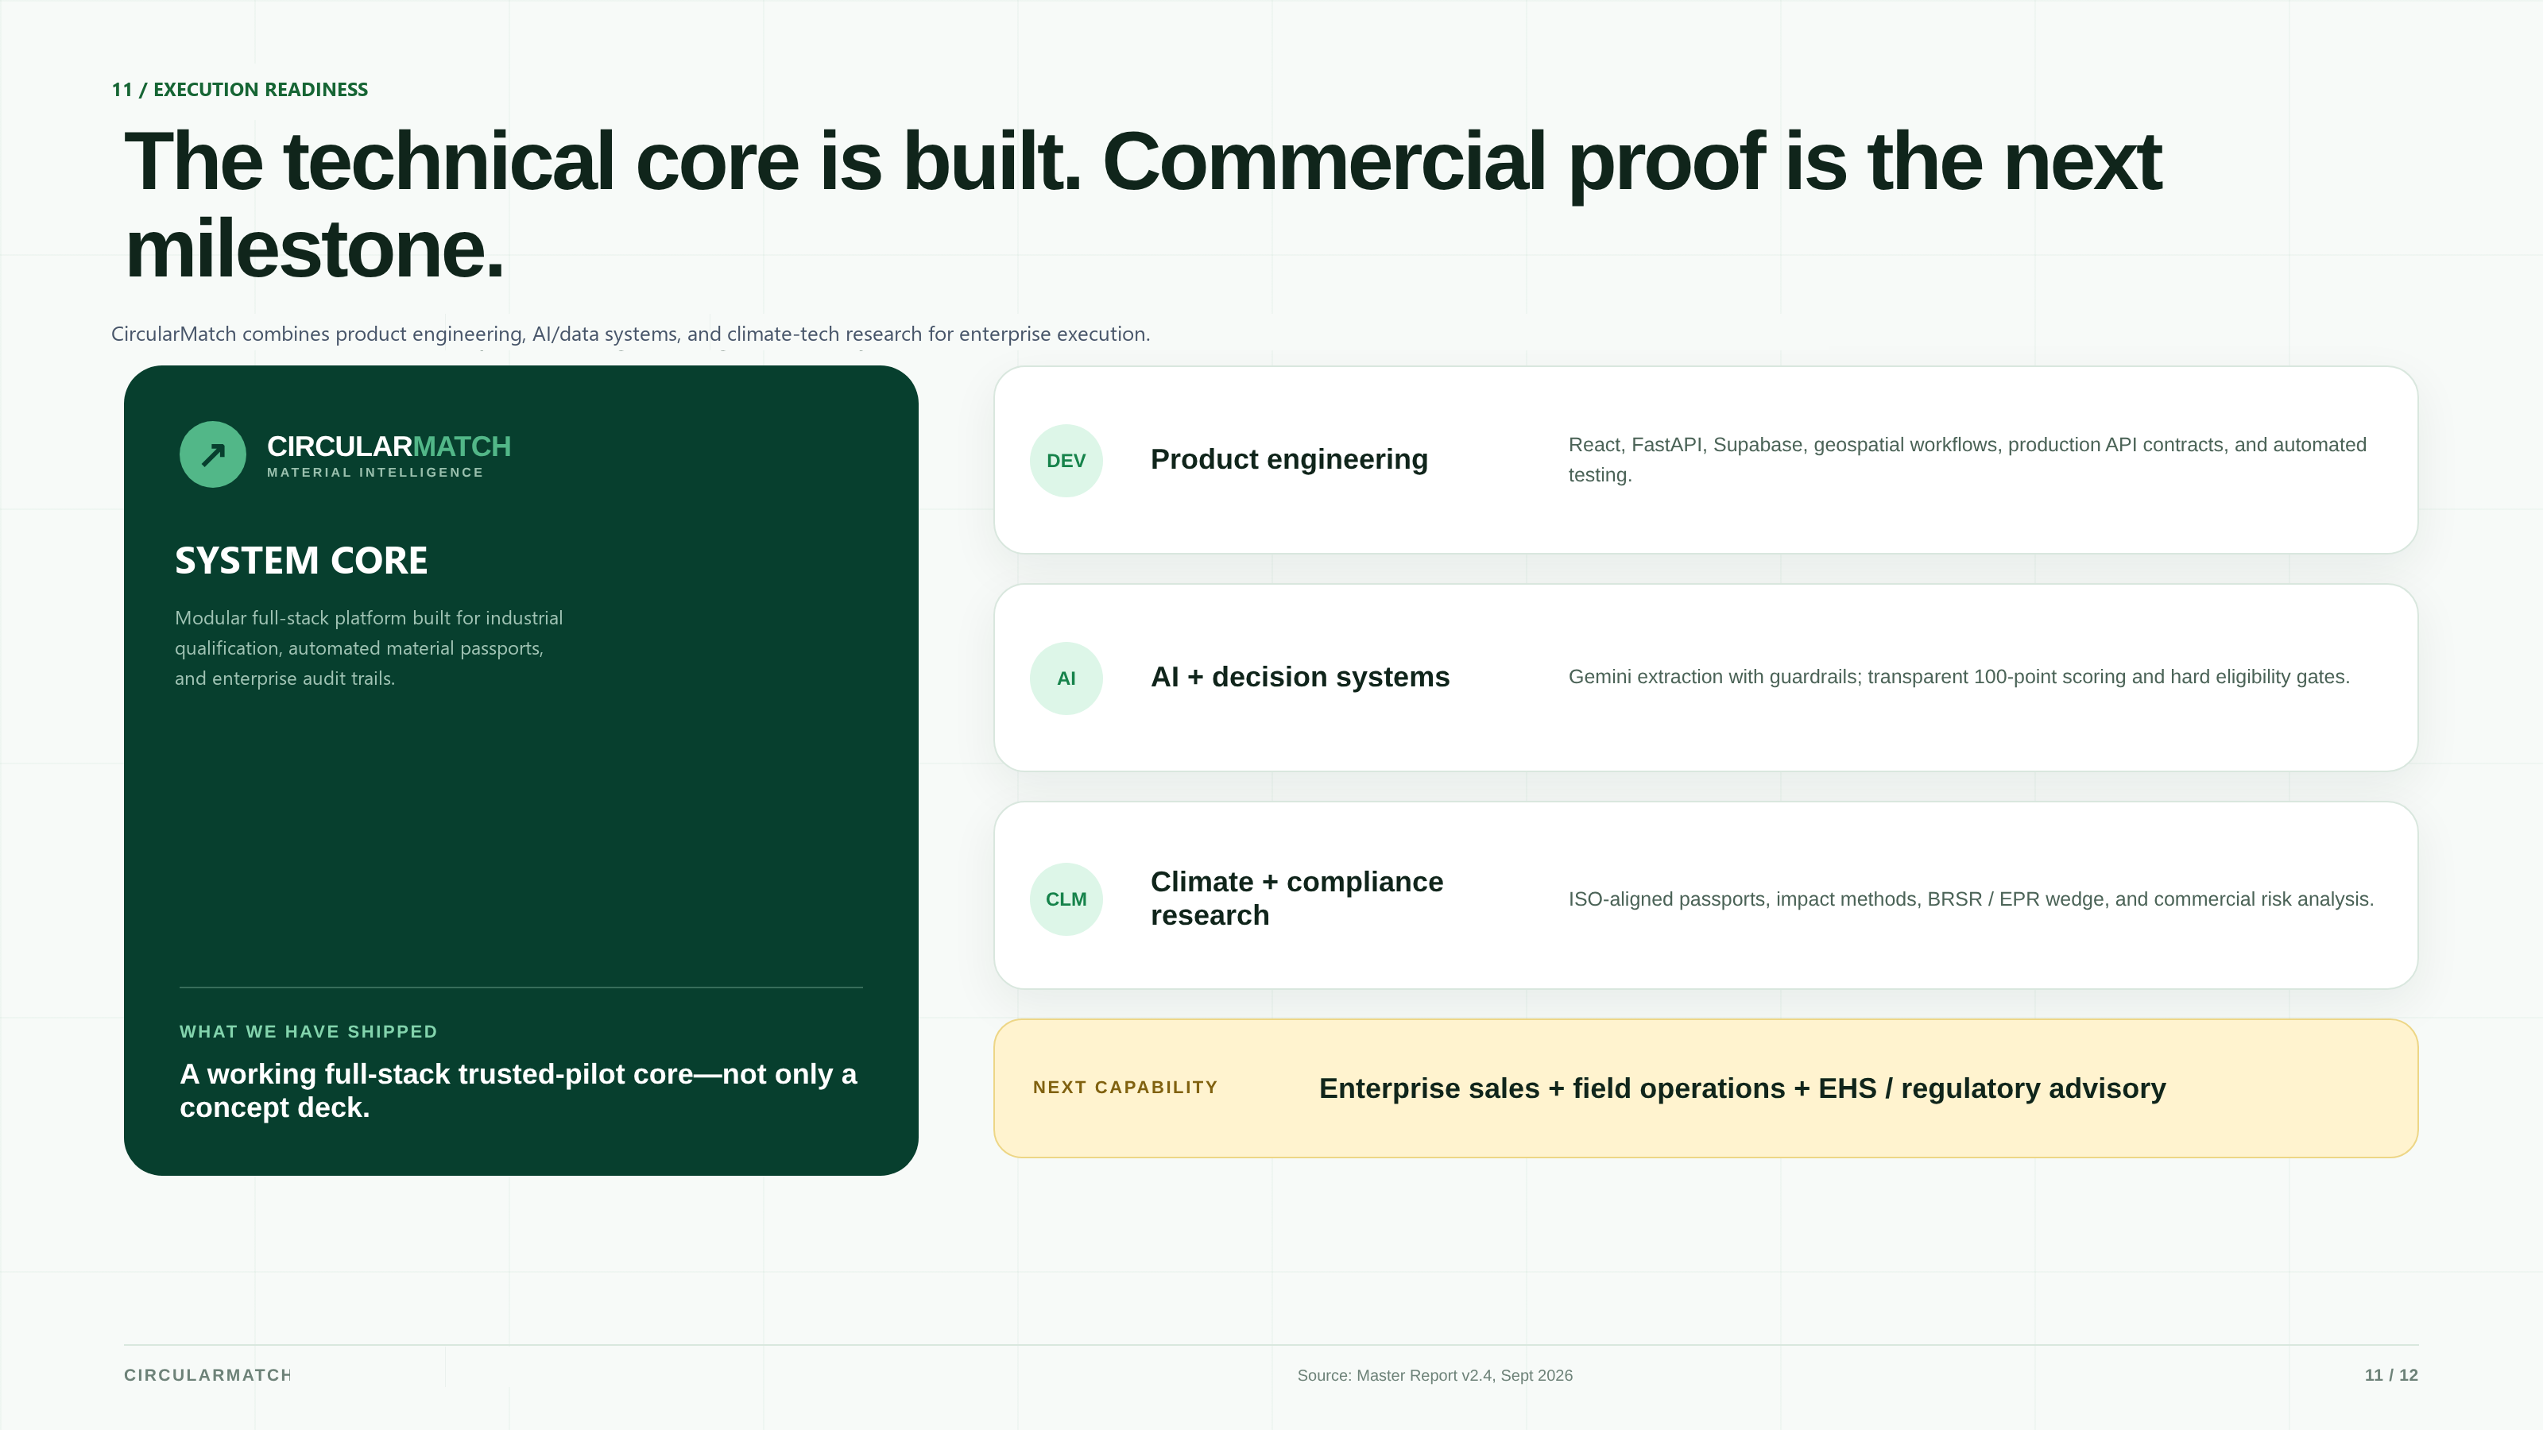
Execution Readiness — Engineered for industrial rigor.

Slide 12
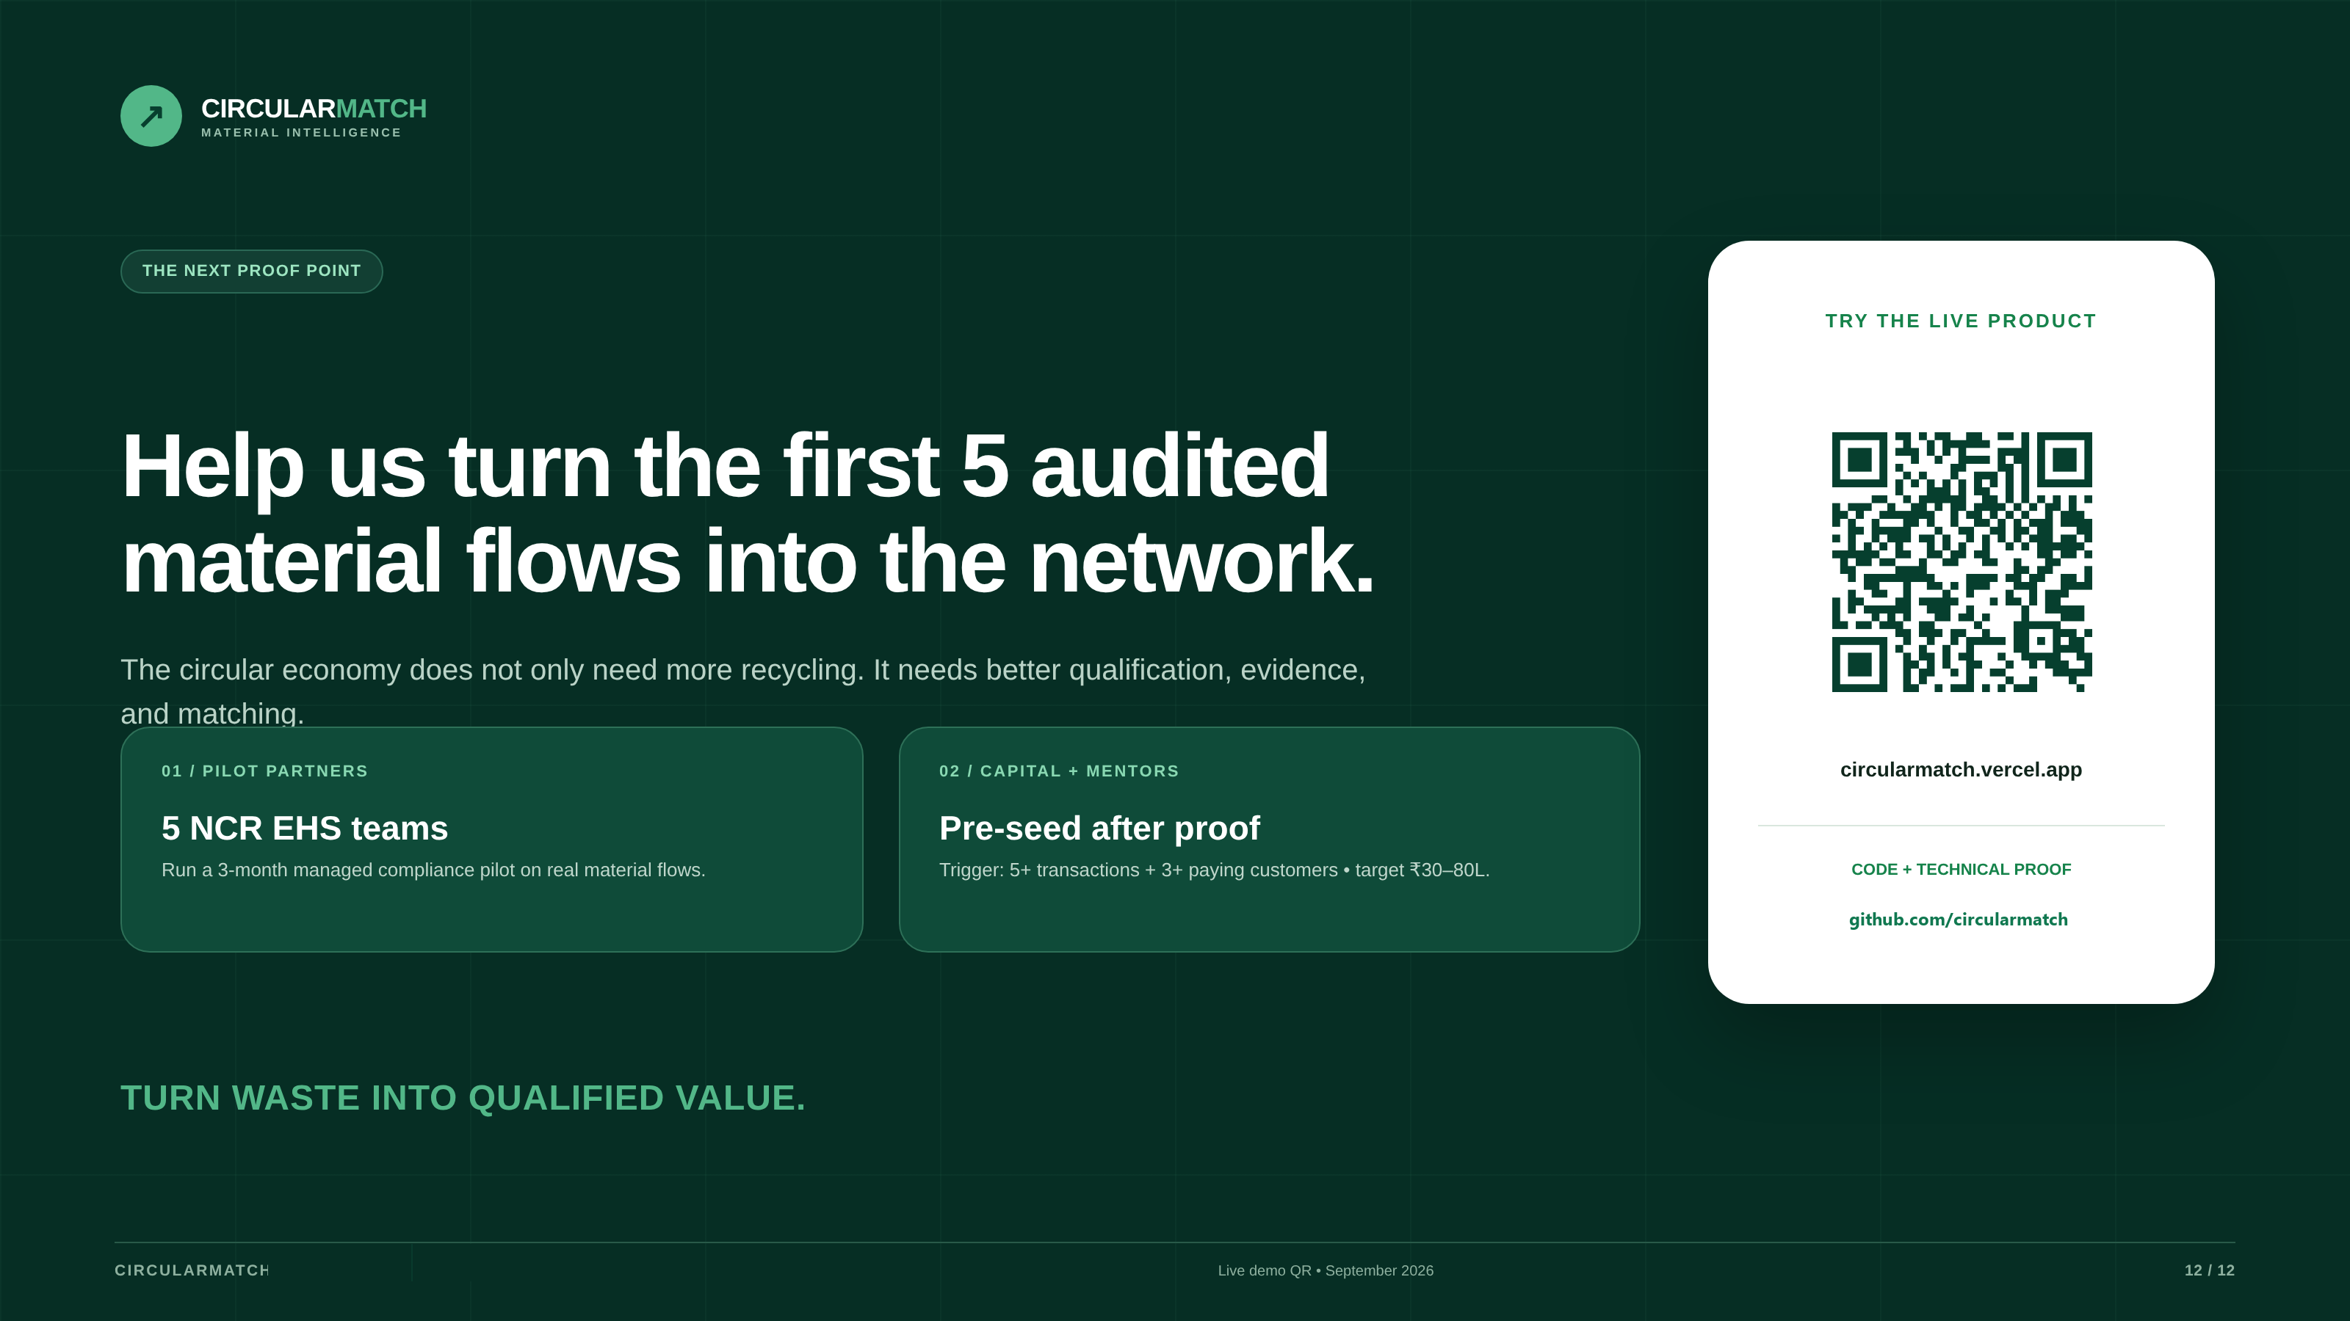
Close — Help us turn the first 5 audited material flows into the network.

