Slide 1
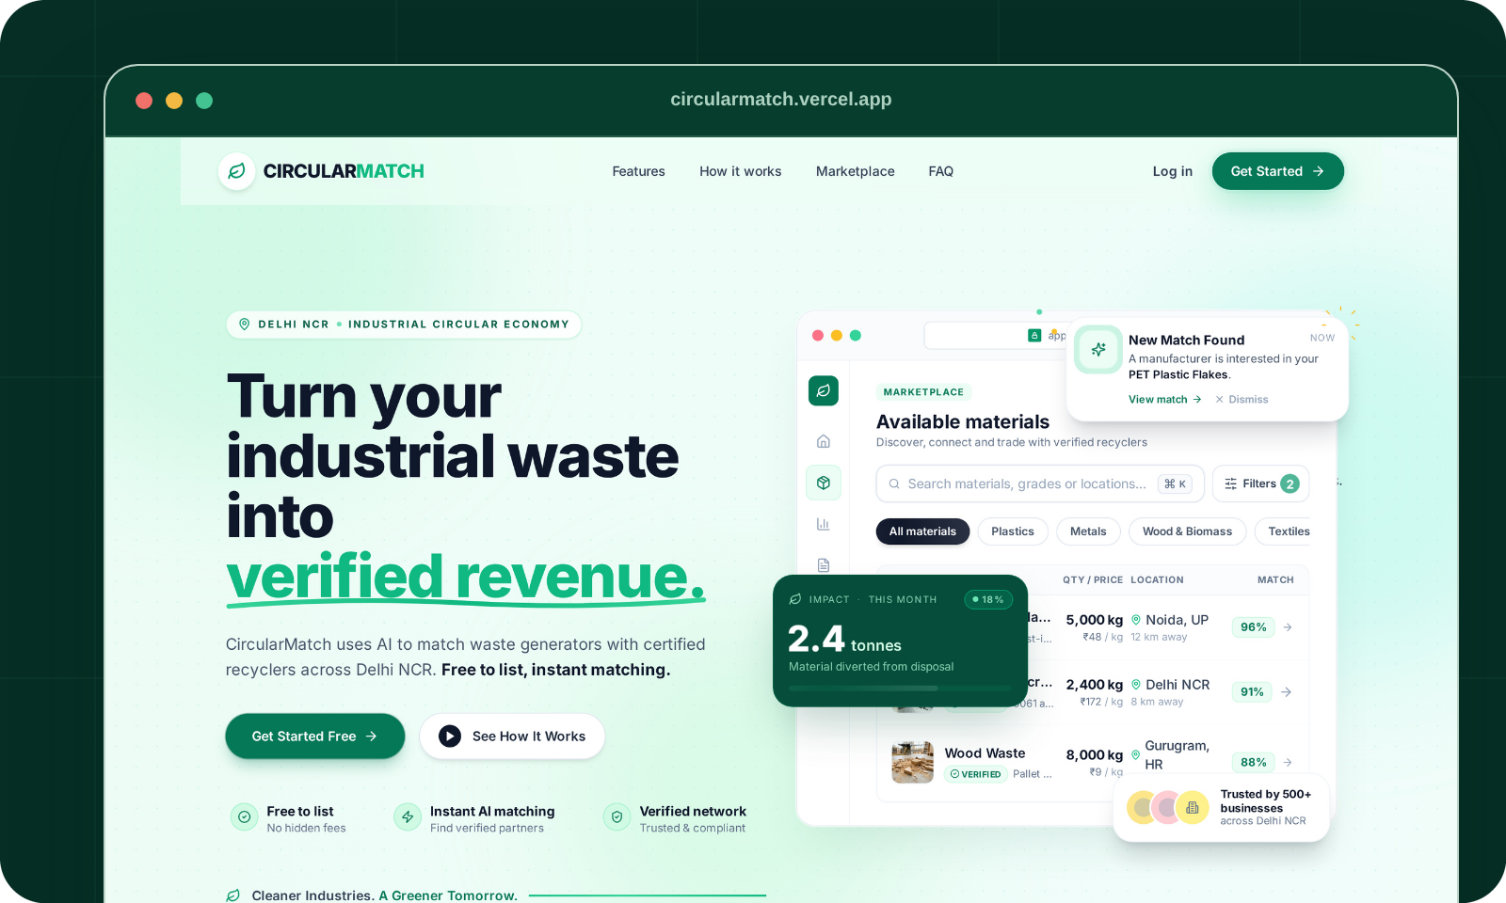
CIRCULARMATCH
INDUSTRIAL MATERIAL INTELLIGENCE
ENTERPRISE PRODUCT PRESENTATION
Turn industrial waste
into qualified,
compliant value.
The intelligence and trust layer connecting factory by-products with verified secondary-material buyers.
EXPLAINABLE
100-point matching
CURRENT STATUS
Trusted pilot core
CIRCULARMATCH • INDUSTRIAL MATERIAL INTELLIGENCE • circularmatch.vercel.app
01 / 12

Slide 2
01 / OVERVIEW
CircularMatch is the qualification layer between waste and reuse.
It turns messy material claims into evidence-backed records, ranked buyers, and an auditable transaction path.
01 INPUT
Describe
One natural-language factory description without form friction.
02 AI
Structure
Editable fields with deterministic schema fallback validation.
03 RULES
Qualify
Hard eligibility gates before transparent 100-point scoring.
04 EVIDENCE
Prove
Lot-level passport and 4-tier verification hierarchy.
05 WORKFLOW
Transact
Sample request → verified offer → pickup → audit receipt.
ONE SYSTEM. THREE OUTCOMES.
Generators
Better buyer fit, transparent unit economics, and reusable compliance evidence.
Buyers
Pre-qualified material lots, visible evidence gaps, and fewer gate rejections.
EHS Teams
Chain-of-custody audit records designed for statutory BRSR and EPR workflows.
CIRCULARMATCH • Platform Architecture & Value Chain Positioning
02 / 12

Slide 3
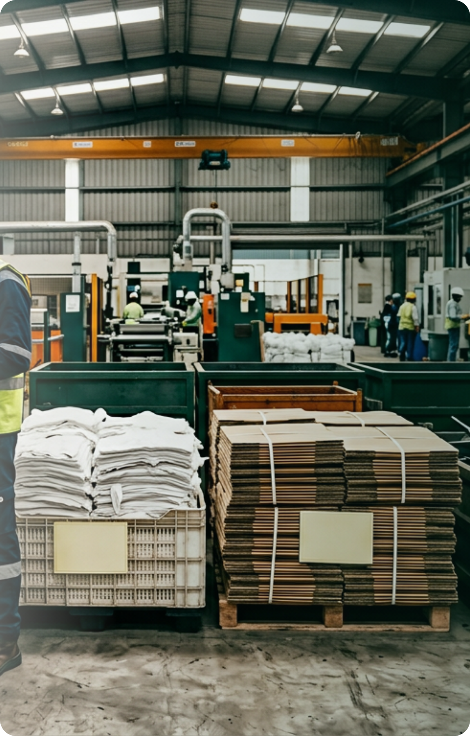
02 / THE PROBLEM
Discovery is solved. Qualification is not.
The market breaks when specifications, evidence, and compliance must survive the physical handoff.
BUYER GATE
30–60%
of new-supplier secondary material is rejected upon arrival at the buyer's gate.
01 Generic specifications
Grade, contamination, form, and moisture evidence are completely missing from informal listings.
02 Freight before proof
Material moves before acceptance criteria are locked, creating catastrophic dead-haulage risk.
03 No audit trail
Informal broker paper receipts fail statutory SEBI BRSR and CPCB EPR compliance mandates.
THE REAL GAP IN THE VALUE CHAIN
Technical qualification + verifiable evidence + chain of custody.
Without verified qualification upfront, digital discovery only accelerates gate rejections and financial waste.
CIRCULARMATCH • Source: CPCB Secondary Material Reports & Field Interviews
03 / 12

Slide 4
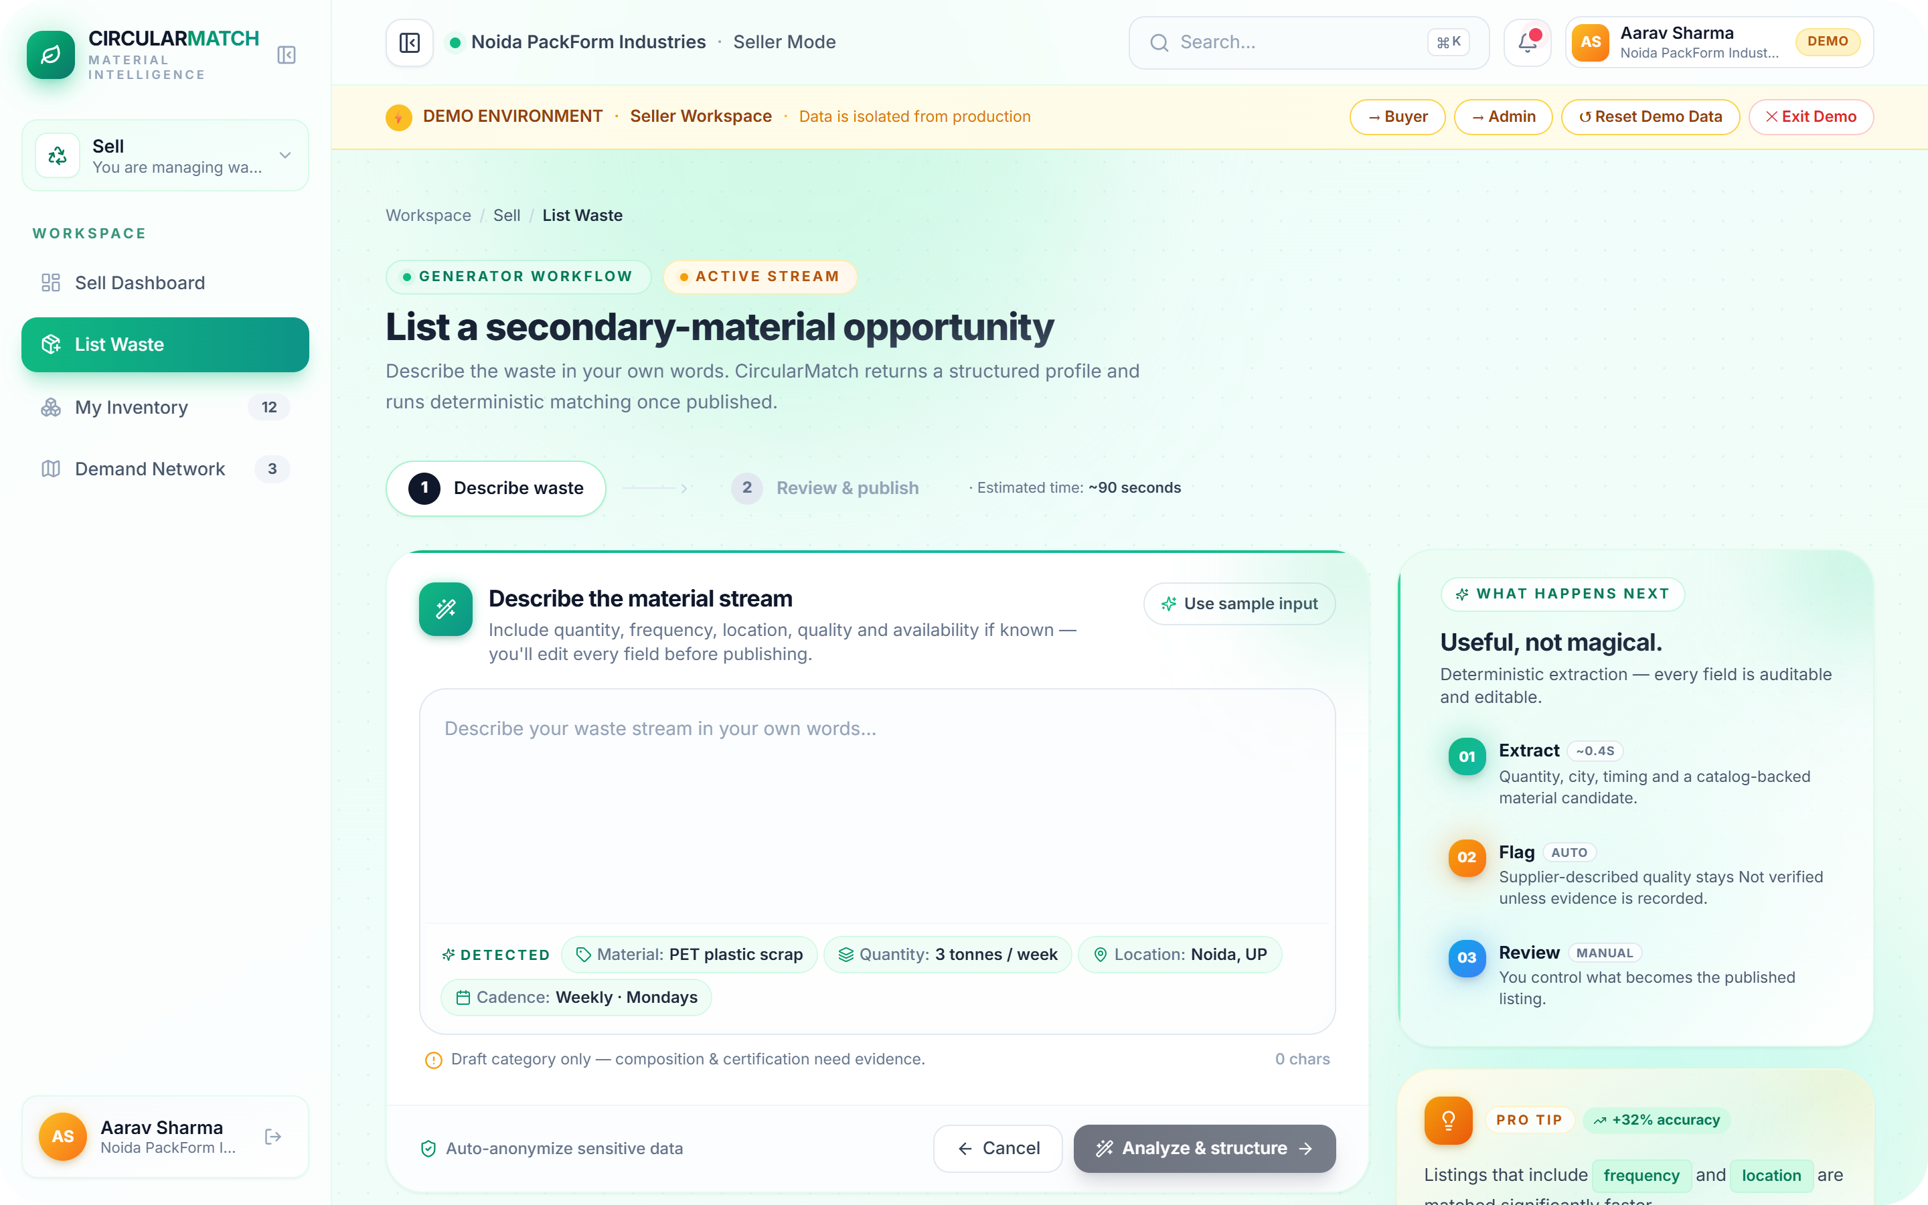
03 / THE SOLUTION
AI structures the material. Deterministic rules qualify the match.
AI is used where flexibility helps; explicit logic is used where industrial decisions need reproducibility.
[AI] Natural-language extraction
Factory scrap descriptions become controlled, editable schema records without manual form burden.
[GATE] Hard eligibility gates
Material category mismatch, hazardous contaminants, minimum grade, and radius limits are screened first.
[100] Explainable scoring engine
Material fit (35) • Quality (20) • Quantity (20) • Logistics (15) • Evidence completeness (10).
[EPR] Passport + procurement chain
ISO 59040-aligned evidence states carry into sample verification, commercial offer, and audit receipts.
CIRCULARMATCH • Source: Platform Architecture v2.4
04 / 12

Slide 5
04 / LIVE DEMO — INGESTION
One sentence becomes a controlled material record.
The operator remains in control: every extracted field is visible, editable, and reviewable before publishing.
01 Describe naturally
"Around 3 tonnes of clean PET manufacturing scrap every week in Noida." Plain text, voice, or WhatsApp format.
02 Extract deterministically
Gemini structures material, quantity, cadence, location, and standard catalog candidates into typed JSON.
03 Review before publish
Supplier-described claims stay unverified until physical evidence or lab test certificates exist.
USEFUL, NOT MAGICAL.
Gemini 2.0 Flash uses strict JSON schema at temperature 0, backed by rule-based catalog fallback validation.
CIRCULARMATCH • PRODUCT DEMO • Live Platform Verification
05 / 12

Slide 6
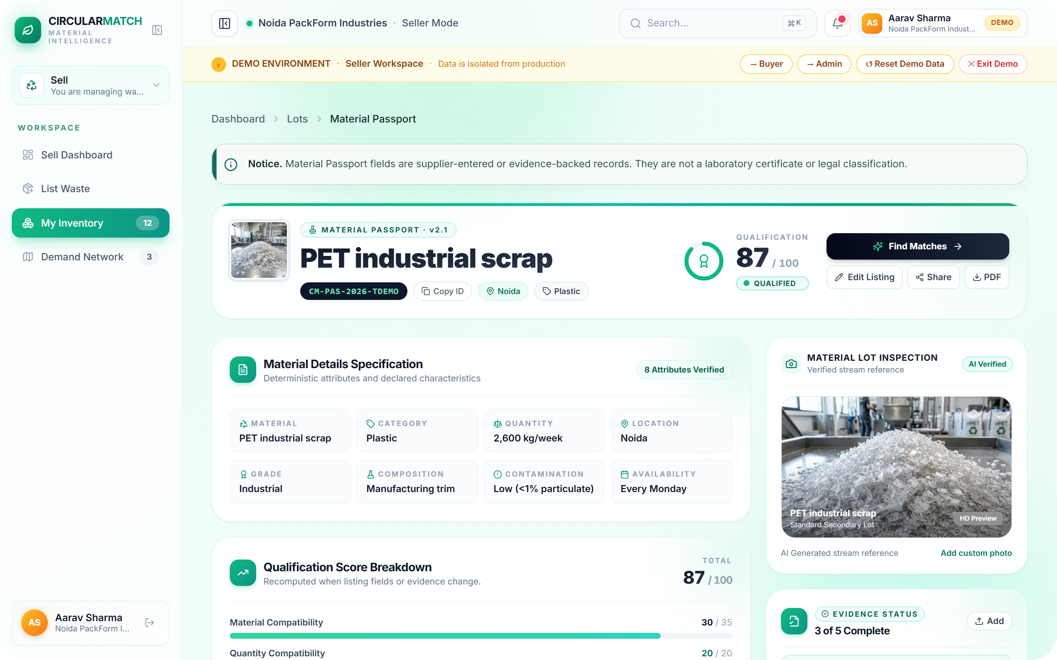
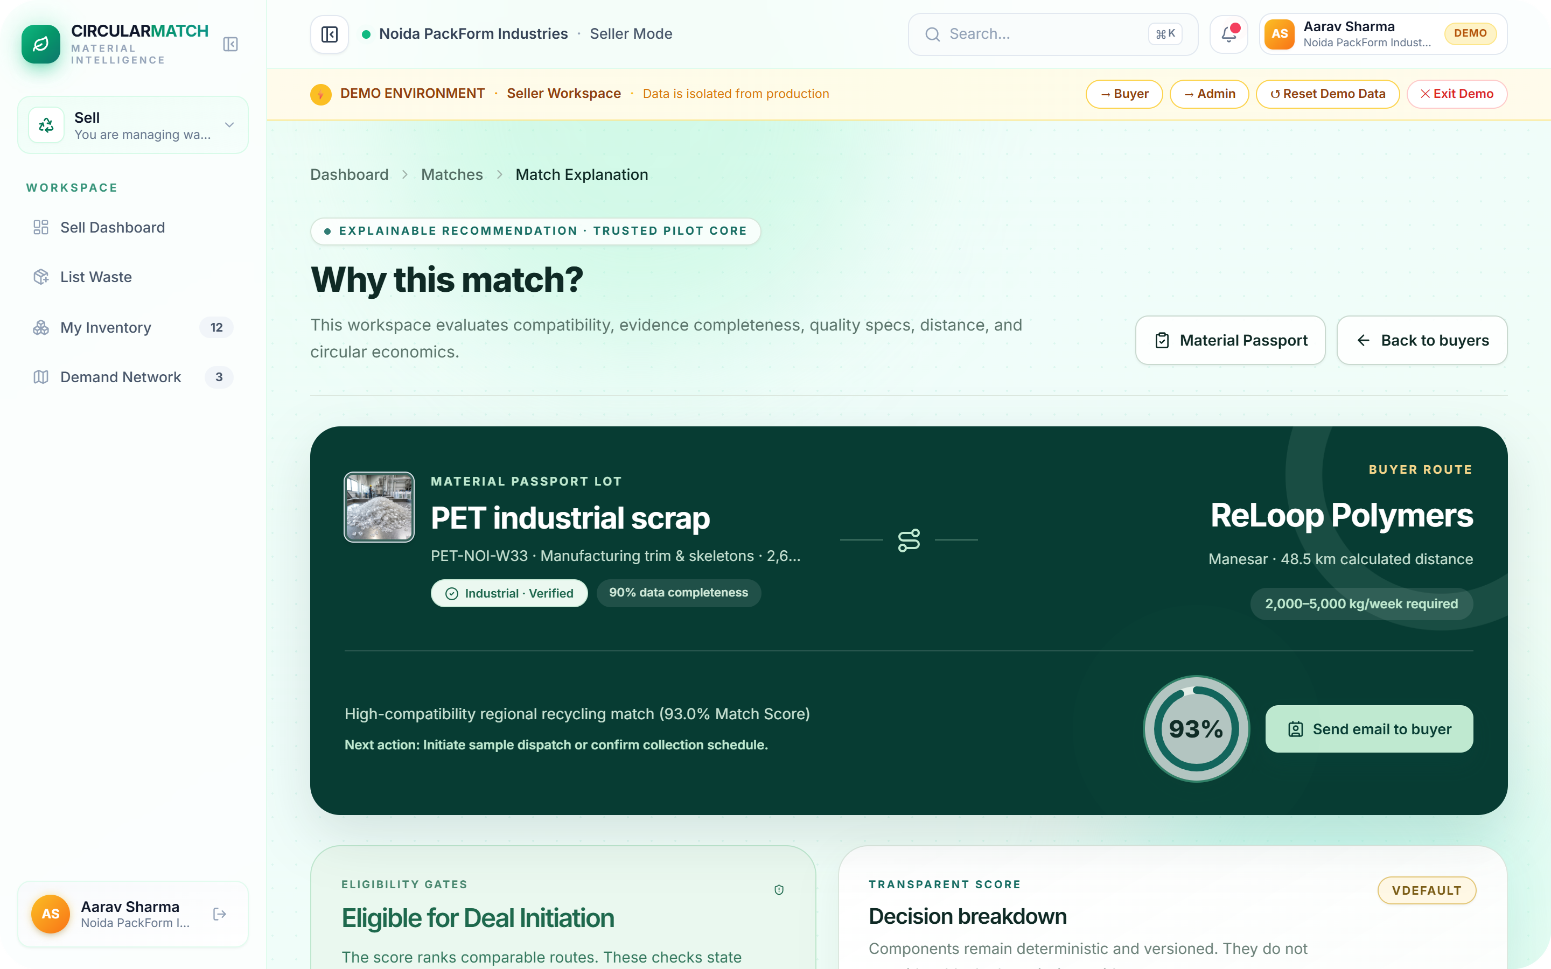
05 / LIVE DEMO — EVIDENCE & ROUTE
Every recommendation carries its evidence and route.
The score is never the whole answer. The passport shows what is known; eligibility gates show what must happen next.
02 Prove the lot
Attributes, contamination, test certificates, evidence completeness, and carbon impact remain auditable.
03 Advance the route
Hard eligibility verification, evidence gaps, net unit economics, sample workflow, and road logistics.
CIRCULARMATCH • PRODUCT DEMO • Live Captures • Passport + Match Engine
06 / 12

Slide 7
06 / MARKET OPPORTUNITY
A ₹3,000–10,000 Cr NCR material flow is ready for a trusted layer.
The addressable opportunity is not all waste management—it is the industrial trading and documentation layer.
SERVICEABLE MARKET (NCR)
₹3K–10K Cr
Non-hazardous NCR secondary-material GMV across ~2,500 facilities (PET, cotton, cardboard, mild steel).
1,000 · LISTED COMPANIES
SEBI BRSR Core mandate legally requires traceable waste reporting by FY26-27.
30 → 60% · RECYCLED CONTENT
Statutory rigid-plastic recycled content targets rise through FY28-29 under EPR regulations.
TAM • INDIA INDUSTRIAL SCRAP
₹80,000–1,20,000 Cr
18 FEB 2027 · EU DIGITAL PRODUCT PASSPORT
Indian manufacturing exporters need machine-readable digital product passports to enter the EU.
SAM • NCR MANUFACTURING CLUSTERS
₹3,000–10,000 Cr
INITIAL MARKET WEDGE
EHS teams already exposed to statutory audit liabilities cannot afford informal broker transactions.
SOM • PILOT PHASE (YEAR 1–2)
₹1–7.5 Cr / month
CIRCULARMATCH • MARKET • Source: CPCB, SEBI BRSR & Market Sizing
07 / 12

Slide 8
07 / BUSINESS MODEL
Compliance SaaS makes the marketplace hard to bypass.
Discovery attracts both sides. Documentation creates recurring value. Verification adds transaction upside.
01 FREE HOOK
Listing + Discovery
₹0
Acquire supply and demand without friction.
Unlimited catalog browsing, natural-language listing, and standard match discovery.
02 RECURRING CORE
Compliance Documentation
₹5K–25K / mo
Verifiable evidence states, lot-level passports, chain-of-custody PDF export, and statutory BRSR & EPR audit readiness.
03 VOLUME UPSIDE
Verification + Facilitation
₹500–5K / lot + 1.5–2%
Pre-shipment batch sample testing, escrow payment facilitation, and guaranteed dispatch protection.
WHY CUSTOMERS STAY (RETENTION MOAT)
The platform remains indispensable after discovery because evidence, inspection records, and compliance histories continue to compound.
COMMERCIAL READINESS
Current State: Fully operational trusted pilot core.
Immediate Target: 5 paying EHS pilot customers • 100 documented material transactions across Delhi-NCR.
CIRCULARMATCH • BUSINESS • Unit Economics & Commercial Model
08 / 12

Slide 9
08 / COMPETITIVE MATRIX
We do not win on discovery—we win on qualification + compliance.
CircularMatch's advantage is a narrow industrial B2B workflow—not a claim that competitors lack technology.
CAPABILITY | RECYKAL | INDIAMART | SCRAP BROKERS | CIRCULARMATCH
Discovery & network reach | Core | Core | Local only | Focused Pilot
Industrial spec qualification | Emerging | None | Manual / Phone | Core (Automated)
Explainable match logic | Not disclosed | None | Manual / Informal | Core (100-Point)
Lot-level evidence passport | Emerging | None | Limited | Core (ISO-Aligned)
BRSR & EPR chain of custody | Emerging | None | Zero / Cash | Core Wedge
DIFFERENTIATED CUSTOMER VALUE
We transform informal ad listings into auditable, buyer-acceptable, evidence-backed secondary material lots.
STRATEGIC EXECUTION WINDOW
Existing platforms focus on aggregation volume. Our defensive moat is deep technical qualification and statutory audit trust.
CIRCULARMATCH • COMPETITION • Capability Matrix & Moat Analysis
09 / 12

Slide 10
09 / TECHNICAL ARCHITECTURE
Explainable decisions—not black-box matching.
Flexible AI structures messy inputs; deterministic gates and scoring govern operational recommendations.
01 / INPUT
Text + lot data + evidence
Natural-language scrap description, quantity, grade, location, photos, and lab specs.
02 / STRUCTURE
Gemini 2.0 Flash
Strict JSON schema at temperature 0 with catalog grounding and deterministic fallback.
03 / SCREEN
Eligibility gates
Hard pass/fail filters: category mismatch, hazardous contamination, minimum grade, radius.
04 / RANK
100-point engine
Material (35) + Quality (20) + Quantity (20) + Logistics (15) + Evidence (10).
05 / ACT
Passport + workflow
Ranked buyer candidates, automated sample request, verified offer, and BRSR chain of custody.
SYSTEM FOUNDATION: REACT 18 + TS • FASTAPI + PYDANTIC • SUPABASE POSTGRES + RLS • LEAFLET + RECHARTS • 7 AUTOMATED TEST SUITES (100% PASS)
ROADMAP INTEGRATIONS: Computer-vision scrap grading • Weighbridge OCR ingestion • Automated CPCB / BRSR XML export
CIRCULARMATCH • ARCHITECTURE • Production Stack & Deterministic Engine
10 / 12

Slide 11
10 / EXECUTION READINESS
The technical core is built. Commercial proof is the next milestone.
CircularMatch combines product engineering, AI/data systems, and climate-tech research for enterprise execution.
CIRCULARMATCH
SYSTEM CORE
Modular full-stack platform built for industrial qualification, automated material passports, and statutory enterprise audit trails.
WHAT IS CURRENTLY LIVE:
A working full-stack trusted-pilot platform deployed on circularmatch.vercel.app with complete end-to-end interactive demo flows.
[DEV] Product Engineering
React 18, TypeScript, FastAPI, Supabase PostgreSQL, geospatial Leaflet routing, production API contracts, and automated testing.
[AI] Decision Systems
Gemini 2.0 Flash extraction with strict schema guardrails; transparent 100-point matching formula and hard eligibility screening.
[CLM] Climate & Compliance Research
ISO 59040-aligned Digital Material Passports, LCA carbon displacement methodology, and SEBI BRSR Core compliance workflows.
[OPS] Enterprise Operations & Scale
Ground-level pilot execution, weighbridge verification protocols, and EHS regulatory alignment across NCR manufacturing hubs.
CIRCULARMATCH • Execution Readiness & Core Architecture
11 / 12

Slide 12

11 / THE NEXT PROOF POINT
Help us turn the first 5 audited material flows into the network.
The circular economy does not only need more recycling. It needs better qualification, evidence, and matching.
TRY THE LIVE PRODUCT
01 / PILOT PARTNERS
5 NCR EHS Teams
Run a 3-month managed compliance pilot on real manufacturing scrap streams.
02 / CAPITAL + SCALE
Pre-seed After Proof
Trigger: 5+ transactions + 3+ paying customers • target ₹30–80L expansion capital.
TURN WASTE INTO QUALIFIED VALUE.
Join us in transforming industrial discard streams into transparent, auditable secondary material supply chains.
circularmatch.vercel.app
CODE & TECHNICAL PROOF
github.com/circularmatch
Interactive demo environment with isolated mock database.
CIRCULARMATCH • Live Demo & Architecture Access
12 / 12

