Slide 1
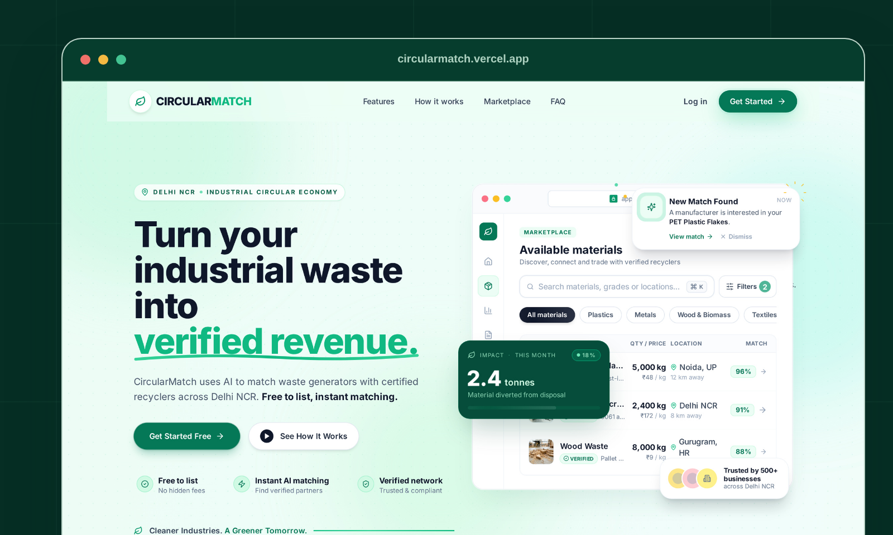
THEME 02: SWISS INTERNATIONAL • SLIDE 1/4: COVER & CORE HOOK | FONTS: Arial Black + Arial | PALETTE: White (#FFFFFF) • Black (#000000) • Vermilion (#FF3B00)
CIRCULARMATCH / 2026
INDUSTRIAL MATERIAL INTELLIGENCE
Turn industrial waste
into qualified,
compliant value.
The qualification and trust layer connecting factory by-products with verified secondary-material buyers.
ALGORITHM
100-Point Match
STATUS
Live Pilot Core

Slide 2
THEME 02: SWISS INTERNATIONAL • SLIDE 2/4: PROBLEM & FRICTION | FONTS: Arial Black + Arial | PALETTE: White (#FFFFFF) • Black (#000000) • Vermilion (#FF3B00)
THE REJECTION CRISIS AT THE GATE
Discovery is solved. Qualification is not.
GATE REJECTION RATE
30–60%
of new-supplier secondary material is rejected upon arrival at the buyer's factory gate due to unspecified contamination, moisture, or polymer grade mismatch.
01 / GENERIC SPECIFICATIONS
Informal WhatsApp text omit polymer grade, melt flow index, and moisture test metrics.
02 / FREIGHT BEFORE PROOF
Trucks dispatch before acceptance criteria are locked, generating catastrophic dead haulage.
03 / COMPLIANCE LIABILITIES
Informal cash broker receipts fail statutory SEBI BRSR and CPCB EPR chain-of-custody audits.

Slide 3
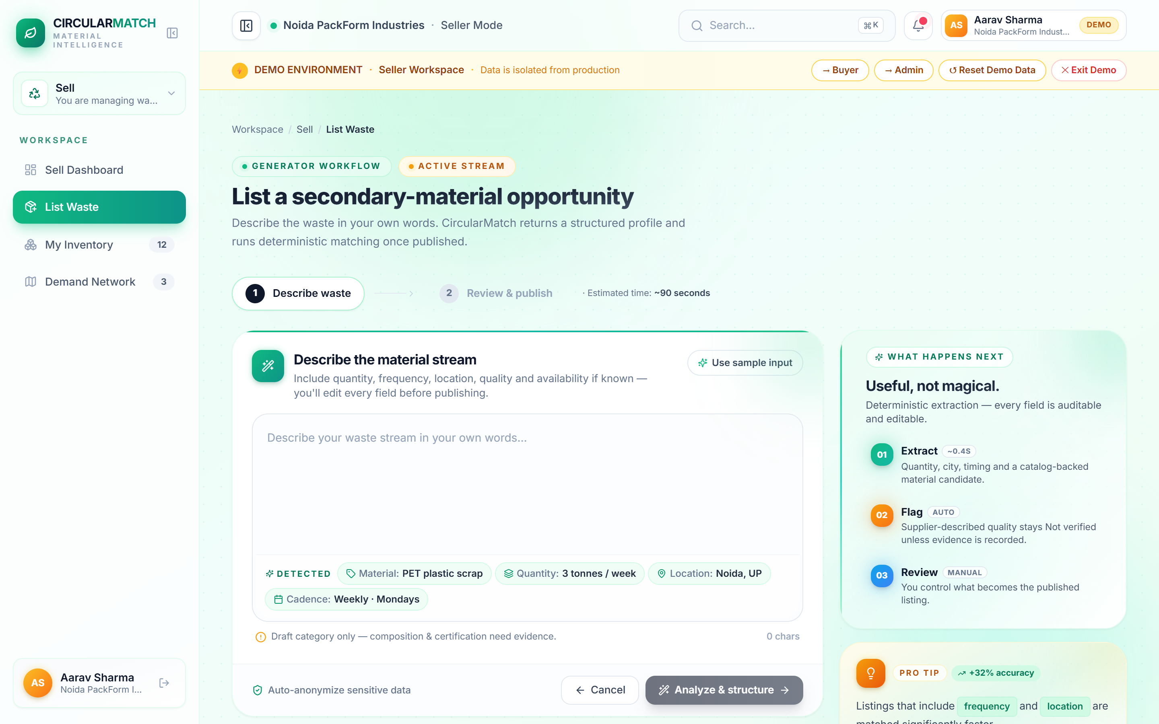
THEME 02: SWISS INTERNATIONAL • SLIDE 3/4: LIVE INGESTION DEMO | FONTS: Arial Black + Arial | PALETTE: White (#FFFFFF) • Black (#000000) • Vermilion (#FF3B00)
04 / LIVE DEMO — STEP 1: INGESTION
One natural sentence becomes a controlled material record.
01 · DESCRIBE NATURALLY
"Around 3 tonnes of clean PET manufacturing scrap every week in Noida." Plain text, voice, or WhatsApp format.
02 · EXTRACT SCHEMAS
Gemini structures material, quantity, cadence, location, and standard catalog candidates into typed JSON.
03 · OPERATOR CONTROL
Supplier-described claims stay unverified until physical lab evidence or test certificates exist.

Slide 4
THEME 02: SWISS INTERNATIONAL • SLIDE 4/4: TECHNICAL ARCHITECTURE | FONTS: Arial Black + Arial | PALETTE: White (#FFFFFF) • Black (#000000) • Vermilion (#FF3B00)
08 / TECHNICAL ENGINE
Explainable decisions — not black-box matching.
01
INGESTION
Raw plant text, photos, lab specs, location.
02
PARSING
Gemini 2.0 Flash at temp=0 with catalog grounding.
03
GATING
Hard eligibility filters: contaminants, radius, purity.
04
RANKING
100-point formula: Spec(35), Qual(20), Qty(20), Dist(15).
05
ACTION
Ranked matches, sample request, BRSR audit receipt.
CORE SYSTEM FOUNDATION
React 18 + TS • FastAPI + Pydantic • Supabase PostgreSQL (pgvector + RLS) • Leaflet • 7 Automated Test Suites (100% Green)

Slide 5
THEME 04: EDITORIAL SERIF & LUXURY • SLIDE 1/4: COVER & THESIS | FONTS: Georgia + Calibri | PALETTE: Parchment (#F9F6F0) • Oxford Green (#14241C) • Gold (#B8860B)
CIRCULARMATCH
INSTITUTIONAL SECONDARY MATERIAL PLATFORM
Transforming industrial discard into certified secondary raw material.
The verifiable qualification and digital passport layer connecting factory discard streams with audited industrial recyclers.
STANDARDS ALIGNED
ISO 59040 Passports
READINESS
NCR Trusted Pilot

Slide 6
THEME 04: EDITORIAL SERIF & LUXURY • SLIDE 2/4: MARKET ECONOMICS & TAM | FONTS: Georgia + Calibri | PALETTE: Parchment (#F9F6F0) • Oxford Green (#14241C) • Gold (#B8860B)
MARKET OPPORTUNITY & REGULATORY CATALYSTS
A ₹3,000–10,000 Cr NCR material flow is ready for a trusted layer.
SERVICEABLE ADDRESSABLE MARKET (DELHI-NCR)
₹3,000 – 10,000 Cr
Non-hazardous manufacturing discard across ~2,500 facilities (PET flakes, cotton spinning waste, cardboard, steel scrap).
• TAM: ₹80,000–1,20,000 Cr (India Total Industrial Discard)
• SAM: ₹3,000–10,000 Cr (NCR Industrial Hubs)
• SOM: ₹1.0–7.5 Cr / month (Pilot Phase Anchor Facilities)
1,000+ LISTED CORPORATES — SEBI BRSR Core Mandate
By FY26-27, listed entities face direct statutory audit liabilities for unverified supply-chain waste disposal.
30% TO 60% MANDATORY — Statutory EPR Escalation
Statutory minimum recycled content quotas in rigid packaging surge under MoEFCC guidelines.
18 FEBRUARY 2027 — EU Digital Product Passport
Indian textile and polymer manufacturing exporters require machine-readable passports to clear EU customs.

Slide 7
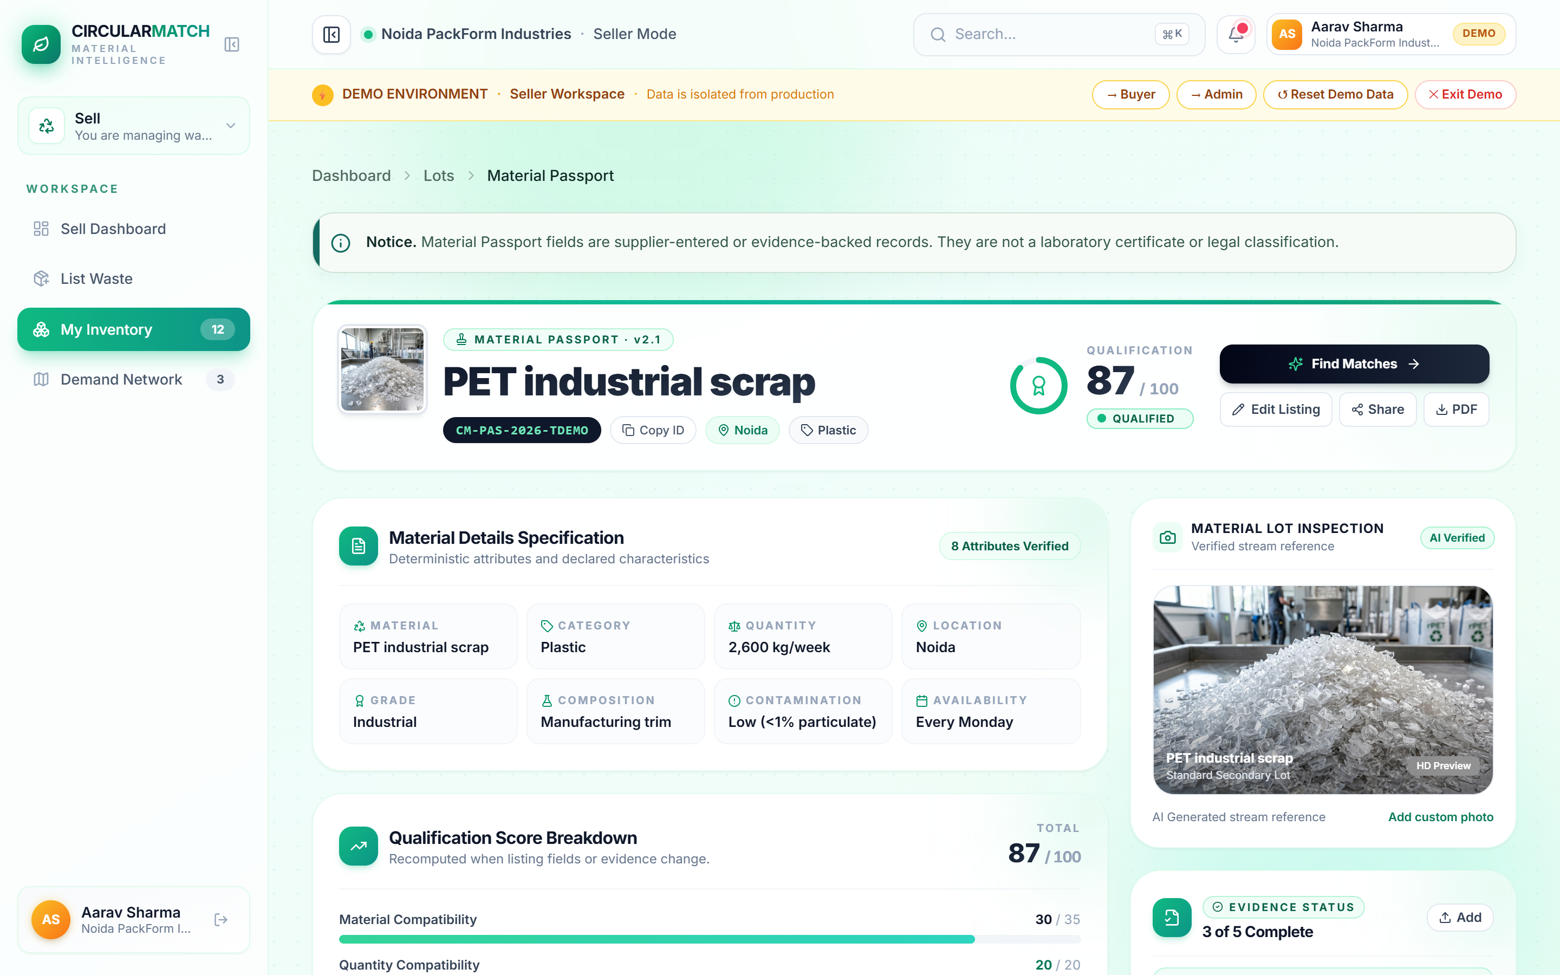
THEME 04: EDITORIAL SERIF & LUXURY • SLIDE 3/4: PRODUCT PASSPORT DEMO | FONTS: Georgia + Calibri | PALETTE: Parchment (#F9F6F0) • Oxford Green (#14241C) • Gold (#B8860B)
THE QUALIFICATION STANDARD
Digital Material Passport (ISO 59040 Aligned)
I. VERIFIABLE PROVENANCE
Every discard lot carries precise manufacturing GPS coordinates, facility license numbers, and batch dates.
II. AVOIDED CARBON AUDIT
Standardized Scope 3 lifecycle carbon reduction metrics computed directly for statutory ESG disclosures.
III. CHAIN-OF-CUSTODY RECEIPTS
Digital bill-of-lading and weighbridge verification records eliminate paper fraud and ensure tax compliance.

Slide 8
THEME 04: EDITORIAL SERIF & LUXURY • SLIDE 4/4: BUSINESS MODEL & MOAT | FONTS: Georgia + Calibri | PALETTE: Parchment (#F9F6F0) • Oxford Green (#14241C) • Gold (#B8860B)
COMMERCIAL ARCHITECTURE & REVENUE MODEL
Compliance SaaS creates an impenetrable customer retention moat.
TIER I
Listing & Catalog Discovery
₹0
Zero-friction supplier onboarding.
Free catalog search and match browsing.
TIER II
Compliance SaaS Core
₹5K – 25K / mo
Digital Material Passports, verifiable evidence states, chain-of-custody export.
TIER III
Facilitation & Volume Escrow
₹500–5K + 1.5%
Third-party laboratory testing, sample escrow, and verified transport protection.
THE COMPOUNDING RETENTION MOAT
Industrial clients do not leave the platform after discovery because their historical compliance logs, certified lot passports, and regulatory evidence compound over time.

Slide 9
THEME 06: CLEAN ENTERPRISE CORPORATE • SLIDE 1/4: PLATFORM OVERVIEW | FONTS: Calibri / Arial | PALETTE: Slate (#F1F5F9) • Cobalt (#1D4ED8) • Emerald (#10B981)
ENTERPRISE MATERIAL MANAGEMENT SUITE
Turn industrial waste into qualified, compliant value.
The enterprise intelligence layer connecting manufacturing scrap generators with certified secondary-material buyers.
AUTOMATED QUALIFICATION
Deterministic 100-point algorithm eliminates buyer gate rejection liabilities.
AUDIT-READY PASSPORTS
Machine-readable compliance records built for statutory SEBI BRSR and EPR reporting.
MANAGED TRANSACTION TRAIL
End-to-end sample requests, digital offers, and verified weighbridge receipts.

Slide 10
THEME 06: CLEAN ENTERPRISE CORPORATE • SLIDE 2/4: SOLUTION ARCHITECTURE | FONTS: Calibri / Arial | PALETTE: Slate (#F1F5F9) • Cobalt (#1D4ED8) • Emerald (#10B981)
SOLUTION ARCHITECTURE
AI structures the material. Deterministic rules qualify the match.
[AI] Natural-Language Scrap Ingestion
Raw voice, text, or WhatsApp descriptions converted into structured JSON records.
[GATE] Hard Eligibility Safeguards
Category mismatch, toxic contaminants, and transit radius pre-screened automatically.
[100] Transparent Matching Engine
Spec (35) • Quality (20) • Volume (20) • Logistics (15) • Evidence Completeness (10).
[EPR] Digital Material Passports
ISO 59040-aligned verification carrying into sample requests and statutory CPCB export.

Slide 11
THEME 06: CLEAN ENTERPRISE CORPORATE • SLIDE 3/4: COMPETITIVE MATRIX | FONTS: Calibri / Arial | PALETTE: Slate (#F1F5F9) • Cobalt (#1D4ED8) • Emerald (#10B981)
COMPETITIVE CAPABILITY COMPARISON
We do not win on discovery volume — we win on qualification & compliance.
CRITICAL CAPABILITY | RECYKAL | INDIAMART | SCRAP BROKERS | CIRCULARMATCH
Industrial Spec Qualification | Emerging | None (Ad Only) | Manual / Phone | Automated Core
Explainable Match Logic | Not Disclosed | None | Informal | 100-Point Formula
Lot-Level Evidence Passport | Emerging | None | Limited | ISO 59040 Aligned
Statutory BRSR & EPR Audit | Emerging | None | Zero / Cash | Core Enterprise Wedge
CLIENT VALUE PROPOSITION
Transform unverified informal factory ad listings into buyer-acceptable, auditable secondary material lots.
ENTERPRISE MOAT
Deep compliance integrations, ISO passports, and statutory audit histories create insurmountable switching costs.

Slide 12
THEME 06: CLEAN ENTERPRISE CORPORATE • SLIDE 4/4: EXECUTION READINESS | FONTS: Calibri / Arial | PALETTE: Slate (#F1F5F9) • Cobalt (#1D4ED8) • Emerald (#10B981)
TECHNICAL READINESS & PLATFORM STACK
The technical core is built. Commercial proof is the active milestone.
CIRCULARMATCH
SYSTEM CORE
Modular full-stack platform built for industrial qualification, automated material passports, and statutory enterprise audit trails.
CURRENT PRODUCTION STATUS:
Fully functional trusted-pilot platform deployed on circularmatch.vercel.app with complete end-to-end interactive demo flows.
[DEV] Product Engineering
React 18, TypeScript, FastAPI, Supabase PostgreSQL, geospatial Leaflet routing, production API contracts, and automated testing.
[AI] Decision Systems
Gemini 2.0 Flash extraction with strict schema guardrails; transparent 100-point matching formula and hard eligibility screening.
[CLM] Climate & Compliance Research
ISO 59040-aligned Digital Material Passports, LCA carbon displacement methodology, and SEBI BRSR Core compliance workflows.
[OPS] Enterprise Operations & Scale
Ground-level pilot execution, weighbridge verification protocols, and EHS regulatory alignment across NCR manufacturing hubs.

Slide 13
THEME 07: WARM ECO-CRAFT & EARTH • SLIDE 1/4: COVER & THESIS | FONTS: Century Gothic throughout | PALETTE: Linen (#F4EFEA) • Olive (#2D3A29) • Terracotta (#C86446)
CIRCULARMATCH
CIRCULAR COMMERCE PLATFORM
Closing the loop on industrial material discard.
Connecting manufacturing by-products with certified reuse partners through digital material passports and transparent unit economics.
TRACEABILITY
100-Point Match
ACTIVE PILOT
NCR Production Core

Slide 14
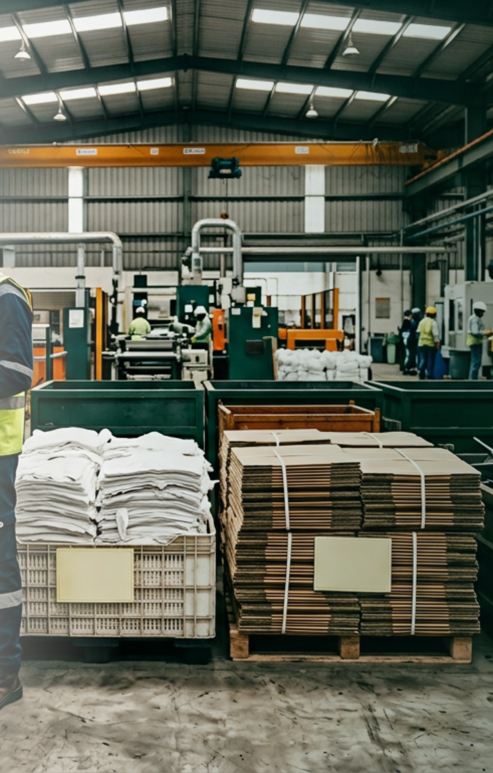
THEME 07: WARM ECO-CRAFT & EARTH • SLIDE 2/4: PHYSICAL FRICTION & PROBLEM | FONTS: Century Gothic throughout | PALETTE: Linen (#F4EFEA) • Olive (#2D3A29) • Terracotta (#C86446)
THE RECYCLING FRICTION
Discovery is solved. Physical qualification is not.
BUYER GATE
30–60%
of new-supplier secondary material is rejected upon arrival at the buyer's gate.
01 Generic descriptions
Informal scrap listings omit polymer purity, melt flow index, and moisture metrics.
02 Freight before proof
Trucks dispatch before acceptance criteria are locked, creating dead-haulage waste.
03 No compliance trail
Informal cash receipts fail statutory SEBI BRSR and CPCB EPR chain-of-custody audits.
THE MISSING INTERVENTION
Without verified qualification upfront, digital discovery only accelerates dead-haulage and gate rejection costs.

Slide 15
THEME 07: WARM ECO-CRAFT & EARTH • SLIDE 3/4: MATERIAL PASSPORT DEMO | FONTS: Century Gothic throughout | PALETTE: Linen (#F4EFEA) • Olive (#2D3A29) • Terracotta (#C86446)
DIGITAL MATERIAL PASSPORT (ISO 59040)
Evidence-backed records that survive the physical handoff.
TRACEABLE ORIGIN
Every lot records generator manufacturing coordinates, batch timestamp, and verified plant contact.
AVOIDED CARBON DISPLACEMENT
Quantified Scope 3 carbon reduction calculated per ISO 14040/44 lifecycle assessment.
CHAIN-OF-CUSTODY COMPLIANCE
Weighbridge verification and digital bill-of-lading receipts ready for statutory CPCB reporting.

Slide 16

THEME 07: WARM ECO-CRAFT & EARTH • SLIDE 4/4: VISION & CALL TO ACTION | FONTS: Century Gothic throughout | PALETTE: Linen (#F4EFEA) • Olive (#2D3A29) • Terracotta (#C86446)
THE NEXT MILESTONE
Help us turn the first 5 audited material flows into the regional network.
TRY THE LIVE PRODUCT
01 / PILOT PARTNERS
5 NCR EHS Teams
3-month managed compliance pilot on active factory plastic and textile discard streams.
02 / CAPITAL + SCALE
Pre-Seed After Proof
Trigger: 5+ verified volume transactions + 3+ paying SaaS customers.
circularmatch.vercel.app
CODE & TECHNICAL PROOF
github.com/circularmatch
TURN INDUSTRIAL WASTE INTO QUALIFIED VALUE.
Join us in transforming industrial discard streams into transparent, auditable secondary material supply chains.

