Slide 1
Project Presentation of Industry Oriented Hands on Experience (22CS422)
On
AI-Based Detection of Spiritual Burnout Using Behavioral Pattern Analysis
Shivansh Jaiswal
2210992323
Supervised By
Dr. Preeti Saini
Department of Computer Science and Engineering,
Chitkara University, Punjab

Slide 2
Introduction
Spiritual burnout causes gradual decline in engagement and motivation.
Traditional detection methods rely on surveys and observation.
Digital spiritual platforms generate behavioral data useful for analysis.
AI and Machine Learning can identify early signs of disengagement.
Proposed system uses behavioral pattern analysis for burnout prediction.
‹#›

Slide 3
Problem Statement
Spiritual burnout is difficult to detect at an early stage.
Existing approaches are subjective and delayed.
Need for an automated and data-driven detection system.
Early identification can help improve engagement and well-being.
‹#›

Slide 4
Objectives
Analyze behavioral patterns from digital spiritual platforms.
Extract engagement-related behavioral features.
Develop ML models for burnout classification.
Detect early signs of disengagement using anomaly detection.
Provide timely intervention support.
‹#›

Slide 5
Methodology
Data Collection
Data Preprocessing
Feature Extraction
Model Development
Classification
Evaluation
‹#›

Slide 6
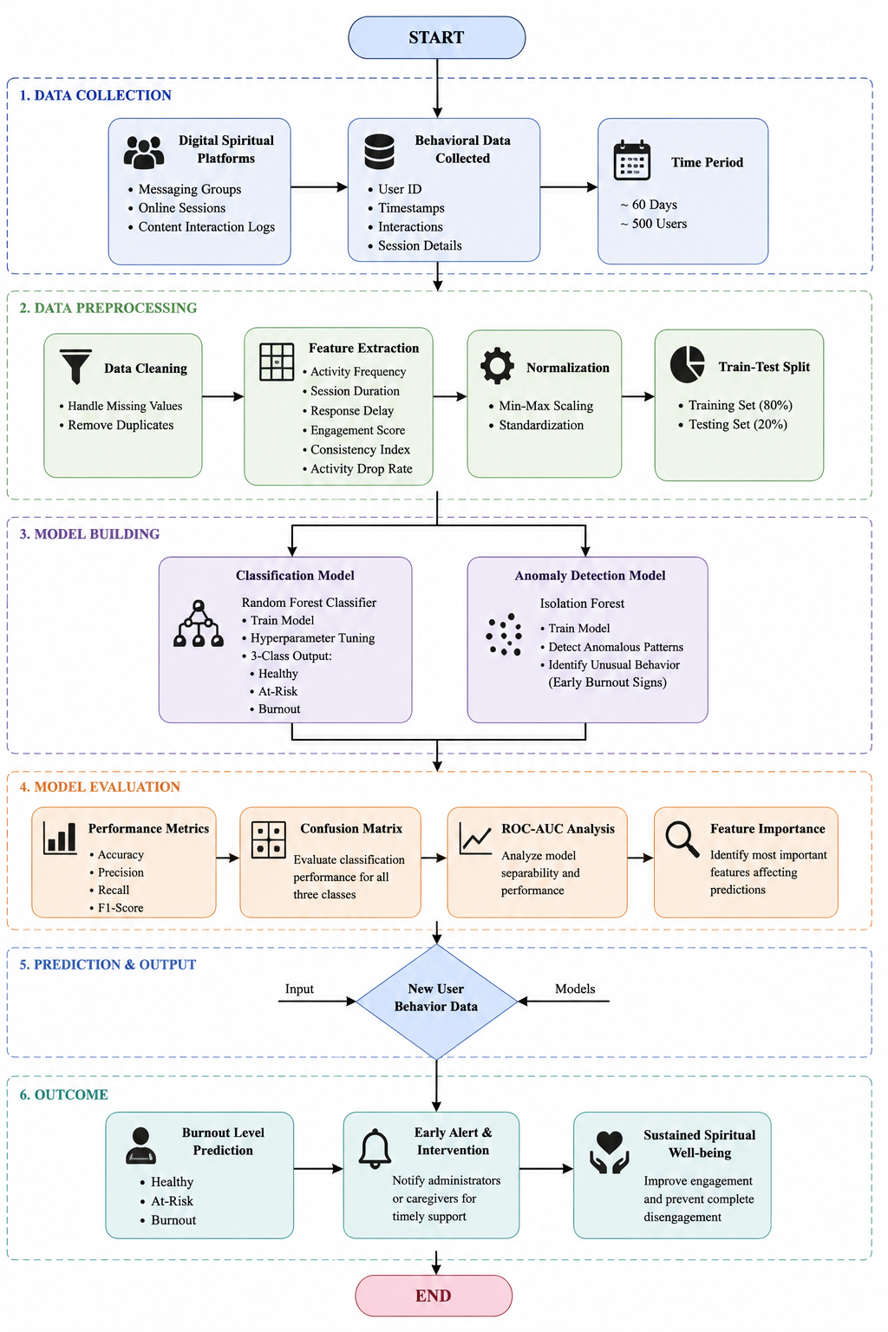
Fig. Flowchart of the proposed AI-based spiritual burnout detection system

Slide 7
Dataset & Features
Dataset Description
Simulated dataset
500 users
60 days monitoring
Three classes:
Healthy
At-Risk
Burnout
Extracted Features
Consistency Index
Engagement Score
Response Delay
Session Duration
Activity Drop Rate
‹#›

Slide 8
Model Development
Machine Learning Models
Random Forest Classifier
Main classification model
Handles non-linear relationships
Robust and accurate
Isolation Forest
Anomaly detection
Detects unusual behavior patterns
Identifies early burnout signs
‹#›

Slide 9
Results and Analysis
Results
Accuracy: 91%
Precision: 89%
Recall: 90%
F1-Score: 89.5%
Findings
Reduced engagement indicates burnout
Response delay is a strong indicator
Consistency Index is highly important
‹#›

Slide 10
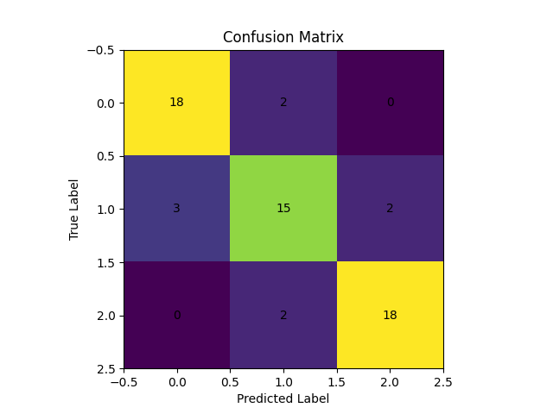
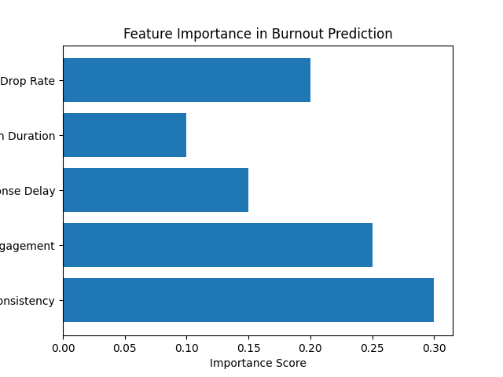
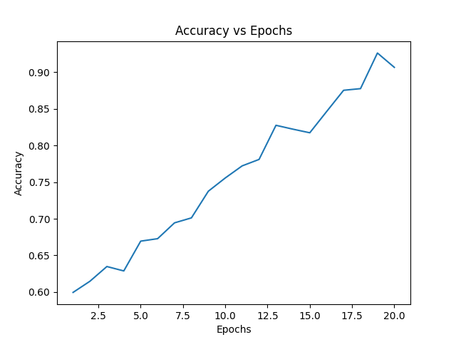

Slide 11
Comparative Analysis
Model | Accuracy
Random Forest | 91%
SVM | 84%
Logistic Regression | 81%
Conclusion
Random Forest performed best for burnout prediction.
‹#›

Slide 12
Real World Applications
Applications
Digital spiritual communities
Online learning systems
Workplace burnout detection
Student engagement monitoring
Benefits
Early intervention
Improved participation
Better mental well-being
‹#›

Slide 13
Ethical Considerations & Limitations
Ethical Considerations
User privacy protection
Data anonymity
Secure data handling
Human oversight required
Limitations
Simulated dataset
Subjective nature of burnout
Requires real-world validation
‹#›

Slide 14
Conclusion & Future Work
Conclusion
AI can effectively detect spiritual burnout.
Behavioral patterns are reliable indicators.
Early intervention becomes possible.
Future Work
Real-world datasets
Mobile application
Real-time monitoring
Deep learning integration
‹#›

Slide 15
Thank You
‹#›

