Slide 1
SchemeBot
AI Government Scheme Assistant
Team: CODEX
SkillUp Hackathon with IBM SkillsBuild

Slide 2
The Problem
Navigating government schemes is confusing for citizens.
High volume of policies makes discovery difficult.
Complex eligibility criteria require reading lengthy documents.
Filling out massive forms is intimidating and time-consuming.

Slide 3
The Solution: SchemeBot
An AI-powered conversational assistant that simplifies discovery.
Replaces rigid forms with a natural chat interface.
Dynamically asks step-by-step questions based on missing information.
Queries the live api.myscheme.gov.in database for real-time matches.

Slide 4
Technology Stack
Frontend: React (Vite), Framer Motion, Lucide Icons
Backend: Node.js, Express.js
AI Assistant: IBM Bob (Used as core development partner)
Data Source: Live integration with myScheme portal API

Slide 5
How We Used IBM Bob
IBM Bob was our primary AI coding assistant throughout the hackathon.
Architecture: Scaffolded the React and Node.js boilerplate.
Complex Logic: Designed the backend state-machine for conversational memory.
API Integration: Analyzed Burp Suite network intercepts to extract the X-Api-Key.
Debugging: Provided instant drop-in code fixes for React state issues.

Slide 6
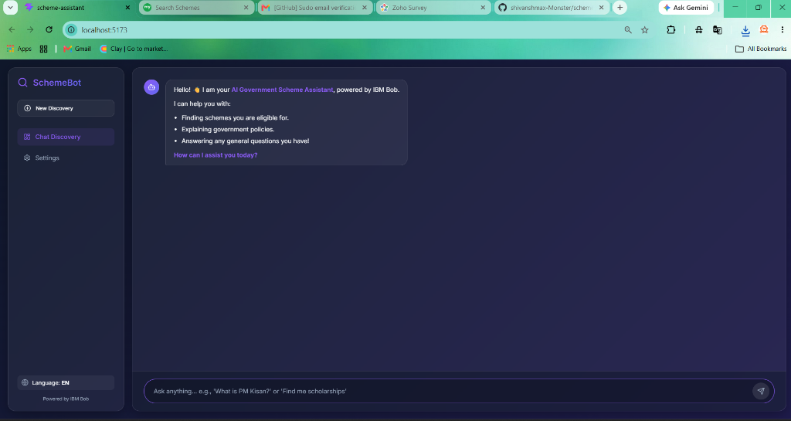
Demo: Initial Chat Interface

Slide 7
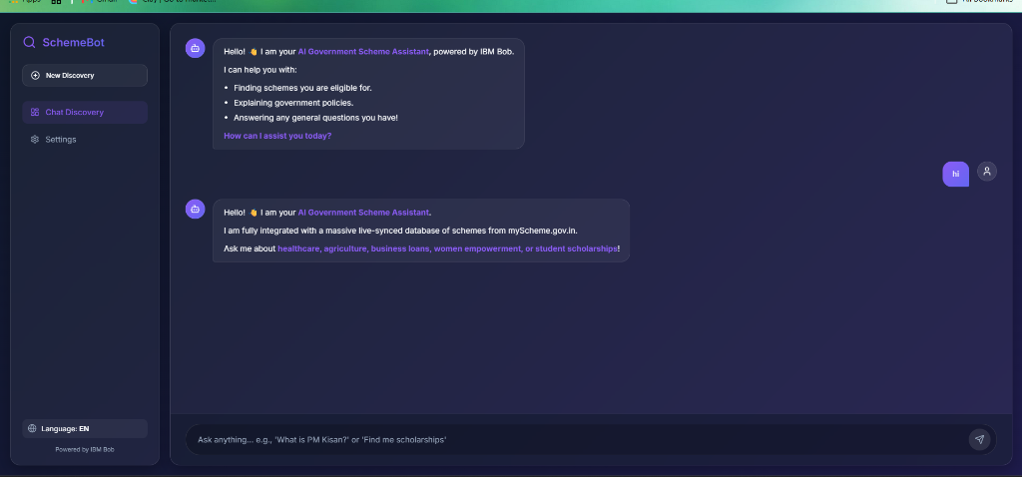
Demo: Conversational Interaction

Slide 8
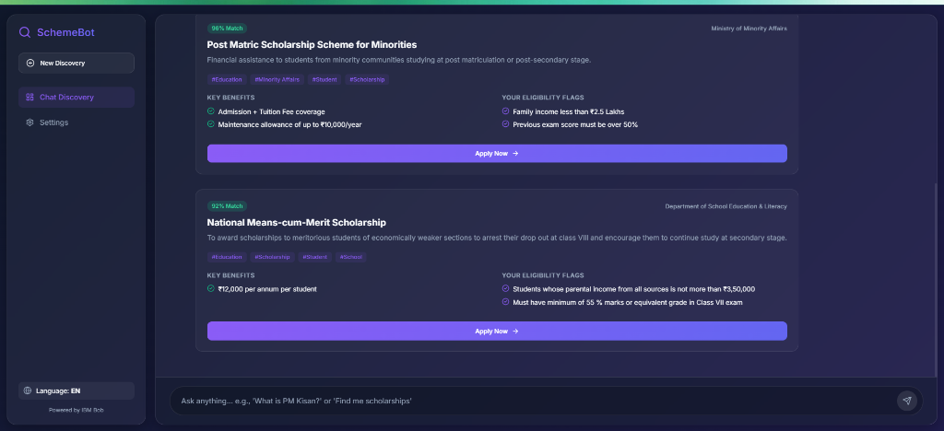
Demo: Live API Results

Slide 9
Conclusion & Future Scope
SchemeBot successfully bridges the gap between citizens and government policies.
Future Scope: Multi-lingual voice support.
Future Scope: Direct application processing via UMANG API.
Future Scope: Integration with WhatsApp for wider accessibility.

