Slide 1

DiaTwin
A digital twin for Type 2 Diabetes that forecasts glucose, warns before spikes and lows, explains why, and simulates what-if choices
Digital Twin Challenge 2026 | Happiest Health | Team leader: Shivansh Porwal, IMT Ghaziabad
Notes:
Introduce the team and the one-line pitch. DiaTwin fuses a patient's EHR with live wearable and CGM data, forecasts glucose 30, 60 and 120 minutes ahead, warns before a spike or a low, explains each forecast and lets the doctor simulate choices.

Slide 2
Diabetes care is reactive
101M
Indians living with diabetes
What clinicians see today
Lab values such as HbA1c, reviewed every few months
Occasional glucose readings
No view of what the next two hours hold
Spikes, and lows on insulin or sulfonylureas, go unseen
136M
more with prediabetes
11.4%
of the population has diabetes
Source: ICMR-INDIAB study, The Lancet Diabetes & Endocrinology, 2023
Notes:
About 101 million people with diabetes and 136 million with prediabetes in India (ICMR-INDIAB, Lancet Diabetes & Endocrinology, 2023). Care is mostly retrospective. A digital twin makes it proactive.

Slide 3




Meet DiaTwin
Fuse
Forecast
Warn
Simulate
Merge the static EHR with CGM, wearable and meal-diary streams for each patient.
Glucose at +30, +60 and +120 minutes with an 80% uncertainty band.
Hyper and hypo alerts, with a why-this-forecast panel for the doctor.
What if I eat, halve the meal, walk or skip? See the curve first.
Scope: one condition, Type 2 Diabetes, as the challenge requires. A proof of concept on synthetic data.
Notes:
Four verbs: fuse, forecast, warn and explain, simulate. Type 2 Diabetes was chosen because it is prevalent in India, glucose is measurable continuously and the two-hour window is actionable.

Slide 4
Built to the challenge brief
Challenge requirement | How DiaTwin meets it
Fuse static EHR with dynamic real-time data | Synthetic EHR + simulated CGM, heart rate, HRV, steps, sleep and meal diary: 43 fused features
Algorithmic model that predicts an adverse event | 2-hour glucose forecast, spike-onset and hypoglycaemia alerts, with uncertainty
Conceptual UI dashboard for a doctor | Working Streamlit app: twin view, cohort board, what-if planner, explanations
Anonymised, open-source or synthetic data only | 100% synthetic; Synthea-compatible importer; DPDP Act and HIPAA safe
Public GitHub repo with full README | README with every required item, MIT licence, tests, CI, Docker
Demo video, architecture diagram, presentation | 20-minute script, 2-page architecture PDF, this deck
Notes:
This slide maps each line of the challenge brief to what we built, so the jury can tick them off.

Slide 5

Two data streams, one patient
Static: simulated EHR
Dynamic: wearables
Demographics, BMI, disease duration
HbA1c, fasting glucose, eGFR, LDL
TCF7L2 genetic risk marker
Medication, comorbidities, lifestyle
CGM glucose every 5 min, with dropouts
Heart rate, HRV, steps, sleep stages
Meal diary, only 85% logged
Medication effects: dosing, skipped meals
400
14
1.6M
43
virtual patients
days each
sensor readings
fused features
Synthetic only, as the sandbox rules require: DPDP Act and HIPAA safe by construction.
Notes:
Static stream: a synthetic EHR with a Synthea-compatible schema and importer. Dynamic stream: simulated CGM, heart rate, HRV, steps, sleep and a meal diary. Imperfections are modelled on purpose: CGM dropouts and unlogged meals.

Slide 6
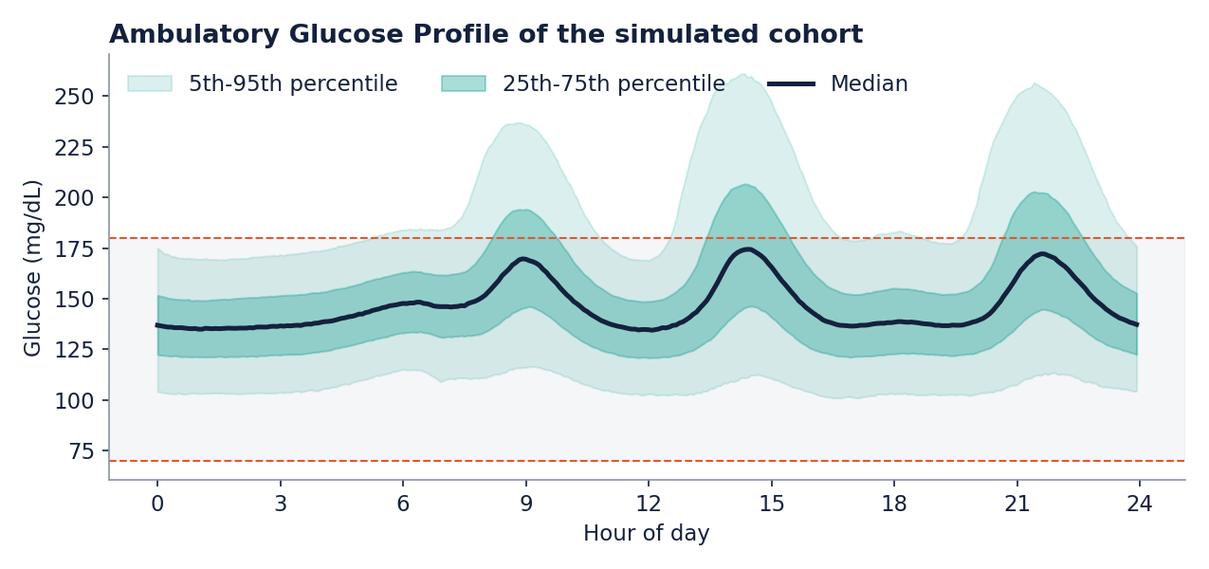
Is the synthetic data credible?
Metric | Cohort | Consensus
Time in range 70-180 | 86% | > 70%
Time above 180 | 14% | < 25%
Time below 70 | 0.12% | < 4%
GMI | 6.9% | -
CV | 17% | <= 36%
Honest caveat: the cohort is better controlled and less variable than typical real-world Indian Type 2 Diabetes, so absolute errors are optimistic. What transfers: model ranking, cold-start effect, robustness and the evaluation method.
Notes:
The AGP is the clinical standard way of showing CGM data: median and percentile bands by time of day. The three meal peaks are visible. Cohort metrics sit in the consensus ranges. We state plainly that it is more benign than real life.

Slide 7
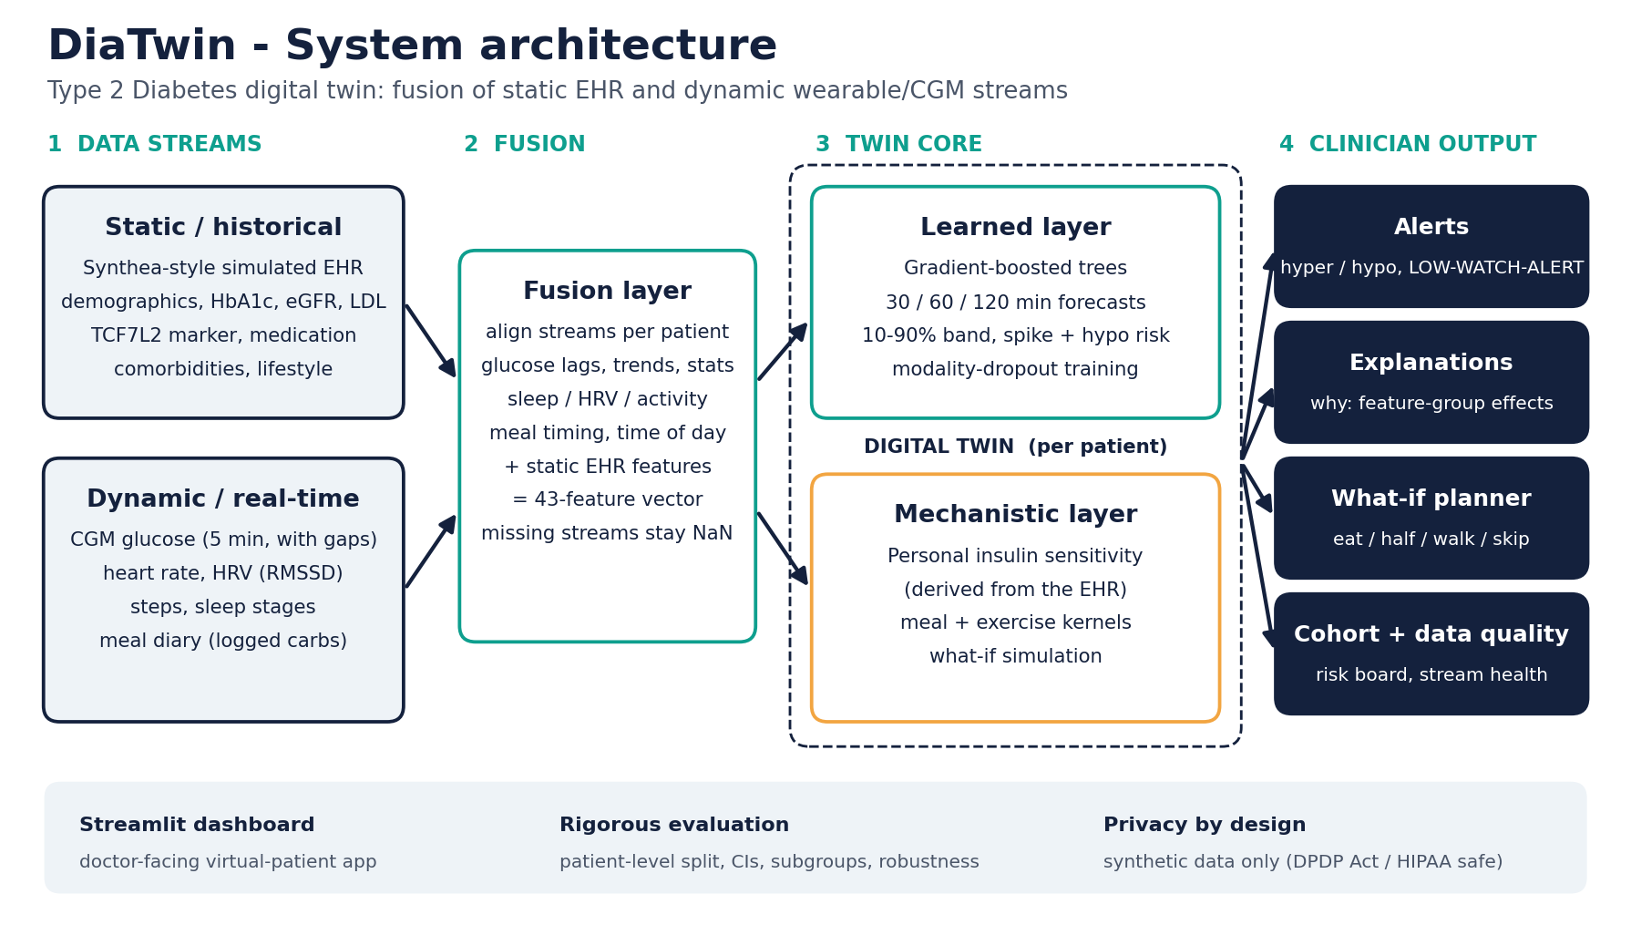
System architecture
Notes:
Left to right: two streams, the fusion layer, the twin core (a learned layer and a mechanistic layer), and four clinician-facing outputs: alerts, explanations, the what-if planner and the cohort board with data quality.

Slide 8
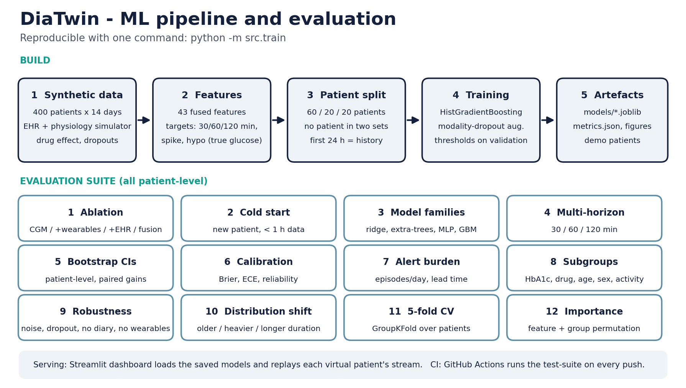
ML pipeline and evaluation
Notes:
Reproducible with one command. Twelve evaluation tests, all patient-level so no patient appears in more than one split.

Slide 9
How the twin predicts
Learned layer
12.9
0.93
Gradient-boosted trees on 43 fused features: three forecast horizons, 10-90% band, spike and hypo classifiers. Modality-dropout training.
MAE in mg/dL at 2 h
ROC-AUC, spike alert
persistence 26.5
calibration ECE 0.009
Mechanistic layer
Personal insulin sensitivity from the EHR drives meal and exercise kernels for what-if scenarios.
73%
79%
Explanation layer
within 15 mg/dL
band coverage
Neutralise each data group to see how much it moves the forecast.
of true glucose
nominal 80%
Notes:
Metrics are on 81 held-out patients. Spike onset means glucose is currently at or below 180 and crosses 180 within 2 hours. The band is meant to cover 80% and covers 79%.

Slide 10
Does fusion help?
-51%
error vs persistence
95% CI 12.4-13.5 mg/dL
1.22
mg/dL gain over CGM only
paired 95% CI 1.02 to 1.43
Notes:
Patient-level bootstrap. Fusion beats CGM only by 1.22 mg/dL with a CI that excludes zero: a real but modest gain, because glucose history already reveals the patient's baseline. The next slide shows where the EHR matters most.

Slide 11
The cold-start advantage
-20%
error for a new patient
16.4 to 13.1 mg/dL
With under an hour of CGM data, the EHR supplies the baseline the sensor cannot yet show. That is what a twin is for: a head start on day one.
Notes:
Cold start: only the last 30 minutes of glucose, no 24-hour statistics and no sleep history. The EHR closes most of the gap.

Slide 12
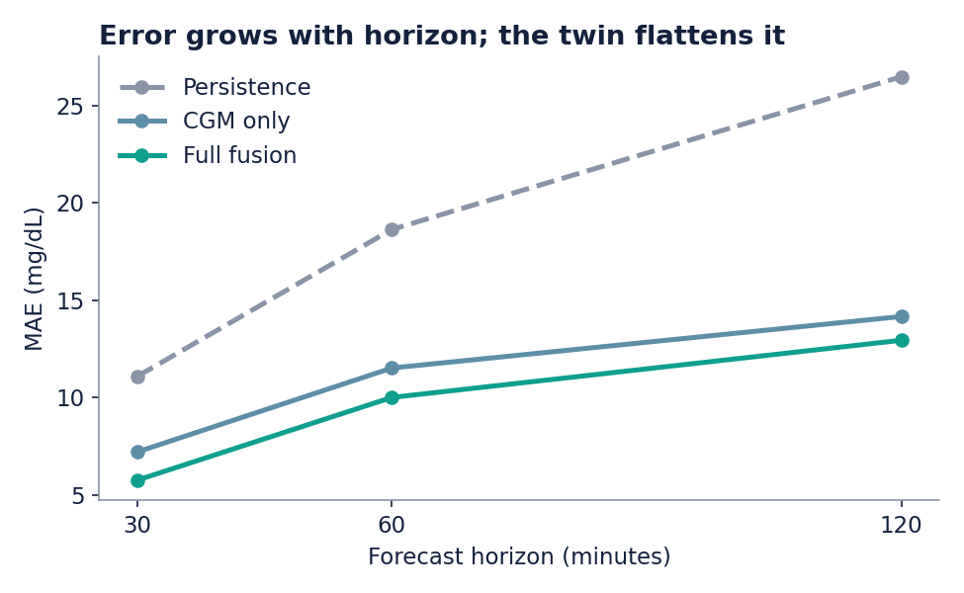
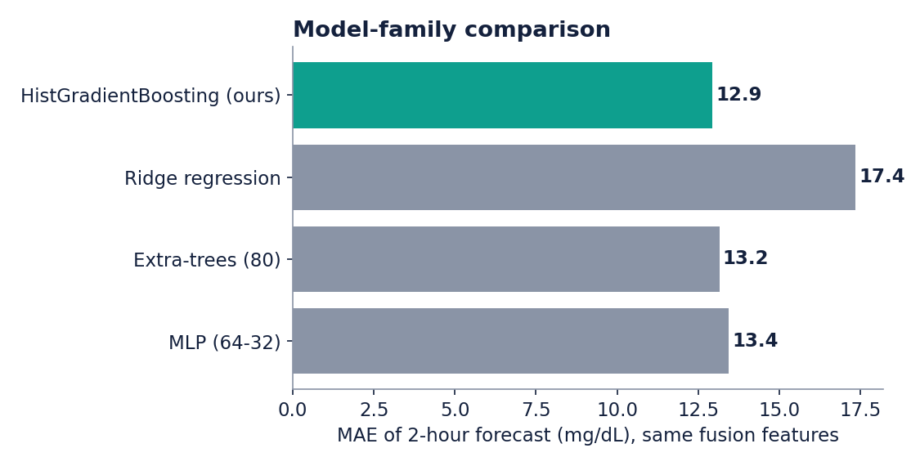
Horizons and model families
Error at +30 / +60 / +120 min: 5.7 / 10.0 / 12.9 mg/dL. Gradient boosting is the most accurate of four model families (extra-trees 13.2, MLP 13.4); ridge regression is far behind (17.4).
Notes:
We did not just pick one model. Ridge, extra-trees, an MLP and gradient boosting were compared on identical features. Boosting was chosen for native missing-value handling, speed and quantile support, not because it is uniquely best.

Slide 13
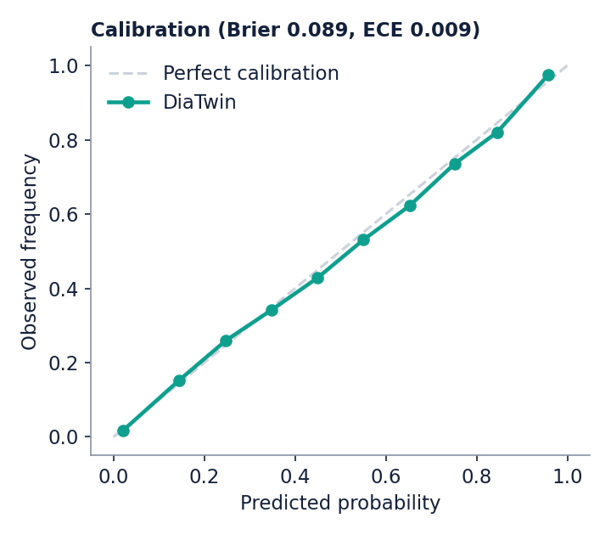
Alerts you can trust
0.929
0.089
spike-onset ROC-AUC
Brier score
95% CI 0.923-0.937
ECE 0.009
+0.014
82% / 65%
AUC gain vs CGM only
recall / precision
CI 0.010 to 0.020
at the tuned threshold
Notes:
The predicted probabilities match observed frequencies closely, which matters if a clinician is going to read '70% risk' as meaning 70%.

Slide 14
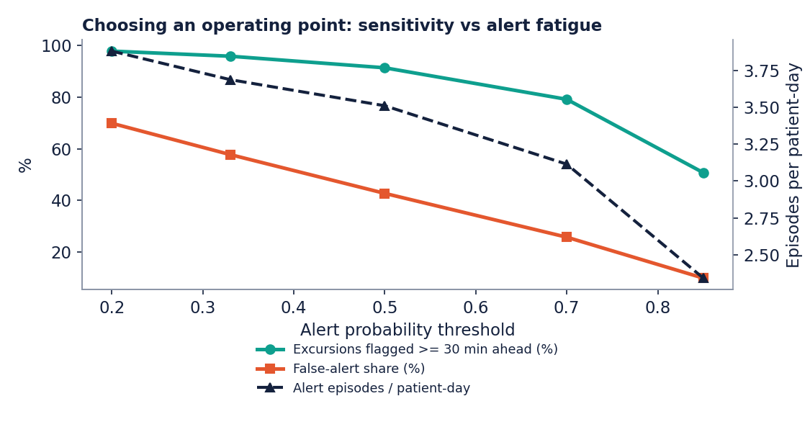
Alert fatigue is a design choice
Threshold | Alerts / day | False share | Flagged >=30 min
0.20 | 3.9 | 70% | 98%
0.33 * | 3.7 | 58% | 96%
0.50 | 3.5 | 43% | 91%
0.70 | 3.1 | 26% | 79%
0.85 | 2.3 | 10% | 51%
At the tuned threshold (*), 58% of alert episodes are not followed by a spike. Raising the threshold cuts false alerts but misses more excursions. The clinician chooses the trade-off.
Notes:
This is the honest weak point. At the default threshold the alert is sensitive but noisy. We expose the whole trade-off table rather than hide it. A deployed system would add snooze logic and per-patient thresholds.

Slide 15
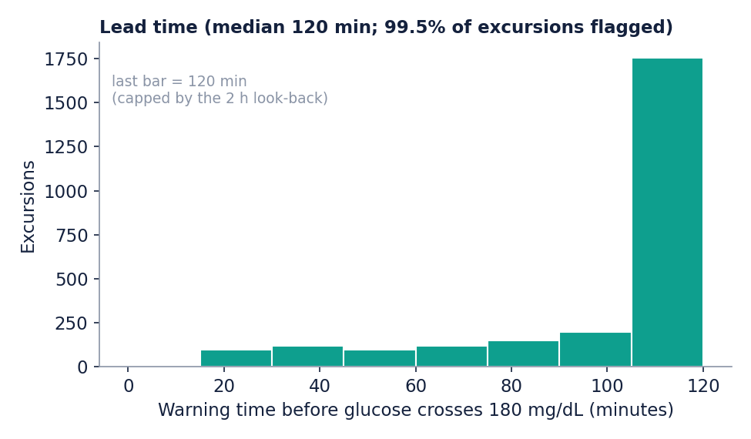
Early warning and hypoglycaemia
Hypoglycaemia: a rare event
312 positive rows from 7 patients (6 on insulin)
ROC-AUC 0.970 vs CGM only 0.973: no AUC advantage from the EHR
Recall 89% at precision 9%: a screening aid, not a diagnosis
Spike warnings come a median 120 min ahead (capped at 120) and flag 99.5% of excursions.
Notes:
Lead time is capped by the two-hour look-back. For hypoglycaemia we report the result as it is: with few events from few insulin users, the EHR does not improve AUC over CGM alone, so this is a proof of concept.

Slide 16
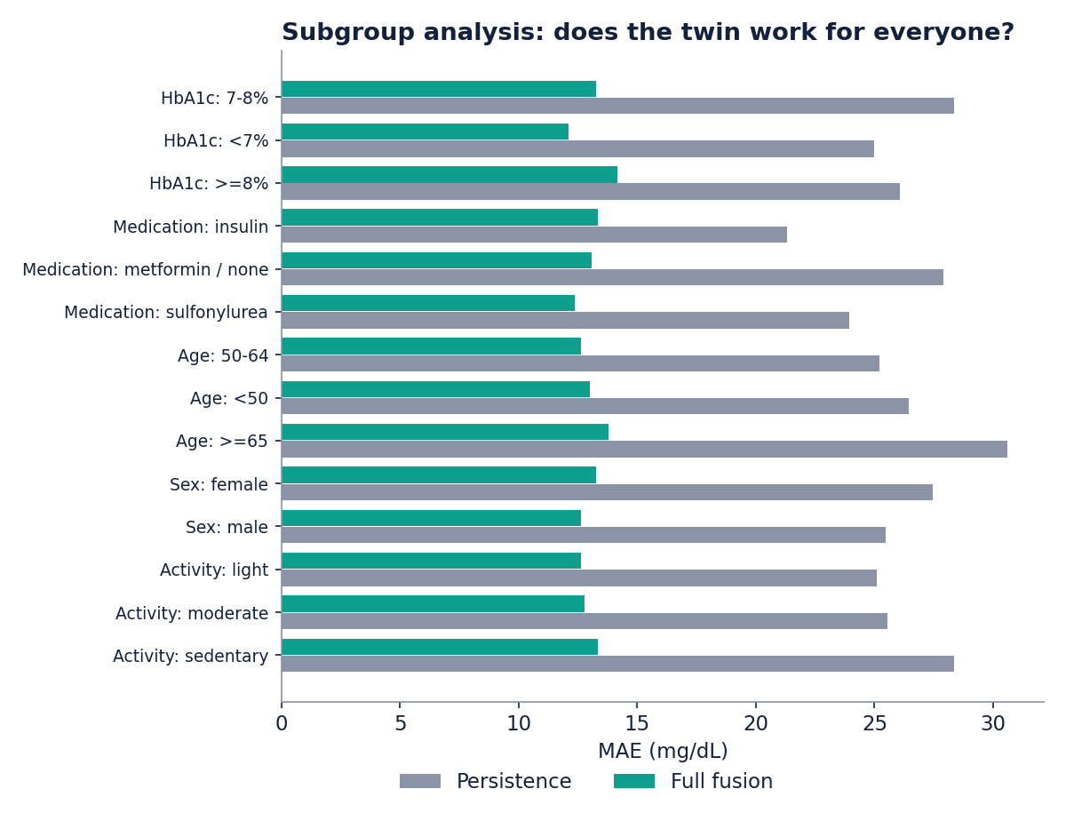
Does it work for everyone?
12.1-14.2
MAE range, mg/dL
HbA1c <7% to HbA1c >=8%
>= 46%
better than persistence
in every subgroup of 10+ patients
Notes:
Five dimensions: HbA1c band, medication, age, sex and activity. Performance is fairly even; the weakest groups are still far better than the baseline. Small groups such as the six insulin users are flagged in the repo, not over-read.

Slide 17
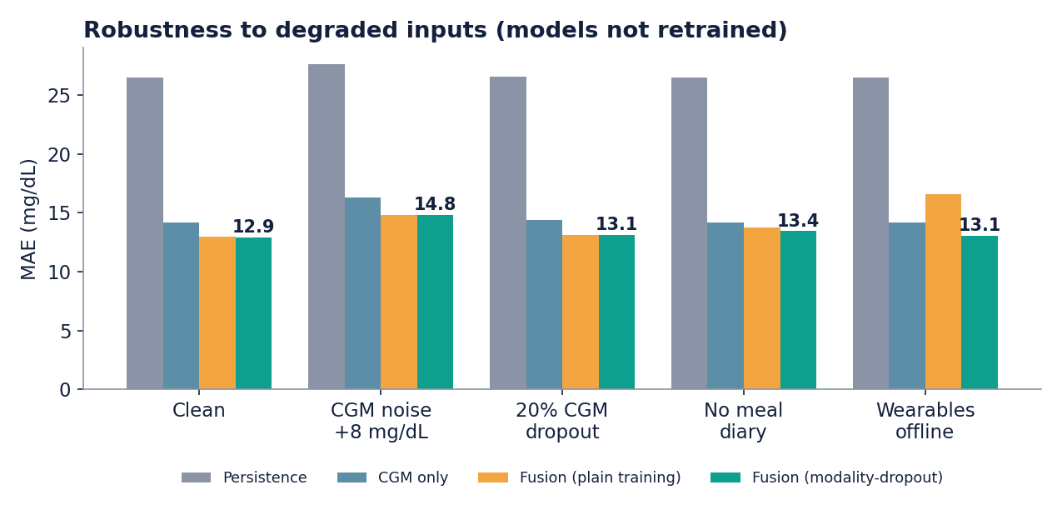
Robust when inputs break
16.6
plain model, wearables off
worse than CGM only (14.2)
13.1
modality-dropout model
same scenario, same data
Notes:
Real devices fail. A plain fusion model collapses when the wearables go offline. Training with random masking of wearables and the meal diary keeps the error at the clean level. The dashboard has a data-quality simulator to show this live.

Slide 18
Holds up beyond the test set
Distribution shift
5-fold patient-level CV
Unseen cohort of 120: older (63 vs 52 y), heavier (BMI 30.1 vs 27.7), longer disease (9.9 vs 6.6 y).
Whole patients are held out in every fold.
13.43 +/- 0.06
16.4
fusion MAE
CGM only 14.60 +/- 0.14
13.5
fusion MAE
CGM only 18.1, persistence 33.7
cold-start fusion MAE
CGM-only cold 17.0
Notes:
Two more ways to check we are not fooling ourselves: an independent cohort with a different age, weight and disease-duration mix, and five-fold cross-validation grouped by patient. Rankings hold; error rises under shift because that population is harder.

Slide 19
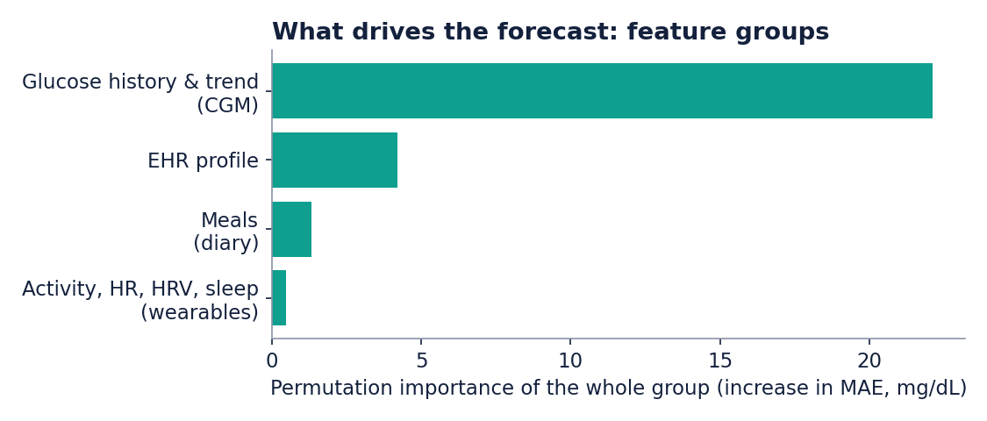
Why this forecast?
In the dashboard
Per-patient bars show how each data group pushes this forecast up or down
Red raises glucose, green lowers it
Stream-health warnings when data is missing
Globally, glucose history dominates, the EHR is second, meals third and wearables add least in this simulation, partly because exercise already shows up in the CGM trace.
Notes:
Permutation importance by group: CGM 22.1, EHR 4.2, meals 1.3, wearables 0.5 mg/dL. The per-patient explanation neutralises a group to its training median and reports how the forecast moves.

Slide 20
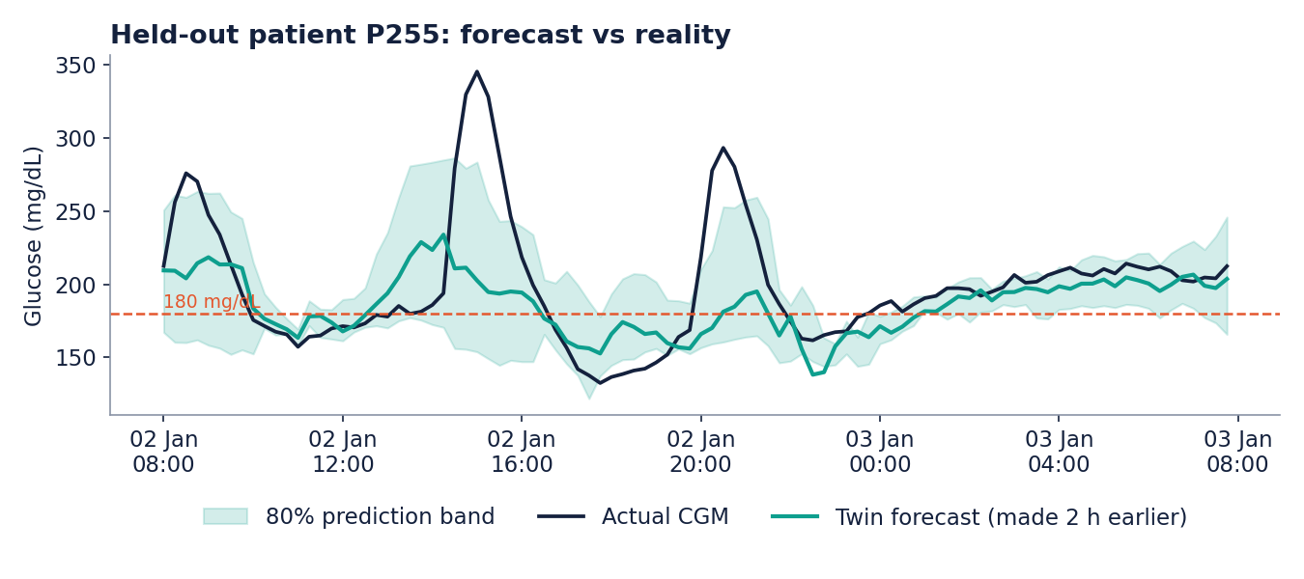
Forecast vs reality
79%
inside the 80% band
Held-out virtual patient. Each forecast was made two hours earlier. The sharpest peaks are underestimated; the band widens to show uncertainty.
Notes:
The twin anticipates the shape and timing of meal excursions. Sharp peaks are underestimated, which is a known limitation of any regression-to-the-mean forecaster.

Slide 21



The doctor's view
Twin view
Cohort board
What-if planner
Forecasts, hyper and hypo tiles, why-this-forecast, clinical summary.
Every patient ranked by risk right now.
Eat, halve, walk after or skip: the next three hours.
Data fusion
Data-quality simulator
Model performance
EHR profile, wearable streams and the fused feature vector.
Switch off wearables, diary or CGM and watch it degrade safely.
Every evaluation in this deck, interactive.
Streamlit app in the repository: streamlit run app/dashboard.py | Docker image included
Notes:
Switch to the live dashboard here. Pick patient P305 (insulin), set the replay slider to 359 and show the hypoglycaemia alert about two hours before glucose falls to the mid-50s. Then flip the data-quality toggles.

Slide 22



Safe, private, accountable
Human in the loop
Privacy by design
Fair and regulated
Decision support only: it never doses
Uncertainty is always shown
Missing streams are flagged, not hidden
No real patient data
Synthetic EHR and sensors
DPDP Act and HIPAA safe
Performance by 5 subgroup types
Alert-fatigue trade-off exposed
Software-as-medical-device review before any clinical use
Notes:
The tool supports a clinician and never doses. All data is synthetic. A real deployment needs consent, data minimisation, in-region processing and a regulatory review as software that could influence treatment.

Slide 23
Where DiaTwin fits
Common approaches today
DiaTwin
CGM apps: show glucose history and trends
Care programmes: coaching and logging
Hospital analytics: periodic risk scores
Fuses EHR and wearables per patient
Forecasts, warns and explains
Simulates choices before they are made
The gap we close: personalised, forward-looking, explainable and simulatable.
Our assessment of common approaches, not an exhaustive market survey.
Notes:
Before recording, replace or extend the left column with specific startups from the ValleyNxt Ventures Tracxn screen: name, what they do, what they do not do. That is the team's strongest differentiator.

Slide 24
Limits and roadmap
What we do not claim
Next steps
All results are on synthetic data: not clinical claims
Simulated CGM is less variable than real life
What-if layer shares the simulator's assumptions
Hypoglycaemia: few events, 7 test patients
Default alert threshold is noisy
Validate on real anonymised CGM and EHR data
Learn the mechanistic parameters from data
Add dose and medication timing; sequence models
Clinician usability study, per-patient alert thresholds
Drift monitoring and regulatory review
Notes:
Be candid: absolute numbers are properties of our simulator. The transferable results are the ranking of models, the cold-start effect, the robustness to missing streams and the evaluation methodology.

Slide 25
Predict. Warn. Simulate.
DiaTwin turns a patient's records and wearables into a virtual twin that a doctor can consult before the spike or the low, not after.
Team DiaTwin | IMT Ghaziabad | Code, README, technical report and demo video in the public GitHub repository

