Slide 1

Internship Complete: Siemens Project Manager Simulation
Job Simulation · August 2026 · Project Management Track

Slide 2


The Challenge
Cross-Functional Complexity
Urban rail expansion project demanding coordination across engineering, environmental, and community teams simultaneously.
Multi-Dimensional KPIs
Tasked with developing performance indicators spanning technical feasibility, sustainability, and community impact.
Real-World Complexity
Project management challenges modeled on live infrastructure programmes — not simulated simplicity.

Slide 3
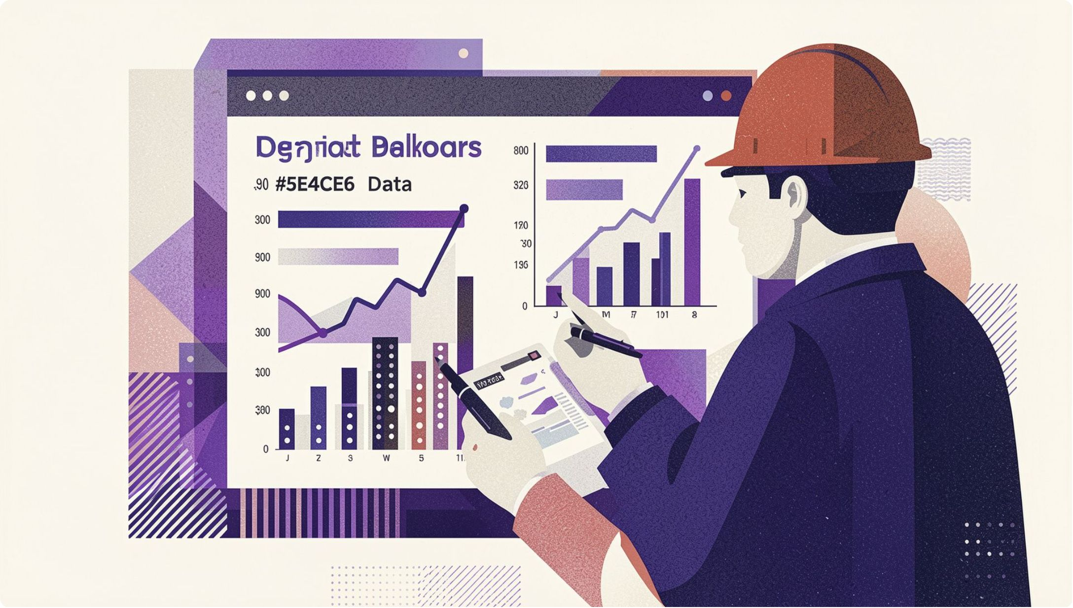
KPI Development: Technical Feasibility
Construction Schedule Adherence
Tracked milestone completion rates against baseline timelines to surface schedule risk before it cascaded into cost overruns or integration failures.
Systems Integration Readiness
Measured critical interface verification progress across signaling, power supply, and communications — ensuring interoperability before commissioning.

Slide 4
KPI Development: Sustainability & Community
🌿 Embodied Carbon Intensity
🚗 Modal Shift Impact
🤝 Community Engagement
Quantified passenger car reduction attributable to the new rail corridor, benchmarked against city-wide green transport targets.
Measured satisfaction scores and accessibility improvements for priority populations along the corridor.
Normalized greenhouse gas emissions per km of track, driving low-carbon material selection across the supply chain.

Slide 5
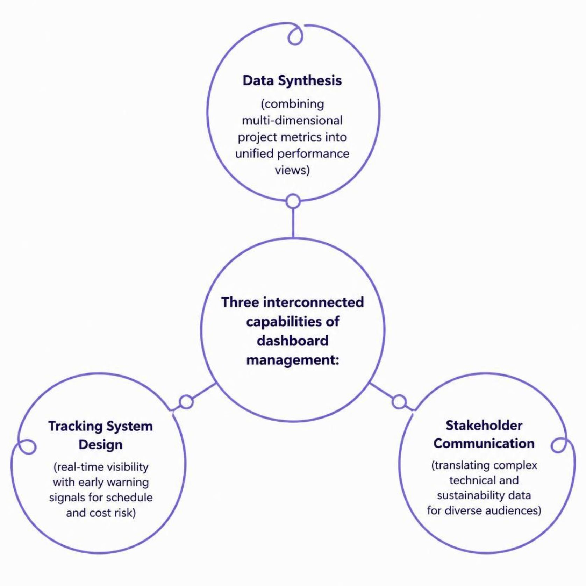
Dashboard Management Skills
Managing a live project dashboard required more than data entry — it demanded analytical thinking and clear visual communication.
Synthesized multi-dimensional data into actionable performance metrics
Designed tracking systems for real-time visibility and early warning signals
Communicated complex technical and sustainability data to diverse stakeholders

Slide 6

Project Management Learnings
1
Delays Are Never Isolated
Cascading construction delays impact cost, schedule, and system integration simultaneously — early signals matter.
2
Integration Is Everything
Balancing technical delivery, environmental goals, and community acceptance requires unified metrics, not siloed reporting.
3
Transparency Builds Trust
Early measurement and open visibility reduce risk exposure and build lasting stakeholder confidence.

Slide 7



Technical & Career Growth
KPI Design Mastery
Hands-On PM Tools
Stakeholder Alignment
Applied structured measurement frameworks to design KPIs that are meaningful, trackable, and decision-ready.
Gained practical experience with project management tools and data analysis workflows used in real infrastructure programmes.
Developed skills in translating technical complexity into clear narratives that align diverse stakeholders around shared goals.

Slide 8


What's Next
READY TO CONTRIBUTE
Apply the Frameworks
Bring KPI methodology and performance tracking skills to real-world projects and operational challenges from day one.
Deepen the Expertise
Continue building capability in project controls, risk management, and data-driven decision-making.
Ready for Scale
Prepared to contribute meaningfully to complex, multi-stakeholder initiatives where integrated thinking drives results.

