Slide 1

Unlocking Insights from the Indian Premier League
Ranjith
&
Shivanshu
Notes:
Each country has a sport that is more famous than the other, In India, cricket is the most famous sport, so investors are interested in it and it has a famous championship, which is the Indian Premier league. Generating talent, revenue as well as entertainment. Like in Canada we have Ice Hockey or Canadian football team.
Cricket is a bat-and-ball game played between two teams of eleven players each on a cricket field, Each phase of play is called an innings, during which one team bats, attempting to score as many runs as possible, whilst their opponents bowl and field, attempting to minimize the number of runs scored. When each innings ends, the teams usually swap roles for the next innings.

Slide 2

Contents - Introduction - Objectives - Cleaning dataset - EDA - Visualization / Dashboard - Predictions using Machine Learning - Conclusion of the project

Slide 3
Introduction
Established in 2008 by the Board of Control for Cricket in India (BCCI).
Twenty20 cricket league, where each team plays each other in a double round-robin format followed by playoffs.
The IPL has significantly boosted the Indian economy, with franchises, sponsorships, and broadcasting rights generating substantial revenue and entertainment.
Source of the dataset is ESPN cricket info
Notes:
The Indian Premier League (IPL) is a premier Twenty20 cricket league established in 2008 by the BCCI. With 8 franchise teams representing Indian cities, it merges cricket with entertainment and serves as both an economic booster and a platform for emerging talent.
IPL's value per match $13.4 million USD and there are 70 matches in a season.

Slide 4

Objectives
Analyze IPL match trends and patterns.
Determine key performance indicators for teams and players.
Predict future match outcomes via machine learning.
The questions above are foundational; the depth of analysis from the data is vast and limitless.
Which city hosted the most IPL matches?
Which team played the most IPL matches?
How many matches were tied, and what's the likelihood of a tie in future matches?
Batting first vs. batting second: Which had more match wins?
Notes:
Two teams plays and they win on the basis on win by wicket or win by Run.

Slide 5

Cleaning
Preparing the data — Remove empty and unrealistic values, sensitive personal information, NULL values, useless columns and prepare the data for analysis. This step usually takes more than half of the complete end to end process

Slide 6
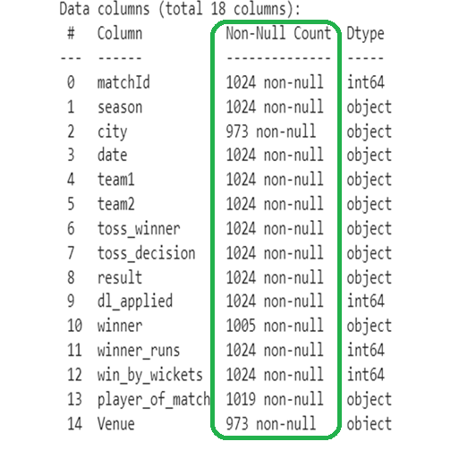
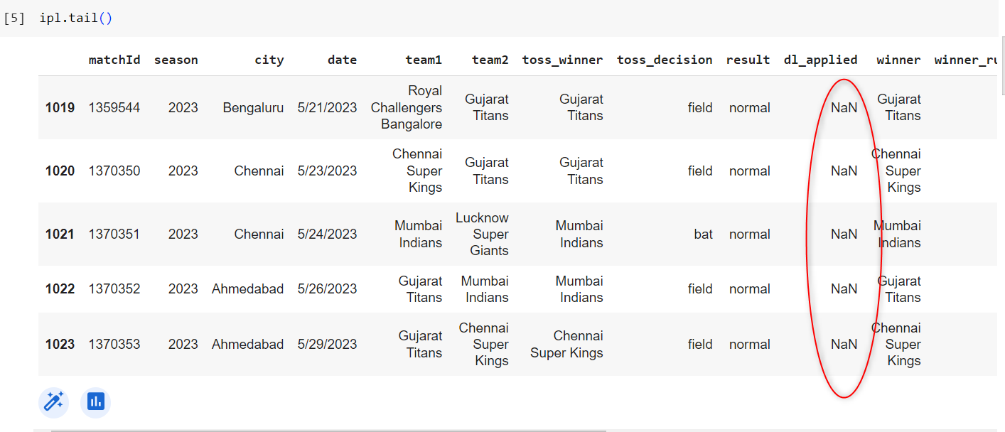
Cleaning Dataset Before After

Slide 7
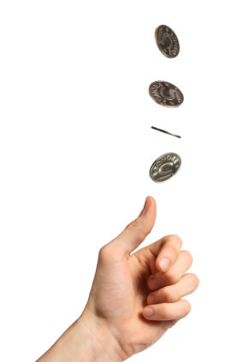
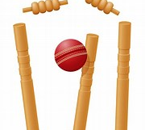
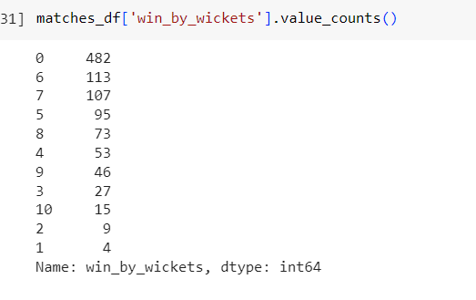
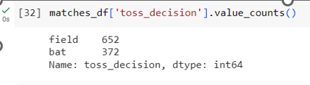
Toss decision
So, in this dataset, teams decided to field first more often (652 times) than they chose to bat first (372 times) after winning the toss.
win by wickets
In cricket, 'win by wickets' indicates how many wickets a team had left when they met the target. A win by 0 wickets means a close match, while a win by 10 suggests a dominant performance.

Slide 8
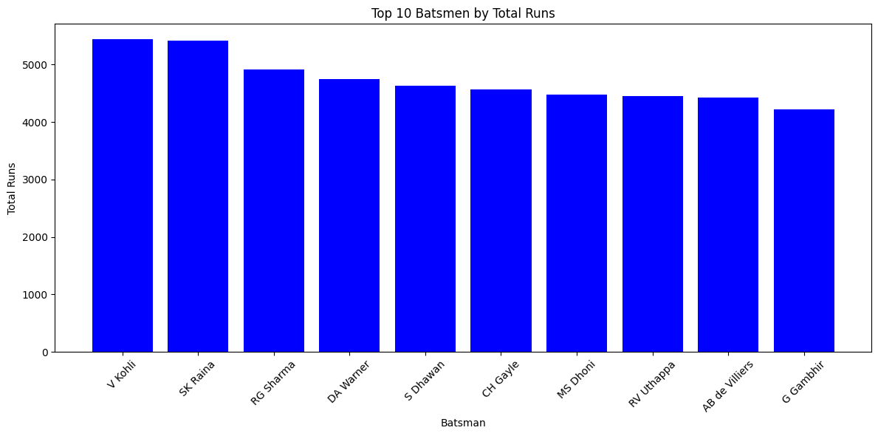
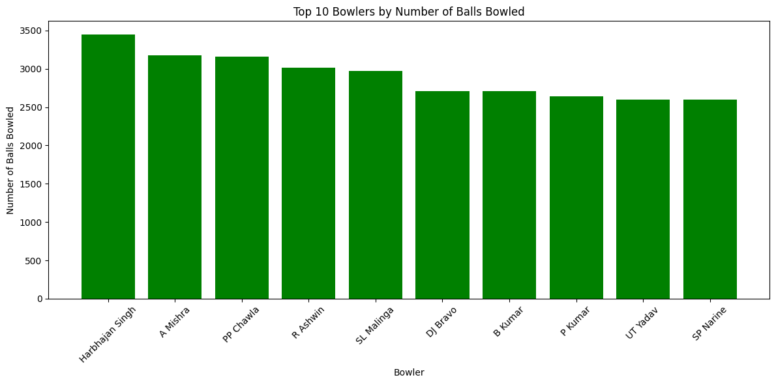
we can quickly identify who the top run-scorers are among the listed batsmen Virat Kohli is the top run-scorer with 5434 runs, followed closely by Suresh Raina with 5415 runs, and so on.
Top 10 Batsmen by Total Runs
Top 10 Bowlers who bowled the most.
We can identify that Harbhajan Singh bowled the maximum balls 3451, followed by Amit Mishra 3172 and so on.

Slide 9
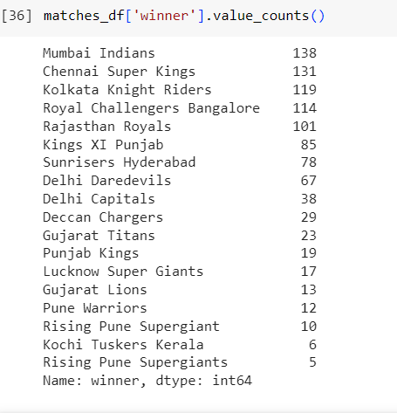
Most Wins
The 'winner' column represents the team that won each cricket match. The output thus indicates the number of wins each team has had.
'Mumbai Indians' won the most matches in this dataset, with 138 victories.
'Chennai Super Kings' won 131 matches, making it the second most successful team in the dataset.
'Kolkata Knight Riders' and 'Royal Challengers Bangalore' have won 119 and 114 matches, respectively, placing them third and fourth.
'Rising Pune Supergiant's has the fewest wins, with only 5 victories.

Slide 10

EDA Conclusion
Toss Decisions: Upon winning the toss, teams chose to field first 652 times, compared to batting first 372 times, indicating a preference to know their target score upfront.
Match Outcomes: Out of all matches, 1005 had regular outcomes, 14 were tied, and only 5 had no result, suggesting most matches were competitive with clear winners.
Teams Performance: The Mumbai Indians lead with 138 wins, followed by the Chennai Super Kings with 131, indicating consistent performances by these teams over the seasons.
Player Performance: AB de Villiers, CH Gayle, and RG Sharma were the most frequently awarded "Player of the Match", suggesting these players often made significant contributions to their team's victories.
Toss Winning vs. Match Winning: The additional analysis by creating the 'toss_winner_is_winner' column would provide insights about the correlation between winning the toss and winning the match. This could potentially help to understand the strategic implications of toss decisions on match outcomes.

Slide 11
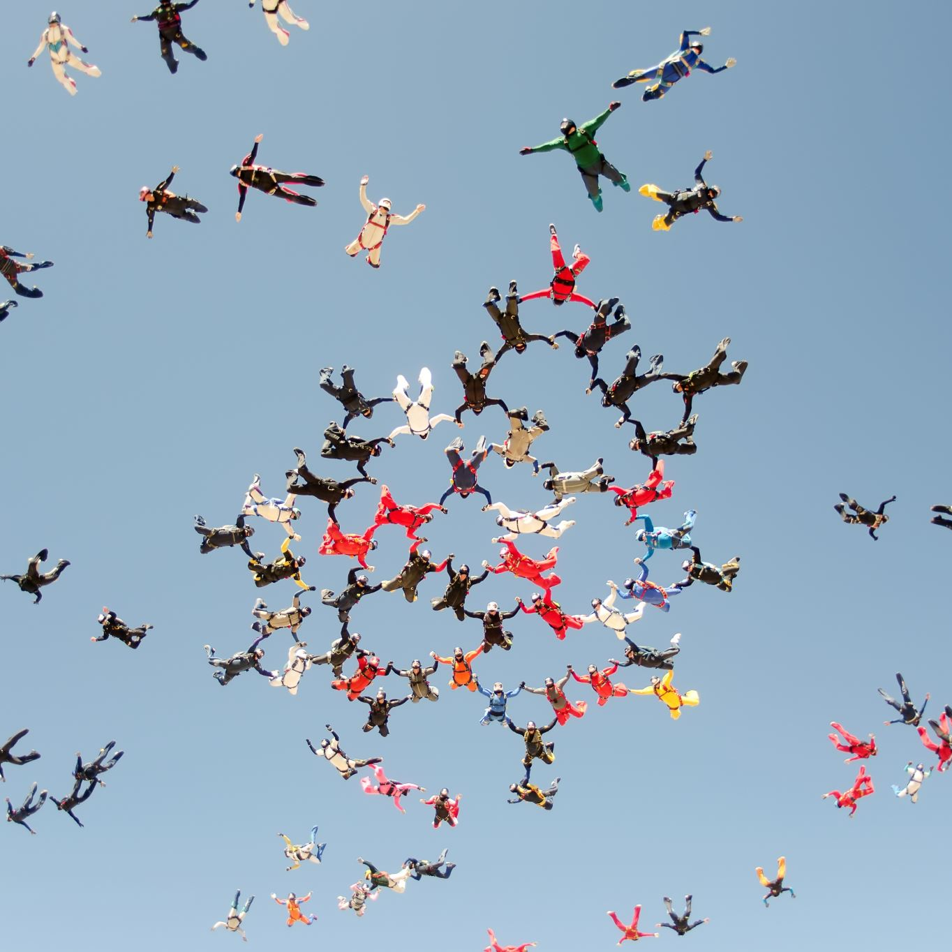
Why Predictions ?
Predictive analytics helps teams strategize, sponsors make informed decisions, and fans engage more deeply with the sport.

Slide 12
Algorithms explored
Match Outcome Prediction (Classification): Determine the winner of a given match based on various features.
Time Series Forecasting: Forecast team performance metrics over upcoming matches to discern patterns and trends.

Slide 13

Match Outcome Prediction
Objective: Predict the winner of a match.
Features Used: Teams playing, city, toss decision, etc.
Model Selection & Training:
We used the Random Forest classifier, which generally provides good results without much hyperparameter tuning.
Model Evaluation:
Used accuracy as a metric to evaluate the model on the testing set.
Model & Results: Utilized the Random Forest Classifier with an accuracy of approximately 49.25%.

Slide 14

Model Conclusion
Predicting the winner of a cricket match is a complex task due to the game's inherent unpredictability. An accuracy of around 49.25%.
49.25% suggests that the model is slightly better than random guessing. This performance can potentially be enhanced with the inclusion of more granular features, advanced algorithms, and hyperparameter tuning.

Slide 15
Toss Decision Optimization
Objective: Predicting the best toss decision (bat/field) given certain conditions (e.g., opponent team, city, etc.).
Features Used: Opponent team, city, toss winner, toss decision
Methodology: Utilized a Random Forest Classifier.
Performance: Achieved an accuracy of approximately 100%

Slide 16
Challenges faced
The Random Forest classifier achieved an accuracy of 100%. This indicates that the model perfectly predicts the toss decision (bat/field) based on the given features.
However, an accuracy of 100% might be suspicious. It's uncommon to achieve such a high accuracy in real-world scenarios. A few considerations:
Overfitting: The model might be overfitting the training data, which means it may not perform as well on new, unseen data.
Data Leakage: There might be a chance of data leakage, where some feature might indirectly or directly be giving away the toss decision.
Model Evaluation: We might need to delve deeper using other metrics or cross-validation to confirm the model's performance.

Slide 17

Deeper Evaluation
To perform a deeper evaluation, we'll consider the following steps:
Cross-Validation: This will help in assessing the model's performance across different subsets of the data, providing a more robust accuracy estimate.
Classification Report: This provides detailed metrics like precision, recall, and F1-score for each class. Feature Importance: Understanding which features are most influential in the model's decision can provide insights into potential data leakage or overfitting.
Confusion Matrix: This will give a clear picture of where the model is making correct and incorrect predictions. Let's start with cross-validation to get a more robust accuracy estimate.

Slide 18
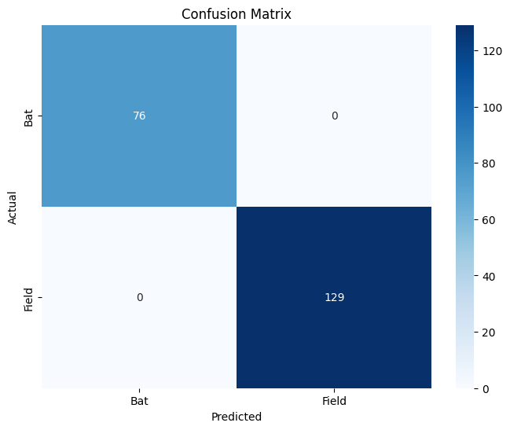
Confusion Matrix
The matrix confirms that all predictions are correct, with no misclassifications. Recommendations:
To create a valid model for predicting toss decisions, the toss_decision feature should be removed from the training data. Only then will the model be based on genuine patterns in the data rather than on direct information. After removing this feature, the model should be retrained and evaluated to get a realistic understanding of its performance.
({'0': {'precision': 1.0, 'recall': 1.0, 'f1-score': 1.0, 'support': 76}, '1': {'precision': 1.0, 'recall': 1.0, 'f1-score': 1.0, 'support': 129}, 'accuracy': 1.0, 'macro avg': {'precision': 1.0, 'recall': 1.0, 'f1-score': 1.0, 'support': 205}, 'weighted avg': {'precision': 1.0, 'recall': 1.0, 'f1-score': 1.0, 'support': 205}}, {'city': 0.010940815244045509, 'team1': 0.01356484779245802, 'team2': 0.01034148093398025, 'toss_winner': 0.012928493004438562, 'toss_decision': 0.9522243630250776})

Slide 19

Updated Features
Features Used: Opponent team, city, toss winner
Methodology: Utilized a Random Forest Classifier.
Performance: Achieved an accuracy of approximately 64.88%
Reason: feature importance.
Feature Importance: The toss decision feature has an overwhelming importance of 95.22%, while the other features have minimal impact.
This is a clear indication of data leakage. The model is likely using the toss_decision feature to predict itself, which explains the perfect accuracy. In real-world scenarios, this feature should be excluded from the training data.

Slide 20
Model Conclusion
The model can correctly predict the optimal toss decision (either to bat or field) about two-thirds of the time based on the given features.
This suggests that there are certain patterns or tendencies teams follow based on conditions like the opponent and city.
However, like any sport, cricket involves human decisions that can be influenced by numerous factors, making it inherently unpredictable to a certain extent.

Slide 21
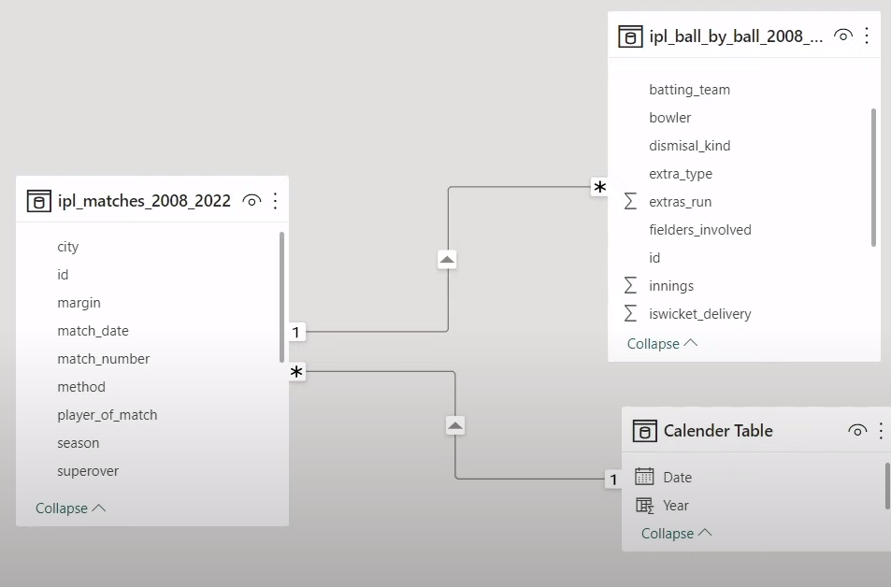
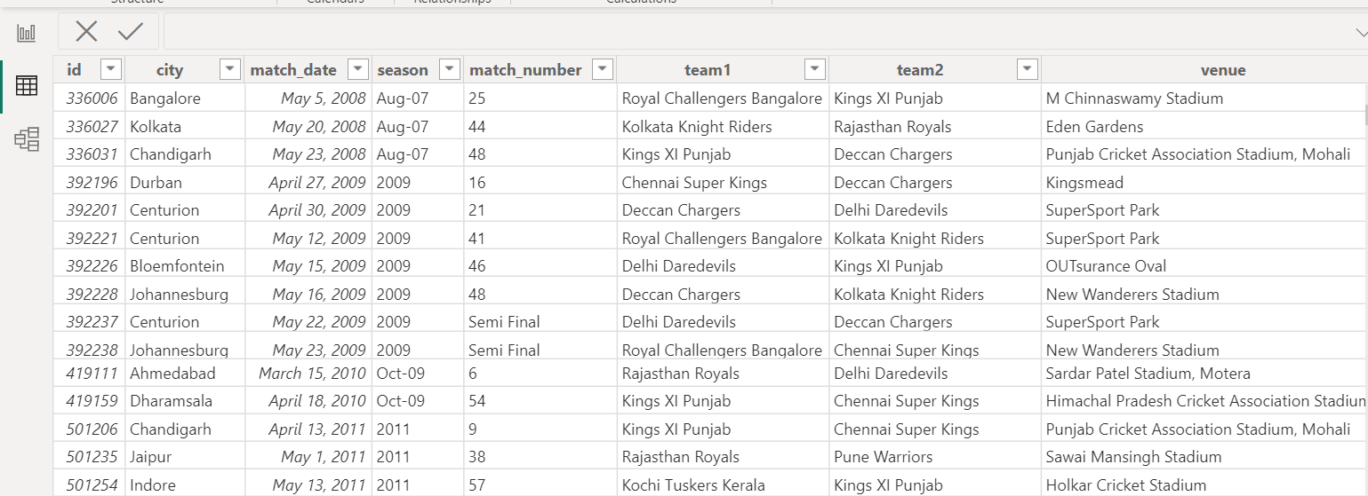
PostgreSQL to Power BI connection and data view:
Upon connecting PostgreSQL to Power BI, the platform intelligently generated a DAX (Data Analysis Expressions) model.
Power BI established relationships between the tables in the PostgreSQL database seamlessly.
These relationships facilitate the consolidation of data from different tables for coherent and meaningful visualization.
Within Power BI, the Data view provides us with an organized, structured, and interactive representation of our connected tables.
This data view serves as the foundation for creating insightful visualizations and conducting in-depth analysis of the IPL dataset.

Slide 22
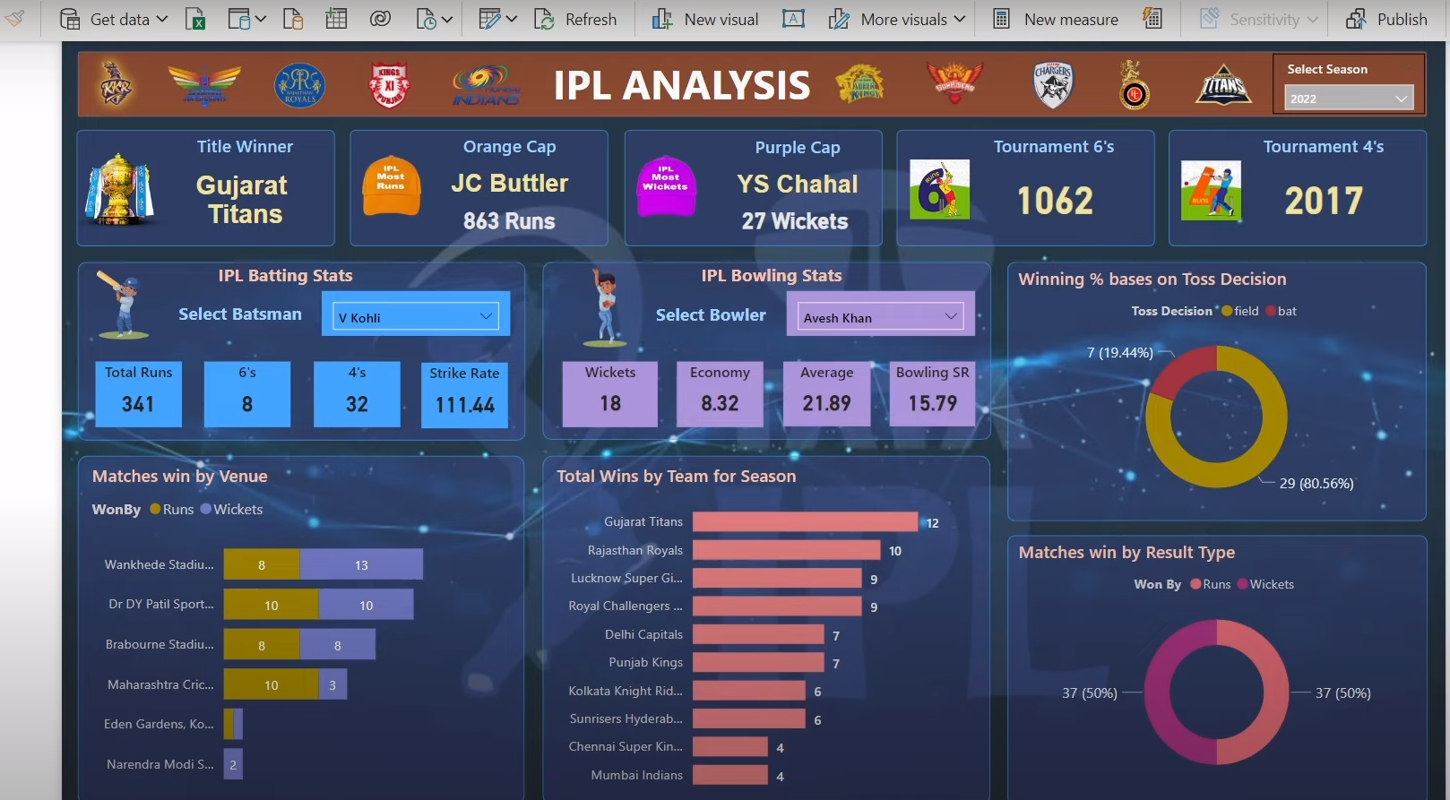
Final View of Dashboard

Slide 23
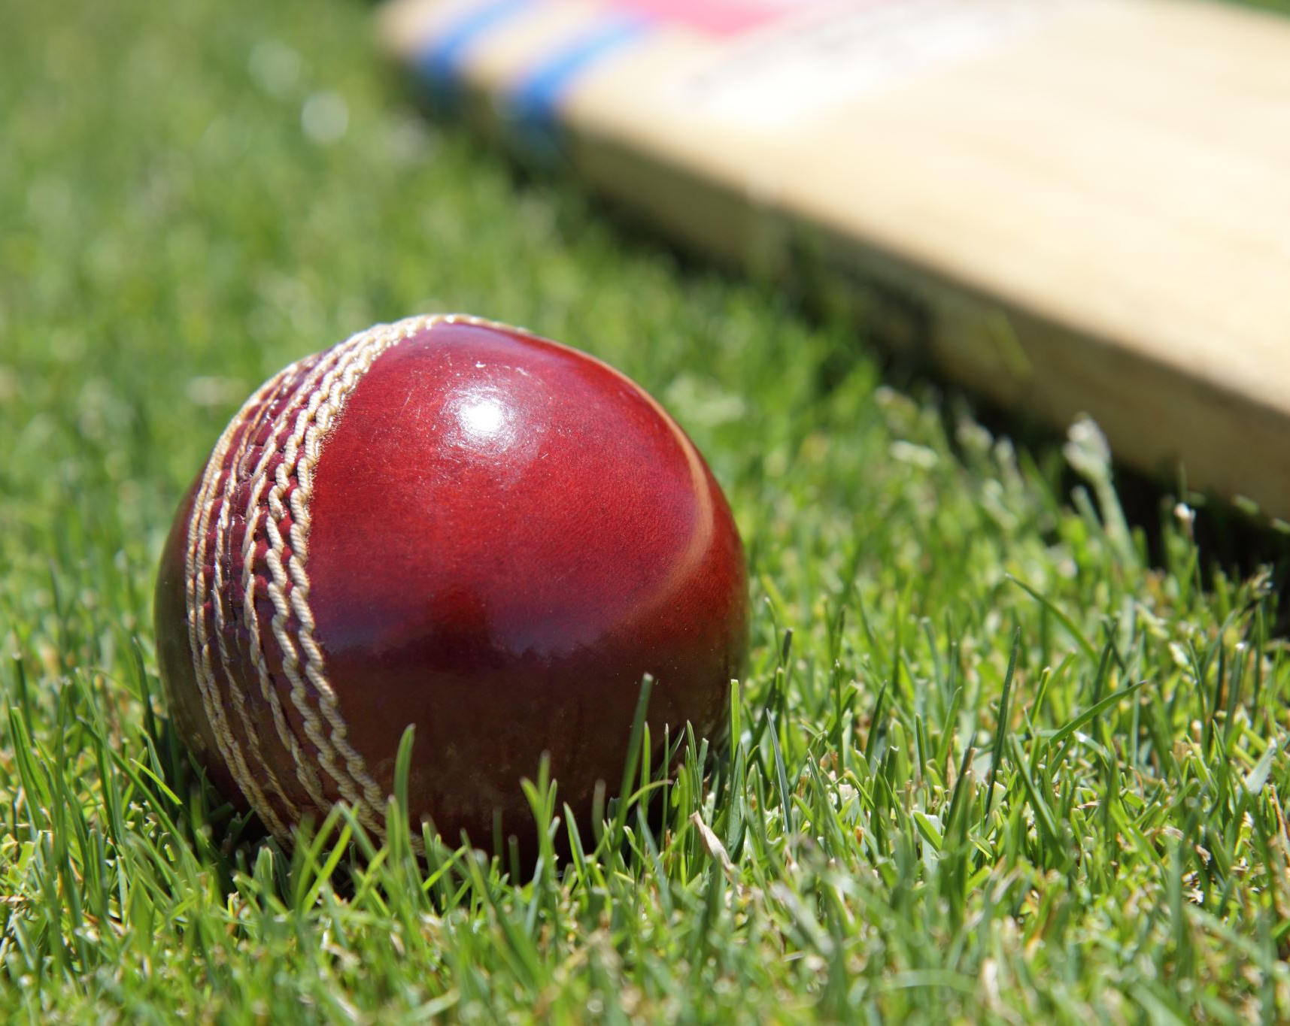
Conclusion
while the models provide useful insights and predictions, cricket remains an intricate sport with many variables affecting outcomes. The models can be improved further with more detailed data, sophisticated algorithms, and advanced feature engineering.

Slide 24
Thank you
Save paper
Save trees

