Slide 1

Black-box and Gray-box Strategies for Virtual Machine Migration
Timothy Wood, Prashant Shenoy,
Arun Venkataramani, and Mazin Yousif*
University of Massachusetts Amherst
*Intel, Portland

Slide 2
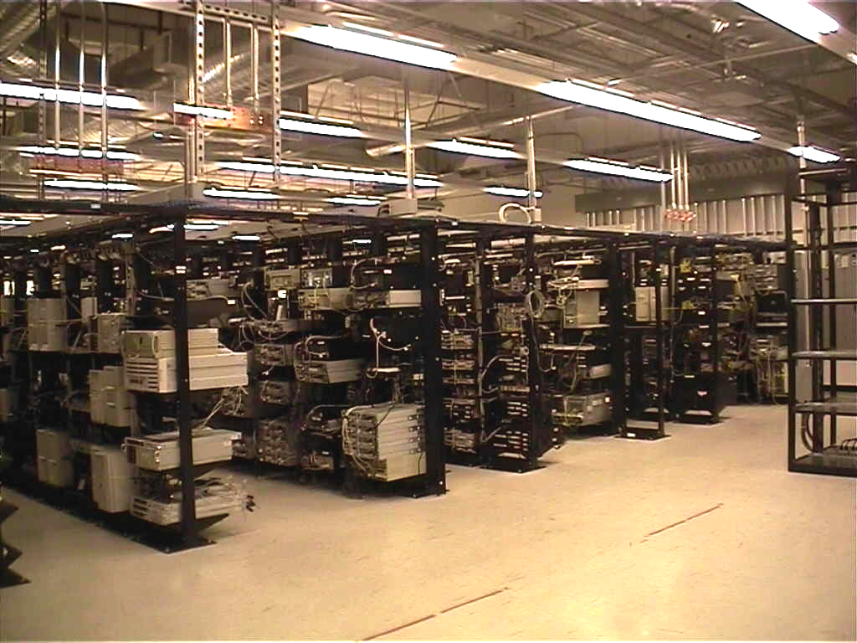
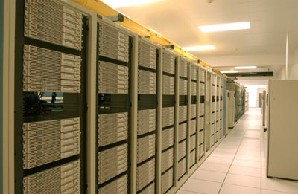


Enterprise Data Centers
Data Centers are composed of:
  Large clusters of servers
  Network attached storage devices
Multiple applications per server
  Shared hosting environment
  Multi-tier, may span multiple servers
Allocates resources to meet
Service Level Agreements (SLAs)
Virtualization increasingly common

Slide 3


Benefits of Virtualization
Run multiple applications on one server
  Each application runs in its own virtual machine
Maintains isolation
  Provides security
Rapidly adjust resource allocations
  CPU priority, memory allocation
VM migration
  “Transparent” to application
  No downtime, but incurs overhead
How can we use virtualization to more
efficiently utilize data center resources?

Slide 4


Data Center Workloads
Web applications see highly dynamic workloads
  Multi-time-scale variations
  Transient spikes and flash crowds
1200
140000
120000
100000
Arrivals per min
Arrivals per min
80000
Request Rate (req/min)
60000
40000
0
20000
0
1
2
3
4
5
0
0
5
10
15
20
Time (hrs)
Time (days)
How can we provision resources to
meet these changing demands?

Slide 5

Provisioning Methods
Hotspots form if resource demand exceeds provisioned capacity
Static over-provisioning
  Allocate for peak load
    Wastes resources
    Not suitable for dynamic workloads
    Difficult to predict peak resource requirements
Dynamic provisioning
  Adjust based on workload
    Often done manually
    Becoming easier with virtualization

Slide 6
Problem Statement
How can we automatically detect and eliminate
hotspots in data center environments?
Use VM migration and dynamic
resource allocation!

Slide 7
Outline
Introduction & Motivation
System Overview
When? How much? And Where to?
Implementation and Evaluation
Conclusions

Slide 8

Research Challenges
Sandpiper: automatically detect and mitigate hotspots through virtual machine migration
When to migrate?
Where to move to?
How much of each resource to allocate?
How much information needed to make decisions?
A migratory bird

Slide 9
Sandpiper Architecture
Nucleus
  Monitor resources
  Report to control plane
  One per server
Control Plane
  Centralized server
Hotspot Detector
  Detect when a hotspot occurs
Profiling Engine
  Decide how much to allocate
Migration Manager
  Determine where to migrate
Nucleus
VM 1
VM 2
…
PM 1
PM N
Hotspot
Detector
Profiling
Engine
Migration
Manager
Control Plane
PM = Physical Machine
VM = Virtual Machine

Slide 10



Black-Box and Gray-Box
Black-box: only data from outside the VM
  Completely OS and application agnostic
Gray-Box: access to OS stats and application logs
  Request level data can improve detection and profiling
  Not always feasible – customer may control OS
Black Box
???
Gray Box
Application logs
OS statistics
Is black-box sufficient?
What do we gain from gray-box data?

Slide 11
Outline
Introduction & Motivation
System Overview
When? How much? And Where to?
Implementation and Evaluation
Conclusions

Slide 12
Black-box Monitoring
Xen uses a “Driver Domain”
  Special VM with network and disk drivers
  Nucleus runs here
CPU
  Scheduler statistics
Network
  Linux device information
Memory
  Detect swapping from disk I/O
  Only know when performance is poor
Driver
Domain
Nucleus
VM
Hypervisor

Slide 13

Hotspot Detection – When?
Resource Thresholds
  Potential hotspot if utilization exceeds threshold
Only trigger for sustained overload
  Must be overloaded for k out of n measurements
Autoregressive Time Series Model
  Use historical data to predict future values
  Minimize impact of transient spikes
Utilization
Utilization
Utilization
Time
Time
Time
Not overloaded
Hotspot Detected!

Slide 14
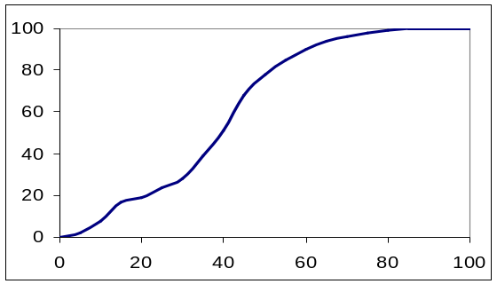
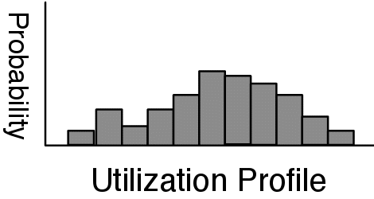
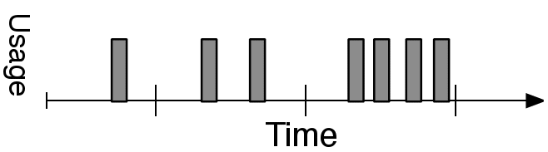


Resource Profiling – How much?
How much of each resource to give a VM
  Create distribution from time series
  Provision to meet peaks of recent workload
What to do if utilization is at 100%?
Gray-box
  Request level knowledge can help
  Can use application models to determine requirements
Historical data
Utilization Profile
Probability
% Utilization

Slide 15

Determining Placement – Where to?
Migrate VMs from overloaded to underloaded servers
Use Volume to find most loaded servers
  Captures load on multiple resource dimensions
  Highly loaded servers are targeted first
Migrations incur overhead
  Migration cost determined by RAM
  Migrate the VM with highest Volume/RAM ratio
Volume =
1
1
1
*
*
net
1-cpu
1-net
1-mem
cpu
mem
Maximize the amount of load transferred while
minimizing the overhead of migrations

Slide 16

Placement Algorithm
First try migrations
  Displace VMs from high Volume servers
  Use Volume/RAM to minimize overhead
Don’t create new hotspots!
  What if high average load in system?
Swap if necessary
  Swap a high Volume VM for a low Volume one
  Requires 3 migrations
    Can’t support both at once
PM1
PM2
VM1
VM2
VM3
VM4
Migration
Spare
PM1
PM2
Swaps increase the number
of hotspots we can resolve
VM1
VM2
VM5
VM3
VM4
Swap

Slide 17
Outline
Introduction & Motivation
System Overview
When? How much? And Where to?
Implementation and Evaluation
Conclusions

Slide 18
Implementation
Use Xen 3.0.2-3 virtualization software
Testbed of twenty 2.4Ghz P4 servers
Apache 2.0.54, PHP 4.3.10, MySQL 4.0.24
Synthetic PHP applications
RUBiS – multi-tier ebay-like web application

Slide 19
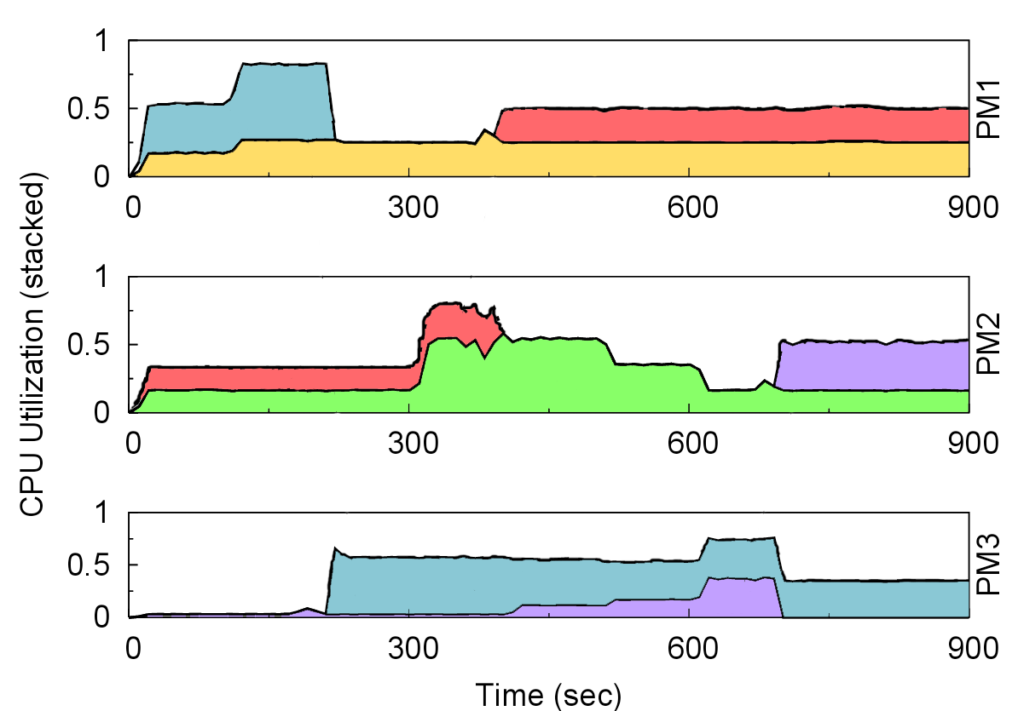

Migration Effectiveness
3 Physical servers, 5 virtual machines
  VMs serve CPU intensive PHP scripts
Migration triggered when CPU usage exceeds 75%
Sandpiper detects and responds to 3 hotspots
PM 1
CPU Usage (stacked)
PM 2
PM 3

Slide 20
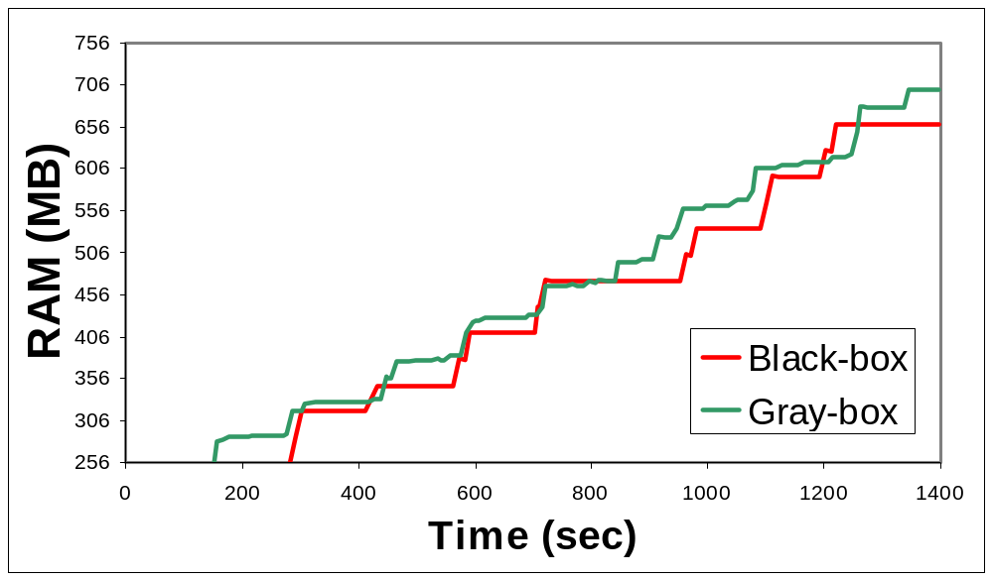
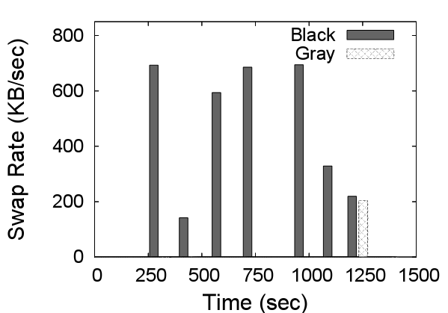

Memory Hotspots
Virtual machine runs SpecJBB benchmark
  Memory utilization increases over time
Black-box increases by 32MB if page-swapping observed
Gray-box maintains 32 MB free
  Significantly reduces page-swapping
Gray-box can improve application
performance by proactively increasing allocation

Slide 21
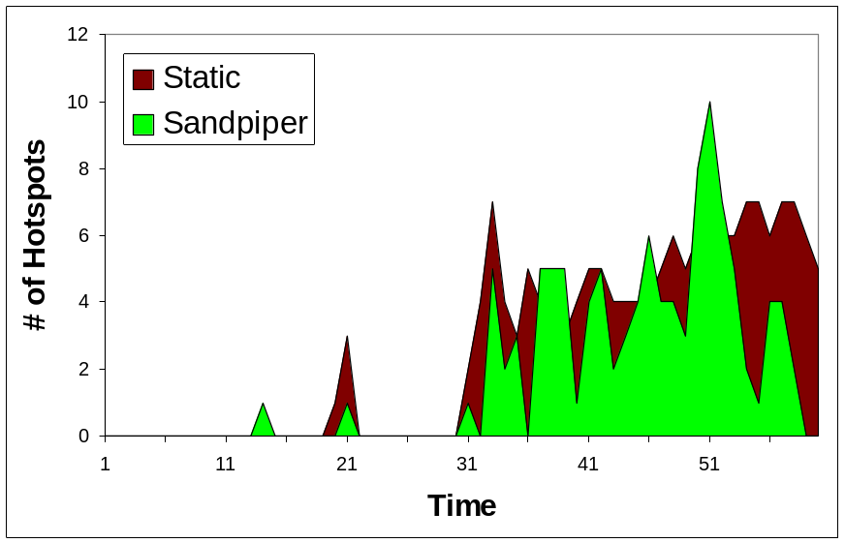
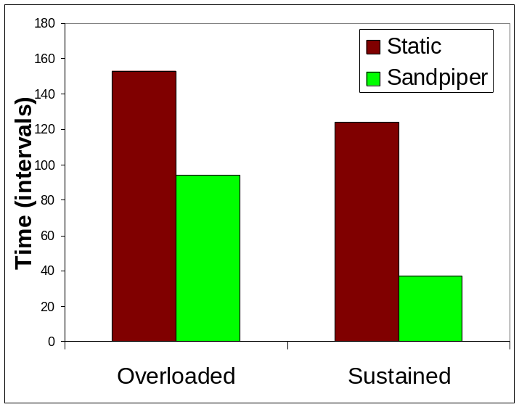


Data Center Prototype
16 server cluster runs realistic data center applications on 35 virtual machines
6 servers (14 VMs) become simultaneously overloaded
  4 CPU hotspots and 2 network hotspots
Sandpiper eliminates all hotspots in four minutes
  Uses 7 migrations and 2 swaps
  Despite migration overhead, VMs see fewer periods of overload

Slide 22
Related Work
Menasce and Bennani 2006
  Single server resource management
VIOLIN and Virtuoso
  Use virtualization for dynamic resource control
  in grid computing environments
Shirako
  Migration used to meet resource policies determined by application owners
VMware Distributed Resource Scheduler
  Automatically migrates VMs to ensure they receive their resource quota

Slide 23
Summary
Virtual Machine migration is a viable tool for dynamic data center provisioning
Sandpiper can rapidly detect and eliminate hotspots while treating each VM as a black-box
Gray-Box information can improve performance in some scenarios
  Proactive memory allocations
Future work
  Improved black-box memory monitoring
  Support for replicated services

Slide 24
Thank you
http://lass.cs.umass.edu

Slide 25
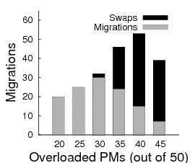
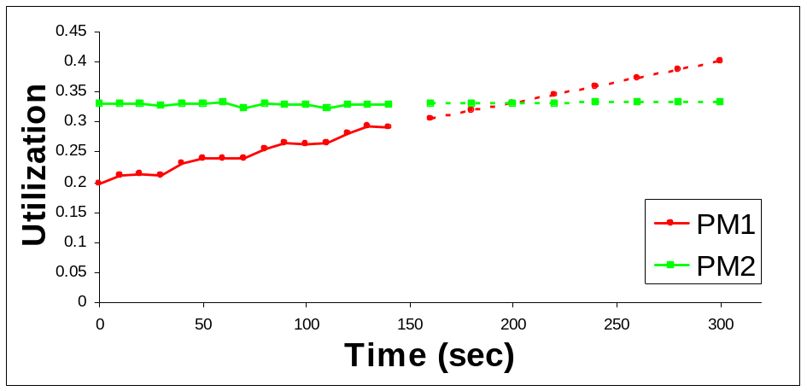
Stability During Overload
Predict future usage
  Will not migrate if destination could become overloaded
Each set of migrations must eliminate a hotspot
  Algorithm only performs bounded number of migrations
Measured Predicted

Slide 26
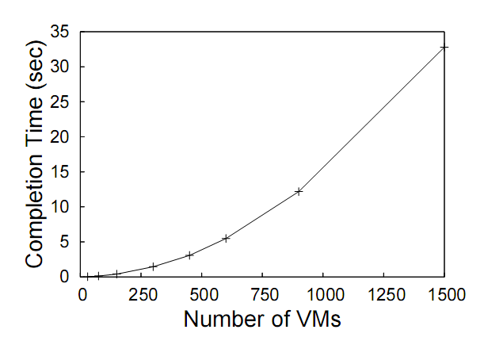
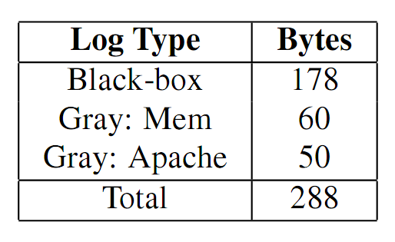
Sandpiper Overhead
CPU/mem same as monitoring tools (1%)
Network bandwidth negligible
Placement algorithm completes in less than 10 seconds for up to 750 VMs
  Can distribute computation if necessary

Slide 27
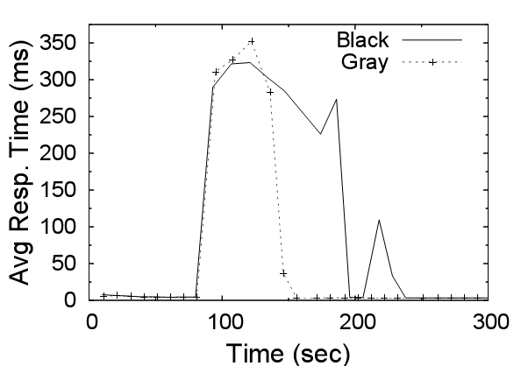
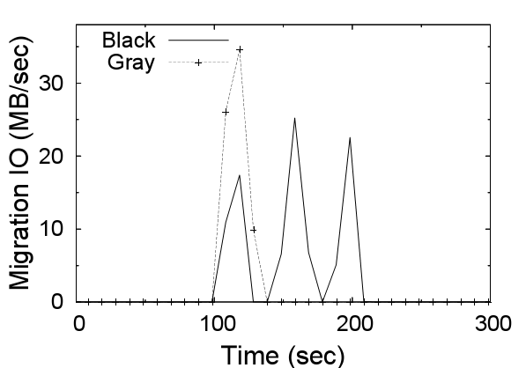
Gray v. Black - Apache
Load spikes on 2 web servers cause CPU saturation
Black-box underestimates each VM’s requirement
  Does not know how much more to allocate
  Requires 3 sequential migrations to resolve hotspot
Gray-box correctly judges resource requirements by using application logs
  Initiates 2 migrations in parallel
  Eliminates hotspot 60% faster
Web Server Response Time
Migrations

