Slide 1
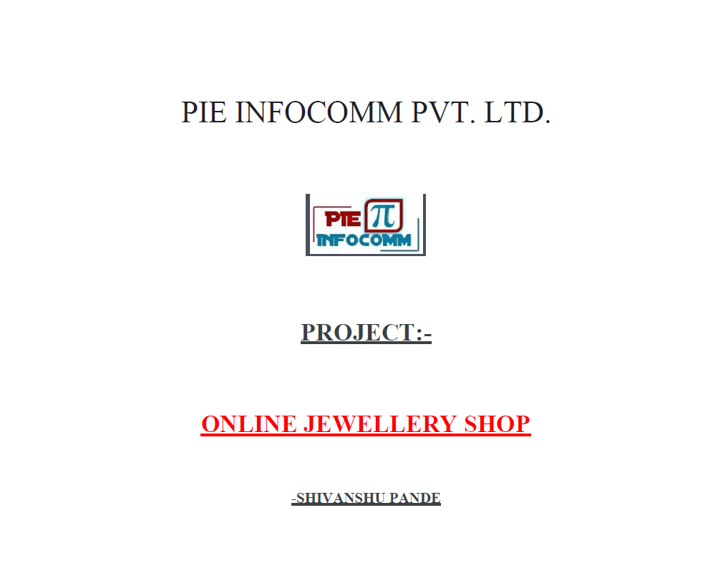

Slide 2
INTRODUCTION
This project has the name suggest is a web application based on concepts of sql, php,basic- css/Javascript and html for a user to register and buy the needful jewellery as a saved order and then track it or register for a complain/query/feedback.

Slide 3
OBJECTIVE
My main goal was to provide a simple yet practical version of a online jewellery shoppe for the consumer/client to place a saved order and then track it post validation.

Slide 4
BACKGROUND
The background of this project is quite simple, once I was assigned this project my by teacher and guide aishwariya mam my next thought was what are the basic operation of a jewerelly web application?
The answer I researched was quite simple option to buy, track purchased order and then file a complaint or feedback or query for the same. Unlike many websites my UI is quite simple and humble yet efficient using the homepage one can access any of the three feature mentioned above. After which <table> is used to provide a clean view of the items for sale which takes input qnt-required by the user and rest is left to javascript☺ and sql coding.
The inspiration for the same was taken by many websites like tanisq,amazon,caratlane ..etc.The goal was simple to put into practical use concepts learned in class.

Slide 5
HARDWARE AND SOFTWARE REQUIREMENTS
Hardware Requirements:
1. A PC with the following or greater specifications:
2. Intel Core i3 or higher
3. 8 GB RAM
4. 500 GB Hard Drive
5. A stable internet connection (2Mbps or higher)
• Software Requirements:
1. Operating system : Windows, Linux
2. Front end technologies are : HTML, CSS, JavaScript
3. IDE : VS Code,Sublime text
4. Back end requirement : PHP
5. Server : XAMPP server

Slide 6
FUTURE SCOPE
The following project can be further improved using advanced concepts of JS,HTML5,CSS,MYSQL-PHP for example cookies and mysql view are some of the concepts not applied here.
Furthermore to establish safe--secure network connection few security measures should also be added to the same.

Slide 7
CONCLUSION
This concludes the end of the synopsis and I personally have learned multiple concepts in the field of HTML,CSS,JS,MYSQL,SERVER,PHP.This was extremely insightful journey.
My webapplication has different capabilies like validation using SQL principles and Login only using Mysql and session concepy[php].
Furthermore one can only select the item qnt displayed on the website and the rest will be calculated using Js [discount and net price total].Same will be saved under the client id and he/she shall have the option of deleting the same order in the backend of order.php.
In addition to deletion and creation one can also view the current status of his/her order.
Admin homepage is a special portal accessible only due to a special login id-password combination known only to developer so that he can update the status of the order without going to backend database every time[Front end convinence] .Also registered details can also be changed using this and also deletion of order incase consumer fails to do but has mentioned in feedback.
Feedback only takes only id and one feedback at a time so unless all feedback is acknowledged by the admin no new feedback can be added.

Slide 8
REFERENCES AND BIBLIOGRAPHY
http://localhost/phpmyadmin/db_designer.php?db=s_jewerlyshoppe
https://app.diagrams.net/
BMSCE-COLLEGE PROJECT

