Slide 1

Heart Disease Prediction
SHIVANSHU PANDE (1BM19CS151) SAMARTH C SHETTY (1BM19CS141) SHWETA PATIL (1BM19CS156) ROHAN SIWACH (1BM19CS132)
Rekha G.S
Assistant Professor
Department of Computer Science & Engineering
B.M.S. College of Engineering
Notes:
Arpana

Slide 2
OUTLINE
Problem Statement
Proposed Methodology
Tools used for implementation
Implementation
Testing
Results and Discussion
References
Notes:
ap

Slide 3
Problem Statement
It is the primary reason of deaths in adults. Our project can help predict the people who are likely to diagnose with a heart disease by help of their medical history.
Notes:
Anusree

Slide 4
Proposed methodology
KNN
Logistic Regression
Neural Networks
SVM
Decision Tree
SVC
Random Forest Classifier

Slide 5
Tools used for Implementation
Python
Jupyter Notebook
Kaggle
Machine Learning Algorithms
Notes:
Pooja

Slide 6
Logistic Regression Algorithm
Logistic regression is an example of supervised learning. It is used to calculate or predict the probability of a binary (yes/no) event occurring.
Logistic Regression steps. Below are the steps:
Data Pre-processing step
Fitting Logistic Regression to the Training set
Predicting the test result
Test accuracy of the result(Creation of Confusion matrix) ● Visualizing the test set result.

Slide 7
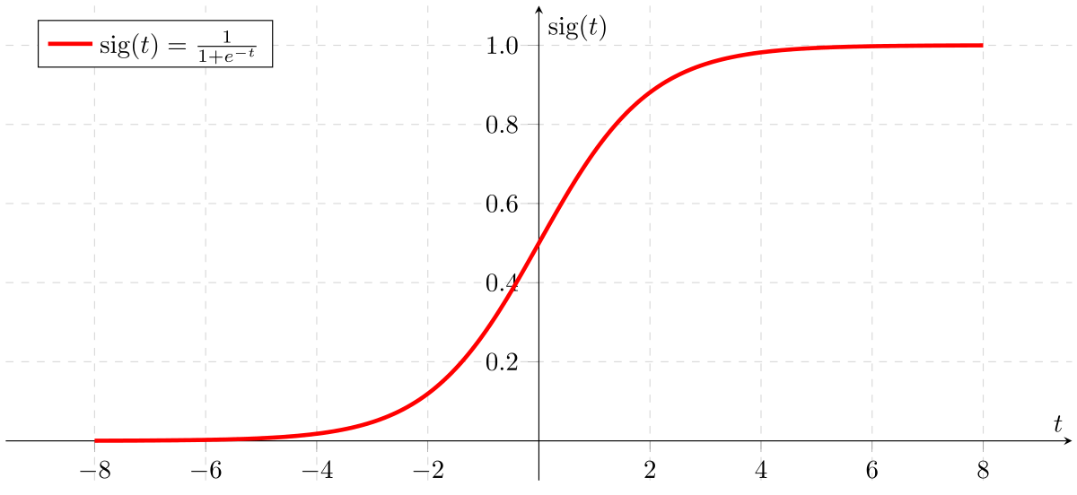
Logistic regression graph

Slide 8
Implementation
KNN
K-Nearest Neighbors deduces the similarity among the brand new statistics and to be had statistics and applies the brand new case or statistics into the class this is maximum much like the to be had categories. It shops all of the to be had statistics and classifies a brand new statistics factor primarily based totally at the similarity.
Select the range K of the neighbors
Calculate the Euclidean distance of K number of neighbors
Take the K nearest neighbors as per the calculated Euclidean distance.
Among these k neighbors, count the number of the data points in each cate- gory.
Assign the new data points to that category for which the number of the neighbor
Notes:
Pooja

Slide 9
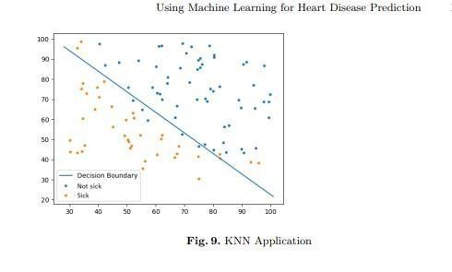
KNN/LOGISTIC ALGORITHM

Slide 10
Neural Networks
Neural Networks procedures statistics in a completely comparable manner to what the human mind does. These networks absolutely examine from the examples that we offer them with, you can’t software them to carry out a selected task.
Information is fed into the input layer which transfers it to the hidden layer.
The interconnections between the two layers assign weights to each input randomly.
A bias added to every input after weights are multiplied with them individually.
The weighted sum is transferred to the activation function.
The activation function determines which nodes it should fire for feature ex- traction.
The model applies an application function to the output layer to deliver the output.
Weights are adjusted, and the output is back-propagated to minimize error.

Slide 11
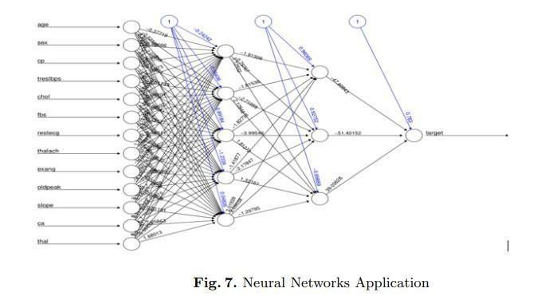
with layers -CNN

Slide 12
SVM
Support Vector Machine or SVM is used for Classification in addition to Regression problems. The purpose of the set of rules is to create the fine line or selection boundary which can segregate n-dimensional area into instructions so that we are able to, without problems place the new statistics factor into the perfect classes so that we can easily put the new data in the correct category in the future.
SVM chooses the extreme factors/vectors that assist in developing the hyperplane. We can without problems look at the “margins” in the discriminative classifiers.
SVM will pick the line that maximizes the margin. Next, we are able to use Scikit-Learns support vector classifier to educate an SVM version in this statistics.
We can easily observe the “margins” within the discriminative classifiers. SVM will choose the line that maximizes the margin.
Next, we will use Scikit-Learns support vector classifier to train an SVM model on this data.

Slide 13
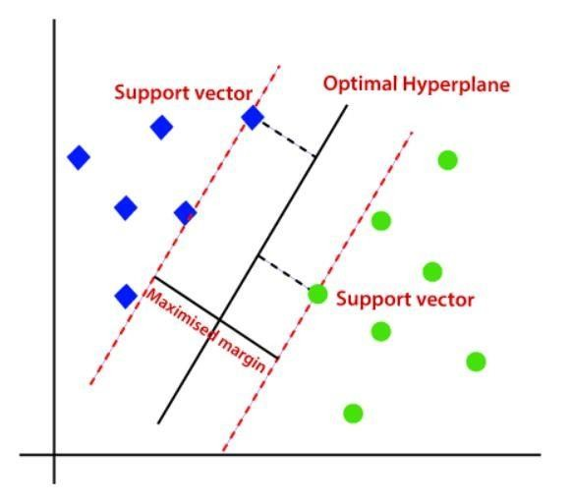
SVM ALGORITHM

Slide 14

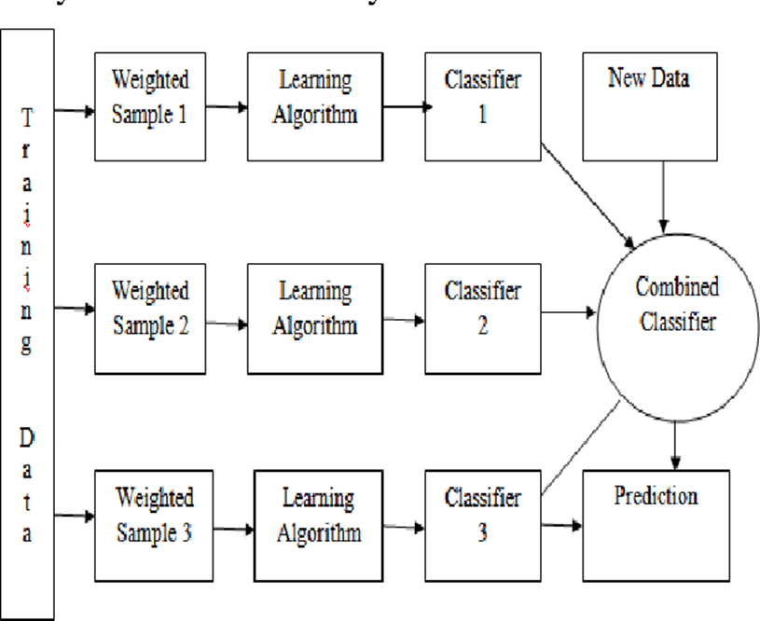

Slide 15

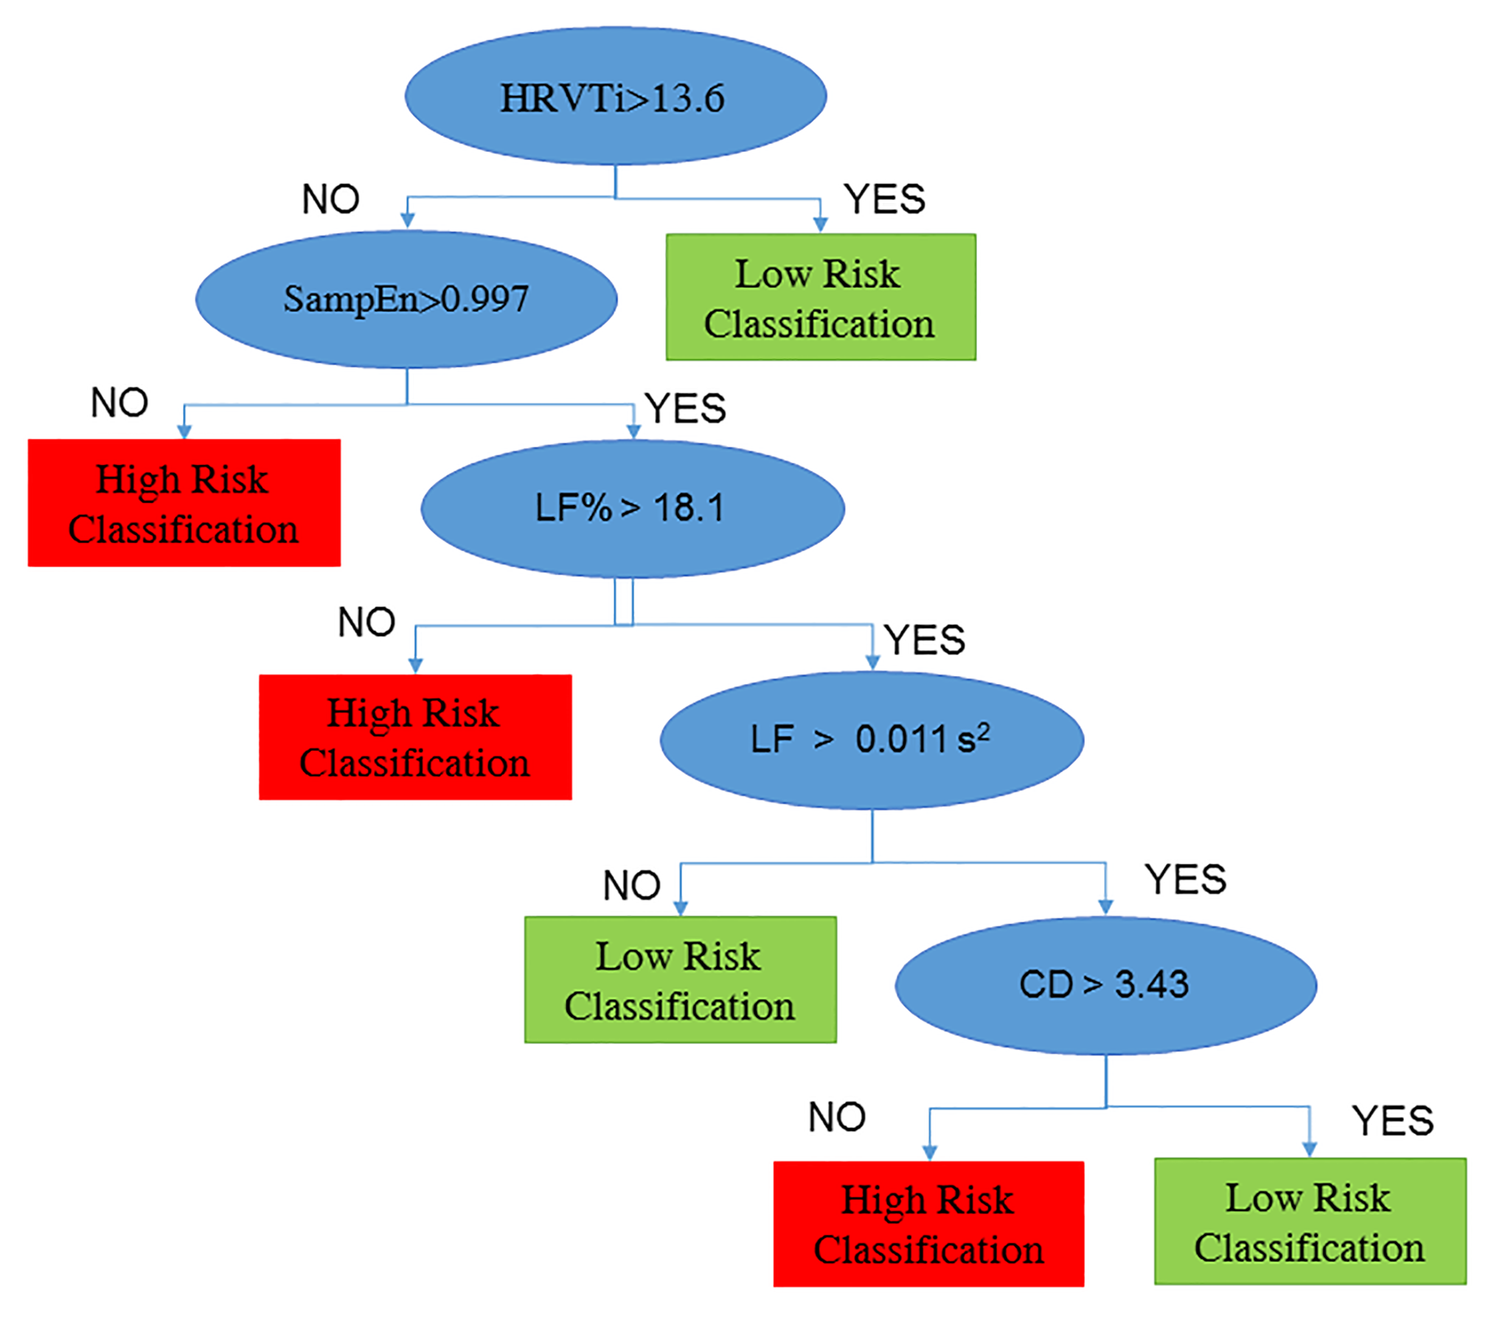
Accuracy 95%

Slide 16
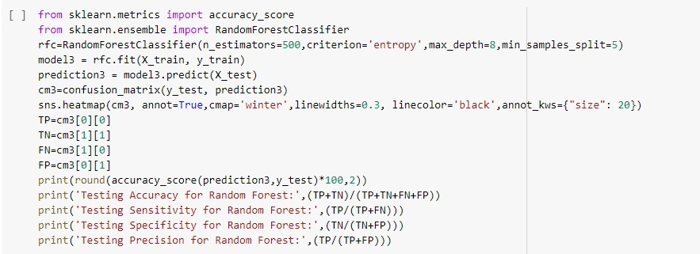
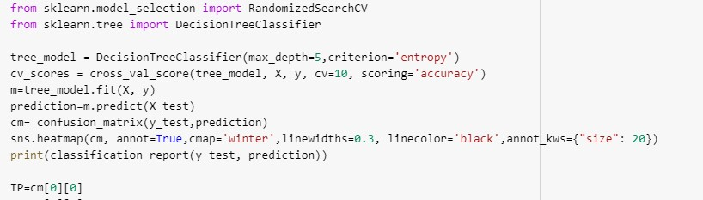
TESTING
DECISION TREE
RANDOM FOREST

Slide 17
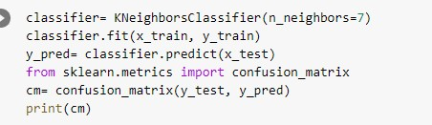
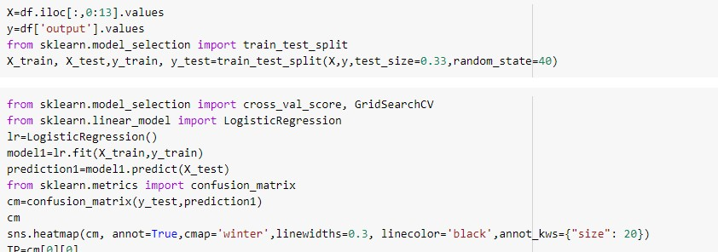
TESTING
KNN
Logistic regression

Slide 18
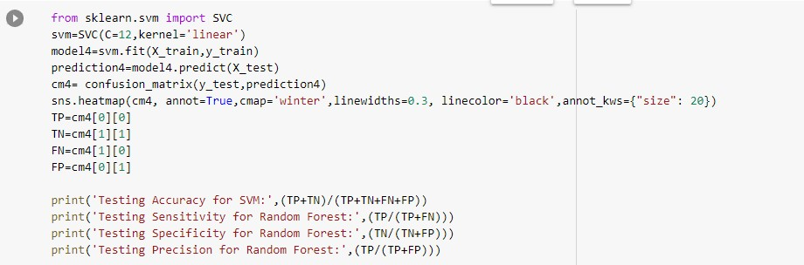
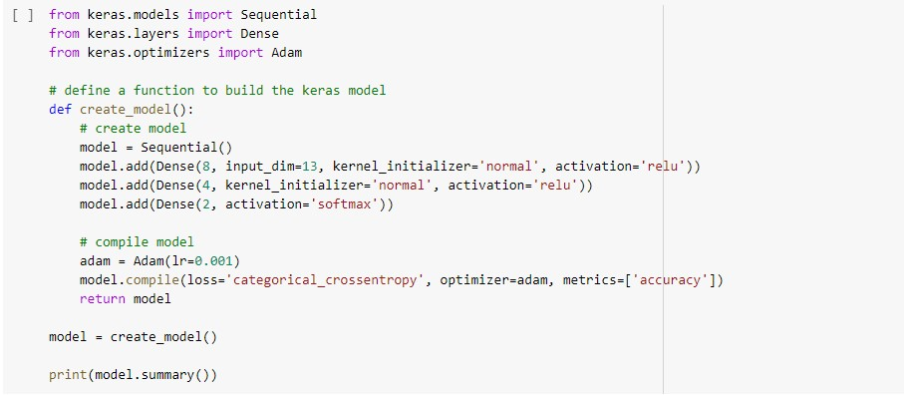
TESTING
SVM
CNN

Slide 19

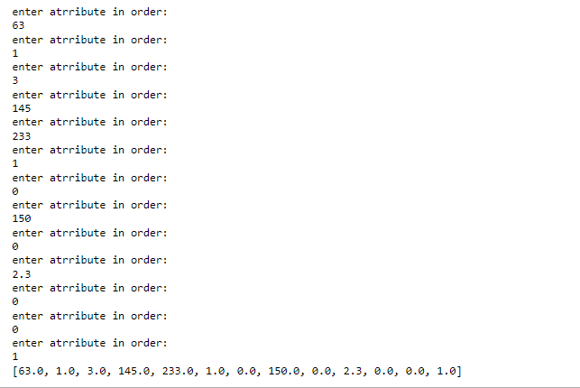
Results and Discussion

Slide 20
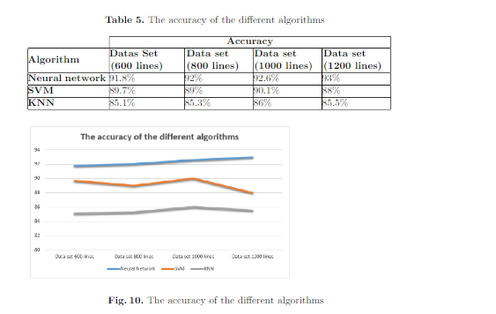
Results and Discussion

Slide 21
Applications or Relevance of the Project
Fuzzy learning models can be applied to predict the intensity of cardiac disease. Moreover, same framework can be used for multidisease prediction such as diabetes, breast cancer and liver disease diagnosis.
N attributes can be applied like obesity and smoking are used to get more accurate results. Neural networks has the capacity to handle millions of variations and thousands of attributes
The use of genetic profiles in risk assessment of coronary heart disease .

Slide 22
References
[1] Soni J, Ansari U, Sharma D & Soni S (2011). Predictive data mining for medical diagnosis: an overview of heart disease prediction. International Journal of Computer Applications, 17(8), 43-8
[12] Dangare C S & Apte S S (2012). Improved study of heart disease prediction system using data mining classification techniques. International Journal of Computer Applications, 47(10), 44-8.
[3] Ordonez C (2006). Association rule discovery with the train and test approach for heart disease prediction. IEEE Transactions on Information Technology in Biomedicine, 10(2), 334-43.
[4] Shinde R, Arjun S, Patil P & Waghmare J (2015). An intelligent heart disease prediction system using k-means clustering and Naïve Bayes algorithm. International Journal of Computer Science and Information Technologies, 6(1), 637-9.

Slide 23
References
[5] Bashir S, Qamar U & Javed M Y (2014, November). An ensemble-based decision support framework for intelligent heart disease diagnosis. In International Conference on Information Society (i-Society 2014) (pp. 259-64). IEEE. ICCRDA
2020 IOP Conf. Series: Materials Science and Engineering 1022 (2021) 012072 IOP Publishing doi:10.1088/1757-899X/1022/1/012072 9
[6] Jee S H, Jang Y, Oh D J, Oh B H, Lee S H, Park S W & Yun Y D (2014). A coronary heart disease prediction model: the Korean Heart Study. BMJ open, 4(5), e005025.
[7] Ganna A, Magnusson P K, Pedersen N L, de Faire U, Reilly M, Ärnlöv J & Ingelsson E (2013). Multilocus genetic risk scores for coronary heart disease prediction. Arteriosclerosis, thrombosis, and vascular biology, 33(9), 2267-72.
[8] Jabbar M A, Deekshatulu B L & Chandra P (2013, March). Heart disease prediction using lazy associative classification. In 2013 International Mutli-Conference on Automation, Computing,Communication, Control and Compressed Sensing (iMac4s) (pp. 40- 6). IEEE.
[9] Dangare Chaitrali S and Sulabha S Apte. "Improved study of heart disease prediction system using data mining classification techniques." International Journal of Computer Applications 47.10 (2012): 44-8.
[10] Soni Jyoti. "Predictive data mining for medical diagnosis: An overview of heart disease prediction." International Journal of Computer Applications 17.8 (2011): 43-8.
[11] Chen A H, Huang S Y, Hong P S, Cheng C H & Lin E J (2011, September). HDPS: Heart disease prediction system. In 2011 Computing in Cardiology (pp. 557-60). IEEE.
[12] Parthiban, Latha and R Subramanian. "Intelligent heart disease prediction system using CANFIS and genetic algorithm." International Journal of Biological, Biomedical and Medical Sciences 3.3 (2008).
[13] Wolgast G, Ehrenborg C, Israelsson A, Helander J, Johansson E & Manefjord H (2016). Wireless body area network for heart attack detection [Education Corner]. IEEE antennas and propagation magazine, 58(5), 84-92.
[14] Patel S & Chauhan Y (2014). Heart attack detection and medical attention using motion sensing device -kinect. International Journal of Scientific and Research Publications, 4(1), 1-4.

Slide 24
References
[15] Zhang Y, Fogoros R, Thompson J, Kenknight B H, Pederson M J, Patangay A & Mazar S T (2011). U.S. Patent No. 8,014,863. Washington, DC: U.S. Patent and Trademark Office.
[16] Raihan M, Mondal S, More A, Sagor M O F, Sikder G, Majumder M A &
Ghosh K (2016, December). Smartphone based ischemic heart disease (heart attack) risk prediction using clinical data and data mining approaches, a prototype design. In 2016 19th International Conference on Computer and Information Technology (ICCIT) (pp. 299-303). IEEE.
[17] Buechler K F & McPherson P H (1999). U.S. Patent No. 5,947,124.
Washington, DC: U.S. Patent and Trademark Office.
[18] Takci H (2018). Improvement of heart attack prediction by the feature selection methods. Turkish Journal of Electrical Engineering & Computer Sciences, 26(1), 1-10.
[19] Worthen W J, Evans S M, Winter S C & Balding D (2002). U.S. Patent No.
6,432, 124. Washington, DC: U.S. Patent and Trademark Office.
[20] Acharya U R, Fujita H, Oh S L, Hagiwara Y, Tan J H & Adam M (2017).
Application of deep ICCRDA 2020 IOP Conf. Series: Materials Science and
Engineering 1022 (2021) 012072 IOP Publishing doi:10.1088/1757-899X/1022/1/012072 10 convolutional neural network for automated detection of myocardial infarction using ECG signals. Information

Slide 25
References
[21] Brown N, Young T, Gray D, Skene A M & Hampton J R (1997). Inpatient deaths from acute myocardial infarction, 1982-92: analysis of data in the
Nottingham heart attack register. BMJ, 315(7101), 159-64.
[22] Piller L B, Davis B R, Cutler J A, Cushman W C, Wright J T, Williamson J D &
Haywood L J (2002). Validation of heart failure events in the Antihypertensive and Lipid Lowering Treatment to Prevent Heart Attack Trial (ALLHAT) participants assigned to doxazosin and chlorthalidone. Current controlled trials in cardiovascular medicine, 3(1), 10.
[23] Folsom A R, Prineas R J, Kaye S A & Soler J T (1989). Body fat distribution and self-reported prevalence of hypertension, heart attack, and other heart disease in older women. International journal of epidemiology, 18(2), 361-7.
[24] Kiyasu J Y (1982). U.S. Patent No. 4,338,396. Washington, DC: U.S. Patent and Trademark Office.
[24] Harshit Jindal.Heart disease prediction using machine learning algorithms.IOP Conference Series: Materials Science and Engineering

Slide 26
THANK YOU
Notes:
ap

