Slide 1
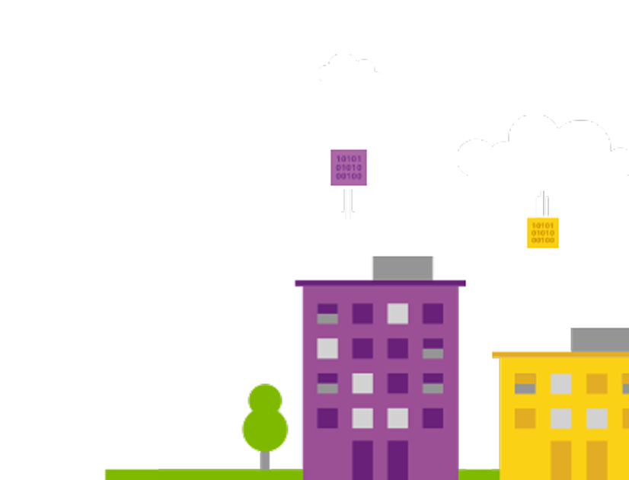
Real world whiteboard design session case study
Building a Resilient
IaaS Architecture

Slide 2

Step 1: Review the customer case study

Slide 3
Customer background FusionTomo Inc. - Corporate Snapshot
FusionTomo Inc. is the leading manufacturer, seller, distributor, and servicer of parts for Heating, Venting and Air-Conditioning (HVAC) systems. Their customer base includes some of the largest corporations and independent firms in the US.
FusionTomo specializes in the datacenter space, designing computer room air conditioning (CRAC) units and contracting in the planning of hyper-scale cloud provider datacenter cooling strategies. As such, the Research and Development group is one of the largest business units in the company.
There are 3 branch offices spread across the United States, and the corporate office and manufacturing facilities are in Austin.
Notes:
FusionTomo Inc. manufactures, sells, distributes, and services parts for major appliances and HVAC systems for large corporations and independent firms. The ordering system is currently housed in Azure on IaaS SQL server instances. Initially, the ordering process was done mainly via phone and expanded to email. Recently, the company has moved to an internet based ordering system with IIS Web Servers in Azure housing the front-end application for the ordering, invoicing, and support options.
They have grown into a viable, sustainable business and would like their technology to mirror the growth and sustainability. This would help cement their reputation in the industry and go a long way to assist their future growth. While business impact analysis (BIA) has not officially been performed, they have an overall plan of wanting to restore from an issue within 4 hours and recover to within the last 8 hours if at all possible.
There is no overall IT shop for FusionTomo Inc. as such. They are pretty much a classic IT company that doesn’t have deep experience in the interactivity of all the
components. They have rolled out sections and departments successfully, but now as the technology matures, they are in need of guidance for their deployments.
Currently, there are 3 branch offices located throughout the U.S. One is in the mid-West, another is on the East Coast and the third is located on the West Coast. Discussions are in progress to grow the business to Europe and a possibility of factories in Mexico and Asia.
Each branch office is small enough that there are no servers housed on-site. Each location has direct connectivity to corporate resources through a VPN connection to the Austin headquarters. Email is accessed via web as is the main ordering application.
At times, various branch offices have experienced connectivity issues due to the internet service provider having issues with the corporate office connection. While there is some understanding of these occurrences, there is a desire to provide a way to resolve this as growth continues. Employees work from home when this occurs.

Slide 4
Customer background FusionTomo Inc. – Current Technology State
FusionTomo IT group is a classic shop, mainly focused on infrastructure.
The AppDev department’s skill set is dated, predominantly focused on client/server development.
The organization has an Internet-based ordering system they recently deployed into Azure. Customers have complained at times of intermittent problems/errors with the website.
They have a legacy application that has its data tightly coupled to the ordering system and this application cannot be changed.
Recent stability issues with the ordering system prompted FusionTomo to perform a business impact analysis of the application. This exercise resulted in an executive mandate for a 4-hour recovery time to within the last 8 hours of data.
Network connectivity issues between the branch offices and the corporate office have occurred intermittently.
Disk storage has a heightened level of attention due to a critical server running out of disk space. This issue highlighted a gap in proactive monitoring.
Notes:
FusionTomo Inc. manufactures, sells, distributes, and services parts for major appliances and HVAC systems for large corporations and independent firms. The ordering system is currently housed in Azure on IaaS SQL server instances. Initially, the ordering process was done mainly via phone and expanded to email. Recently, the company has moved to an internet based ordering system with IIS Web Servers in Azure housing the front-end application for the ordering, invoicing, and support options.
They have grown into a viable, sustainable business and would like their technology to mirror the growth and sustainability. This would help cement their reputation in the industry and go a long way to assist their future growth. While business impact analysis (BIA) has not officially been performed, they have an overall plan of wanting to restore from an issue within 4 hours and recover to within the last 8 hours if at all possible.
There is no overall IT shop for FusionTomo Inc. as such. They are pretty much a classic IT company that doesn’t have deep experience in the interactivity of all the
components. They have rolled out sections and departments successfully, but now as the technology matures, they are in need of guidance for their deployments.
Currently, there are 3 branch offices located throughout the U.S. One is in the mid-West, another is on the East Coast and the third is located on the West Coast. Discussions are in progress to grow the business to Europe and a possibility of factories in Mexico and Asia.
Each branch office is small enough that there are no servers housed on-site. Each location has direct connectivity to corporate resources through a VPN connection to the Austin headquarters. Email is accessed via web as is the main ordering application.
At times, various branch offices have experienced connectivity issues due to the internet service provider having issues with the corporate office connection. While there is some understanding of these occurrences, there is a desire to provide a way to resolve this as growth continues. Employees work from home when this occurs.

Slide 5
Customer background (continued) FusionTomo Inc. – Current Technology State
Servers from multiple departments are starting to be provisioned in Azure, all within the same Azure region and virtual network.
The IT Department deployed an Active Directory Domain Services (AD DS) domain controller on a single VM with the data files on the C:\ drive.
The AppDev team deployed a web farm into an availability set in Azure with a load balancer to distribute customer load. This implementation hosts the business critical ordering web site. Web server scalability is configured manually when needed and often results in servers being left running longer than needed.
The Database Administration team deployed a single node SQL server into Azure supporting the web farm. Data and logs are on dedicated data disks.
The Research and Development team has deployed 35‒40 VMs to date, with more on the way. Currently all servers are using a single storage account for the OS and data disks.
The HR group has a policy requiring that a new storage account be created for every VM in the subscription. They are close to 20 VMs now.
Notes:
Recently, under the overall guidance of Lewis Franklin (Head of Infrastructure and Operations), individual departments have been taking the servers from their scope of influence into Azure. The Active Directory Domain Services team has deployed a few IaaS Domain Controller Virtual Machines to a single region close to the Austin office in South Central U.S. There has been some effort to follow the guidance of Microsoft on the use of Active Directory in Azure, but there are some gaps in the configuration.
The web application team has also deployed Internet Information Servers (IIS) VMs within the same South Central U.S. region. While they do not have administrative rights for the database machines that provide database services for the web application, they do have database rights and can access the databases through normal SQL toolsets.
Taking their cue from the AD and Web teams, the Database Administrators have also rolled out their SQL servers onto IaaS Virtual Machines, choosing to host them in the South Central U.S. region as well from a performance standpoint.
The R&D department has recently been tasked with moving servers into Azure. To date, they have around 35-40 VMs provisioned already, but anticipate continued growth. All their servers are deployed into the same storage account.
FusionTomo Inc. is currently connected via a Windows Server RRAS VPN connection to Azure via a Site-to-Site Gateway in the South Central U.S. location. They are looking for options to provide redundancy for the hybrid connectivity to Azure due to some recent connectivity issues.
While this has served them well, there are some personnel who are beginning to be concerned that all of the servers are located in one region. While they know the Azure Datacenter is located in San Antonio, the recent floods in the Houston area have caused concern for key personnel. Many are questioning if this is such a good idea for FusionTomo Inc. Janet Lewis (Business Continuity Team Director) says that, “It appears that while services have moved to the cloud, the overall paradigm hasn’t moved from the single Datacenter model.”
Over a recent 3-day Holiday weekend, there was an incident with one of the ADDS DCs where the disk drive housing the AD DS database file filled up and corrupted the copy of the AD DS DB. This prompted a high-priority support call to Microsoft. While the damage was mitigated, the team was fortunate that the consequences were minimal.
Retroactively, checks were made on some other IaaS disk drives and there were a number of them that were getting close to filling up due to teams not proactively monitoring their role servers. Key team members are now calling for a proactive approach to monitoring OS disk and data disk free space as well as other items.

Slide 6
Customer background (continued) FusionTomo Inc. – Current Technology State
FusionTomo Inc. currently uses a Windows Server Routing and Remote Access Service (RRAS) VPN connection for site-to-site connectivity to Azure.
Key personnel are starting to be concerned about all the deployments into a single region. They are asking for a way to recover from a region-wide disruption in Azure.
Business units are concerned about data corruption and accidental deletion of resources in Azure.
Notes:
The HR team has requested that they move their server infrastructure into Azure and the process has begun. Their organization has a policy that they create a new storage account for each VM in the subscription. They have deployed about 40-50 VMs but anticipate growth that will more than double the size of their deployment numbers.
Richard Wade (Infrastructure Lead), would really like to see a way for the overall Azure infrastructure to be made resilient so as to be able to recover from a region-wide service disruption. He also is highly interested in protecting against data corruption or even accidental deletion of data or virtual machines.
For the current Active Directory Azure implementation, the team has deployed a single ADDS DC in the South Central U.S. Region. It is running on a D1 Standard Instance with only the OS Disk. Both the NTDS folder containing the Active Directory DB and the SYSVOL folders are located on the OS disk, or drive C:\. No additional configuration changes were made to the IaaS VM for this DC.
Additionally, the Azure SQL and Web site implementation were combined into the same South Central U.S. region as mentioned earlier. SQL has been deployed as a Single Node server with multiple disks. One disk is utilized for the data, the other disk is for backup and log file storage. The team configured SQL backups to be stored on geo-replicated storage in Azure on Standard storage.
They have deployed a load balancer for the web servers and configured a default health probe to monitor the servers in the load balanced pool. When they need scalability, they manually configure another web server and often leave it running even after the need for the scaling has long since passed.
FusionTomo Inc. has received multiple complaints from customers at times when they have intermittently received HTTP 500 errors on the website. Upon investigation, it was discovered that a recent deployment failed on one of the servers in the farm and resulted in files not being correctly copied to this server.

Slide 7
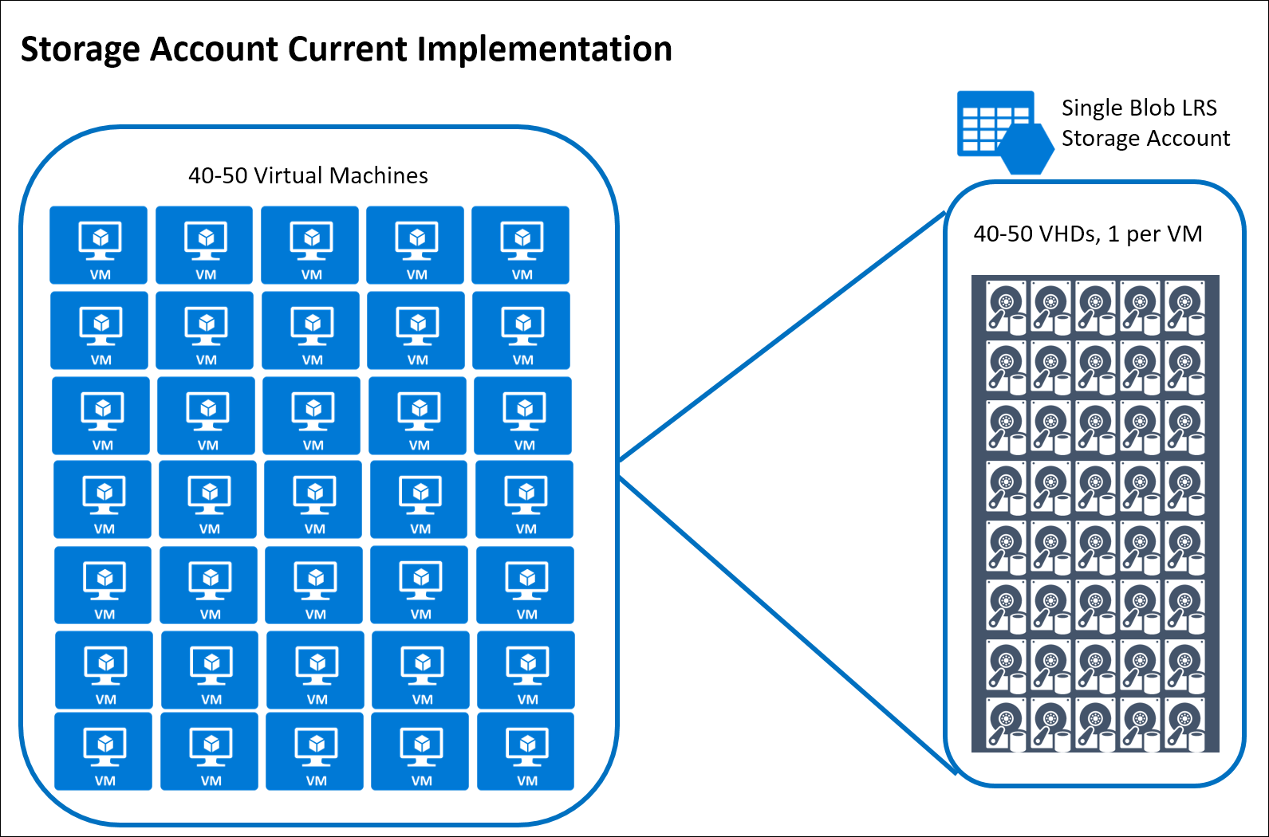
Current R&D Storage Account Configuration

Slide 8
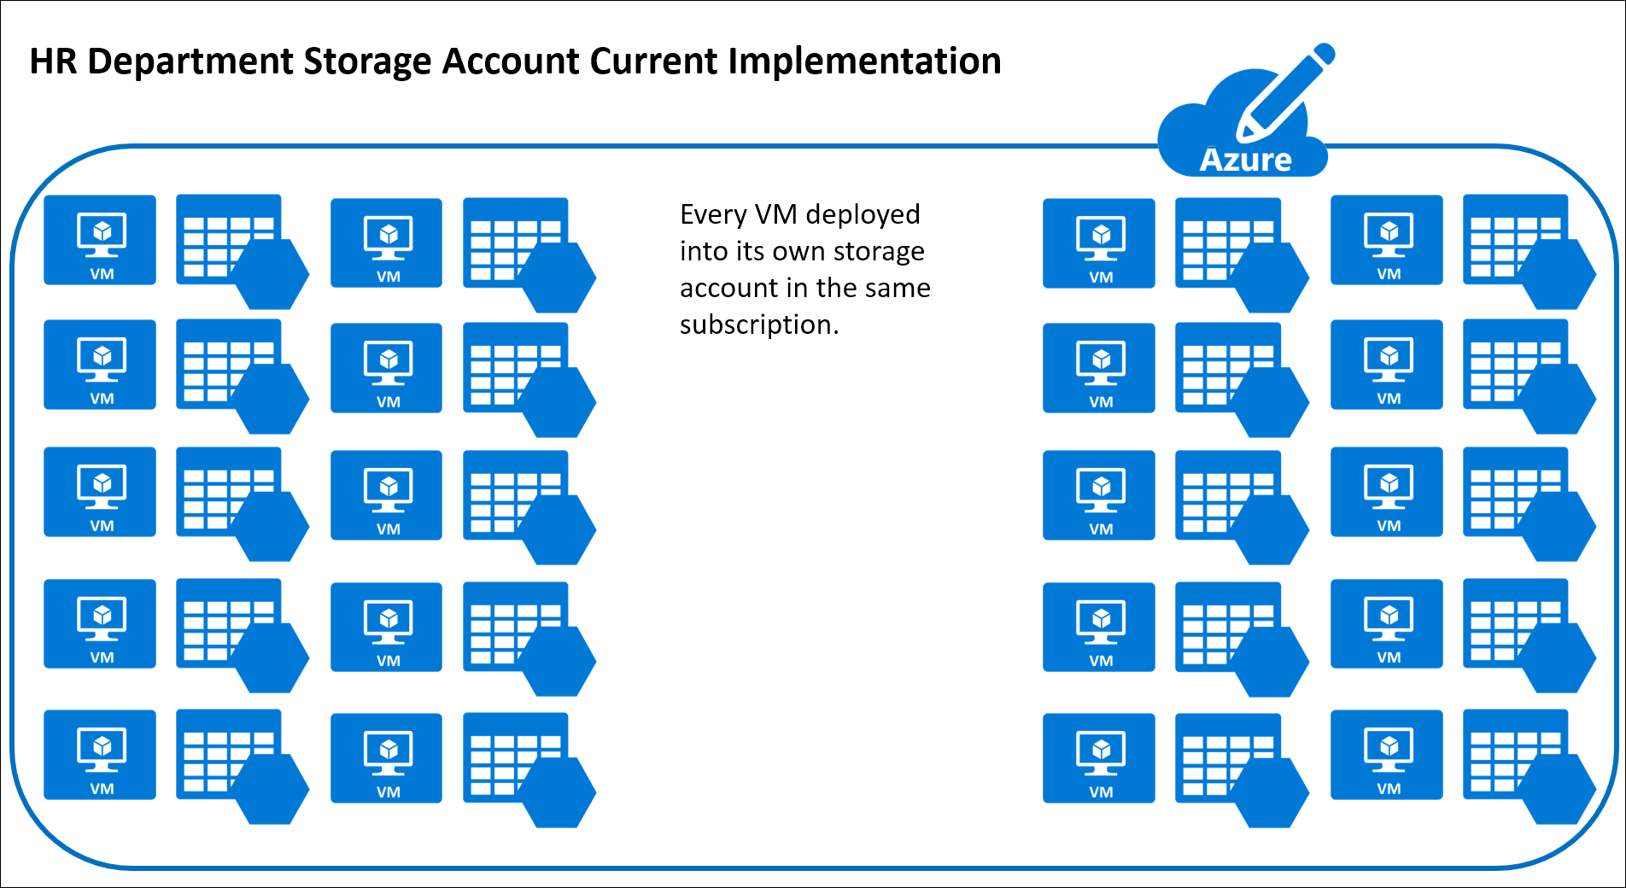
Current HR Storage Policy Configuration

Slide 9
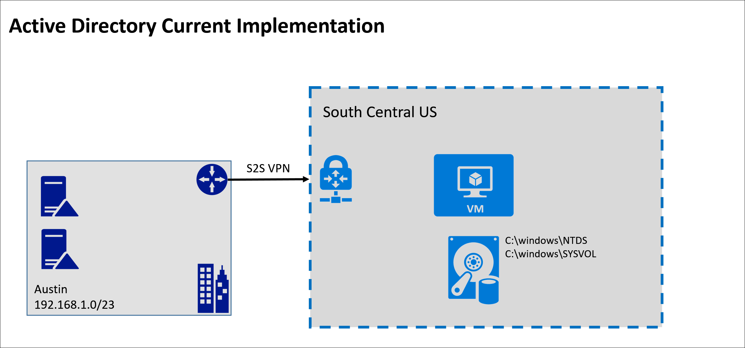
Current Active Directory Configuration

Slide 10
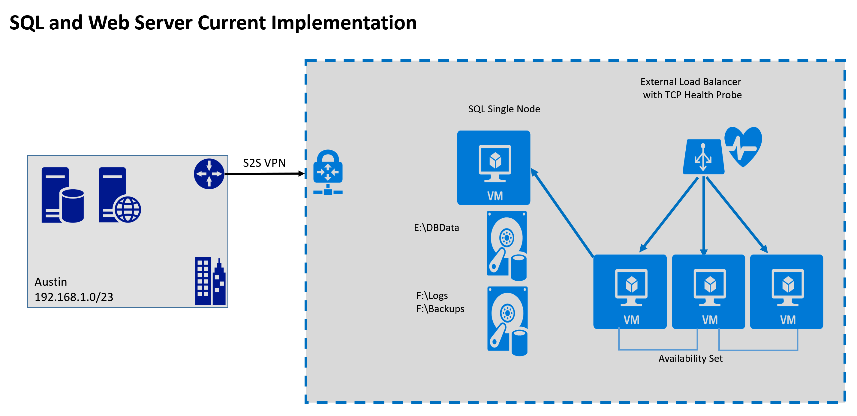
Current SQL and Web Server Configuration

Slide 11
FusionTomo Inc.’s critical applications
Authentication and Authorization infrastructure for the organization.
The ordering website for the employees and the customers to order parts, repairs, and provide support.
This ordering website allows for the tracking of the parts and support incidents.
The database that supports the website for finances, ordering, accounts receivable, and customer information.
The website and database also provide sales leads and a catalog of current inventory for ordering.
Third-party manufacturing plants and factories access their data via the interface of the website as well.

Slide 12
Customer needs
The IT department is new to Azure. Though they have successfully moved some workloads onto the platform, they have asked for guidance on deployment best practices.
Identify the infrastructure requirements that should to be configured to provide redundancy and resiliency to the web servers, the database servers, and the authentication and authorization servers.
Identify components and resources in Azure that can provide the features of resiliency for the organization.
A plan for recovery from a region-wide service disruption.
A plan for recovery from data corruption or accidental deletion.
Backup plans for all server roles and functions.
A functional storage policy in place for the anticipation of growth in Azure.
Monitoring option for issues that may arise on the servers and in Azure.

Slide 13
Customer concerns/objections
“Cost is a huge concern for us. We have already deployed server instances into Azure. We want to avoid any unnecessary expenditures and duplication of effort.”
“The web application needs to have the ability to scale as we grow. What aspect of the cloud will allow this to be a reality?”
“Downtime is becoming more of an issue for us due to development and production environments not being separate. We need to separate these from one another to avoid outages.”
“Connectivity is becoming an issue for our self-hosting of applications. We are concerned that the cloud may be constrained as well.”
“Our current backup/recovery system works just fine.”

Slide 14
Customer objections (continued)
“We already have a point of presence for our customers that we do not want to change. How can we provide cross-region resiliency without impact to our customers?”
“We are very concerned about the disk space issue that occurred earlier with our AD DS Domain Controllers (DCs). This outage impacted our Web Servers and Database Servers as well. Will this be addressed per the resiliency plan?”

Slide 15
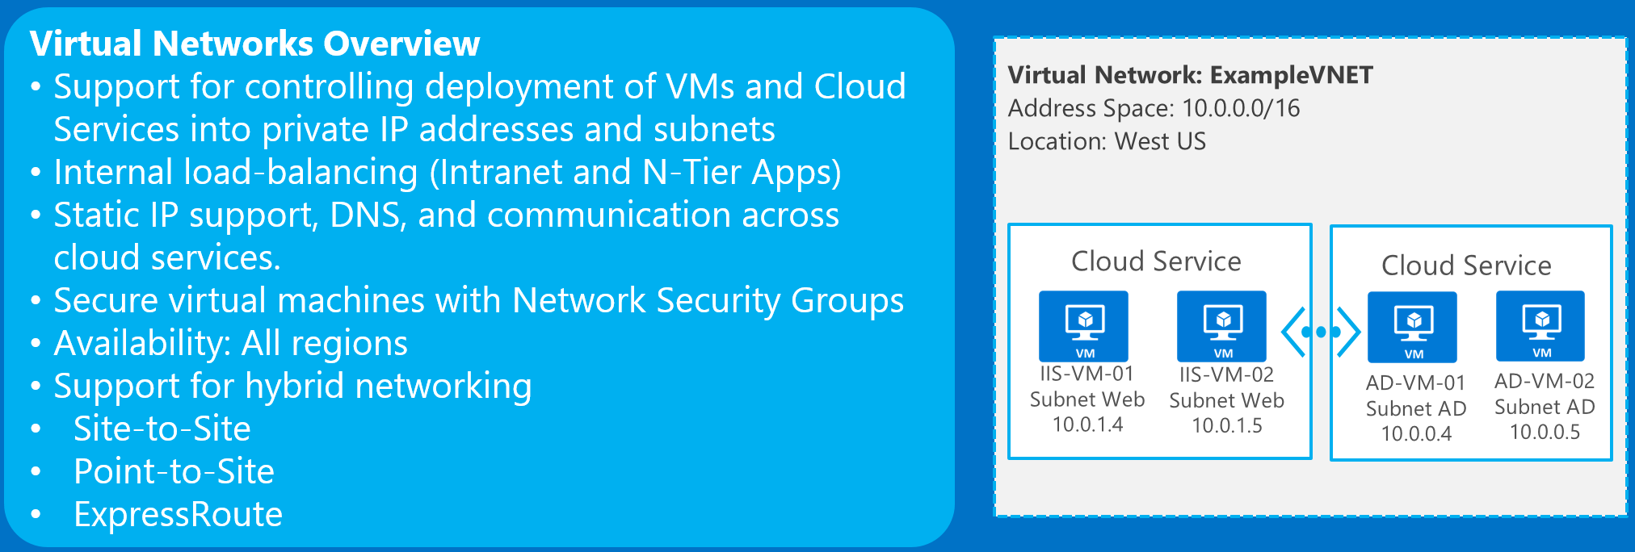
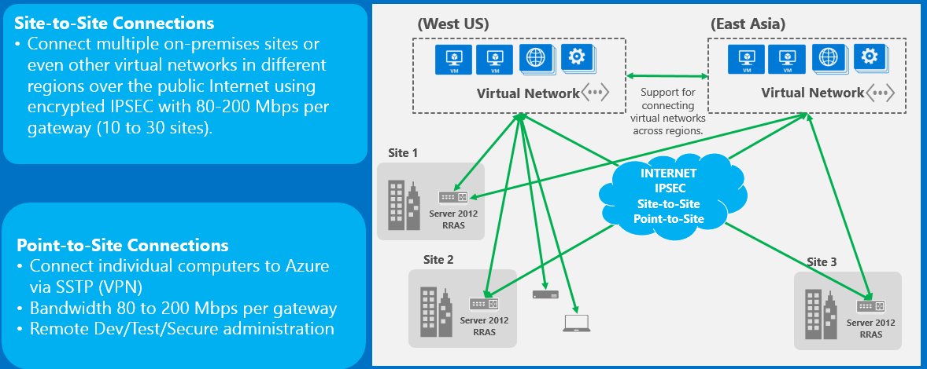
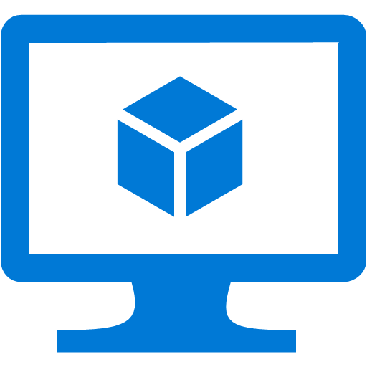
Common scenarios—infrastructure as a service
Virtual Machines overview
Supports Windows or Linux workloads
Sizes from: 1 core 778 MB to 32 and 448 GB
Full control
Direct connectivity to virtual networks
Familiar tools
Support for automated management and deployment using templates or scripts
Notes:
Basic gateway is now 100Mbps
https://docs.microsoft.com/en-us/azure/vpn-gateway/vpn-gateway-about-vpngateways

Slide 16
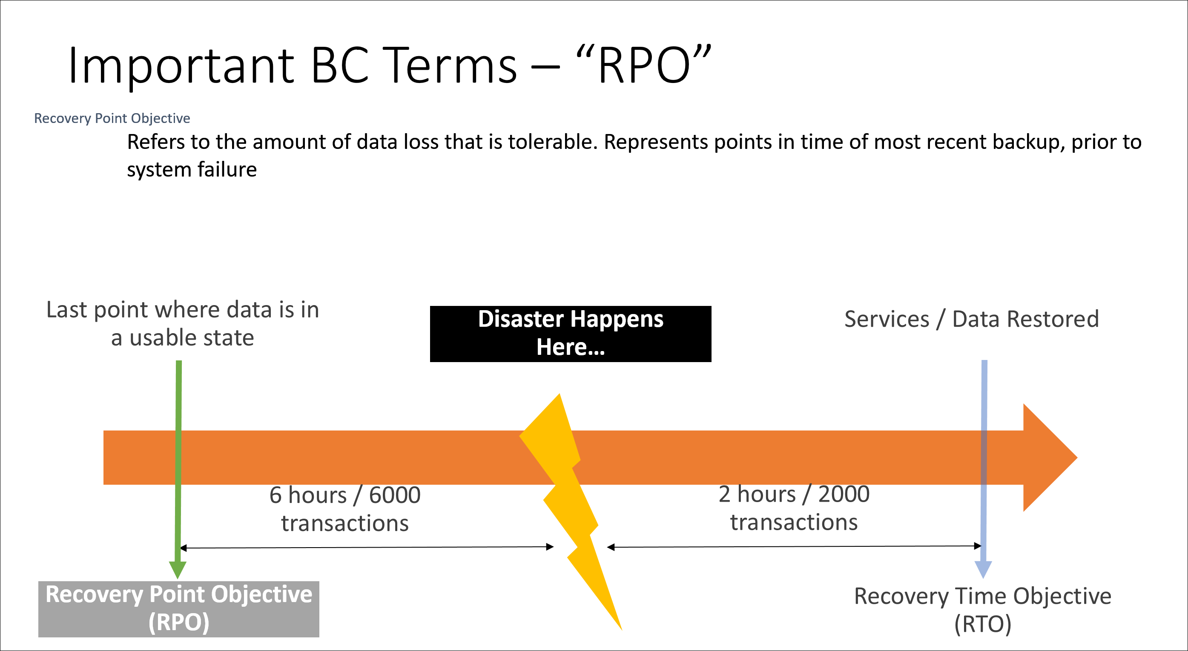
Common scenarios—Recovery Point Objective

Slide 17
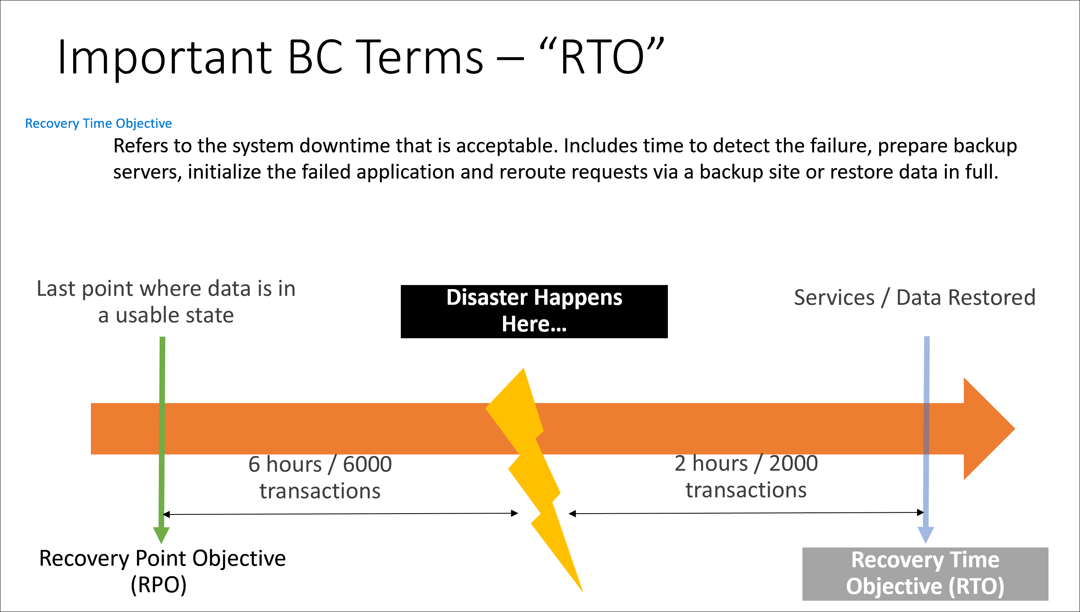
Common scenarios—Recovery Time Objective

Slide 18
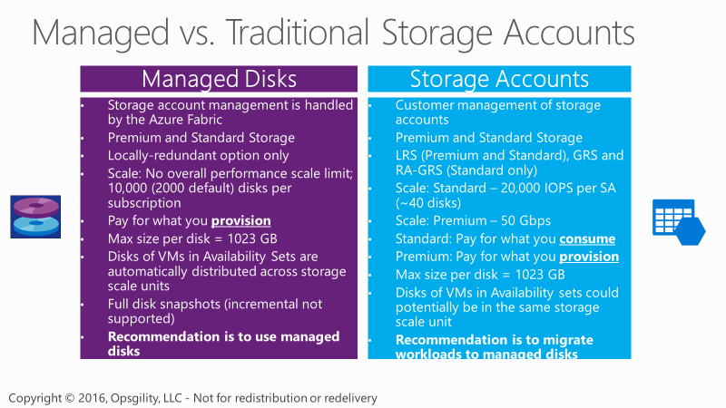
Common scenarios – Managed Disks

Slide 19
Step 2: Call to action—design the solution
Outcome
Design a solution and prepare to present it to the target customer audience in a 15-minute chalk-talk format.
Timeframe
60 minutes
Business needs (10 minutes) | Respond to questions outlined in your guide, and list the answers on a flip chart.
Design (35 minutes) | Design a solution for as many of the stated requirements as time allows. Show the solution on a flip chart.
Prepare (15 minutes) | Identify any customer needs that are not addressed with the proposed solution. Identify the benefits of your solution. Determine how you will respond to the customer’s objections. Prepare for a 15-minute presentation to the customer.

Slide 20
Step 3: Call to action—present the solution
Outcome Present a solution to the target customer audience in a 15-minute chalk-talk format.
Timeframe
30 minutes
Directions
Pair with another table.
One table is the Microsoft team and the other table is the customer.
The Microsoft team presents its proposed solution to the customer.
The customer asks one of the objections from the list of objections.
The Microsoft team responds to the objection.
The customer team gives feedback to the Microsoft team.
Tables switch roles and repeat Steps 2 through 6.

Slide 21
Wrap-up
Outcomes
Identify the preferred solution for the case study.
Identify solutions designed by other teams.
Timeframe
15 minutes

Slide 22
Preferred target audience
Lewis Franklin, Head of Infrastructure and Operations
Richard Wade, Infrastructure Lead
Tony Stark, Research and Development Group Director
Janet Lewis, Business Continuity Team Director

Slide 23
Preferred solution overview
The solution for FusionTomo Inc. involved several technologies, including:
Site-to-Site VPN Gateway for connectivity from on-premises corporate home office and branch office locations in Azure virtual networks.
Site-to-Site VPN Gateway for connectivity between Azure Regions deployed for resiliency.
Resiliency integrated into each aspect of the deployment and architecture to provide the opportunity for high SLA and performance. These include:
The use of Managed disks to alleviate FusionTomo’s management of storage accounts.
Legacy Application deployed to Azure in a VM with premium storage, necessary to achieve 99.9% SLA. VM will be protected with Azure Backup (IaaS VM backup).
Virtual networks deployed in both Azure regions.
Subnets defined Apps, Data, Identity, and VPN Gateway.
Backup Vaults in each of the Azure Regions to provide backups for the servers.
3 domain controllers deployed in Azure, 2 in primary region & 1 in secondary region
2 VM Scale Sets deployed in Azure to service the ordering web site. Initial capacity of primary VMSS (South Central US) is 3 VMs. Initial capacity of secondary VMSS is 1 VM.
2 synchronous SQL replicas in S. Central US. 1 async SQL replica in N. Central US.

Slide 24
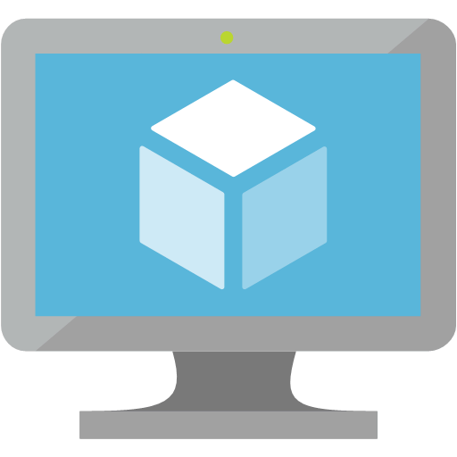






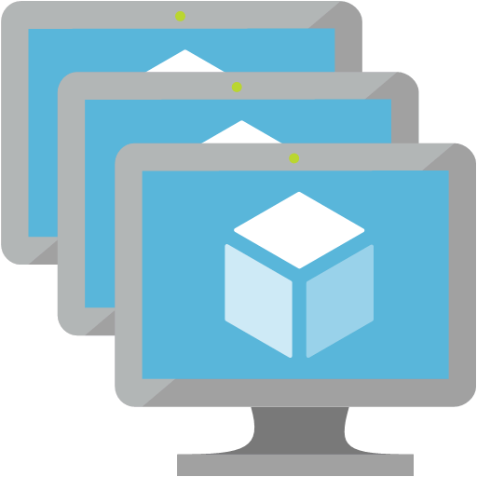


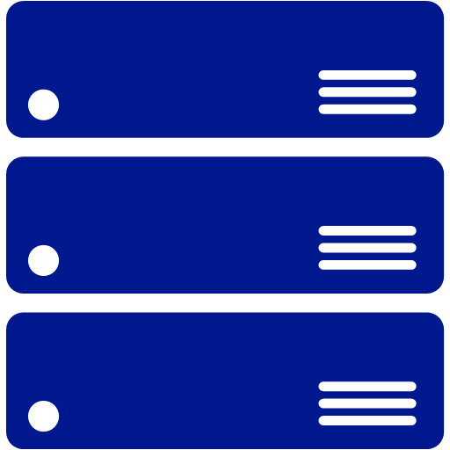





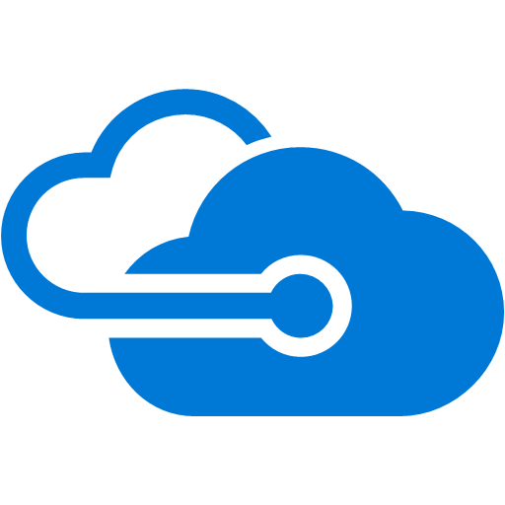
Recommended Approach
NSG
NSG
NSG
NSG
Legacy
App
Vnet DNS Servers
DC1
Sync
SQL1
Azure Backup Server
DC2
SQL2
Web VMSS
OMS Workspace (Monitoring)
Gateway
Subnet
10.0.3.0/29
Headquarters
Identity Subnet
10.0.2.0/24
Data Subnet
10.0.1.0/24
Apps Subnet
10.0.0.0/24
10.0.0.0/16
Pri. 1
Async
Recovery Services Vault
South Central US
Branch Office
NSG
NSG
NSG
NSG
Pri. 2
Traffic Manager (Priority)
DC3
SQL3
Web VMSS
Gateway
Subnet
172.16.3.0/29
Branch Office
Identity
Subnet
172.16.2.0/24
Data
Subnet
172.16.1.0/24
Apps
Subnet
172.16.0.0/24
Legend
172.16.0.0/16
Recovery Services Vault
Availability Set
North Central US
Primary S2S
Branch Office
FusionTomo Subscription
Secondary S2S
From Internet

Slide 25
Preferred solution overview (continued)
SQL configured in an Always On Availability Group (primary, synchronous secondary and asynchronous remote secondary).
All workloads that have multiple VMs are deployed in availability sets for fault and upgrade protection with an SLA of 99.95%
Any single instance workloads will be deployed using Premium Storage to ensure a 99.9% SLA.
Load balancers configured with health probes to remove servers that do not respond out of rotation.
Traffic Manager configured in priority mode for failover should the need arise.
Monitoring and alerting through OMS, to guard against disk space alarms.
IaaS VM Backups configured for all IaaS VMs via Azure Backup
Azure Backup Server deployed to protect SQL databases and system state of 1 domain controller.

Slide 26
Azure Virtual Network configuration architecture
The closest Azure region to Austin, TX is South Central U.S. A VNET is deployed and configured with the address space 10.0.0.0/16 and with subnets for the following tiers:
Apps: 10.0.0.0/24
Data: 10.0.1.0/24
Identity: 10.0.2.0/24
Also, create a GatewaySubnet for a VPN Gateway to allow for Site-to-Site VPN connectivity between Austin and Azure with the following information:
GatewaySubnet: 10.0.3.0/29
Secondarily, in North Central U.S., a VNET is deployed and configured with the address space of 172.16.0.0/16 and with subnets for the following tiers:

Slide 27
Azure Virtual Network configuration (continued)
Apps: 172.16.0.0/24
Data: 172.16.1.0/24
Identity: 172.16.2.0/24
Also, create a GatewaySubnet for a VPN Gateway to allow for Site-to-Site VPN connectivity between Austin and Azure with the following information:
GatewaySubnet: 172.16.3.0/29
Gateways are provisioned in both VNets. Connections are then created between the gateways allowing region-to-region communication, AD replication, SQL replication, backup copies, and redundancy of roles for the SQL servers, IIS servers, and AD DS DCs.
Also, after this is completed, the headquarters and branch sites can also be connected via Site-to-Site VPN to both VNets and allows for resilient IaaS infrastructure to be deployed into Azure.

Slide 28
Network Security Group usage
Network security groups (NSGs) will be used to help secure the configuration by limiting traffic flow exactly as a firewall rule does. NSGs may be applied to either individual NICs or to Subnets. In FusionTomo’s case there will be a single NSG applied to each subnet.
Apps Tier NSG
Name | Priority | Source | Protocol | Source Port Range | Destination | Dest. Port Range | Action
HTTP | 100 | ANY | TCP | ANY | 10.0.0.0/24 | 80 | ALLOW
HTTPS | 110 | ANY | TCP | ANY | 10.0.0.0/24 | 443 | ALLOW
RDP | 120 | 192.168.1.0/23 | ANY | ANY | 10.0.0.0/24 | 3389 | ALLOW
Data Tier NSG
Name | Priority | Source | Protocol | Source Port Range | Destination | Dest. Port Range | Action
 | 100 | 192.168.1.0/23 | TCP | ANY | 10.0.2.0/24 | 1433 | ALLOW
SQLINT | 110 | 10.0.0.0/24 | TCP | ANY | 10.0.2.0/24 | 1433 | ALLOW
RDP | 120 | 192.168.1.0/23 | ANY | ANY | 10.0.2.0/24 | 3389 | ALLOW
Identity Tier NSG
Name | Priority | Source | Protocol | Source Port Range | Destination | Dest. Port Range | Action
RDP | 100 | 192.168.1.0/23 | ANY | ANY | 10.0.3.0/24 | 3389 | ALLOW
ADDS Replication1 | 110 | 192.168.1.10 | ANY | ANY | 10.0.3.0/24 | ANY | ALLOW
ADDS Replication2 | 120 | 192.168.1.11 | ANY | ANY | 10.0.3.0/24 | ANY | ALLOW
On-Premise Domain Controllers

Slide 29
Network Security Group usage
Be sure to reproduce the following charts for both regions’ VNETs, adjusting the destination IP range as appropriate for the 172.16.0.0 address space in the North Central U.S.
Apps Tier NSG
Name | Priority | Source | Protocol | Source Port Range | Destination | Dest. Port Range | Action
HTTP | 100 | Any | TCP | Any | 172.16.0.0/24 | 80 | Allow
HTTPS | 110 | Any | TCP | Any | 172.16.0.0/24 | 443 | Allow
RDP | 120 | 192.168.1.0/23 | ANY | Any | 172.16.0.0/24 | 3389 | Allow
Data Tier NSG
Name | Priority | Source | Protocol | Source Port Range | Destination | Dest. Port Range | Action
SQLEXT | 100 | 192.168.1.0/23 | TCP | Any | 172.16.2.0/24 | 1433 | Allow
SQLINT | 110 | 172.16.0.0/24 | TCP | Any | 172.16.2.0/24 | 1433 | Allow
RDP | 120 | 192.168.1.0/23 | ANY | Any | 172.16.2.0/24 | 3389 | Allow
Identity Tier NSG
Name | Priority | Source | Protocol | Source Port Range | Destination | Dest. Port Range | Action
RDP | 100 | 192.168.1.0/23 | ANY | Any | 172.16.3.0/24 | 3389 | Allow
ADDS Replication1 | 110 | 192.168.1.10 | ANY | Any | 172.16.3.0/24 | ANY | Allow
ADDS Replication2 | 120 | 192.168.1.11 | ANY | Any | 172.16.3.0/24 | ANY | Allow
On-Premise Domain Controllers

Slide 30
Virtual Network Gateway configuration details
Within Azure, create a virtual network gateway that will allow for connectivity to FusionTomo Inc.’s Austin office site and allow for connectivity for the three branch office sites via Site-to-Site connectivity. The gateway type is defined as VPN and the VPN type is defined as Route-based to allow for multiple Site-to-Site (S2S) connections.
Route-based VPN Gateway must be the choice here for the option of multiple gateway Internet Protocol Security (IPsec) tunnels. The Gateway SKU needs to be the correct choice as well. In this scenario, a Standard gateway would suffice for the tunnels needed and the bandwidth options. FusionTomo can scale up the gateways to High Performance if needed with a simple PowerShell command.

Slide 31
Storage details
Moving beyond using only one storage account is a must for FusionTomo. The sub-optimal storage configurations at FusionTomo, such as 40 disks in a single storage account, or creating a single storage account per VM disk, are solved using managed disks. Managed disks remove the scalability limits associated with storage accounts, leaving the number of disks per subscription as the only remaining scale consideration.
Managed disks only are available with the LRS resiliency option; however, the lack of platform replication is mitigated:
Second region deployed with the same workloads
Utilizing application-level replication (Active Directory and SQL)
Azure Backups of IaaS VMs, SQL and System State data
Managed Disks honor Availability Sets, so this ensures that VMs in an Availability Sets will not have their storage backend fail for multiple VMs at the same time.

Slide 32

Preferred Storage Approach
OS
OS
OS
P10
C:\
C:\
P10
C:\
P10
Database/Logs
App
Files
P10
F:\
Data Disks Optional
P10
F:\
Domain Controllers
Web VM Scale Set
Legacy App
Premium Managed Disks
Premium Managed Disks
Premium Managed Disks
Storage Considerations
With Premium Pay for size provisioned
LRS Only
Mix Standard & Premium where possible
Single instance VM use Premium for all disks to ensure 99.9% SLA
OS
P10
C:\
Databases
P20
F:\
SQL Servers
Logs
P20
G:\
Premium Managed Disks

Slide 33
Legacy Application Availability
The existing legacy application cannot be moved into an Availability Sets as it is based on only one VM. As a result, the best way to ensure its availability is to run it with Premium storage. Azure introduced single instance SLA’s for VM’s, so moving this application across to Azure would now result in a 99.9% SLA. As the existing hardware on which it’s currently deployed on site is aging, moving this application would benefit from reduced hardware expenditure through a refresh.
The application will eventually require a re-write to take advantage of the advanced features available in Azure. This could be done once the application was in Azure.
To be able to achieve the SLA provided in Azure, the disks used for the VM must be premium storage disks. There is a limitation on Azure premium storage accounts such that they only support LRS. As such a mechanism to copy the blob across to another region needs to be setup. A backup of the VM will also need to be scheduled.

Slide 34
Active Directory configuration details
Active Directory Domain Services Domain Controllers are deployed into Azure as IaaS Virtual Machines. These are extensions of the on-premises AD DS DCs, and allow for resiliency for the authentication and authorization mechanism that FusionTomo employees use today.
Configure multiple VMs as Domain Controllers in the South Central U.S. region and add another in the North Central Region. AD DS Sites and Services will be configured with the 2 Azure regional virtual networks as new sites in AD. If a prolonged transfer of primary region is set to North Central, an additional AD DS DC will be deployed into the same availability set.
Each Domain Controller will be configured with a Data Disk for the AD DS database and will be configured to back up via Azure Backup for disaster recovery and business continuity. To avoid any issue with the AD DS DB, this data disk needs to be configured with caching set to NONE.

Slide 35
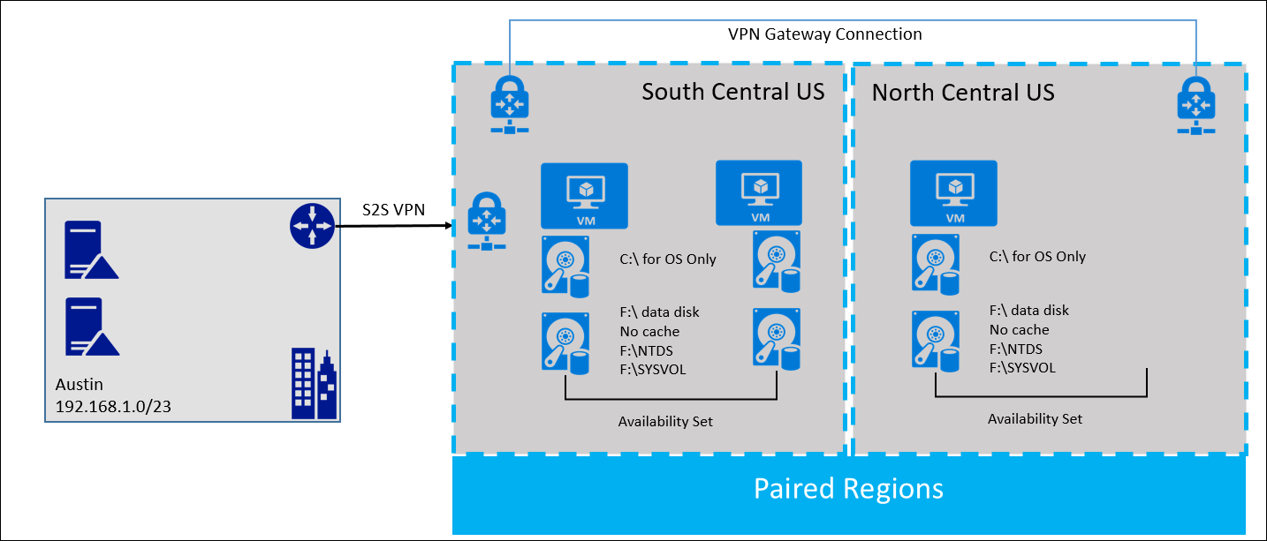
Active Directory Domain Controllers

Slide 36
SQL Always-On configuration details
SQL Server is critical to the availability of the applications at FusionTomo. SQL will be implemented using a total of 3 Servers configured using Always On Availability Groups. The 2 servers in South Central US comprise a single primary and a secondary, synchronously replica of the database. Another replica exists in North Central US, which uses asynchronous replication. The 2 SQL servers in South Central US will be deployed into an Azure Availability set, and are configured behind an internal load balancer which will allow client machines to connect to the Listener which will direct traffic to the machines that is designated as the primary replica machine. If there was a manual failover to North Central replica it would then become the primary and would be read/writeable.
The SQL Servers will use Premium managed disks with a the database and log files on separate disks. The TempDB will be housed on the local host SSD drive and split to match the number of Cores in the VM.
A combination of Azure Backup Server and built-in SQL backup tools will be used to provide the Application consistent backup and DBA required backups required by FusionTomo. The Azure Backup Server provides the application-consistent protection for the databases while the SQL Backup tools can backup and restore the SQL database directly to/from Azure Blob storage which can be critical during some normal operations that DBAs make take on a regular basis.

Slide 37
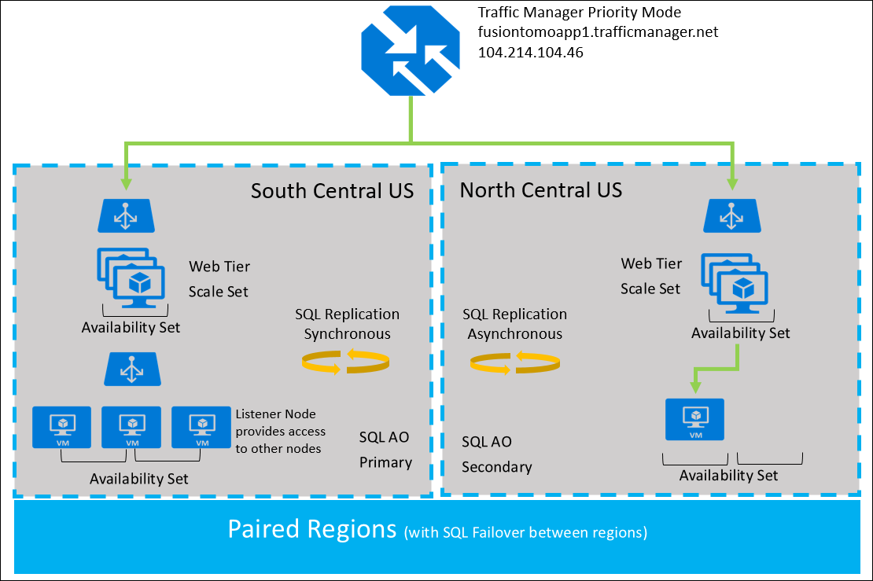
SQL Always On Multi-Region

Slide 38
Web Server configuration details
The IIS Web Servers will be configured in the Apps Subnet and built on IaaS VMs. To help manage the load and provide performance options, the servers will be deployed into a Scale Set within Azure. This will allow FusionTomo the option to scale horizontally (out or in) the numbers of web VMs based on performance metric. This configuration will preclude FT’s practice of scaling manually.
FusionTomo Inc.’s use of an Availability Set for the Web farm VMs should be applauded. Availability Sets provide protection and resiliency against unplanned and planned downtime. We configured the availability set to spread the VMs across three fault domains and five update domains.
A change of the Health Probe on the Load Balancer to use an HTTP health probe rather than a TCP probe is wise. The HTTP probe will monitor for HTTP code 200, indicating a healthy web site. If anything, other than a 200 is detected (such as the HTTP 500 the customers experienced), then that server will be removed from the rotation until the site is deemed healthy again.

Slide 39
Traffic Manager configuration details
FusionTomo’s concern about large deployments in a single Azure region are somewhat at odds with their concerns about cost. To attempt to satisfy both goals, we deployed a smaller subset of their ordering site into the paired region (North Central US) along with a readable SQL replica of the required database. We also deployed a single ADDS DC in the secondary region. Finally, we configured a Traffic Manager profile using the Priority load distribution option. The South Central-based site is the highest priority end-point, so users will always be directed there unless that site is down.
If an outage impacts the highest priority site then the asynchronous SQL replica can be set to primary, making it readable and writeable. A prolonged outage may necessitate adding IaaS VMs in the North Central region to provide a local SQL replica and another ADDS DC. The Web scale set will auto-scale based on load.

Slide 40
Load Balancer configuration details
To assist with resiliency, load balancers will be configured so that there is no single point of failure for any of the tiers of the application.
An external load balancer is deployed and configured for the public-facing website that will direct the traffic from the Internet through to the web servers, providing the application for customers and external users. This load balancer will be set up with an HTTP health probe and will make sure that the servers providing the application are healthy and responding to IIS calls. Should a server not respond with a 200 to the probe, it will be removed from the rotation until such a time that it is healthy again.
An internal load balancer will also be used to direct traffic to the AlwaysOn Availability Group listener resource. This allows SQL clients to find the availability group listener, enabling client connectivity no matter which SQL server is primary. TCP health probes will be configured, monitoring TCP on port 1433. We ensure the firewall on each server and any inline network security groups allows inbound traffic on TCP 1433.

Slide 41
Monitoring configuration details
While diagnostics and other options do exist in the portal, there are deeper and richer options available within Azure and these link with existing monitoring options from System Center Operations Manager to allow for hybrid monitoring. Operations Management Suite (OMS) is the tool of choice to quickly enable robust monitoring. It will help provide a single portal for all management tasks, can be on-boarded in a rapid fashion, can integrate with FusionTomo’s current management tools, enhance System Center, and extend management and monitoring to Azure.
OMS will help FusionTomo identify, assess, and mitigate any missing patches on SQL, IIS, Windows Server, Active Directory, etc. There are options to monitor and apply recommended resolutions for many server types.
https://www.microsoft.com/en-us/cloud-platform/operations-management-suite

Slide 42
Customer objections
Objection
“Cost is a huge concern for us. With looming infrastructure and server replacement costs, we want to avoid any unnecessary expenditures.”
Potential answer
FT can restructure the way IT budgets are spent and ultimately save funds by rolling out the infrastructure into Azure as opposed to rolling out the infrastructure in the Austin office. By, building out the infrastructure in Azure there is no upfront capital investment. The cost moves to an operating expense in a pay only for what you need and use model. This frees up FustionTomo’s capital for other investments which are more strategic to the growth of the company. This is also done in a more professional way in that Azure datacenters are world-class, enterprise-level datacenters providing a server environment that FT could never build on their own. Also, deploying virtual machines in Azure provides resiliency at a lower cost than physical hardware.
Also, consider that the cost of downtime might far outweigh the cost of the resiliency being built into the environment.

Slide 43
Customer objections
Objection
“The web application needs to have the ability to scale as we grow. What aspect of the cloud will allow this to be a reality?”
Potential answer
Scale sets from an IaaS perspective is a great choice to provide scaling of the web application. In the future, as the organization continues to grow, Azure Web Apps may also be an option from the PaaS perspective. This would allow for websites to scaled in many ways without the burden of managing VMs.

Slide 44
Customer objections
Objection
“Downtime is becoming more of an issue for us due to development and production environments not being separate. We need to separate these from one another to avoid outages.”
Potential answer
Azure allows for several ways to mirror a production environment and use it for development and testing. Backing up the infrastructure and restoring it to Azure is one way. Another way would be Azure Site Recovery (ASR). ASR can replicate VMs and physical machines to Azure to mirror the production environment. Another option could be to create a DevTest Lab in Azure to provide a complete separate environment for developers and testers.

Slide 45
Customer objections
Objection
“Connectivity is becoming an issue for self-hosting our application’s ordering system, support website, etc. We are concerned that the cloud may be constrained as well.”
Potential answer
Azure utilizes one of the largest worldwide networks and Microsoft has invested billions of dollars for the infrastructure and connectivity to be world-class. Should there be performance issues, the applications can be scaled to address the needs of the business. There are resizing options and VM instances that address network performance options as well.

Slide 46
Customer objections
Objection
“Our current backup/recovery system works just fine.”
Potential answer
Depending on which backup system has been deployed it can be can extended into Azure. There is no need to replace the current system; augment it. Azure backup works with Microsoft System Center Data Protection Manager (DPM) or you can use Microsoft Azure Backup Server to perform disk-to-disk-to-cloud VSS backups. For SQL Backup, use Azure Backup Server or direct backup to Azure Blob Storage. Using Microsoft Azure Recovery Services Agent, you can back up Windows Server and Client Files and Folders directly to the cloud as well. IaaS instances are also able to be protected with Azure Backup and all can be monitored in one central location.

Slide 47
Customer objections
Objection
“We already have a web application URL for our customers that we do not want to change. How can we provide cross-region resiliency without impact to our customers?”
Potential answer
Traffic Manager will allow multiple regions to be configured in a priority (or failover) algorithm using your existing web application URL. It will also allow one region or the other to be taken down for maintenance while the customers remain unaffected.

Slide 48
Customer objections
Objection
“We are very concerned about the disk space issue that occurred earlier with our ADDS DCs and nearly our Web Servers and Database Servers. Will this be addressed per the resiliency plan?”
Potential answer
Azure has built-in monitoring capabilities that will address the issue of an outage. Availability sets spread the IaaS VMs across multiple racks for fault protection. For ARM, 100 VMs can be spread across 3 fault domains and up to 20 upgrade/update domains in Azure, allowing for your application to be protected from outages caused by faults or updates to the hosts. Alerting can provide you with emails and even scripts that can be automated when the alert occurs to take recovery actions. There is also monitoring that can be configured to monitor the health of the storage accounts and provide reporting on this. Operations Management Suite can also be used for monitoring workloads.

Slide 49
Customer quote
“By using Azure, we can build out resiliency for all aspects of our environment. It allows for infrastructure, networking, web applications, Active Directory, and other items to be redundant and highly available. With some planning and deployment of resilient resources, I envision our LOB apps and websites will no longer be impacted by outages.”
—Lewis Franklin, Head of Infrastructure and Enterprise Operations, FusionTomo, Inc.

