Slide 1
Sign language detection using python
NAME: Shivansh Vashisth
UNIVERSITY ROLL NO: 2219660
SECTION: B2

Slide 2
INTRODUCTION
PROBLEM STATEMENT
Sign language detection using python
In a world where communication is a fundamental aspect of our daily lives, there exists a unique language of expression — sign language. For individuals with hearing impairments, sign language serves as a powerful means of communication, allowing them to convey thoughts, emotions, and ideas. However, bridging the communication gap between those who use sign language and those who do not can be a significant challenge.
Objective: The aim of our project is to develop a Sign Language Detection system using Python, harnessing the capabilities of computer vision and machine learning. This system not only recognizes and interprets hand gestures but also opens avenues for seamless communication between individuals who use sign language and the broader community.
.

Slide 3
WHAT IS sign language DETECTION?
Sign language detection refers to the process of using technology, particularly computer vision and machine learning, to interpret and understand sign language gestures made by individuals who use sign language as a means of communication. Sign language is a visual-gestural language that uses hand movements, facial expressions, and body postures to convey meaning. The goal of sign language detection is to enable machines to recognize and interpret these gestures, facilitating communication between individuals who use sign language and those who may not be familiar with it.
Key components of sign language detection systems include:
Hand Landmark Detection: Precise identification and tracking of key landmarks on the user's hand using computer vision techniques. Landmarks represent specific points on the hand that are crucial for interpreting gestures.

Slide 4
METHODOLOGY
Libraries used :-
OpenCV (cv2):
Purpose: Computer Vision Library
Description: OpenCV is a powerful open-source computer vision and machine learning software library. It provides tools for image and video processing, including features like image manipulation, object detection, and camera calibration.
NumPy:
Purpose: Numerical Computing Library
Description: NumPy is a fundamental package for scientific computing in Python. It provides support for large, multi-dimensional arrays and matrices, along with mathematical functions to operate on these arrays.
Mediapipe:
Purpose: Hand Landmark Detection Library
Description: Mediapipe is a library developed by Google that provides solutions for various perception tasks, including hand tracking. In this code, it's used for detecting hand landmarks.

Slide 5
.
4. CSV:
Purpose: CSV File Handling
Description: The csv module is a built-in Python module for reading and writing CSV (Comma-Separated Values)
files, which are commonly used for storing tabular data.
5.CvFpsCalc:
Purpose: Custom Utility (Not a standard library)
Description: It seems to be a custom utility for calculating frames per second (FPS) in a video stream using
OpenCV.
6.Model:
Purpose: Custom Modules (Not standard libraries)
Description: KeyPointClassifier and PointHistoryClassifier are custom machine learning models or modules
used for classifying hand gestures and finger gestures, respectively.

Slide 6
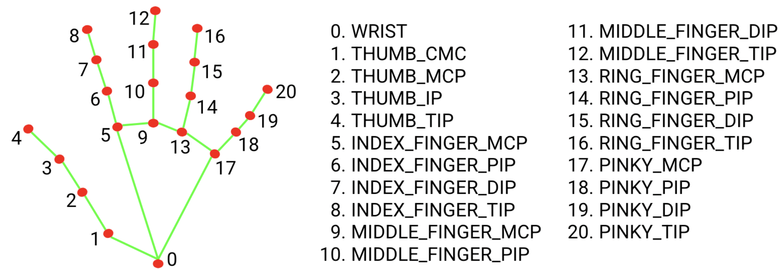
Hand landmark detection
The hand landmark model bundle detects the keypoint localization of 21 hand-knuckle coordinates within the detected hand regions. The model was trained on approximately 30K real-world images, as well as several rendered synthetic hand models imposed over various backgrounds.
The hand landmarker model bundle contains a palm detection model and a hand landmarks detection model. The Palm detection model locates hands within the input image, and the hand landmarks detection model identifies specific hand landmarks on the cropped hand image defined by the palm detection model.

Slide 7
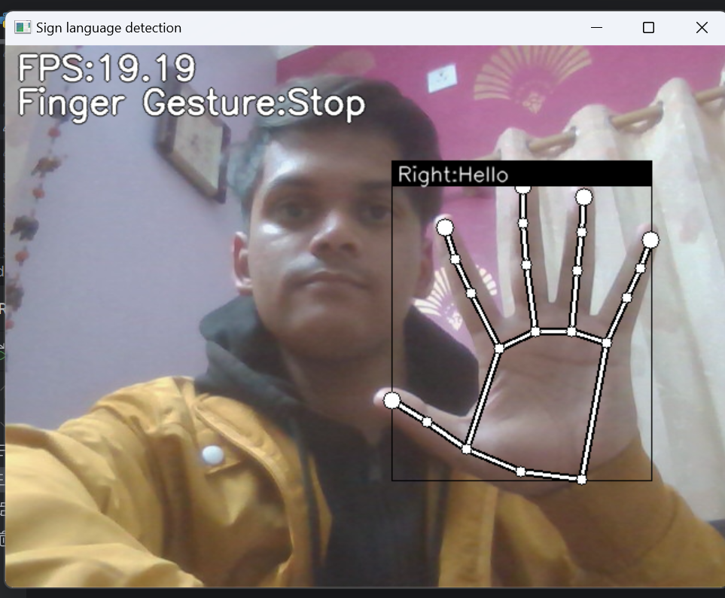
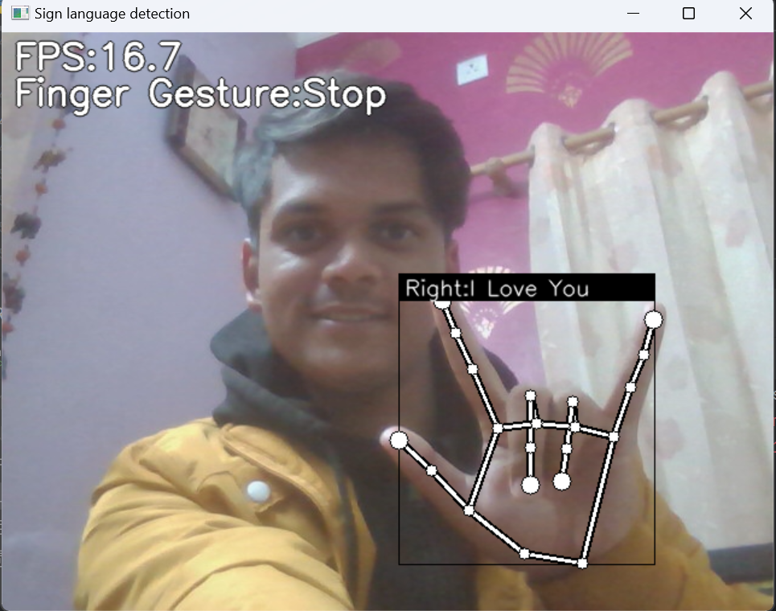
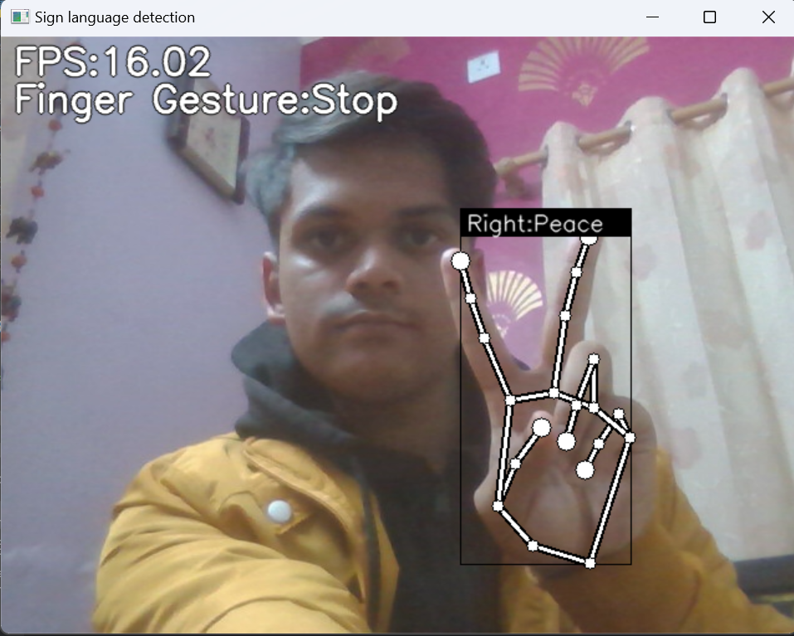
RESULT AND DISCUSSION

Slide 8
CONCLUSION AND FUTUTRE WORK
The code successfully integrates hand landmark detection with custom machine learning models to recognize hand gestures
and finger gestures in real-time.
It includes functionality for logging key points and point history data to facilitate the collection of labeled training data for the
machine learning models.
The code offers a simple user interface where users can interact and log gestures by pressing specific keys.
Future Work:
Model Optimization:
Further optimize the custom machine learning models (KeyPointClassifier and PointHistoryClassifier) for better accuracy and
real-time performance.
Expand Gesture Vocabulary:
Extend the gesture vocabulary by collecting and labeling more hand gestures to improve the system's versatility.
Dynamic Gesture Recognition:
Implement dynamic gesture recognition, considering the sequence of gestures over time rather than individual frames.
User Interface Enhancements:
Develop a more user-friendly interface for interaction, allowing users to define and customize their own gestures.

