Slide 1
WikiBot
CS6120:Natural Language Processing
Group 30
Ayush Patel
Shivansh Verma
Spandan Maaheshwari

Slide 2
Table of Contents
01
02
03
04
Data Mining
Scrapped data from web for Wikipedia Level -4 articles
Data Pre-processing
Cleaned the data using various NLP techniques
Summarization
Models such as TextRank, LDA, NMF and Bart
Recommendation
Built a recommendation system which recommends users articles based on their topic of interest

Slide 3
Data Mining
The Wikipedia Vital Level 4 dataset is a curated collection of over 10,000 articles that cover essential topics in human knowledge. These articles meet certain criteria, such as being notable, widely recognized, and having a significant impact on human knowledge.
By leveraging BeautifulSoup4 we crawled the Vital Level 4 articles homepage at https://en.wikipedia.org/wiki/Wikipedia:Vital_articles/Level/4
Then we found all the title headers for all the articles in each of the 11 subsections by identifying correct articles titles using complex BS4 logic and simultaneously removing all the pages that contained noise and improper articles.
Finally after getting all the article title headers from the webpage we would then feed the article titles to the Python Wikipedia-api to fetch the articles and the summary. Since the API endpoints are rate-limited we have implemented appropriate timeouts in the API calls to avoid requests getting blocked by the endpoint. We are using this API as it is already load balanced for research purposes.

Slide 4
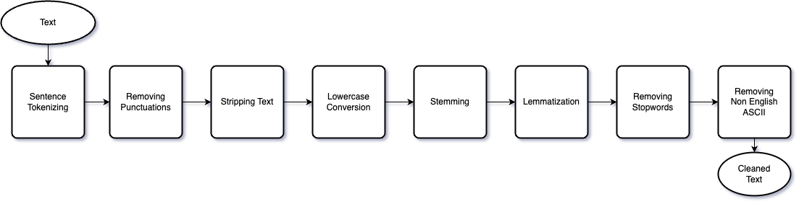
Data Cleaning

Slide 5
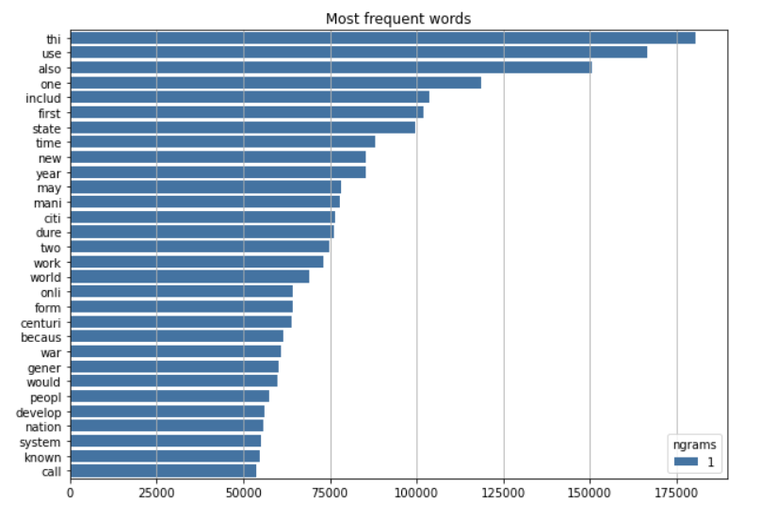
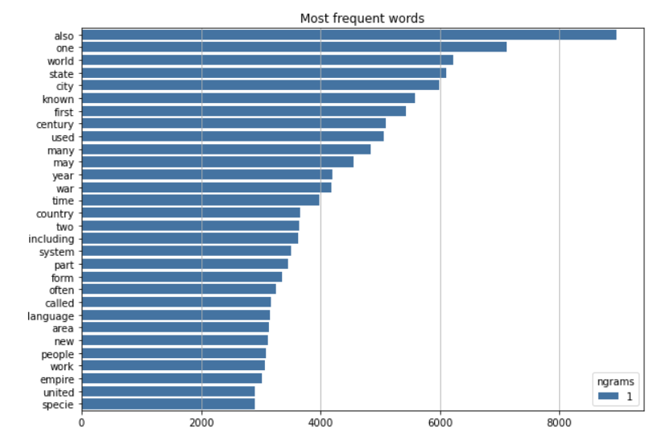
Data Analysis
This is a list of top most frequent words
Top words in article for unigram
Top words in summary for unigram

Slide 6
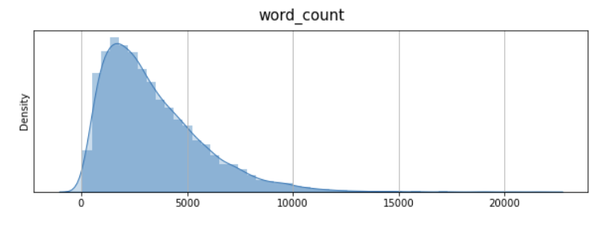
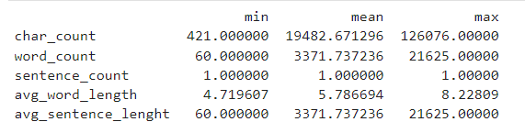
Data Analysis
Statistics for word and sentence counts

Slide 7
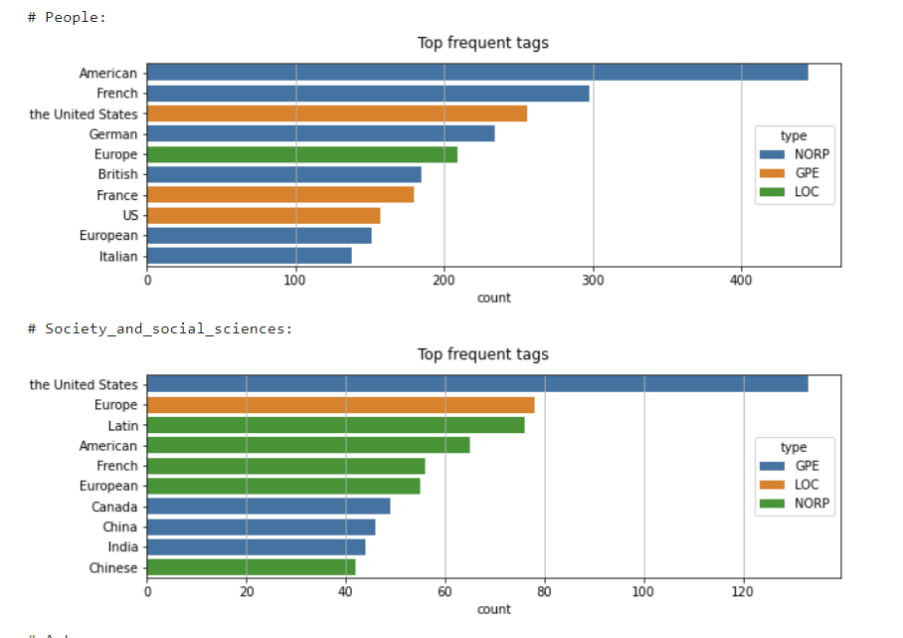
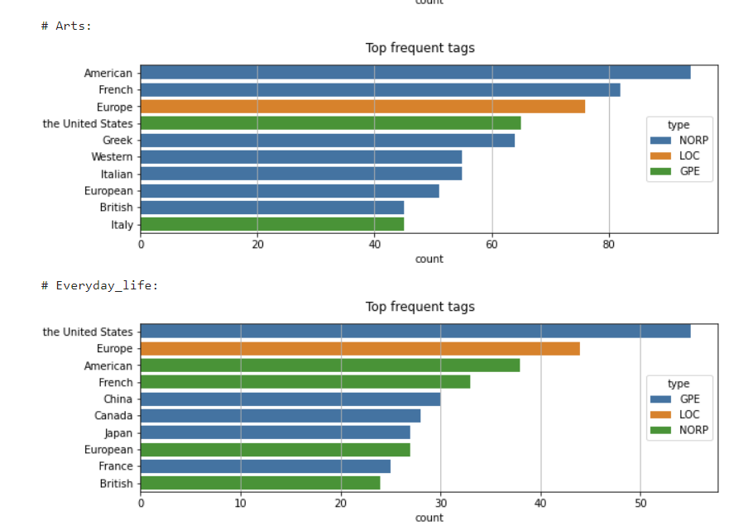
Data Analysis
This is a list of top most frequent words

Slide 8
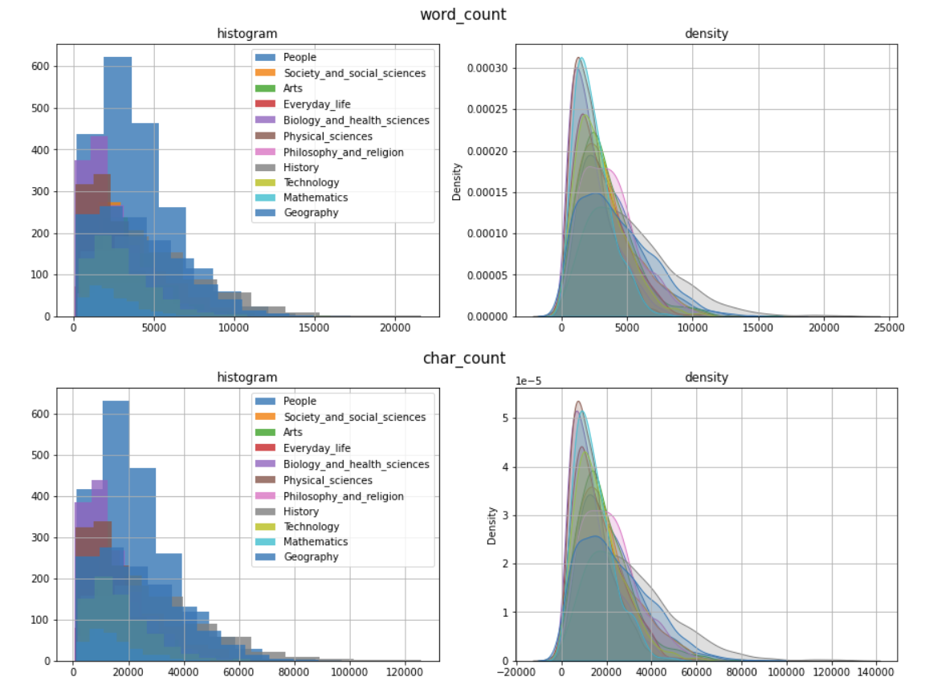
Data Analysis
Density Distribution for words and characters for all categories

Slide 9
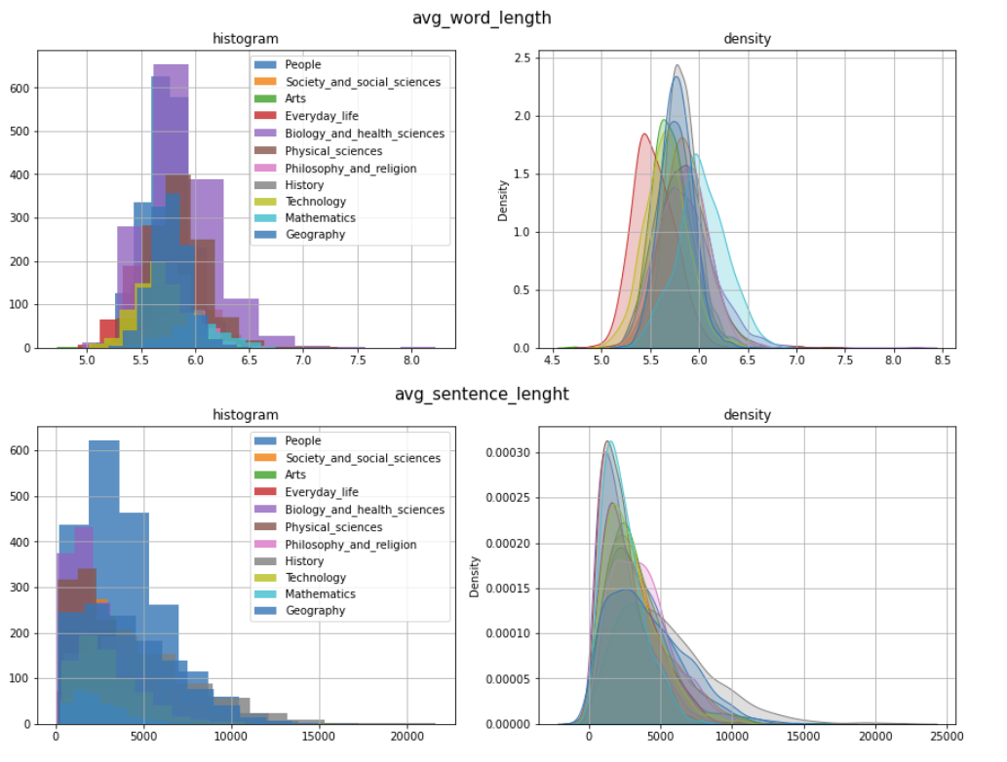
Data Analysis
Density Distribution for average word length and average sentence length for all categories

Slide 10
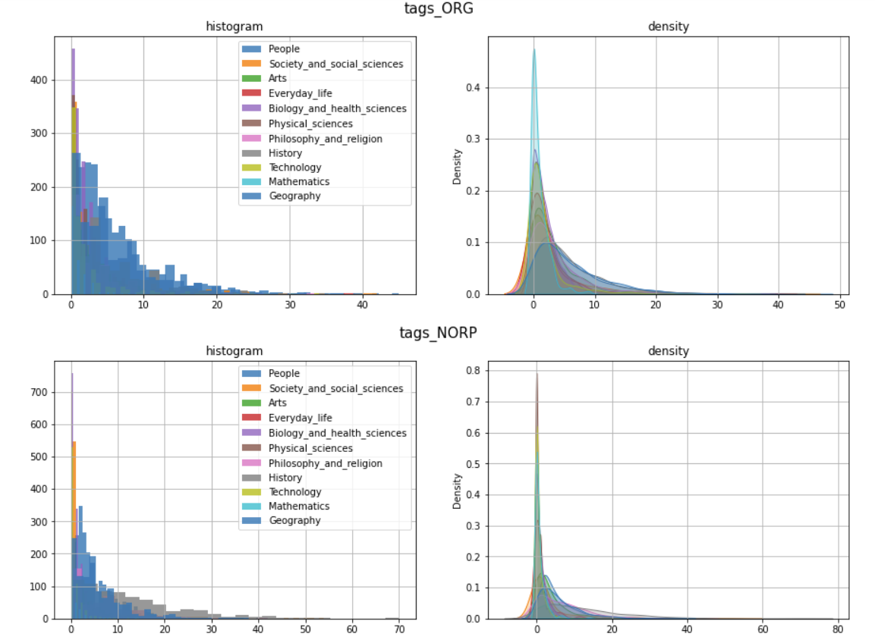
Data Analysis
Density distribution of Organization and Nationalities or religious or political groups for all categories

Slide 11
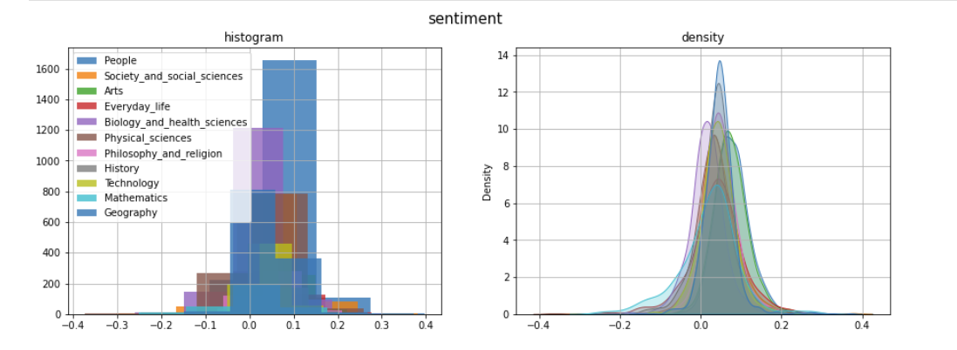
Data Analysis
Density Distribution of sentiment of articles. Sentiment ranges from -1 to 1 (-1 being negative 1 being positive)

Slide 12
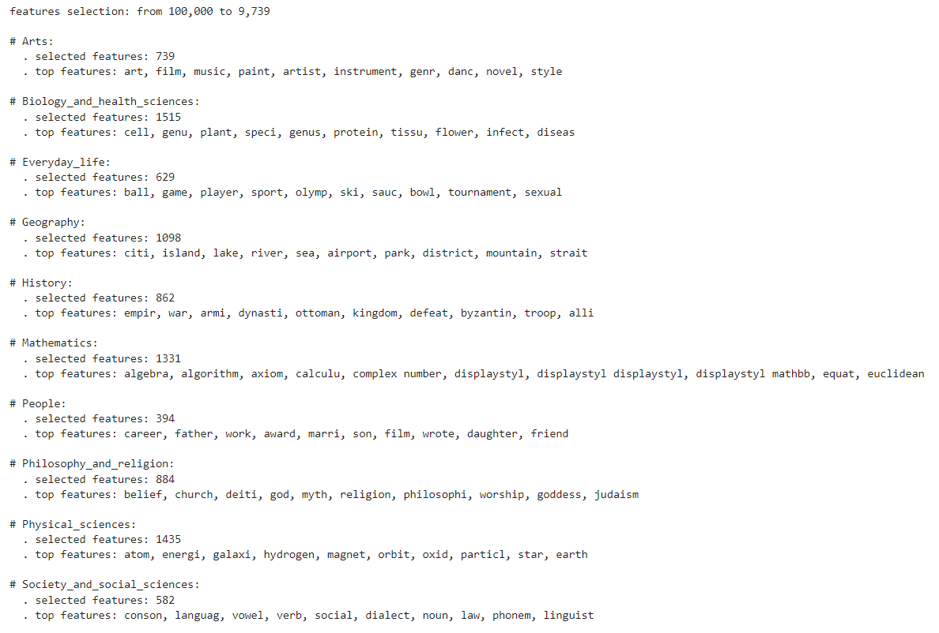
Data Analysis

Slide 13
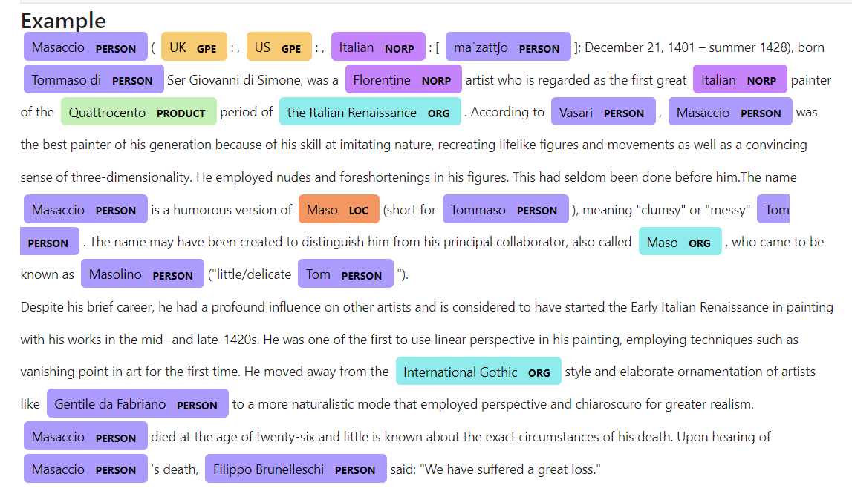
Named Entity Recognition
Named Entity Recognition involves identifying and categorizing named entities in text into predefined categories such as person names, organizations, locations, medical codes, etc.
NER has various applications in different fields such as information extraction, sentiment analysis, question answering, and summarization. For example, in our project, we used NER to highlight important entities in Wikipedia articles which could be helpful in generating summaries.

Slide 14
Multi-Class Classification
The model describes the process of multi-class text classification using Doc2Vec and logistic regression algorithms.
The Doc2Vec model was used to convert the text data into fixed-length feature vectors, which were then used as input to a logistic regression classifier.
Doc2Vec is an unsupervised algorithm that can generate fixed-length feature vectors for a given text document by considering the context of words within the document, allowing it to capture the semantic meaning of the text.
The results showed that the proposed approach achieved an accuracy of over 75%, demonstrating the effectiveness of Doc2Vec and logistic regression for multi-class text classification tasks.

Slide 15
Extractive Vs Abstractive Summarization
Extraction-based Summarization:
The extractive approach involves picking up the most important phrases and lines from the documents. It then combines all the important lines to create the summary. So, in this case, every line and word of the summary actually belongs to the original document which is summarized. Extractive summaries can often be inconsistent grammatically, as sentences are stitched together haphazardly.
Abstraction-based Summarization:
The abstractive approach involves summarization based on deep learning. So, it uses new phrases and terms, different from the actual document, while keeping the points the same, just like how we actually summarize. This results in a natural, grammatically accurate summary. This makes it much harder than the extractive approach.

Slide 16
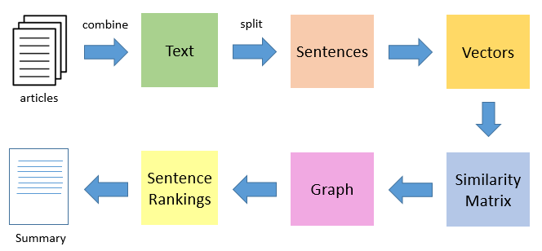
Extractive Summarization Using TextRank
Like all Extractive Summarization methods TextRank takes parts of the text (Sentences,Phrases,Paragraphs etc). Therefore identifying right sentences for summarization is a vital process for summarization.
TextRank algorithm is based on PageRank algorithm which was originally developed by Google to rank pages for their search engines.
Inplace of Web pages, TextRank uses the sentence and its corresponding similarities as a transition is equated to page transition probability.

Slide 17
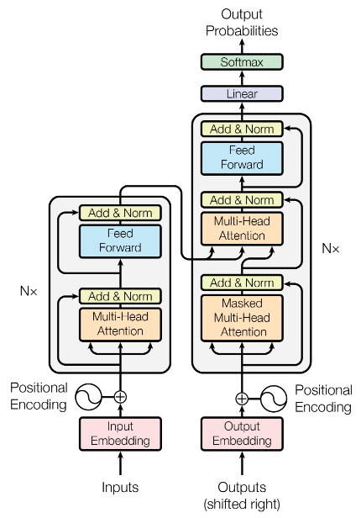
Abstractive Summarization Using BART
BART (Denoising Autoencoder from Transformer) is a transformer-based model that was introduced by Facebook AI in 2020.
BART (Bidirectional and Auto-Regressive Transformers) uses a standard seq2seq machine translation architecture with a bidirectional encoder (similar to BERT) and a left-to-right decoder (similar to GPT). The pretraining task involves randomly shuffling the order of the original sentences and a novel in-filling scheme, where spans of text are replaced with a single mask token.
Itis trained to reconstruct the original sentence from a corrupted version of it, which is called denoising auto-encoding. This allows BART to learn more robust representations of the text and to handle more complex language tasks.

Slide 18
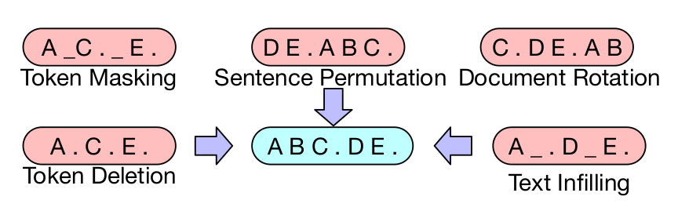
BART is just a standard encoder-decoder transformer model. Its power comes from three ideas:
BART's encoder is bidirectional. It uses the context from both sides of a word.
Uses an autoregressive decoder to generate natural-sounding language sequences.
During pre-training, BART learns a language model that contains all the complexities and nuances of a real-world natural language. By deliberately introducing all kinds of noise, deletions, and modifications in its input data to make it difficult to learn, BART gains the ability to generate linguistically correct sequences even when input text is noisy, erroneous, or missing.
This denoising language model is versatile and can be adapted for any downstream text generation or understanding tasks like summarization, question-answering, machine translation, or text classification.
How Does BART Summarize Text?

Slide 19
Most Resilient to Real-World Noisy Data
Produces Grammatically Correct Summaries
Simple to Fine-Tune
Runs on CPUs Without GPUs
BART's Quality Is Comparable to the Smaller GPT-3 Models
Efficient Model Size Compared to GPT Models
What sets BART apart is that it explicitly uses not just one but multiple noisy transformations. So, BART learns to generate grammatically correct sentences even when supplied with noisy or missing text.
We are using the BART-Large version which is of 1.5GB, it contains 1024 hidden layers and 406M parameters and has been fine-tuned using CNN, on a news summarization dataset.
This is a good trade-off for not using GPT models which are larger in size and require more computational units.
Reasons to Use BART

Slide 20
Extractive Summarization using LDA and NMF
Latent Dirichlet Allocation (LDA) is a generative statistical model that explains a set of observations through unobserved groups, and each group explains why some parts of the data are similar. The LDA is an example of a topic model. In this, observations (e.g., words) are collected into documents, and each word's presence is attributable to one of the document's topics. Each document will contain a small number of topics. This is a method of topic Modelling.
It assumes that documents are generated by a process in which a set of topics are chosen, and then words are generated based on those topics. This means that the topics are latent variables that are inferred from the observed words in the documents.
NMF is a form of Topic Modelling — the art of extracting meaningful themes that recur through a corpus of documents. A corpus is composed of a set of topics embedded in its documents. A document is composed of a hierarchy of topics. A topic is composed of a hierarchy of terms.
NMF is a matrix factorization technique that decomposes a matrix into two non-negative matrices that represent a set of basis vectors and a set of coefficients. In the context of topic modeling, the vectors represent the topics and the coefficients represent the distribution of topics in each document. It is often used as an alternative to LDA, particularly in cases where the number of topics is small and well-defined.

Slide 21
Article Recommendation
Article recommendation is a type of recommendation system that suggests relevant articles to users based on their interests and preferences.
The recommender takes an input article and calculates the cosine similarity between that article and other articles in the same cluster. It then selects the K-nearest neighbors based on the similarity distance and recommends articles that match both the category and the keywords of the input article.
While cosine similarity is a widely used metric for article recommendation, it has some limitations. For example, it may not work well for articles with very short or very long content. It also does not take into account the temporal aspects of articles, such as the publication date or the popularity of the article. Therefore, it is important to carefully consider the limitations of cosine similarity when designing an article recommendation system.
The summarizer creates features from the summary of the document in consideration and then finds similar documents based on their cosine similarity

Slide 22
Future Work
Multi-lingual support: Currently, WikiBot only supports English Wikipedia articles. Adding support for other languages would make the tool accessible to a wider audience and expand its usefulness.
Fine-tuning summarization algorithms: While WikiBot's current summarization algorithms work well for most articles, there is always room for improvement. Fine-tuning the algorithms with additional training data and exploring new techniques such as GPT-3 models could improve the quality of the generated summaries.
Personalization: Adding personalization features such as user profiles and learning user preferences could improve the accuracy of the recommendation system and make the tool more engaging for users.
Integration with other knowledge sources: While Wikipedia is a vast and comprehensive knowledge source, integrating WikiBot with other sources such as academic journals, news outlets, and other online databases could provide users with even more information and resources.

Slide 23
Thank you!

