Slide 1
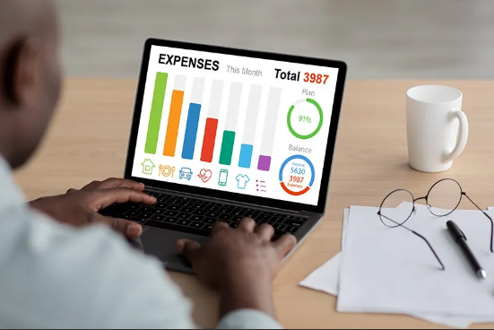
expense TRACKER
-A java based real-time expense tracking project
GUIDE: MONISHA HM
GROUP MEMBERS:
J.S.SHIVANVITHA(1BF24CS127)
KIRTI KUMARI(1BF24CS140)
KAPPALABANDA KEERTHI(1BF24CS133)

Slide 2
INTRODUCTION AND OVERVIEW
PROJECT OVERVIEW:The Expense Tracker is a Java-based application designed to record, categorize, and visualize personal financial transactions using JavaFX for a modern and responsive GUI.
OOP CONCEPTS USED:Implements core OOP concepts — Encapsulation for data security, Inheritance for code reuse, Polymorphism for flexible behavior, and Abstraction for clean design.
KEY GOAL:To create a real-time, user-friendly platform for managing and analyzing expenses without database dependencies, ensuring lightweight and portable operation.

Slide 3
Technologies & Tools Used
Frameworks and Components Behind the Application
Java and JavaFX:Core programming language and framework used to build a responsive GUI application supporting charts, forms, and dynamic interactions.
Scene Builder:Graphical interface tool for visually designing JavaFX layouts, simplifying the process of arranging controls and styling the UI.
CSV File Integration:Used as lightweight data storage for expenses. The system reads, writes, and updates CSV files in real time without external databases.
JavaFX Scene Chart:The javafx.scene.chart library enables creation of interactive PieCharts and LineCharts for visual data analysis.

Slide 4
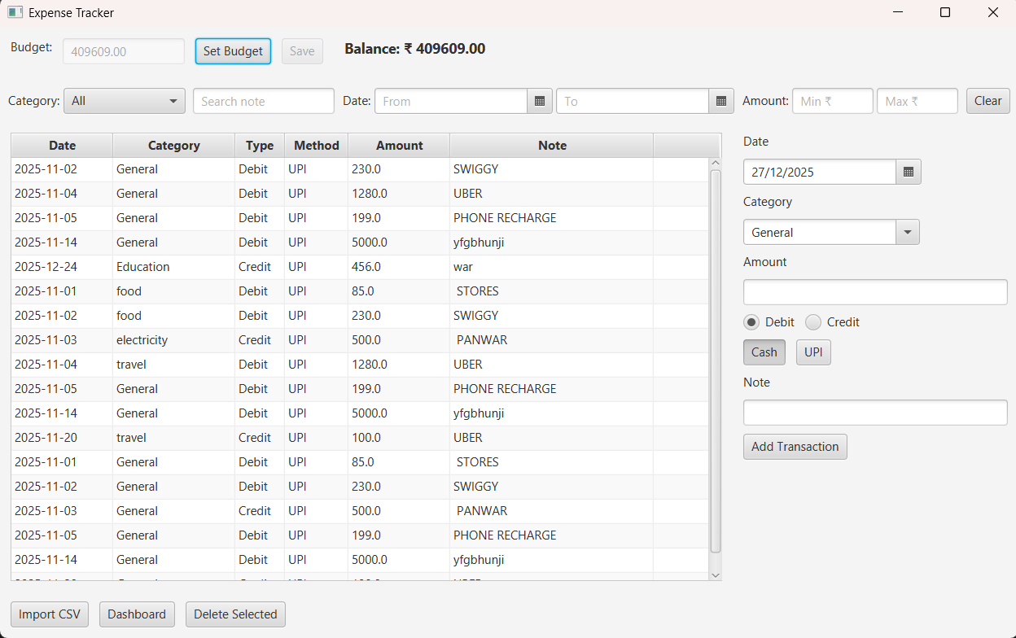
Main Window & Category Interface
The main window allows users to input expense details such as amount, category, payment method, and date. It ensures smooth data validation and feedback.
Users can create or delete transactions to organize expenses efficiently. This flexibility helps maintain accurate data segmentation.
Buttons, combo boxes, and text fields are linked with JavaFX event handlers to perform instant actions such as record saving and clearing fields.
Each transaction triggers a CSV file update to ensure real-time synchronization between GUI and storage.

Slide 5
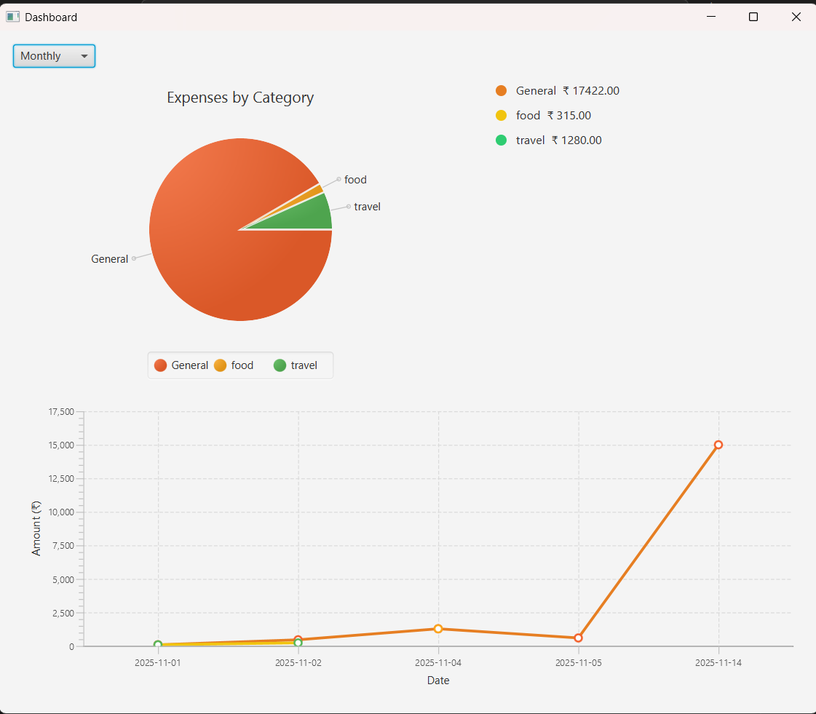
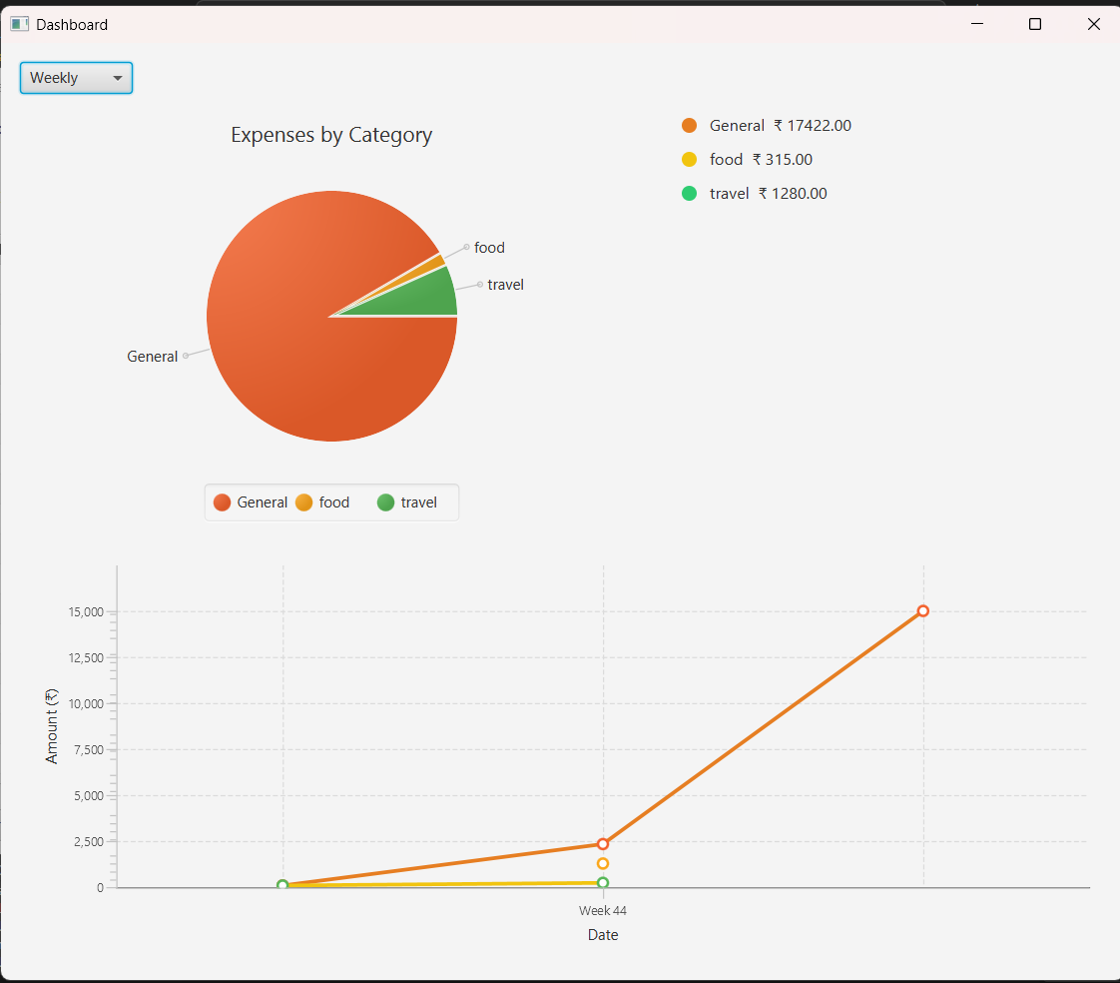
Dashboards & Visualization
PIE CHARTS:Visualizes expense distribution across categories, allowing users to instantly identify major spending areas.
LINE CHARTS:Displays spending patterns over time, enabling monthly or weekly comparison of expenses and income.
DYNAMIC CHARTS UPDATE:Charts refresh automatically as new data is added or categories are modified, ensuring real-time visualization.

Slide 6
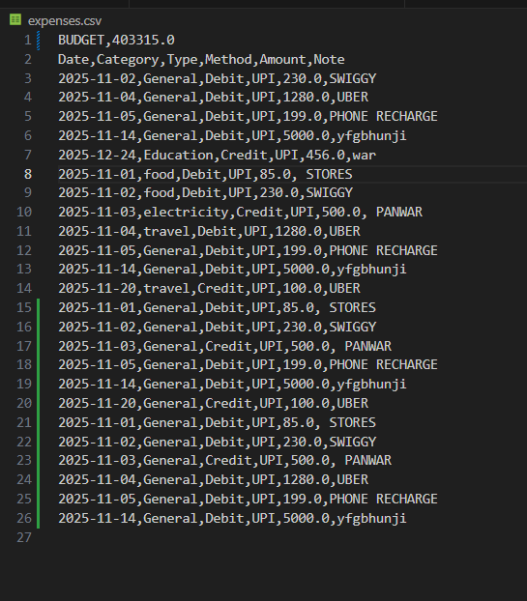
CSV File Handling & Outputs
CSV File Structure:Stores data fields such as Date, Category, Amount, and Payment Method, allowing easy readability and external use.
File Operations:Java file handling ensures smooth reading and writing of transactions with buffered streams and exception handling.
Data Consistency:Each operation updates the CSV in real time, maintaining synchronization between UI and storage.
Output Verification:CSV outputs can be opened in Excel or text editors for validation and reporting.

Slide 7
Challenges, Conclusion & References
Challenges Faced:Overcoming UI responsiveness issues, ensuring CSV synchronization, and handling chart refresh operations using JavaFX event loops.
Key Learnings:Enhanced understanding of JavaFX, event-driven programming, OOP principles, and data persistence using file I/O.
Acknowledgment:Project successfully completed under the guidance of Monisha H.M. with teamwork and iterative improvement.
References:GitHub Repository: shivanvithajayam/ExpenseTracker , JavaFX Docs , Oracle Java Tutorials

