Slide 1
JOB BOARD
Find your dream job

Slide 2
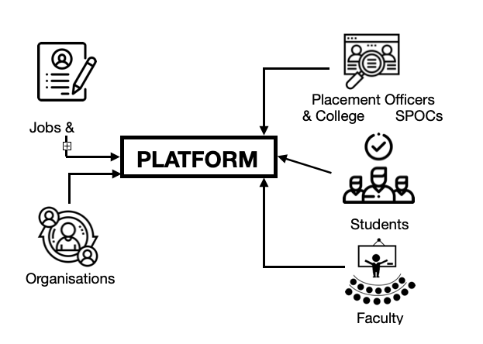
PROBLEM STATEMENT
Designing a platform which connects multiple organisational stakeholders to help students to find matching jobs for their profile. The functionality of the platform is depicted below:

Slide 3



Slide 4
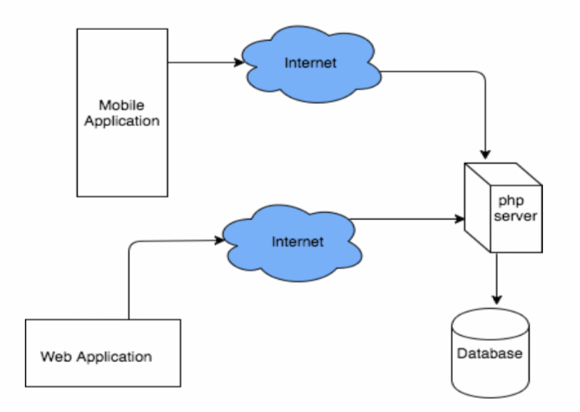
SYSTEM ARCHITECTURE

Slide 5
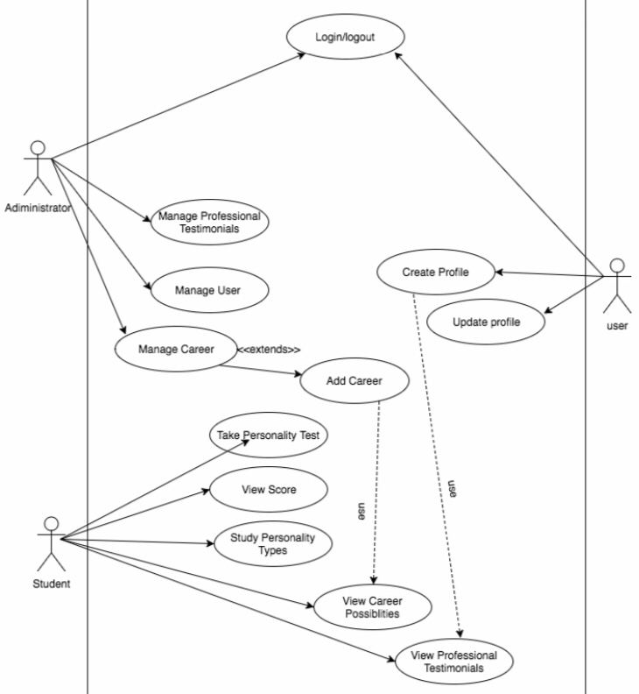
USE CASE
DIAGRAM

Slide 6
PROPOSED SOLUTION
Here’s a platform which connect the stakeholders of different organisations , students , placement officers , college SPOC’s through website
The website is open for all the students , organisations , SPOCs & Placement Officers ti create & maintain their own profile
The platform mainly focus on students finding their dream jobs based on their skills & talents
There is an added advantage of having mentor ship & training from placement cell through this website

Slide 7
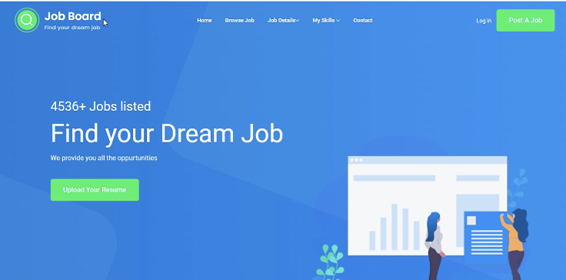
PROTOTYPE

Slide 8
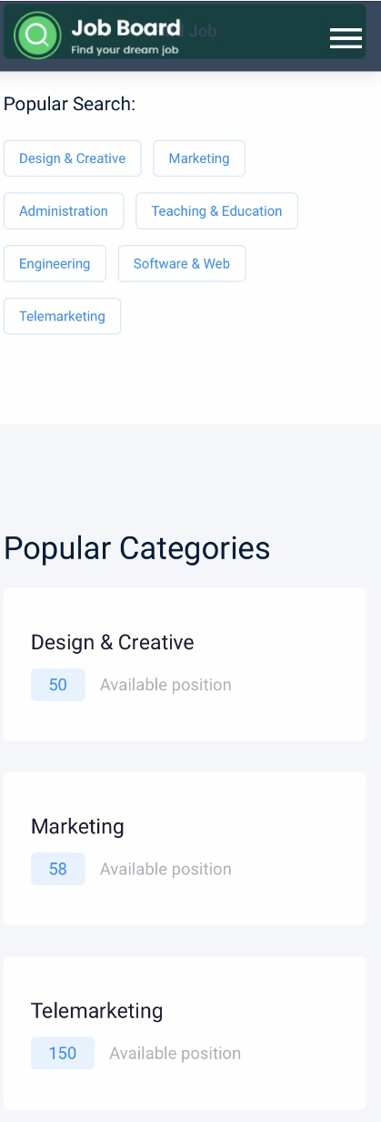
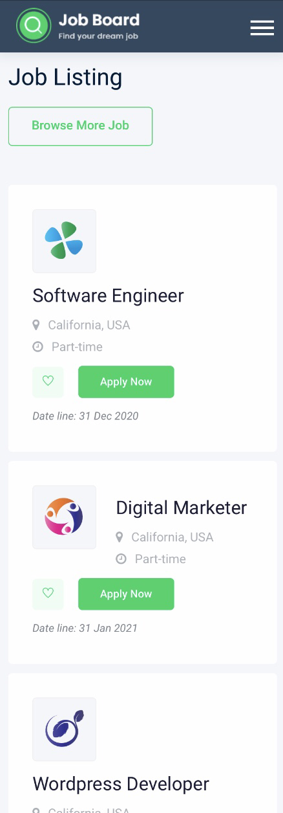
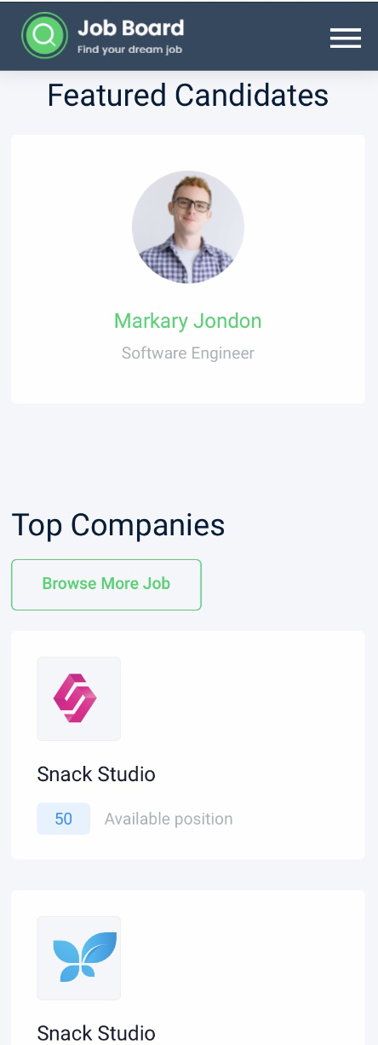
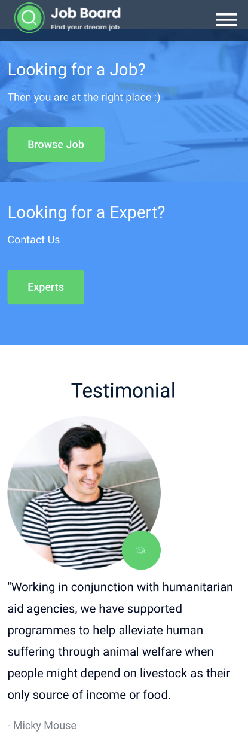

Slide 9
FUTURE SCOPE
The mobile application should be developed for other people to access the application through Android and iOS
Need to develop a virtual recruitment process within the application
Have premium features on the application that require students to pay to be able to use as an alternative revenue model for the application

Slide 10
THANK YOU

