Slide 1
ECE - 593 Fundamentals of pre-silicon validation Winter- 2024
Design And Verification Of
Asynchronous FIFO Using UVM
Team: Shiva Prasad Balne sbalne@pdx.edu
Ram Gopal Kasireddy ramgopal@pdx.edu
Praveen Kumar Palli prapalli@pdx.edu

Slide 2
Reference links for HLDS & Source Code
HLDS:
https://docs.google.com/document/d/1p_mz_XaneJj9R24BJinUscyHiJDL75WzMmbrr9t_WmQ/edit
GITHUB:
https://github.com/shivaprasadbalne/PRE_SI

Slide 3
Contents
Introduction
Roles and Responsibilities
Block Diagram
HLDS and Test Plan
UVM Testbench Architecture
Transcript
Results
Conclusion and Future scope

Slide 4
INTRODUCTION
Data transfer between two designs which are operating at different clocks needs synchronization and buffering
FIFO’s ensure to deliver data to destination in the same order they received from source
Asynchronous FIFO’s will synchronize, and store burst data to memory
The depth of memory will depend on write and read clocks speed
Applications such communication interfaces (Ex. UART), Clock Domain Crossings (CDC)
Notes:
Asynchronous FIFO (AFIFO):
An asynchronous FIFO (AFIFO) is a data buffer that operates using independent clock domains for the read and write operations. This means the read clock and write clock can have different frequencies and phases. APPLICATIONS:
Communication Interfaces(Ex: UART) – We can implement async fifo for communication between computers and peripheral devices.
Clock Domain Crossing(CDC) applications -
Data Synchronization and Flow Control

Slide 5
INTRODUCTION
Objective of the project is to design and verify the Asynchronous FIFO using UVM.
Documented High-Level Design Specification (HLDS) and designed Async FIFO comprising write, read pointer, memory , binary to gray converters and synchronizers.
Developed class based testbench and UVM verification environment with sequence, sequencer, driver, agent, monitor and scoreboard.
Performed unit level testing and verified the functionality of FIFO. Achieved 91.7% coverage with an effective test plan.
Notes:
Asynchronous FIFO (AFIFO):
An asynchronous FIFO (AFIFO) is a data buffer that operates using independent clock domains for the read and write operations. This means the read clock and write clock can have different frequencies and phases. APPLICATIONS:
Communication Interfaces(Ex: UART) – We can implement async fifo for communication between computers and peripheral devices.
Clock Domain Crossing(CDC) applications -
Data Synchronization and Flow Control

Slide 6
Roles and Responsibilities
Shiva Prasad Balne: Design modules: Write Pointer and Full logic, Producer and Consumer.
Verification Modules: Write agent, Environment and Integration of all modules.
Ram Gopal Kasireddy: Design modules: Read Pointer and Empty logic , Producer and Consumer.
Verification Modules: Read agent, Environment and Integration of all modules.
Praveen Kumar Palli: Design modules: FIFO memory and synchronizer , Producer and Consumer.
Verification Modules: Environment and Integration of all modules.

Slide 7
HLDS & TEST PLAN
In HLDS document we have included
Purpose and features of the Async FIFO.
Description of Design and specs.
tools & software used for simulation.
Interfaces and pin-level description.
Design modules and SV constructs used.
Objective and level of verification used along with functions that are verified.
Elaborated and detailed HLDS gave a clear road map and led us to a well-designed Asynchronous FIFO.

Slide 8
TEST plan
Our test plan document includes
Objective of the Verification plan with top level block diagram.
Verification level used.
Tools used for verification.
List of async FIFO functions verified and not verified.
Testing method and testbench architecture.
Testcase scenarios.
successive writes , successive reads , Reset ,FIFO full ,FIFO empty ,Concurrent Read and Write and Overflow
Coverage requirements.
Assertions planned.
Both the HLDS and test plan documentations made sure that our design choices were clear and made verification process a bit easier.

Slide 9
DESIGN SPECIFICATIONS:
Producer clock frequency = 750 MHz
Consumer Clock frequency = 250 MHz
Duty cycle = 50%
Maximum write burst size = 500
Number of ideal cycles between successive writes = 0
Number of ideal cycles between successive reads = 2
Minimum FIFO Depth = 445

Slide 10
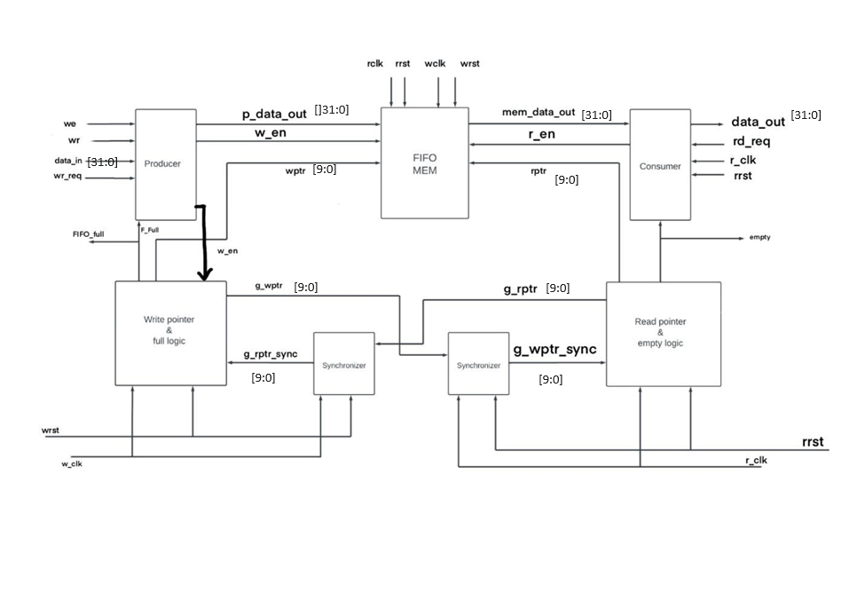
BLOCK DIAGRAM

Slide 11
IMPORTANT LOGIC IMPLEMENTATIONS
Binary to Gray Conversion:
FIFO FULL CONDITION:
FIFO EMPTY CONDITION:

Slide 12
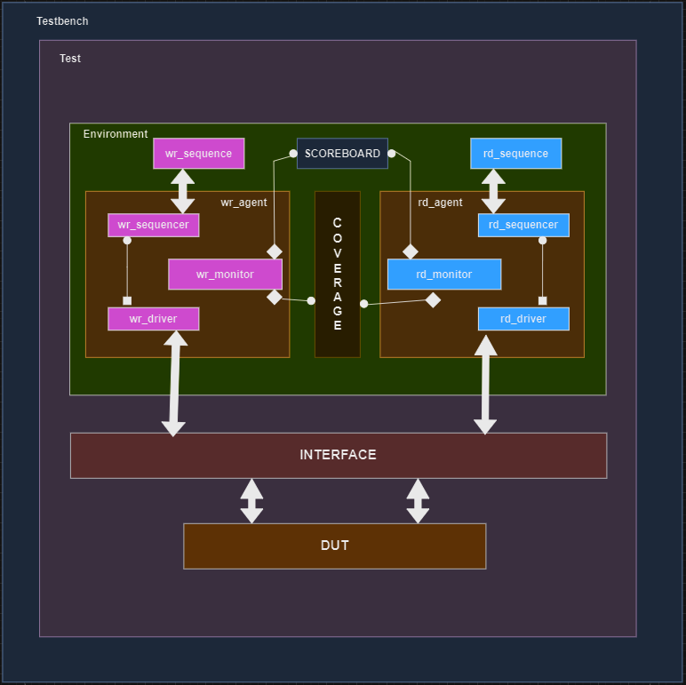
UVM TB ARCHITECTURE

Slide 13
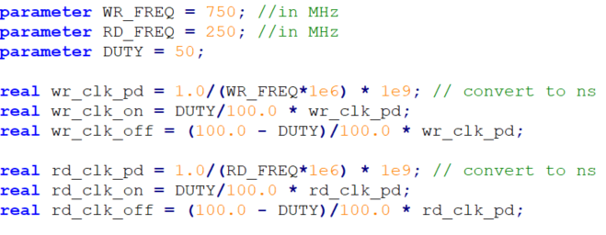
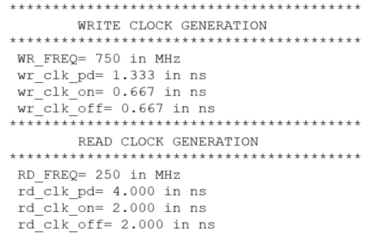
CLOCK GENERATION

Slide 14
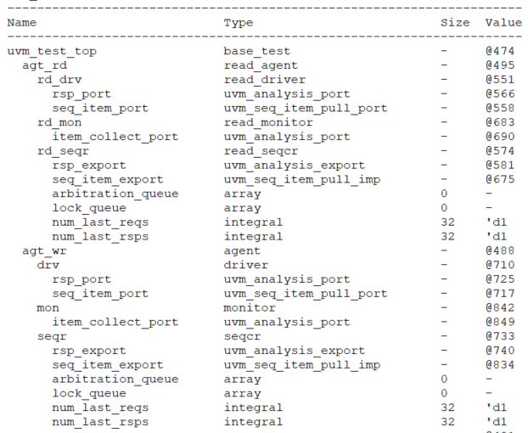
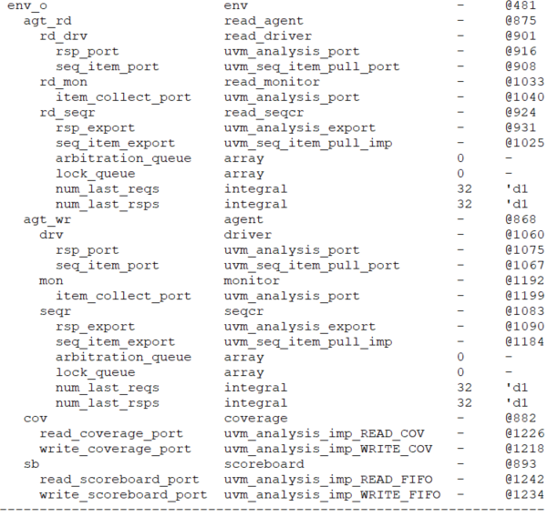
TOPOLOGY

Slide 15
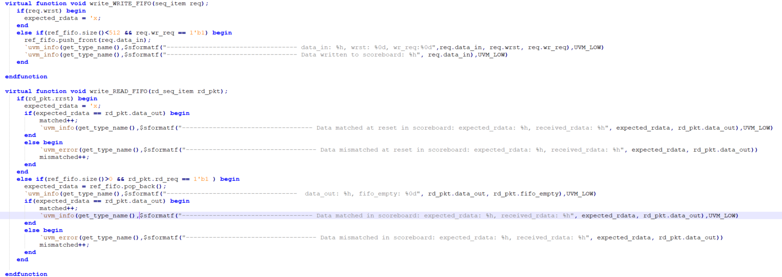
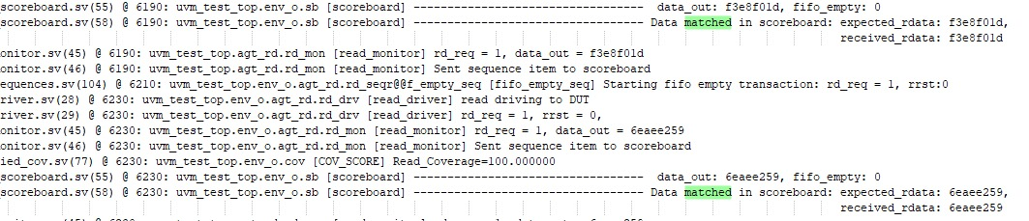
SCOREBOARD

Slide 16
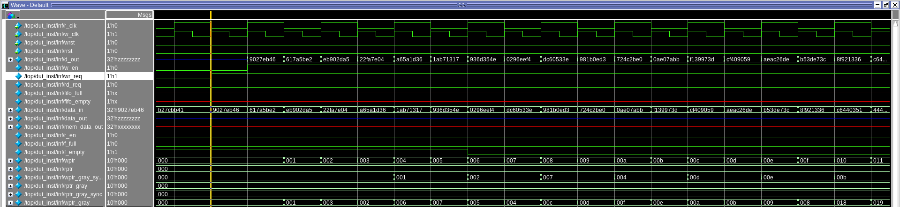
WAVEFORMS
Write Operations

Slide 17
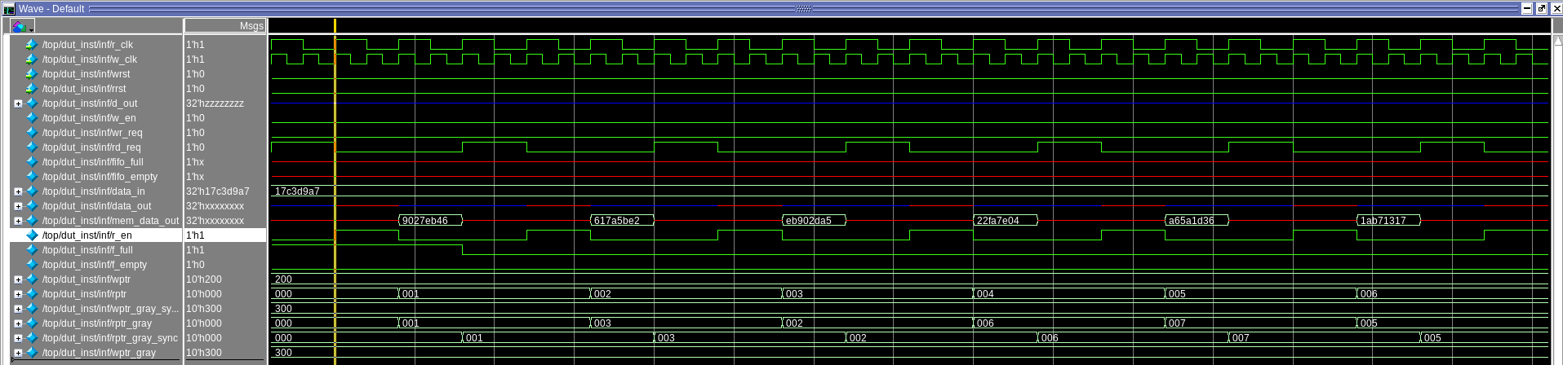
WAVEFORMS
‘
Read Operations

Slide 18
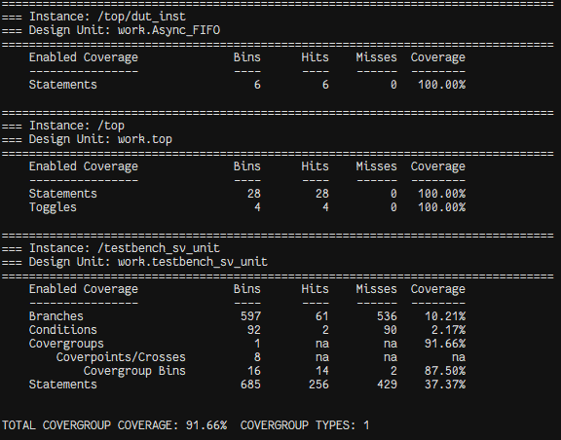
COVERAGE

Slide 19
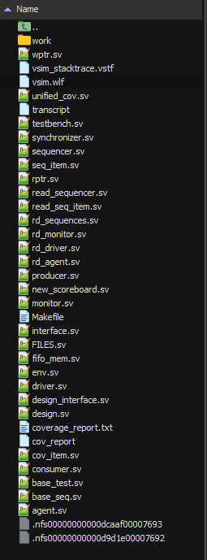
Directory structure

Slide 20
ASSERTIONS
Currently we are implementing assertions (Immediate and concurrent) in the project.
Planned assertions are:
Write request, write enable and no write reset, data_in should be valid.
Read request, read enable and no read reset, data_out should be valid.
No writes upon fifo_full.
No reads upon fifo_empty.
fifo_full and fifo_empty should be asserted with respect to full and empty conditions.

Slide 21
CHALLENGES FACED
We found it challenging while integrating the modules together.
A lot of time was spent on debugging.
Development of scoreboard.
Due to steep learning curve, it was challenging to adapt with UVM environment.
Every challenge we faced led us to learn new things.

Slide 22
References
http://www.sunburst-design.com/papers/cummingssnug2002sj_fifo1.pdf
http://www.sunburst-design.com/papers/cummingssnug2002sj_fifo2.pdf
https://hardwaregeeksblog.files.wordpress.com/2016/12/fifodepthcalculationmadeeasy2.pdf
https://www.youtube.com/watch?v=dcj5hanacd8&t=664s
https://www.youtube.com/watch?v=mgrey8u9els&t=1111s
https://vlsiverify.com/uvm/

Slide 23


