Slide 1
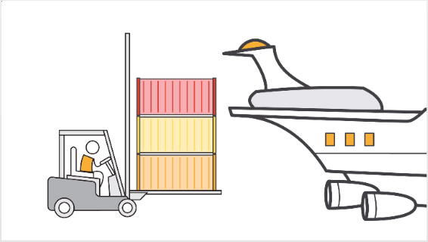
Docker

Slide 2
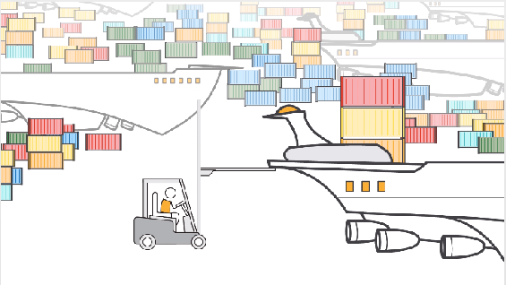
Docker

Slide 3
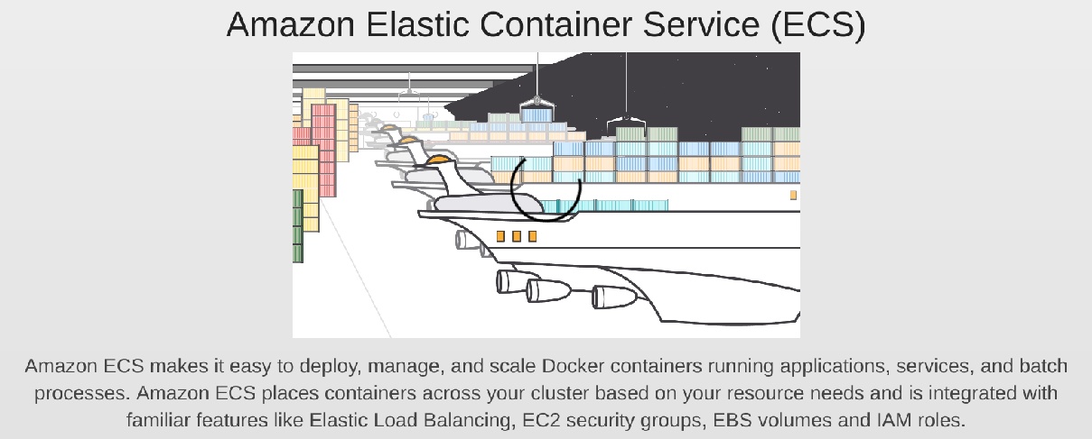
Docker

Slide 4
Docker
docker run \
-u <user-id> \
--name <container-name> \
--rm \
-d \
-p 8080:8080 \
-p 50000:50000 \
-v jenkins-data:/var/jenkins_home \
-v /var/run/docker.sock:/var/run/docker.sock \
jenkinsci/blueocean

Slide 5
Docker
-u
user who runs docker ( usually root by default)
needs to be in docker group
should own the volume group
more details in slide 7 for non-root user

Slide 6
Docker
--rm
Automatically removes the Docker container (which is the instantiation of the jenkinsci/blueocean image below) when it is shut down. This keeps things tidy if you need to quit Jenkins.

Slide 7
Docker
-d
Runs the jenkinsci/blueocean container in the background (i.e. "detached" mode) and outputs the container ID. If you do not specify this option, then the running Docker log for this container is output in the terminal window.
Similar to background job using &

Slide 8
Docker
-p
Maps (i.e. "publishes") port 8080 of the jenkinsci/blueocean container to port 8080 on the host machine. The first number represents the port on the host while the last represents the container’s port ( not visible to bash netstat command)

Slide 9
Docker
-v $HOME/jenkins:/var/jenkins_home
maps the container’s /var/jenkins_home (this is not visible on bash shell but is internal to container filesystem – docker exec -it -u <user>/<root> <container id>) directory to the jenkins subdirectory within the $HOME directory on your local machine, which would typically be /Users/<your-username>/jenkins or /home/<your-username>/jenkins

Slide 10
Docker
The Docker daemon binds to a Unix socket instead of a TCP port. By default that Unix socket is owned by the user root and other users can only access it using sudo. The Docker daemon always runs as the root user like any other OS abstraction- Containerization (OS-based virtualization) environment.
However to run as non-root user
sudo groupadd docker
sudo usermod -aG docker $user

Slide 11
Docker
As non-root user (cotd)
mkdir $PWD/jenkins
sudo chown -R 1000:1000 $PWD/jenkins
or
sudo chown -R <user>:<user> $PWD/jenkins
Ref: https://github.com/jenkinsci/docker/issues/177

Slide 12
Docker
Run/Start a container
docker start <container-id>/<container-name>
Stop all running containers
docker stop $(docker ps -aq)
Remove all containers
docker rm $(docker ps -aq)
List all containers
docker ps -aq
Enter a container as root
docker exec -u 0 -it <container-id> bash
Enter a container as current user (also in docker group docker)
docker exec -u $UID -it <container-id> bash

Slide 13
Docker Compose
Tool for defining creating and running multi container docker application
Configuration application services with a single yaml file docker-compose.yml
Starts all services with
docker-compose up
Stops all services with
docker-compose down
Can scale up services with –scale argument

Slide 14
Docker Compose
services:
database:
image: mysql
web:
image: nginx
ports:
- 9090: 80
version: '3.0'
Validate : docker-compose config

Slide 15
Docker vs Virtual Machines
VM provides an abstract machine that uses device drivers targeting the abstract machine
GUEST OS 1 GUEST OS 2 ………………….. GUEST OS N
APPS
APPS
APPS
VIRTUALIZATION PLATFORM / HYPERVISOR
HARDWARE / OS

Slide 16
Docker vs Virtual Machine
Containers provides an abstract OS
RUNTIME RUNTIME RUNTIME
APPS
APPS
APPS
CONTAINER MANAGER
OS

Slide 17
Docker init
Tini is Docker's default init system. Tini is the simplest init .
Tini spawns a single child (Tini is meant to be run in a container), and waits for it to exit, reaping (re-parenting) zombies ( -s ) and performing signal forwarding ensuring signal handlers to work.
or
After spawning your process, Tini will wait for signals and forward those to the child process, and periodically reap zombie processes that may be created within your container.
To enable Tini, just pass the --init flag to docker run

Slide 18
Docker Hub
The Docker Engine is open source containerization technology combined with a work flow for building and containerizing your applications.
Docker Hub is online Saas public repository of container images with an array of content sources including container community developers, open source projects and independent software vendors (ISV) building and distributing their code in containers
Create , Store , share ,list and certify containers etc.

Slide 19
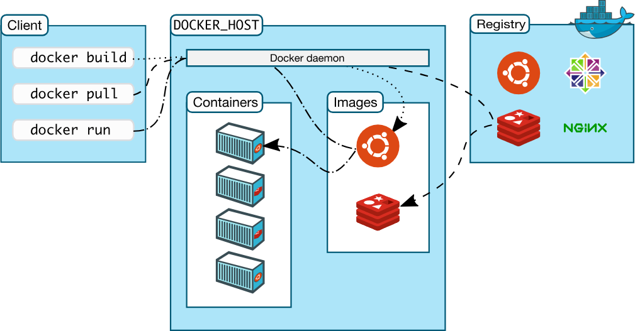
Docker Overview

Slide 20
Docker Registry
The Registry is a stateless, highly scalable server side application that stores and lets you distribute Docker images
docker pull image =>
docker pull docker.io:port/library/image
stateless =>
docker pull site.io:port/image
best way to distribute images inside an isolated network

Slide 21
Container Orchestration
Kubernetes
Meant to coordinate clusters of nodes at scale in production in an efficient manner
Managing and maintaining multiple deployment containers , multiple services, rolling back , health checks etc
It also helps in scheduling and scaling if required.
Other examples: Docker swarm , Ansible Container etc.

Slide 22
Dockerfile
Run a dockerfile to create a docker node web app image , starting a nodejs server at 8081 from within a container mapped to 4900 port.

