Slide 1
NAGIOS
SaaS
Open source network monitoring tool
A key measurement tool for actively monitoring availability of devices and services.
Web interface ( cgi )
Nagios monitors the network for problems caused by overloaded data links or network connections, as well as monitoring routers, switches etc
Monitor availability, uptime and response time of every node on the network
Visual representations and reports

Slide 2
Nagios
Docker installation
sudo docker search nagios
sudo docker run -d --rm -u root -p 80:80 jasonrivers/nagios
sudo docker exec -it -u 0 <container-id>
cd /opt/etc/nagios/
htpasswd -s -c /opt/nagios/etc/htpasswd.users nagiosadmin

Slide 3
Nagios
Nagios allows you to define how you send notifications based on combinations of:
Contacts and lists of contacts
Devices and groups of devices
Services and groups of services
Defined hours by persons or groups.
The state of a service.

Slide 4
Nagios
cgi.cfg Controls the web interface and
security options.
commands.cfg The commands that Nagios uses
for notifications.
nagios.cfg Main configuration file.
conf.d/* All other configuration goes here!
Under conf.d/*
contacts_nagios3.cfg users and groups
generic-host_nagios2.cfg default host template‏
generic-service_nagios2.cfg default service template
hostgroups_nagios2.cfg groups of nodes
services_nagios2.cfg what services to check
timeperiods_nagios2.cfg when to check and who
to notify

Slide 5
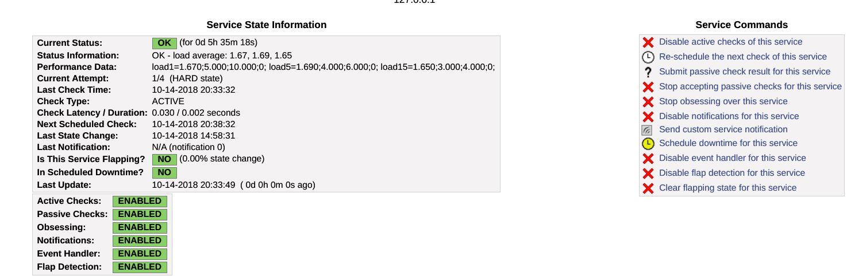
Nagios

