Slide 1
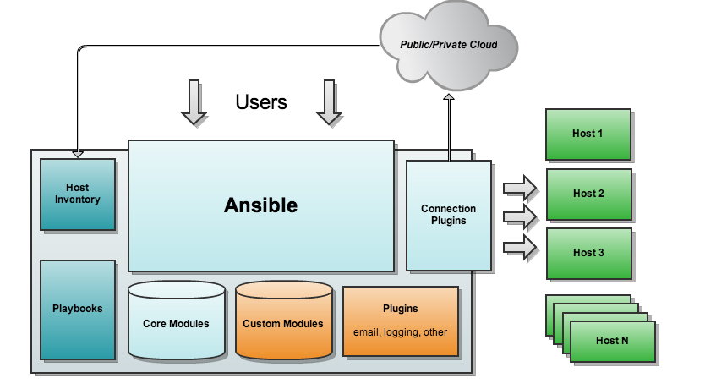
Ansible

Slide 2
Ansible
IT automation software configuration tool
Software provisioning
Configuration management
Application deployment
Orchestration
Automation

Slide 3
Ansible
control and configure nodes from a single machine
SSH infrastructure
push mode, where the configuration is pushed from a master machine to nodes.
Yaml syntax
agentless architecture – no need of any agent installation on nodes or master-slave arch

Slide 4
Ansible
Requirements
Ssh-keygen : generate ssh key
Ssh-copy-id : transfer key to all nodes to be controlled
Ensure ssh username is in sudo group for performing admin tasks
Create an inventory file or playbook

Slide 5
Ansible
The Inventory is a description of the nodes that can be accessed by Ansible, is described by a configuration file /etc/ansible/hosts ( can be pointed with -i option ). The configuration file lists either the IP address or hostname of each node that is accessible by Ansible. In addition, nodes can be assigned to groups.
Eg:
cat hosts
[webservers]
foo.example.com
ansible webservers -m setup

Slide 6
Ansible
Modules
ansible webservers -m ping
Modules (also referred to as “task plugins” or “library plugins”) are discrete units of code that can be used from the command line or in a playbook task.
https://docs.ansible.com/ansible/latest/modules/list_of_all_modules.html

Slide 7
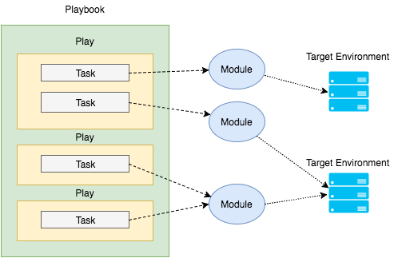
Ansible
Playbook

Slide 8
Ansible
Playbooks
Playbooks are Ansible’s configuration, deployment, and orchestration language.
They describe a policy for remote systems to enforce, or a set of steps in a general IT process.
Rolling updates, fixes, delegate actions, monitor servers and load balancers

Slide 9
Ansible
Playbook example yaml
---
- hosts: webservers
vars:
- WelcomeMsg: "welcome to nginx through ansible"
tasks:
- name: setup nginx
apt: pkg=nginx state=installed update_cache=true
- name: copy index.html file
template: src=index.html dest=/usr/share/nginx/html/index.html
...

Slide 10
Ansible
Plugins ( actions , shells etc)
API ( python has ansible apis )
Inventory ( yaml file)
Modules ( builtin modules )

Slide 11
Ansible
Container Orchestration
Ansible can model containers and non-containers at the same time
Docker instances still need to run on hosts, and those hosts need to be launched, configured, networked, and coordinated, whether they be local machines or full cloud infrastructures.

Slide 12
Ansible Jenkins Provisioning Java
Prepare the target host with the Jenkins user and its SSH keys
Set the Jenkins user’s private key on the credentials repository
Before running the deploy Playbook, consider installing all required roles on the Jenkins server
“sh "ansible-galaxy install -vvv -r provision/requirements.yml -p provision/roles/"”.

Slide 13
Ansible Jenkins Provisioning Java
---
- name: Install Java
hosts: app_server
become: yes
become_user: root
roles:
- geerlingguy.java

Slide 14
Ansible Jenkins
- name: Download Application from Repo
hosts: app_server
tasks:
- get_url:
force: yes
url: "{{ lookup('env','ARTIFACT_URL') }}"
dest: "/tmp/{{ lookup('env','APP_NAME') }}.jar"
- stat:
path: "/tmp/{{ lookup('env','APP_NAME') }}.jar"

Slide 15
Ansible Jenkins
- name: Setup Spring Boot
hosts: app_server
become: yes
become_user: root
roles:
- { role: pellepelster.springboot-role,
spring_boot_file: "{{ lookup('env','APP_NAME') }}.jar",
spring_boot_file_source: "/tmp/{{ lookup('env','APP_NAME') }}.jar",
spring_boot_application_id: "{{ lookup('env','APP_NAME') }}"
}
...

Slide 16
Ansible Jenkins
https://github.com/ricardozanini/soccer-stats/blob/master/provision/playbook.yml

Slide 17
Ansible and Docker
docker_service: compose files to orchestrate containers
docker_container: create, update, stop, start and destroy
docker_image : build, pull, push, tag and remove
docker_login : authenticates
docker (dynamic inventory ): dynamically builds inventory of all available containers

