Slide 1
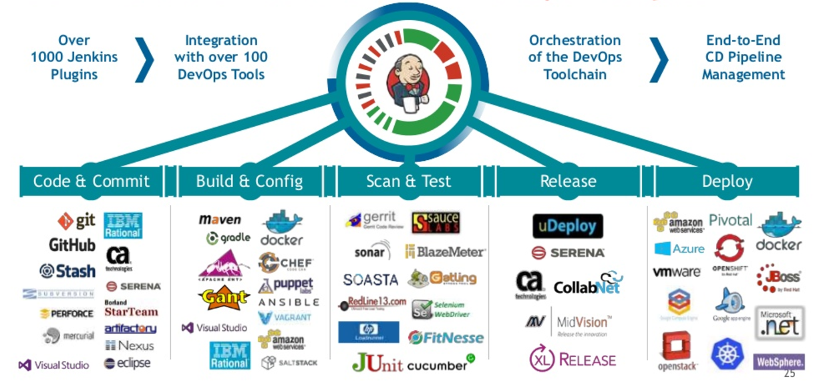
Jenkins

Slide 2
CI Pipeline
Pull Source Code ( Version Control System GIT )
Validate
Compile maven, make
Unit Test Junit ,pytest
Integration Test ( Continuous Integration) Jenkins
Package (Tomcat,
Jboss)
CD Pipeline
Review ( Gerrit )
Test environment(Continuous Ansible
Delivery Docker)
Production environment (Continuous Deployment
Docker, AWS,Kubernetes)

Slide 3
Jenkins
Jenkins, a continuous build tool, enables teams to focus on their work by automating the build, artifact management,and deployment processes
Jenkins’ core functionality and flexibility allow it to fit in a variety of environments and can help streamline the development process for all stakeholders involved
Integrated Built Tested Archived Deployed at (ideally) every commit or at regular frequencies

Slide 4
Jenkins
Branched from Hudson ( now with oracle )
Java based Continuous Build System
Runs in servlet container or standalone
Eg: Glassfish, Tomcat , JBoss
Supported by over 400 plugins
Eg: SCM, Testing, Notifications, Reporting,Artifact Saving, Triggers, External Integration, ant, gradle,maven
Under development since 2005

Slide 5
Jenkins
Jenkins Pipeline (or simply "Pipeline") is a suite of plugins which supports implementing and integrating continuous delivery pipelines into Jenkins.
Example
https://jenkins.io/doc/tutorials/build-a-java-app-with-maven/
https://jenkins.io/doc/tutorials/create-a-pipeline-in-blue-ocean/#setup-wizard

Slide 6
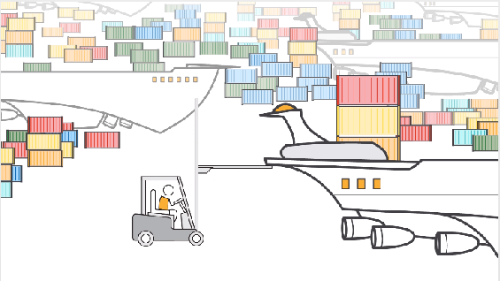
Jenkins
JNLP
JENKINS ( Server Container
Data Volume -persistent b/w restarts)
MAVEN ( AGENT container
Host filesystem cleared
on restarts )
DOCKER ( OS Virtualization/
Container )
AWS KERNEL INSTANCE

Slide 7
Jenkins Pipeline
Implementation:
Way to implement a project’s entire build/test/deploy pipeline in a Jenkinsfile and store that alongside their code, treating their pipeline as another piece of code checked into source control.

Slide 8
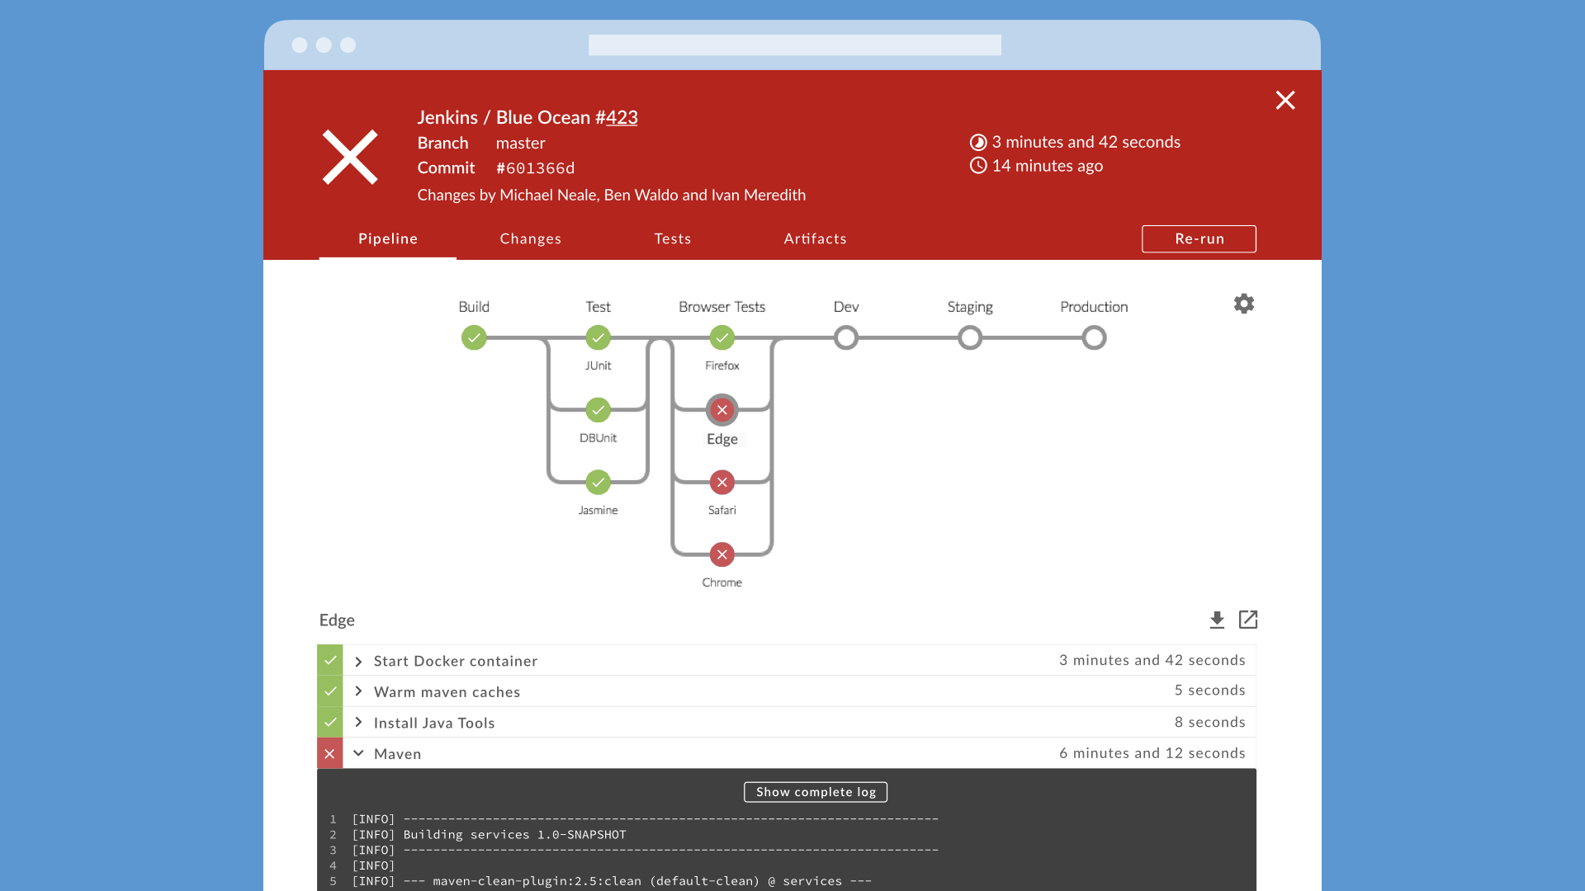
Jenkins Blue Ocean
Blue Ocean rethinks the user experience of Jenkins (https://jenkins.io/doc/book/blueocean/)

Slide 9
Jenkins
The Maven container is a java agent with JNLP protocol to run on docker(in this case) and perform tasks directed by master jenkins. Its filesystem is not persistent and will be erased once server shuts down.
The Jenkins server is a container having a persistent data volume created in docker container will not be erased between restarts.
The docker container runs on instance virtualizing on the OS kernel and communicating with unix sockets and creating a container id for each process id run on it.

Slide 10
Jenkinsfile
Pipeline in Jenkinsfile
Pipeline {
agent {
docker {
image 'maven:3-alpine'
args '-v /root/.m2:/root/.m2'
}
}...
(image directive downloads alpine os, maven
-v does the reciprocal mapping b/w container
and machine)

Slide 11
Jenkinsfile
Stage Build
...stage('Build') {
steps {
sh 'mvn -B -DskipTests clean package'
}
}…
(Defines a stage (directive) called Build that builds the project pulled from git)

Slide 12
Jenkinsfile
Stage Test
...stage('Test') {
steps {
sh 'mvn test'
}
post {
always {
junit 'target/surefire-reports/*.xml'
}
}
}…
(sh – junit tests with mvn
Junit - archives the JUnit XML report

Slide 13
Jenkinsfile
Stage deliver
...stage('Deliver') {
steps {
sh './jenkins/scripts/deliver.sh'
}
}
(Defines a new stage called Deliver
deliver.sh (in repo) installs into jenkins repo – data volume and runs to show up on UI)

