Slide 1
Microservices
Microservices architecture is a distributed approach designed to overcome the limitations of traditional monolithic architectures. Microservices help to scale applications and organizations while improving cycle times
Minimizes Architectural Complexity and Operational Complexity

Slide 2
Microservices Architecture
With a microservices architecture, an application is built as independent components that run each application process as a service. These services communicate via a well-defined interface using lightweight APIs. Services are built for business capabilities and each service performs a single function. Because they are independently run, each service can be updated, deployed, and scaled to meet demand for specific functions of an application.

Slide 3
Microservices
Agility – small independent teams
Scaling - flexible
Easy Deployment : CI/CD
Technological Freedom
Reusability
Resilience – Failsafe
Platform : Amazon Web Services as PaaS

Slide 4
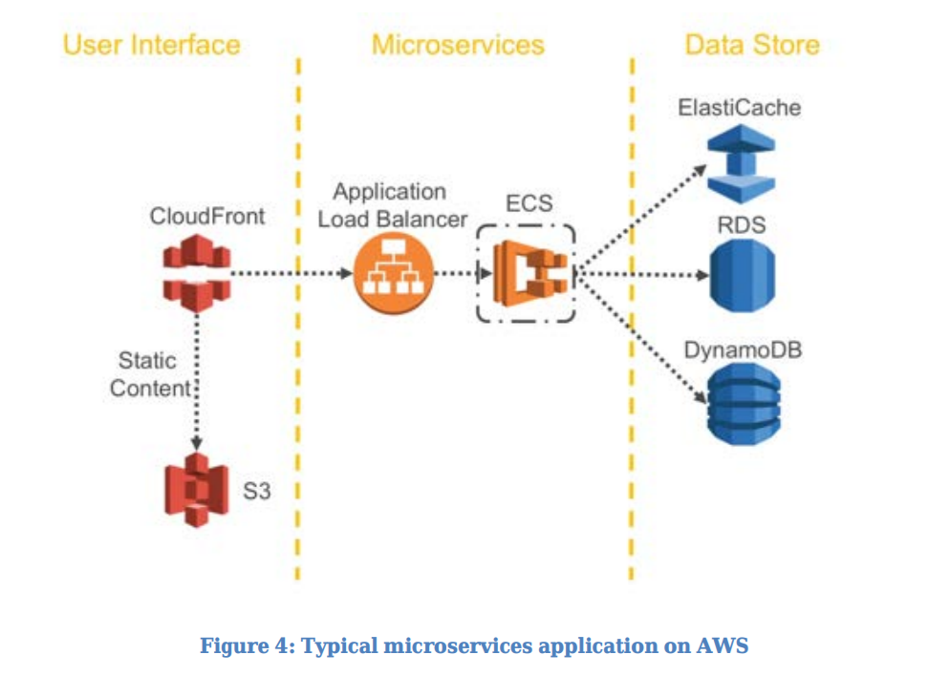
Microservices

Slide 5
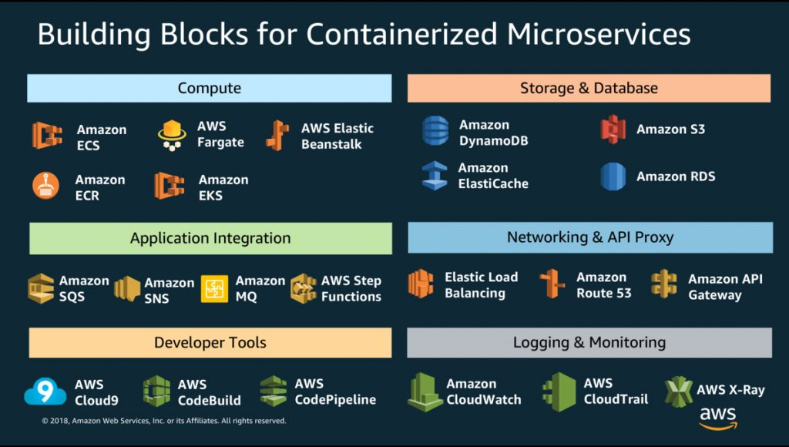
AWS Microservices

Slide 6
AWS PaaS for Microservices
Compute – ECS , Lambda. Amazon ECS container instances are scaled out and scaled in, depending on the load or the number of incoming requests
Storage – Elasticache( in-memory data store or cache in the cloud) , S3(Simple Storage Service-object store) / Glacier , DynamoDB (NoSql - Bigdata) , RDS ( relational dbs – oracle,mysql )
Network - ELB automatically distributes incoming application traffic across multiple Amazon EC2 instances

Slide 7
AWS PaaS for Microservices
Asynchronous Messaging
-AWS SNS: Simple Notification Services for alerts. Using Amazon SNS topics, your publisher systems can fan out messages to a large number of subscriber endpoints for parallel processing, including Amazon SQS queues, AWS Lambda functions, and HTTP/S webhooks. Additionally, SNS can be used to fan out notifications to end users using mobile push, SMS, and email.

Slide 8
AWS PaaS for Microservices
-AWS SQS: Using SQS, you can send, store, and receive messages between software components at any volume, without losing messages or requiring other services to be available.

Slide 9
AWS PaaS for Microservices
Logging and Monitoring:
- AWS Cloudtrail: monitor your AWS deployments in the cloud by getting a history of AWS API calls for your account through sdk, apps etc
- Amazon CloudWatch: collect and track metrics, collect and monitor log files, set alarms, and automatically react to changes across your running services and AWS resources.
-Amazon X-Ray: X-Ray provides an end-to-end view of requests as they travel through your application, and shows a map of your application’s underlying components.

Slide 10
AWS PaaS for Microservices
DevOps: Build and Run
- Amazon Elastic Container Registry (Amazon ECR) : A fully managed Docker container registry that you can use to store, manage, and deploy Docker container images.
- Continuous Delivery AWS Developer Tools: AWS Developer Tools is a set of services that enable developers and IT operations professionals practicing DevOps to rapidly and safely deliver software

Slide 11
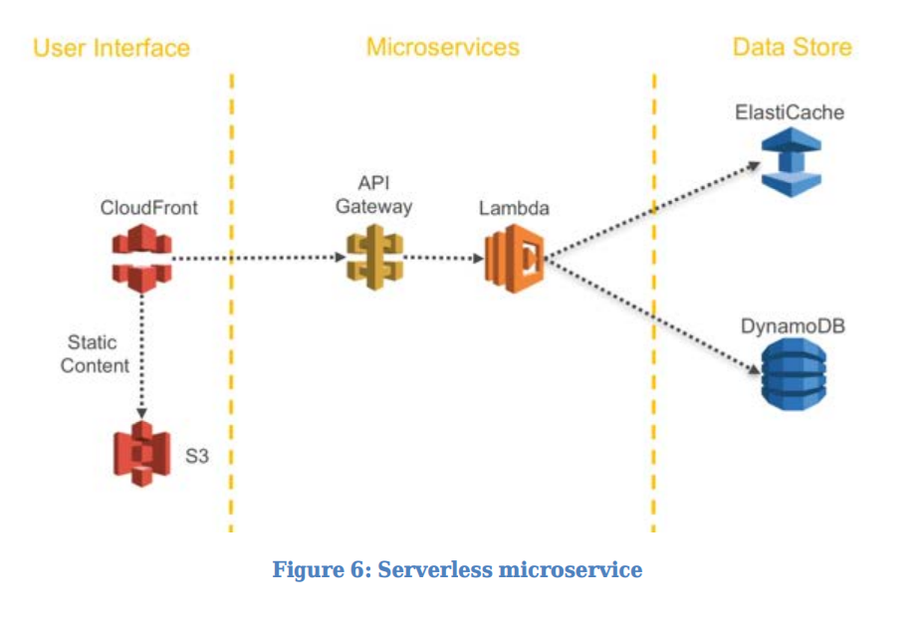
Compute (AWS CloudFormation)
ECS – Elastic Container Service (Server)
AWS Lambda lets you run code without provisioning or managing servers.(Serverless)

Slide 12
Amazon Elastic Container Service
Containers without servers :
- Fargate : Fargate launch type and EC2 launch type. With Fargate launch type, all you have to do is package your application in containers, specify the CPU and memory requirements, define networking and IAM policies, and launch the application. EC2 launch type allows you to have server-level, more granular control over the infrastructure that runs your container applications

Slide 13
Amazon Elastic Container Service
Containerize everything :
-All apps, batch jobs and machine learning can be containerized.
Secure
-IAM roles and policies
Scaling:
-can launch tens or tens of thousands of Docker containers in seconds using Amazon ECS with no additional complexity
AWS Integration with other AWS Services

Slide 14
AWS Storage :NoSQL (Dynamodb) vs Relational DB(RDS)
Hadoop is not a type of database, but rather a software ecosystem that allows for massively parallel computing. It is an enabler of certain types NoSQL distributed databases (such as HBase), which can allow for data to be spread across thousands of servers with little reduction in performance.
A staple of the Hadoop ecosystem is MapReduce, a computational model that basically takes intensive data processes and spreads the computation across a potentially endless number of servers (generally referred to as a Hadoop cluster). A large data procedure which might take 20 hours of processing time on a centralized relational database system, may only take 3 minutes when distributed across a large Hadoop cluster of commodity servers, all processing in parallel.
DAX / DynamoDB Accelarator Reduces latency to milliseconds

Slide 15
AWS API
With simple API calls, you can launch and stop Docker-enabled applications, query the complete state of your cluster, and access many familiar features like security groups, load balancers, Amazon Elastic Block Store (Amazon EBS) volumes, and AWS Identity and AccessManagement (IAM) roles
To define how your applications run on Amazon ECS, you create a task definition in JSON format. This task definition defines parameters for which container image to run, CPU,memory needed to run the image, how many containers to run, and strategies for container placement within the cluster. Other parameters include security,networking, and logging for your containers. Amazon ECS supports container placement strategies and constraints to customize how Amazon ECS places and terminates tasks. A task placement constraint is a rule that is considered during task placement

Slide 16
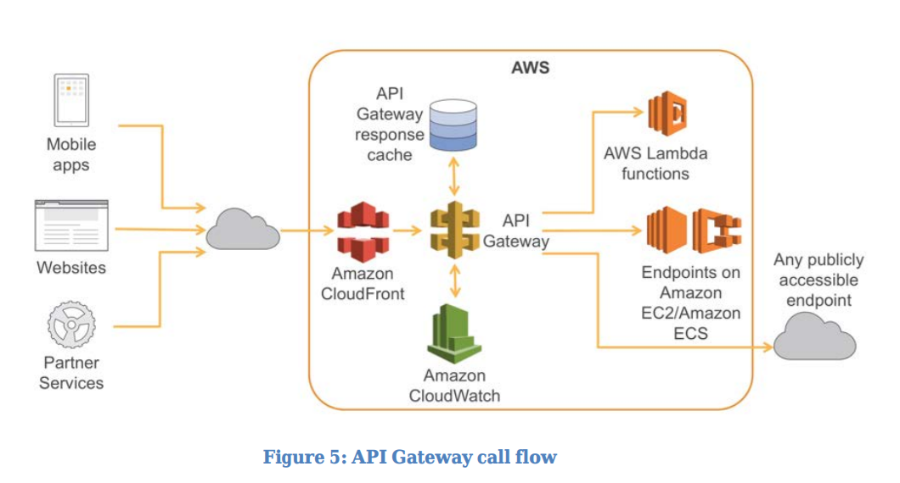
AWS API Gateway Flow

Slide 17
Application Load Balancer
Configure a custom domain name for each microservice and associate the domain name with the Application Load Balancer’s DNS name using a CNAME entry. The DNS names of the service endpoints are then published across other applications that need access
DNS-Based Service Discovery : Amazon Route 53 : Register IP addresses, hostnames, and port information as service records(SRV records) for a specific microservice and restrict access to the VPCs of the relevant client microservices

Slide 18
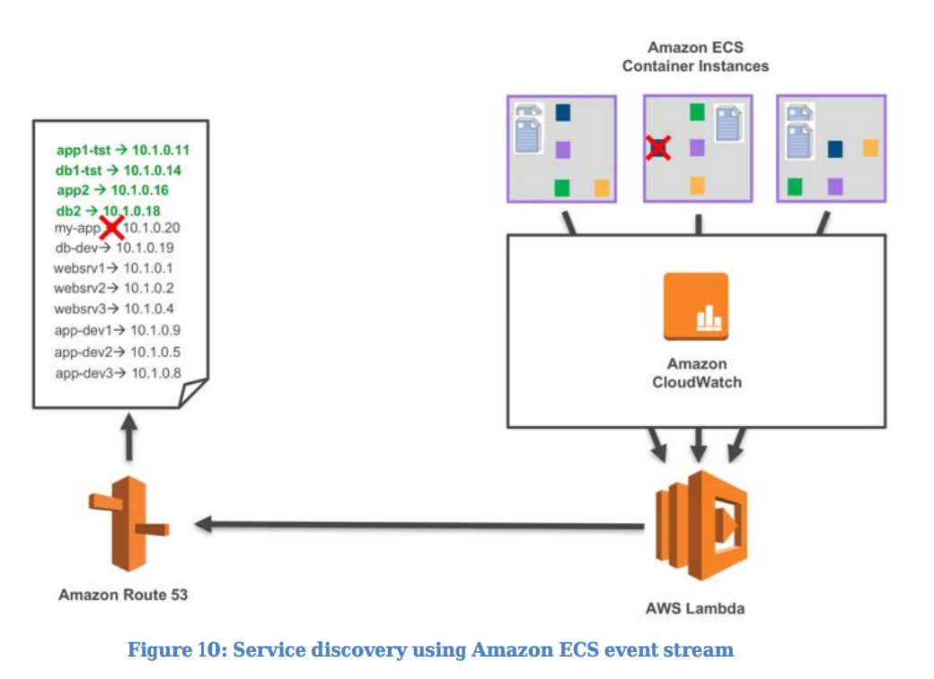
AWS Service Discovery (Amazon ECS Event Stream)

Slide 19
Service Discovery Using Configuration Management
Using Configuration Management tools (like Chef, Puppet, or Ansible) is another way to implement service discovery. Agents running on EC2 instances can register configuration information during server start.
Service Discovery Using Key Value Store: Client-side load-balancing techniques such as Netflix Ribbon. Client-side load balancing can help eliminate bottlenecks and simplify Management.

Slide 20
AWS Step Functions
Step Functions is part of the AWS Serverless Platform and supports orchestration of Lambda functions as well as applications based on compute resources such as Amazon EC2 and Amazon ECS

Slide 21
AWS Logs
CloudWatch to gain system-wide visibility into resource utilization, application performance, and operational health
The primary destinations for log files on AWS are Amazon S3 and Amazon CloudWatch Logs. Amazon Elasticsearch Service (Amazon ES) and Kibana.
Amazon Athena can be used to run ad-hoc queries against centralized logfiles in Amazon S3.

Slide 22
AWS Logs Analysis
Amazon Redshift is a fast, fully managed, petabyte-scale data warehouse service that makes it simple and cost-effective to analyze all your data using your existing business intelligence tools.
Amazon QuickSight is a fast, cloud-powered business analytics service to build visualizations, perform ad-hoc analysis, and quickly get business insights from your data.
Amazon CloudWatch Logs can act as a centralized store for log data, and, in addition to storing the data, it is possible to stream log entries to Amazon Kinesis Firehose.
Kinesis Firehose is a fully managed service for delivering real-time streaming data to destinations such as Amazon S3, Amazon Redshift, or Amazon ES

Slide 23
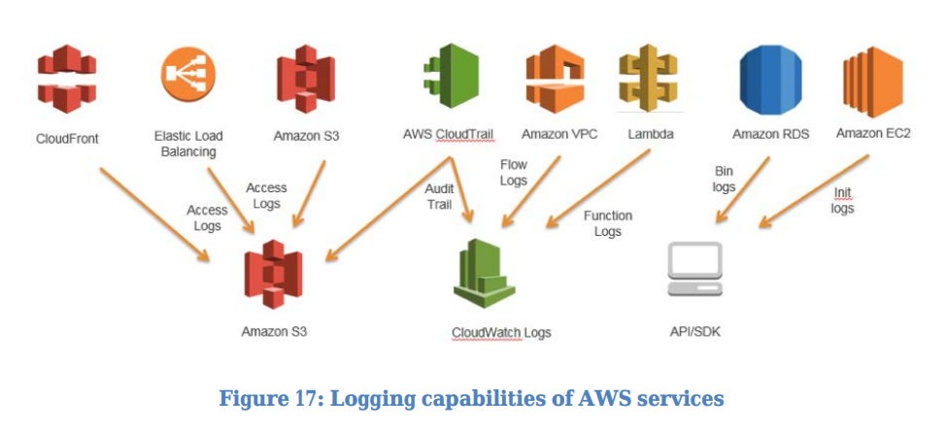
AWS Logs

Slide 24
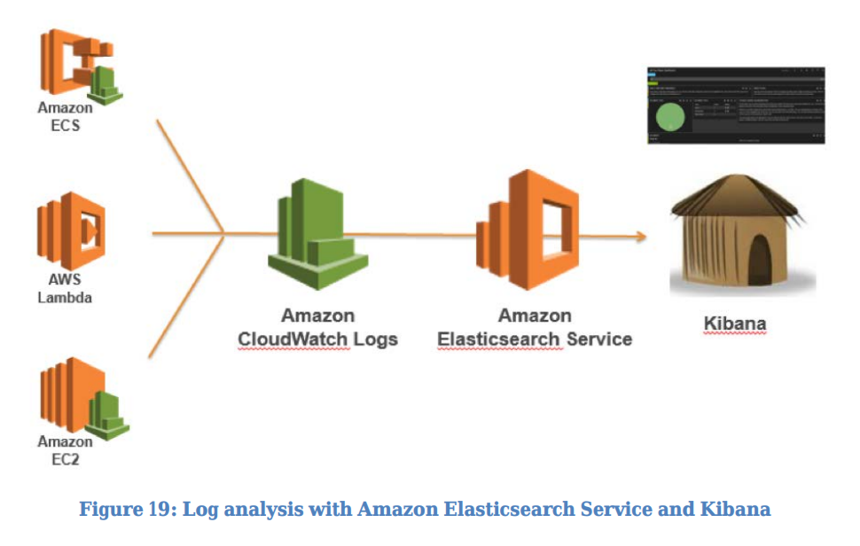
AWS Logs

Slide 25
AWS Audit Trail
AWS CloudTrail is a useful tool for tracking change in microservices because it enables all API calls made on the AWS Cloud to be logged and passed to either CloudWatch Logs in near real time or to Amazon S3 within several minutes.
CloudTrail is a web service that records AWS API calls for your account and delivers log files to you. This includes those taken on the AWS Management Console, the AWS CLI, SDKs, and calls made directly to the AWS API
All user actions and automated systems become searchable and can be analyzed for unexpected behavior, company policy violations, or debugging.

Slide 26
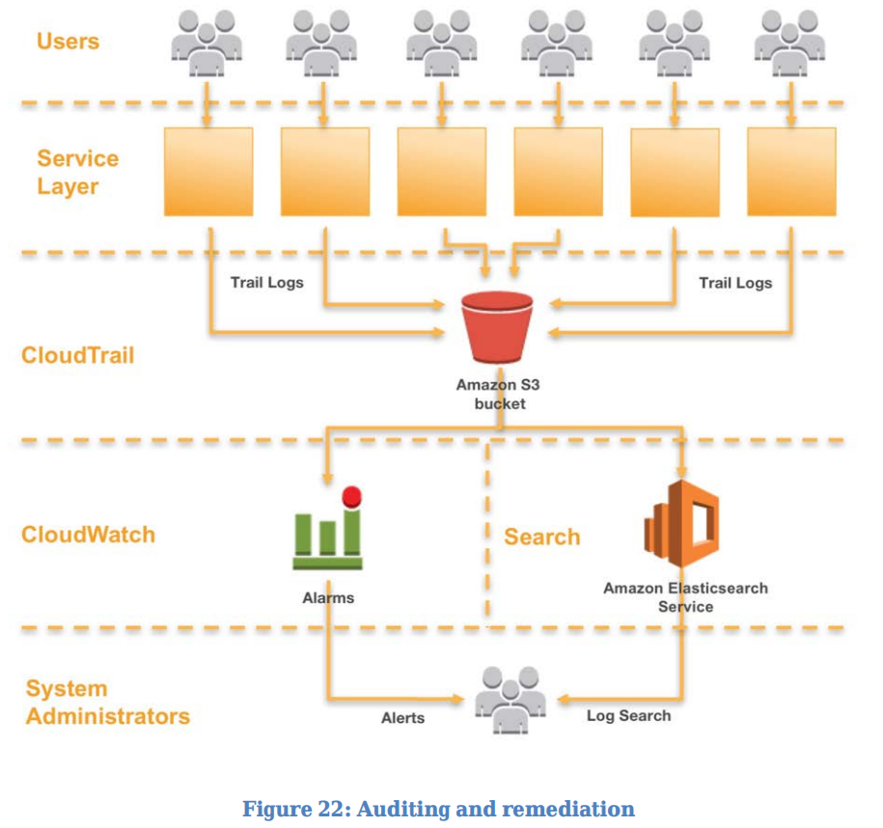
AWS Audit Trail

Slide 27
AWS Config
While CloudTrail and CloudWatch Events track and respond to infrastructure changes across microservices, AWS Config rules allow a company to define security policies using specific rules and automatically detect, track, and alert violations to these policies.
In the example that follows, a developer team made a change to the API Gateway for his microservice to open up the endpoint to inbound HTTP traffic rather than allowing only HTTPS requests. Because this is a security compliance concern for the organization, an AWS Config rule is watching for this type of noncompliance, identifies the change as a security violation, and performs two actions: it creates a log of the detected change in an S3 bucket (for auditing) and creates an SNS notification.

Slide 28
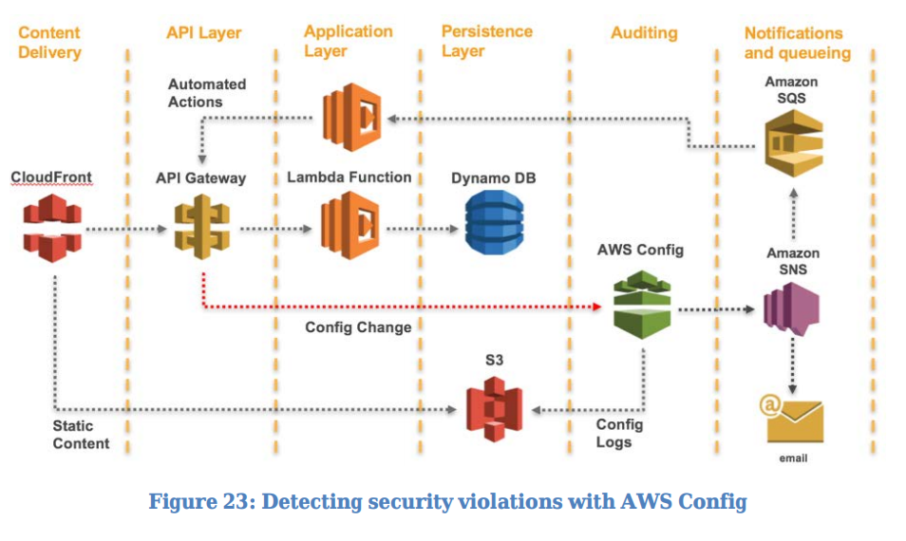
AWS Config

