Slide 1
DevOps
DevOps is a set of processes, methods and systems for communication collaboration and integration between software development ,operations and quality assurance teams.
It facilitates integration, automation, and measurement of cooperation between software developers and other IT professionals

Slide 2
DevOps Technology
Waterfall : Plan/Requirement Driven. SDLC staged in a linear fashion. Release and distribution considered the last hurdle without feedback. Requirement → Design → Code → Test → Integrate → Op(Deliver) → Maintenance.
Agile : SDLC staged in incremental approach to software specification, development and delivery accommodating later changes to requirements throughout the development processes. Teams, scrums and iterations. Continual.

Slide 3
DevOps Technology
Lean: Agile SDLC + Deliver. Lean organizations try to avoid unnecessary meetings, tasks and documentation between development and op teams.
DevOps: Agile development team + Production/Operations team. Automating deployment pipeline

Slide 4
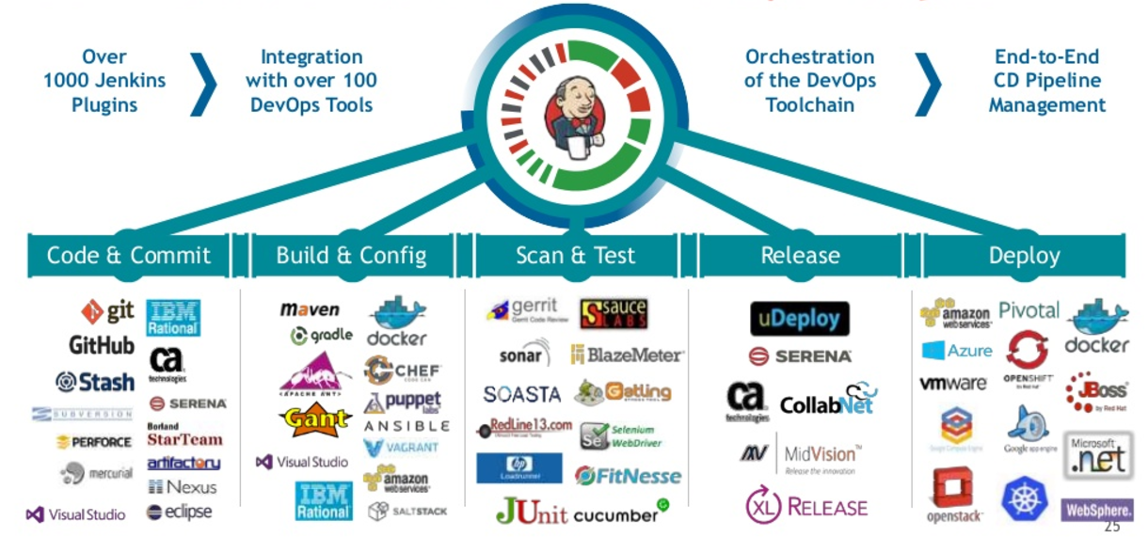
DevOps Tools

Slide 5
DevOps Categories
Collaboration - Confluence
Planning - Gitlab
Issue Tracking – trac, bugzilla
Monitoring - Nagios
Configuration Management – puppet chef capistrano ansible
Source Control – git , svn , jira
Dev Environments – aws
Continuous Integration - Jenkins Tomcat Jboss Hudson
Continuous Testing – Gradle Selenium Junit
Continuous Deployment – Docker AWS Kubernetes

Slide 6
QnA

