Slide 1
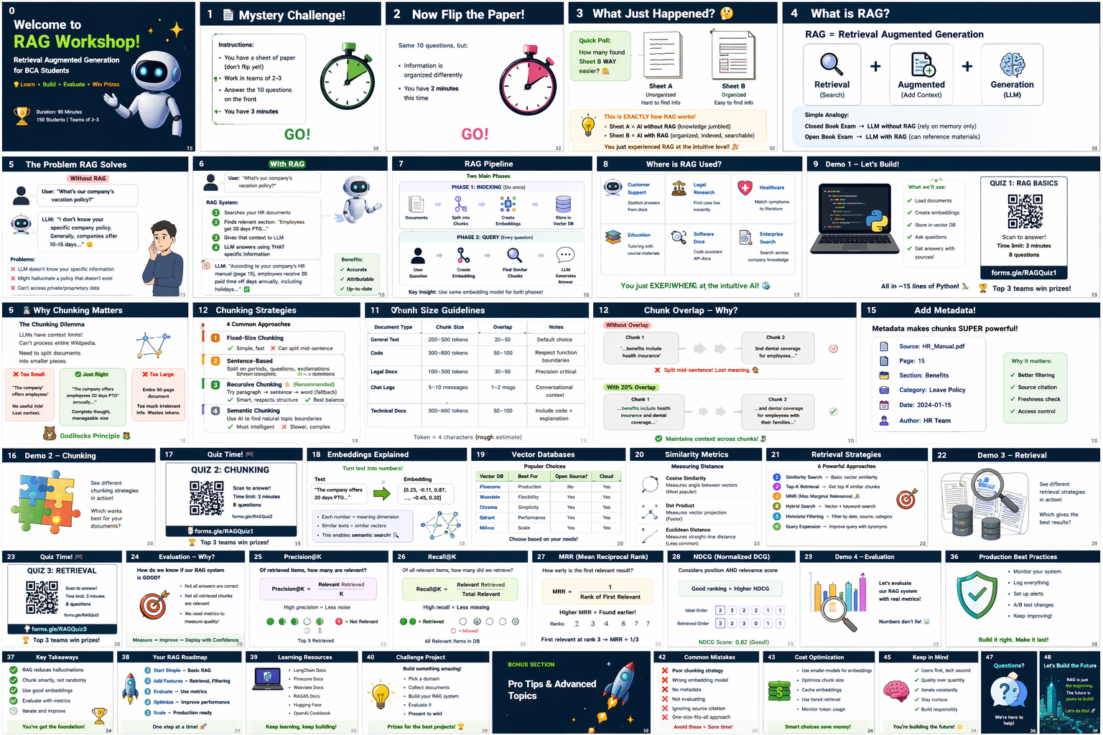
🎉 Welcome to RAG Workshop!
Retrieval Augmented Generation for BCA Students
✅ What is RAG & why it matters ✅ Chunking strategies
✅ Vector databases & retrieval ✅ Evaluation metrics
🚀 Build a working RAG system 🏆 Win prizes in 4 quizzes!
0

Slide 2
SECTION 1: ICE-BREAKER
⏱️ 0–10 minutes

Slide 3
📄 Mystery Challenge!
Instructions:
1. You have a sheet of paper (don't flip yet!)
2. Work in teams of 2-3
3. Answer the 10 questions on the front
4. You have 3 minutes
⏱️ GO! [Start timer]
1

Slide 4
Now Flip the Paper! 🔄
Same 10 questions, but:
• Information is organized differently
• You have 2 minutes this time
⏱️ GO! [Start timer]
2

Slide 5
What Just Happened? 🤔
Quick Poll: How many found Sheet B WAY easier? 🙋
▸ What was different?
• Sheet A: Unorganized paragraphs (hard to find info)
• Sheet B: Organized with headers, metadata, sections
▸ This is EXACTLY how RAG works!
• Sheet A = AI without RAG (knowledge jumbled)
• Sheet B = AI with RAG (organized, indexed, searchable)
You just experienced RAG at the intuitive level! 🎉
3

Slide 6
SECTION 2: RAG BASICS
⏱️ 10–25 minutes

Slide 7
RAG = Retrieval Augmented Generation
▸ Retrieval (Search) + Augmented (Add Context) + Generation (LLM)
★ Simple Analogy:
• Closed Book Exam → LLM without RAG (rely on memory only)
• Open Book Exam → LLM with RAG (can reference materials!)
★ Why RAG?
• 🚫 Reduces hallucinations (LLM making up facts)
• 📅 Provides up-to-date information (not stuck at training cutoff)
• 📚 Enables domain-specific knowledge (your company docs!)
• 💰 Much cheaper than fine-tuning
4

Slide 8
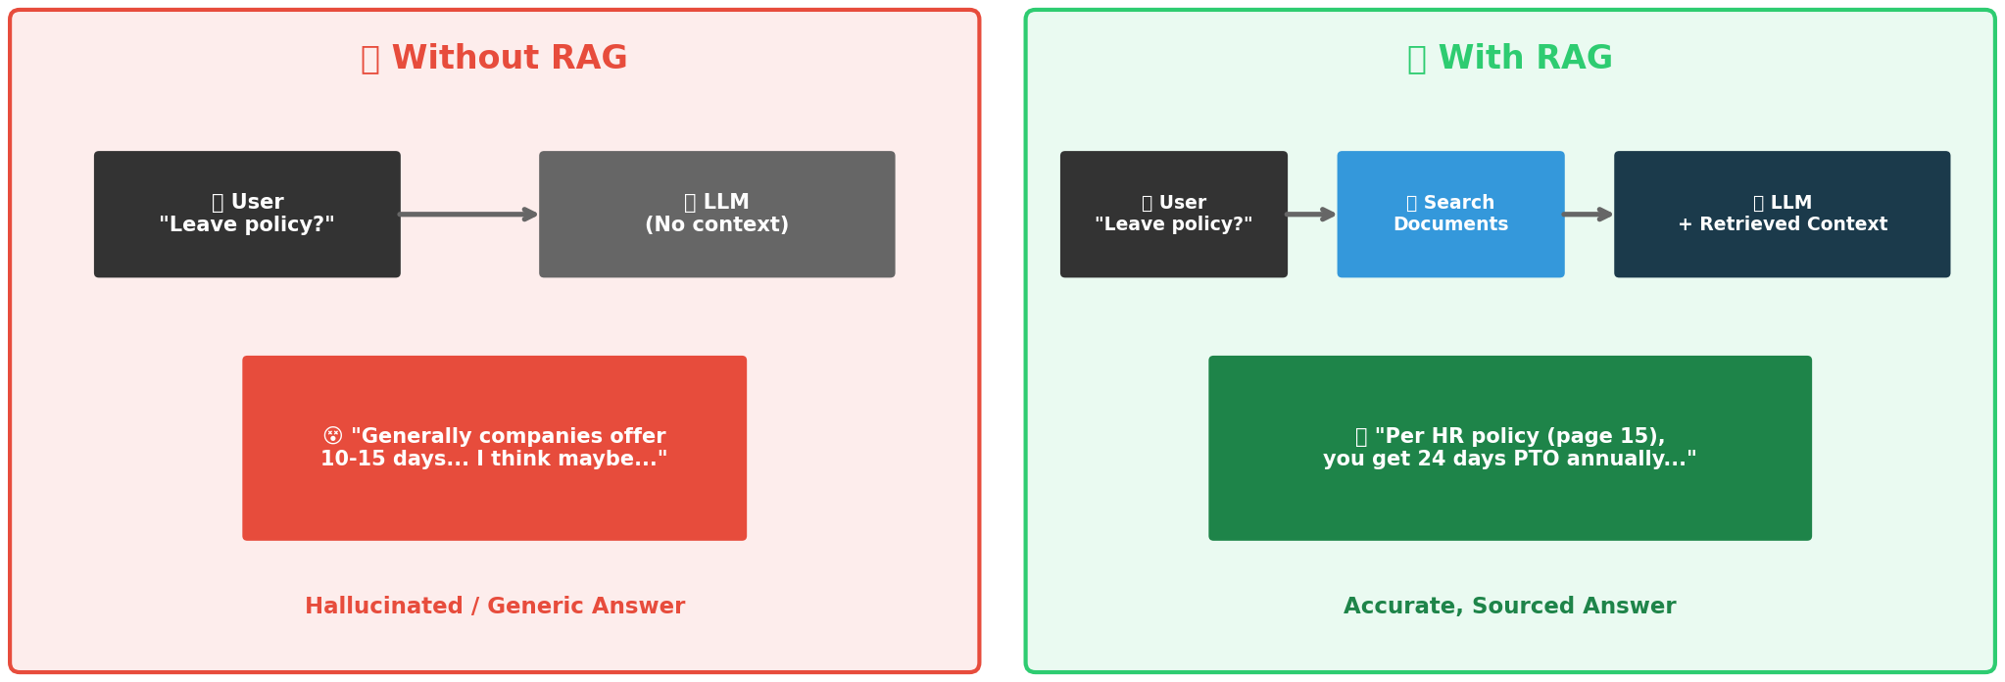
Without RAG ❌ vs With RAG ✅
RAG transforms generic, hallucinated answers into accurate, sourced responses
5

Slide 9
How RAG Works — Step by Step ✅
User asks: "What is our company's vacation policy?"
▸ Step 1: 🔍 Search → Scan your HR documents
▸ Step 2: 📎 Retrieve → Find: "Employees get 20 days PTO..."
▸ Step 3: 📝 Augment → Add that context to LLM prompt
▸ Step 4: 🤖 Generate → LLM answers using THAT specific info
LLM: "According to your HR Manual (page 15),
employees receive 20 paid time off days annually..."
✅ Accurate ✅ Attributable (can cite sources!) ✅ Up-to-date
6

Slide 10
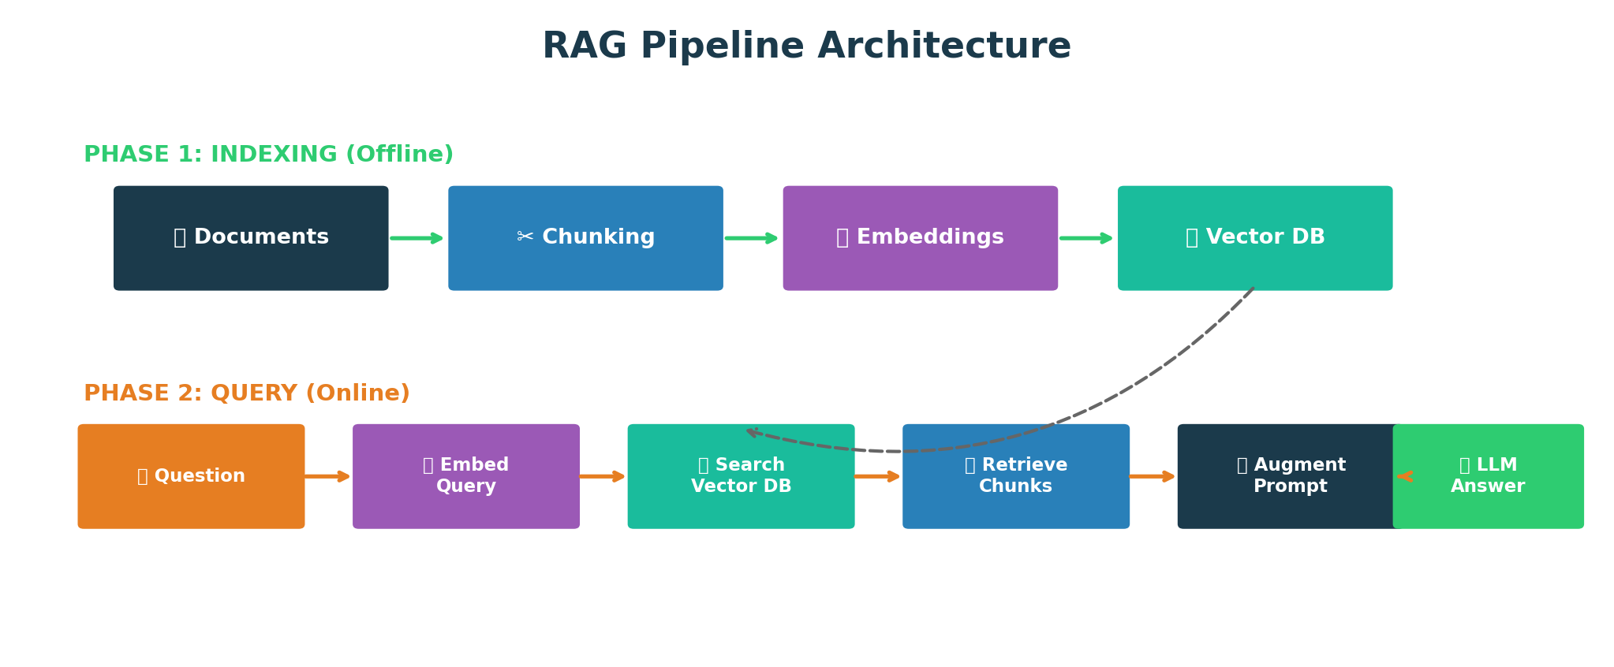
RAG Pipeline Architecture
Phase 1: Index once (offline) → Phase 2: Query every time (online). Use SAME embedding model for both!
7

Slide 11
Where is RAG Used? 🌍
Use Case | Example | Why It Works
Customer Support | Chatbot answers from company docs | Accurate, consistent answers
Legal Research | Find relevant case law instantly | Cite specific precedents
Healthcare | Match symptoms to medical literature | Evidence-based responses
Education | Tutoring bot using course materials | Personalized learning
Software Docs | Code assistant using API documentation | Always up-to-date help
Enterprise Search | Search across all company knowledge | Find anything instantly
8

Slide 12
🔴 LIVE DEMO 1
Building the Simplest RAG — All in ~15 lines of Python! 🐍
9

Slide 13
🎮 Quiz 1: RAG Basics
┌─────────────────────────────────────┐
│ QUIZ 1: RAG BASICS │
│ │
│ Scan the QR Code to answer! │
│ Time limit: 3 minutes │
│ 8 questions │
│ │
│ 🏆 Top 3 teams win prizes! │
└─────────────────────────────────────┘
⏱️ GO! ⏱️
10

Slide 14
SECTION 3: CHUNKING
⏱️ 25–45 minutes

Slide 15
Why Chunking Matters 🧩
▸ Problem: LLMs have context limits! Can't process entire Wikipedia.
★ The Goldilocks Principle:
❌ Too Small (50 tokens):
"The company offers employees" → No useful info on its own!
❌ Too Large (entire document):
50-page document → Too much irrelevant info, wastes tokens
✅ Just Right (200-500 tokens):
"The company offers employees 20 days PTO annually..." → Complete thought! 🎯
Rule: Each chunk should contain a complete, self-contained idea.
11

Slide 16
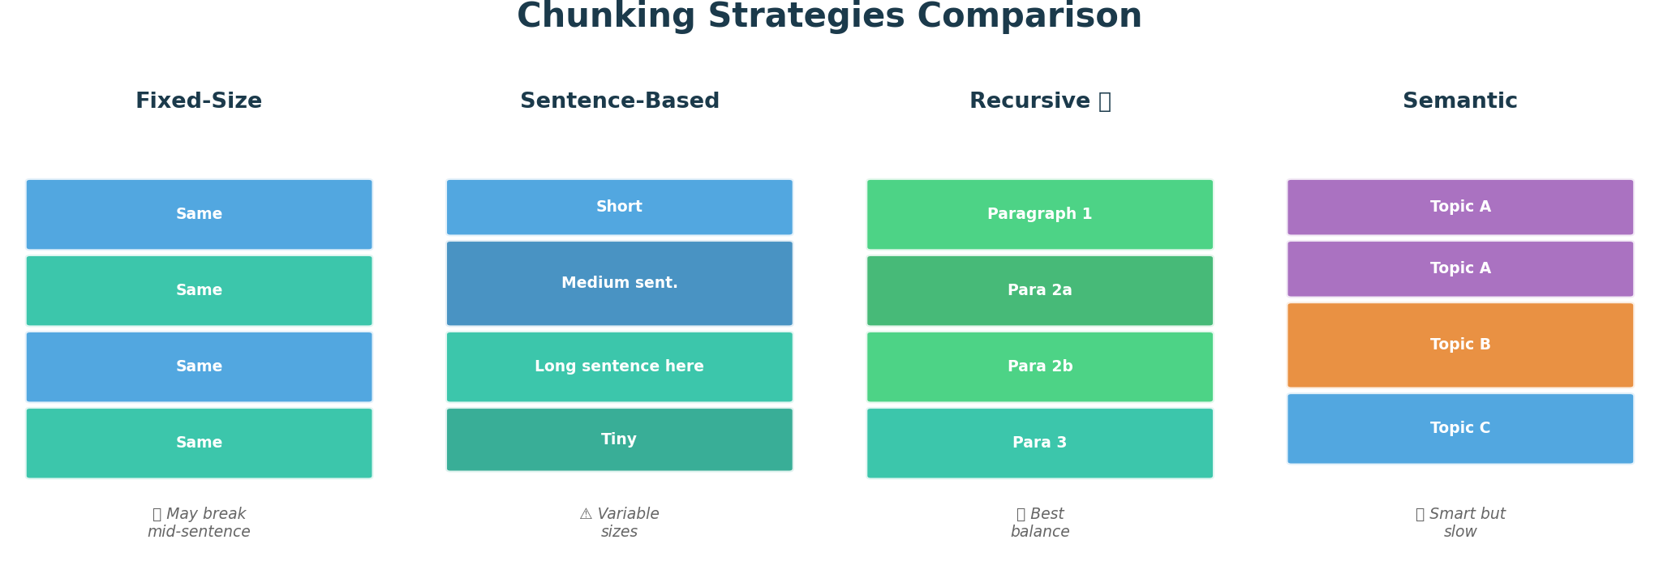
4 Chunking Strategies Compared
Recursive Character Splitting ⭐ is the recommended default — best balance of structure and simplicity
12

Slide 17
Chunk Size Guidelines 📏
Document Type | Chunk Size | Overlap | Notes
General Text | 200-500 tokens | 20-50 tokens | Default choice
Code | 300-800 tokens | 50-100 tokens | Respect function boundaries
Legal Docs | 100-300 tokens | 30-50 tokens | Precision critical
Chat Logs | 5-10 messages | 1-2 messages | Conversational context
Technical Docs | 300-600 tokens | 50-100 tokens | Include code + explanation
13

Slide 18
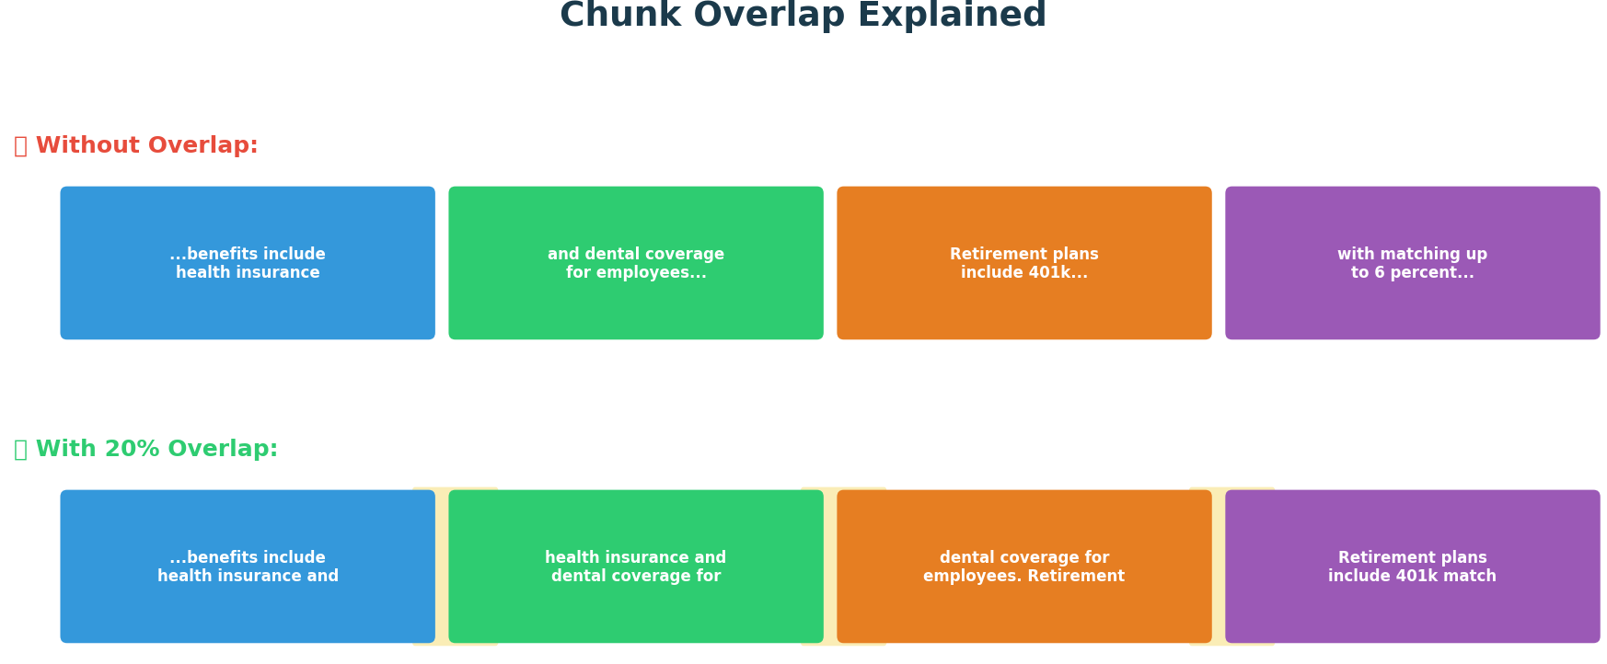
Chunk Overlap — Why It Matters
Typical Overlap: 10-20% of chunk size. Both chunks retain complete context at boundaries!
14

Slide 19
Metadata is Magic ✨
▸ Always add metadata to your chunks!
{ "content": "Employees receive 20 days PTO annually...",
"metadata": {
"source": "HR_Manual_2024.pdf", "page": 15,
"section": "Benefits", "last_updated": "2024-03-01",
"department": "Human Resources", "classification": "internal"
} }
★ Why?
📎 Attribution: "According to HR Manual page 15..."
🔍 Filtering: "Show me only Engineering docs"
📅 Freshness: "Only documents from 2024"
🏢 Multi-tenancy: "Only Company A's data"
15

Slide 20
🔴 LIVE DEMO 2
Chunking Strategies Showdown! 💻
16

Slide 21
🎮 Quiz 2: Chunking
┌─────────────────────────────────────┐
│ QUIZ 2: CHUNKING │
│ Scan the QR Code to answer! │
│ Time limit: 4 minutes | 10 questions │
│ 🏆 Top 3 teams win prizes! │
└─────────────────────────────────────┘
⏱️ GO! ⏱️
17

Slide 22
SECTION 4: VECTOR DB & RETRIEVAL
⏱️ 45–65 minutes

Slide 23
What Are Embeddings? 🔢
▸ Embeddings = Vector representation of meaning
"king" → [0.2, 0.8, 0.1, 0.4, ...] (768 dimensions)
"queen" → [0.2, 0.7, 0.1, 0.5, ...] ← Very similar!
"car" → [0.9, 0.1, 0.7, 0.2, ...] ← Very different!
★ Key Idea:
• Similar meanings → Similar vectors (close in vector space)
• Different meanings → Different vectors (far apart)
Think: GPS coordinates for meanings! 🗺️
In reality: 768-dimensional space (can't visualize!)
But concept is the same — similar things cluster together.
18

Slide 24
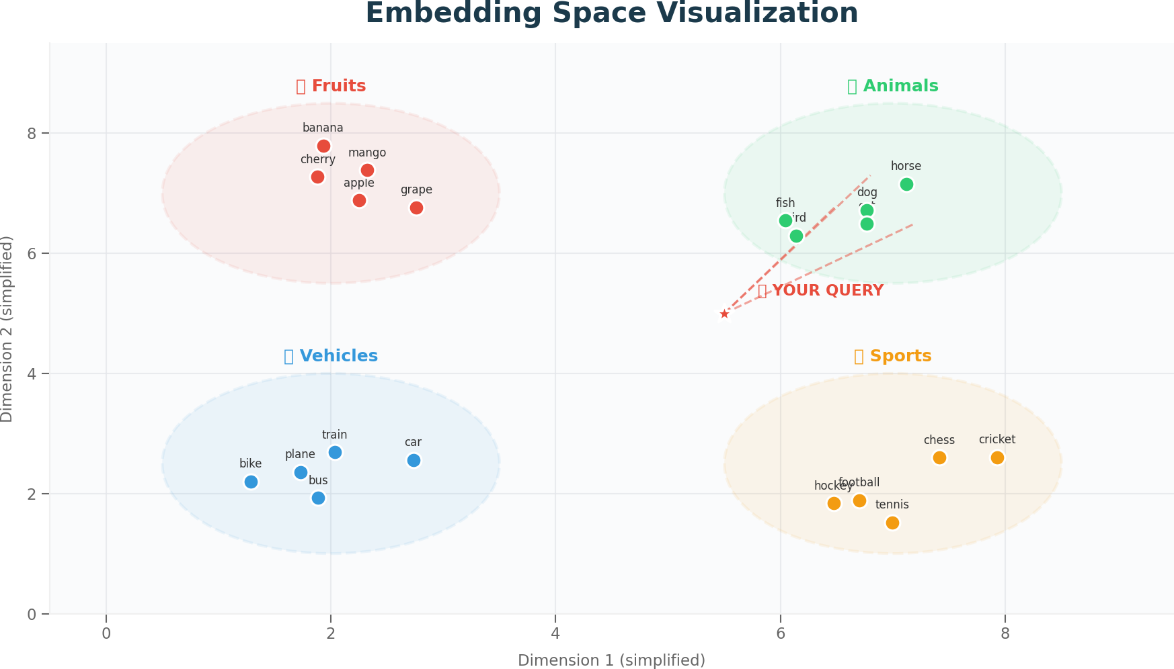
Visualizing Embedding Space
Similar concepts cluster together. Your query is matched to nearest neighbors in this vector space.
19

Slide 25
Popular Vector Databases
Database | Best For | Speed | Ease of Use
ChromaDB | Prototyping, Small-Medium | Good | Easy ⭐
FAISS (Meta) | High-scale, Production | Excellent | Medium
Pinecone | Cloud, Managed | Good | Easy
Weaviate | Feature-rich, Hybrid Search | Good | Medium
20

Slide 26
Similarity Metrics — How to Measure Closeness
1️⃣ Cosine Similarity ⭐ (Most Common)
• Measures angle between vectors | Range: -1 to 1 (1 = identical)
• Formula: cos(θ) = (A · B) / (||A|| × ||B||)
2️⃣ Euclidean Distance
• Measures straight-line distance | Range: 0 to ∞ (0 = identical)
• Formula: d = sqrt(Σ(Ai - Bi)²)
3️⃣ Dot Product
• Measures magnitude AND direction | Fast to compute
For RAG: Use Cosine Similarity (default) ⭐
21

Slide 27
6 Retrieval Strategies 🎯
1️⃣ Cosine Similarity Search (Default) — Top-K most similar. 90% of use cases.
2️⃣ MMR (Maximal Marginal Relevance) — Balance relevance + diversity.
3️⃣ Similarity Threshold — Only return if similarity > threshold (e.g., 0.7).
4️⃣ Metadata Filtering — Filter by category, date, source BEFORE search.
5️⃣ Hybrid Search — Combine vector search + keyword search (BM25).
6️⃣ Reranking — LLM refines results after initial retrieval. Most accurate but slower.
22

Slide 28
When to Use What? 🤔
Your Need | Strategy | Why
General Q&A | Cosine Similarity | Fast, simple, effective
Diverse results | MMR | Avoids redundancy
Quality over quantity | Similarity Threshold | Only confident results
Category-specific | Metadata Filtering | Narrow scope first
Exact terms important | Hybrid Search | Keywords + semantics
Maximum accuracy | Reranking | LLM-powered refinement
23

Slide 29
🔴 LIVE DEMO 3
Vector DBs & Retrieval Strategies! 💻
24

Slide 30
🎮 Quiz 3: Vector DB & Retrieval
┌─────────────────────────────────────┐
│ QUIZ 3: VECTOR DB & RETRIEVAL │
│ Scan the QR Code to answer! │
│ Time limit: 5 minutes | 12 questions │
│ 🏆 Top 3 teams win prizes! │
└─────────────────────────────────────┘
⏱️ GO! ⏱️
25

Slide 31
SECTION 5: EVALUATION METRICS
⏱️ 65–85 minutes | The MOST CRITICAL section!

Slide 32
Why Metrics Matter 📊
★ You Can't Improve What You Don't Measure!
Building RAG without evaluation = Flying blind! ✈️😵
▸ The Question: "Is my RAG system good?"
▸ How to Answer:
• Measure retrieval quality → Are we finding the right documents?
• Measure generation quality → Are the answers good?
• Track over time → Are we improving with each iteration?
⚠️ This section is CRITICAL for production!
Metrics separate hobby projects from production systems.
26

Slide 33
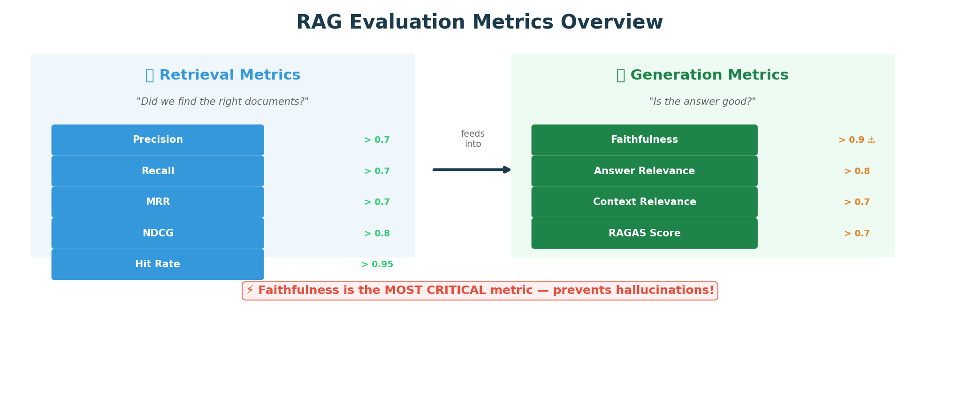
RAG Evaluation Metrics Overview
Retrieval metrics check document finding. Generation metrics check answer quality. Need BOTH!
27

Slide 34
Retrieval Metric #1: Precision 🎯
▸ Of all documents we retrieved, how many are actually relevant?
Precision = (Relevant Docs Retrieved) / (Total Docs Retrieved)
★ Example: Retrieved 5 documents:
✅ Doc 1: Relevant ❌ Doc 2: Not relevant
✅ Doc 3: Relevant ❌ Doc 4: Not relevant ❌ Doc 5: Not relevant
Precision = 2/5 = 0.4 = 40%
★ High Precision = Low false positives (not much junk in results)
Goal: Precision > 0.7
28

Slide 35
Retrieval Metric #2: Recall 📡
▸ Of all relevant documents in the database, how many did we find?
Recall = (Relevant Docs Retrieved) / (Total Relevant Docs in DB)
★ Example:
Database has 10 relevant documents total
We retrieved 5 documents, 3 are relevant
Recall = 3/10 = 0.3 = 30%
★ High Recall = Found most relevant docs (didn't miss much)
Goal: Recall > 0.7
29

Slide 36
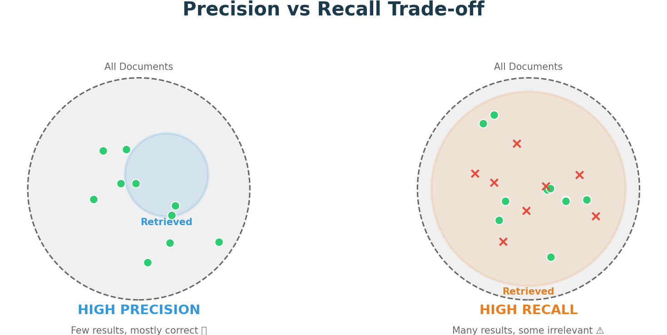
Precision vs Recall Trade-off ⚖️
Legal/Medical → High Precision | Research → High Recall | RAG → Balance both! F1 = Harmonic Mean
30

Slide 37
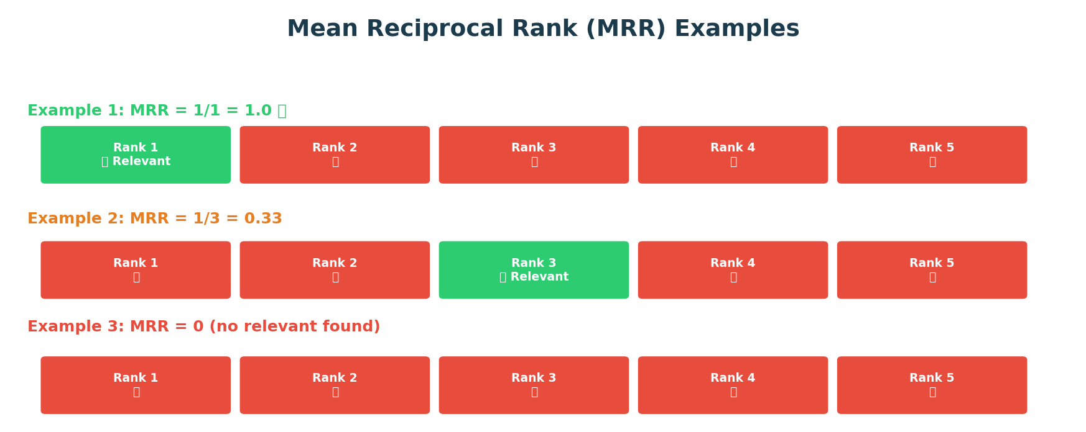
Retrieval Metric #3: Mean Reciprocal Rank (MRR)
MRR = 1/(Rank of First Relevant Doc). Users look at top results first! Goal: MRR > 0.7
31

Slide 38
Retrieval Metric #4: NDCG
▸ NDCG = Normalized Discounted Cumulative Gain
★ The Idea: Relevant docs at TOP positions are worth more!
Results: [✅✅✅❌❌] → NDCG = 0.95 ⭐ (relevant docs on top)
Results: [❌❌✅✅✅] → NDCG = 0.68 (relevant docs at bottom)
Same number of relevant docs, but NDCG captures ranking quality!
★ Formula (Simplified):
DCG = Σ (relevance_i / log₂(position_i + 1))
NDCG = DCG / Ideal_DCG
NDCG = 1.0 → Perfect ranking | NDCG = 0.0 → Worst ranking
Goal: NDCG > 0.8 ⭐
32

Slide 39
Retrieval Metric #5: Hit Rate ✅❌
▸ Did we find AT LEAST ONE relevant document?
Hit Rate = 1 if any relevant doc found, else 0
★ Examples:
Results: [❌, ✅, ❌, ❌] → Hit Rate = 1 ✅
Results: [❌, ❌, ❌, ❌] → Hit Rate = 0 ❌
★ Binary metric — simplest of all:
1.0 = Success! | 0.0 = Complete failure
Averaged over many queries to get overall success rate.
Goal: Hit Rate > 0.95
33

Slide 40
Generation Metric #1: Faithfulness ⚠️ MOST CRITICAL
▸ Does the answer only include information from retrieved documents?
★ High Faithfulness: ✅
Retrieved: "Company offers 20 days PTO" → Answer: "You get 20 days PTO"
★ Low Faithfulness (HALLUCINATION): ❌
Retrieved: "Company offers 20 days PTO" → Answer: "You get 30 days + free gym"
★ Why MOST CRITICAL?
⚠️ Wrong medical advice → Health risk
⚠️ Wrong legal info → Legal liability
⚠️ Wrong financial info → Financial loss
Goal: Faithfulness > 0.9 — Non-negotiable for production!
34

Slide 41
Generation Metric #2: Answer Relevance 🎯
▸ Does the answer actually address the question asked?
★ High Relevance: ✅
Q: "What's the vacation policy?" → A: "Employees receive 20 days PTO..."
★ Low Relevance: ❌
Q: "What's the vacation policy?" → A: "The company was founded in 1990..."
Even if factually correct, it must address the actual question!
Goal: Answer Relevance > 0.8
35

Slide 42
Generation Metric #3: Context Relevance 📎
▸ Are the retrieved documents actually useful for answering?
★ High Context Relevance: ✅
Q: "Vacation policy?" → Retrieved: "Vacation Policy: 20 days..." ← Perfect!
★ Low Context Relevance: ❌
Q: "Vacation policy?" → Retrieved: "Company founded in 1990..." ← Useless!
Bridges retrieval and generation:
If retrieved context is bad, the answer will be bad too!
Goal: Context Relevance > 0.7
36

Slide 43
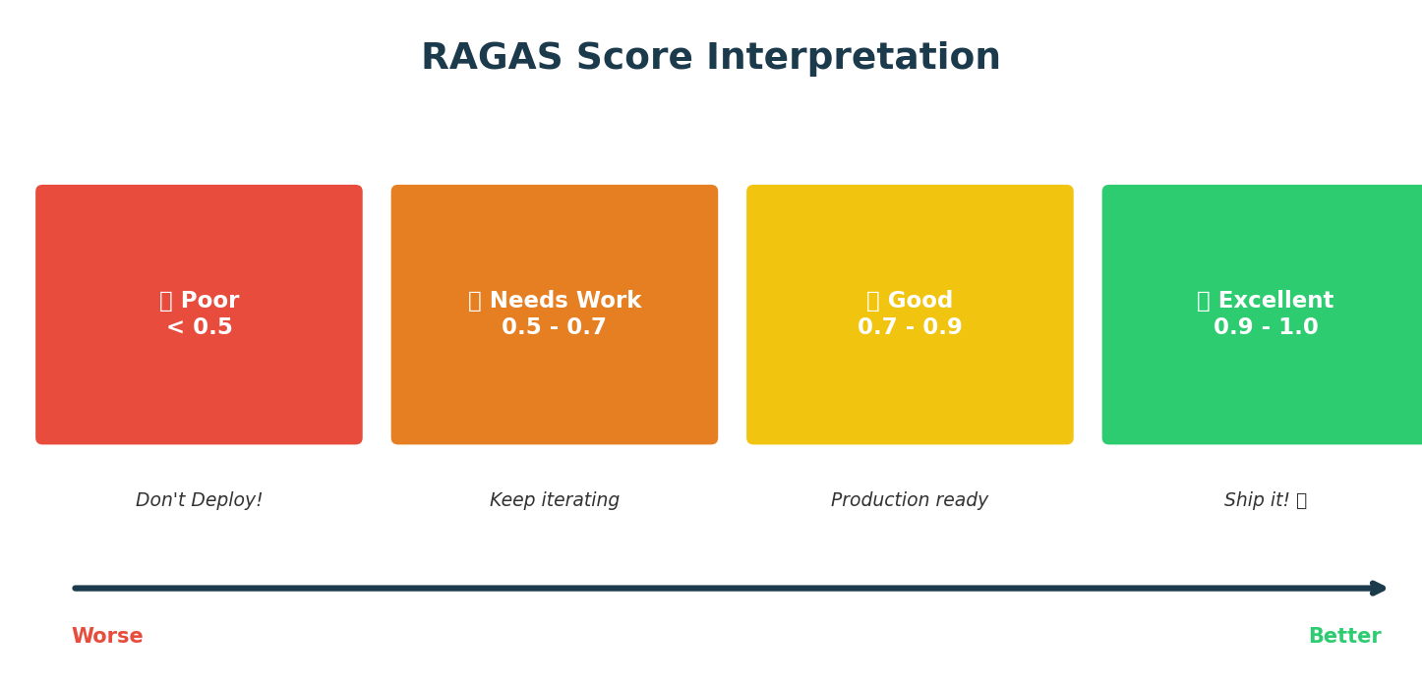
Generation Metric #4: RAGAS Score
RAGAS = Harmonic Mean of Faithfulness + Answer Relevance + Context Relevance. Single number for quality!
37

Slide 44
📋 Metrics Cheat Sheet — Print This!
Metric | What It Measures | Range | Goal
Precision | Accuracy of retrieved docs | 0-1 | > 0.7
Recall | Completeness of retrieval | 0-1 | > 0.7
MRR | Position of first relevant doc | 0-1 | > 0.7
NDCG | Quality of ranking | 0-1 | > 0.8
Hit Rate | At least 1 relevant found | 0-1 | > 0.95
Faithfulness | No hallucinations | 0-1 | > 0.9 ⚠️
Answer Relevance | Answer is on-topic | 0-1 | > 0.8
Context Relevance | Retrieved docs are useful | 0-1 | > 0.7
RAGAS Score | Overall RAG quality | 0-1 | > 0.7
38

Slide 45
🔴 LIVE DEMO 4
Evaluation Metrics in Action! 📊 Precision, Recall, MRR, NDCG, Faithfulness, RAGAS
39

Slide 46
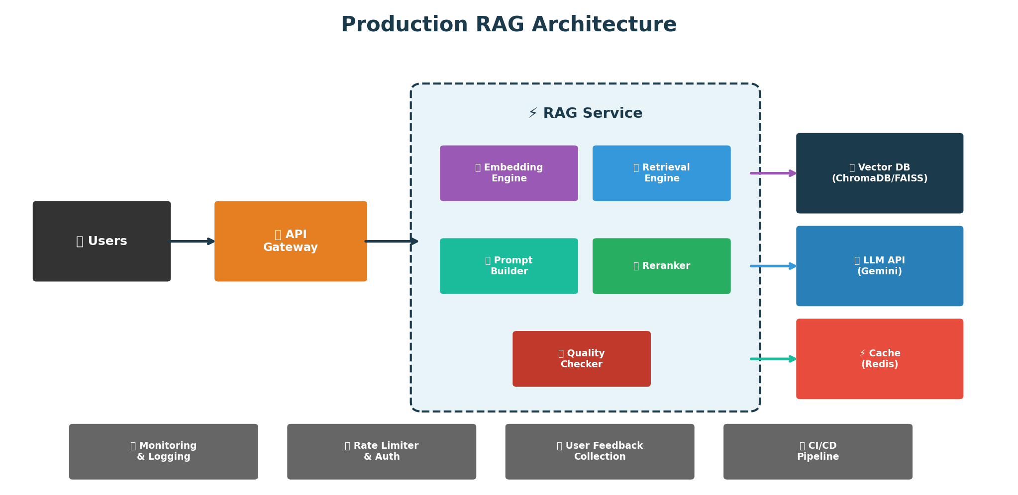
Production RAG Architecture 🏭
API Gateway → RAG Service → Vector DB + LLM + Cache + Monitoring + Logging + Auth + CI/CD
40

Slide 47
🔴 LIVE DEMO 5
Complete Production RAG System! 🚀 Config, logging, error handling, feedback collection
41

Slide 48
🏆 FINAL QUIZ 4: The Ultimate Challenge!
┌─────────────────────────────────────┐
│ 🏆 FINAL CHALLENGE - QUIZ 4! 🏆 │
│ │
│ Kahoot Game PIN: ► 123456 ◄ │
│ Go to: kahoot.it │
│ │
│ 15 questions - Advanced level! │
│ │
│ 🎁 GRAND PRIZES for top 3! 🎁 │
└─────────────────────────────────────┘
⏱️ LET'S GO! ⏱️
42

Slide 49
SECTION 6: WRAP-UP
⏱️ 85–90 minutes

Slide 50
🎓 Key Takeaways
▸ 1. RAG Fundamentals
Retrieval + Augmented + Generation → Reduces hallucinations, enables domain knowledge
▸ 2. Chunking
RecursiveCharacterTextSplitter • 200-500 tokens • 10-20% overlap • Always add metadata!
▸ 3. Vector Databases
ChromaDB for prototyping • FAISS for production scale • Cosine similarity is default
▸ 4. Retrieval Strategies
Cosine for general use • MMR for diversity • Metadata filtering for precision
▸ 5. Evaluation is CRITICAL ⚠️
Measure both retrieval AND generation • Faithfulness prevents hallucinations
RAGAS gives overall quality score
43

Slide 51
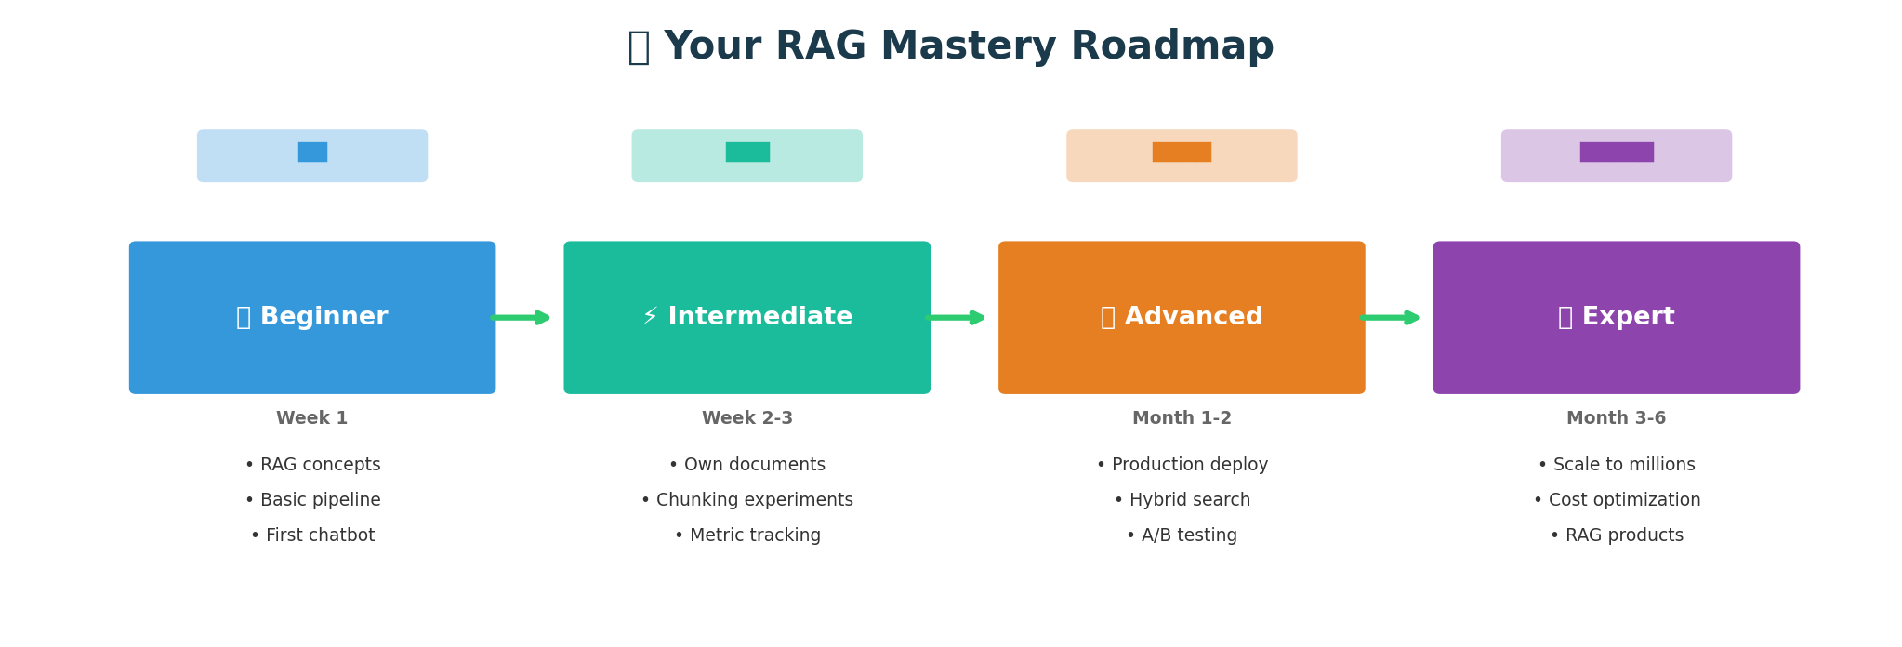
🚀 Your RAG Mastery Roadmap
Beginner (Today!) → Intermediate (1-2 weeks) → Advanced (1-2 months) → Expert (3-6 months)
44

Slide 52
📚 Resources for Further Learning
📖 Documentation & Courses
📄 Papers & Communities
Official Docs:
• LangChain — langchain.com
• ChromaDB — trychroma.com
• FAISS — faiss.ai
• Gemini API — ai.google.dev
Courses:
• DeepLearning.AI: "LangChain for LLM Apps"
• Coursera: "Generative AI with LLMs"
Key Papers:
• "Retrieval-Augmented Generation for
Knowledge-Intensive NLP Tasks"
• "RAGAS: Automated Evaluation of RAG"
Communities:
• r/LocalLLaMA (Reddit)
• LangChain Discord
• Hugging Face Forums
45

Slide 53
🏆 Take-Home Challenge Project
▸ Build a RAG System for Your College!
★ Requirements:
• Use course syllabus / college handbook as knowledge base
• Implement chunking with metadata
• Create a question-answering system
• Evaluate with metrics (report Precision, Recall, RAGAS)
• Submit code + evaluation report
★ Details:
📅 Deadline: 1 week from today
🎁 Prizes: Top 5 submissions win special prizes!
📧 Submission: Email to [your-email]
This will be great for your portfolio! 💼
46

Slide 54
You Did It! 🎉
★ In just 90 minutes, you:
✅ Learned RAG from scratch
✅ Built working systems
✅ Understood evaluation metrics
✅ Saw production patterns
▸ RAG is not magic — it's engineering!
• Measure everything
• Iterate based on data
• Start simple, scale up
You now have the skills to build production-ready RAG systems!
🌟 Now go build something amazing! 🌟
47

Slide 55
Thank You! 🙏
All materials at shivarajkarki/RAG-Workshop-Demo
48

Slide 56
BONUS SLIDES
Extra material if time permits ⏱️

Slide 57
❌ Top 10 RAG Mistakes to Avoid
1. No evaluation → Flying blind, can't improve
2. Wrong chunk size → Too big or too small kills retrieval
3. No metadata → Can't filter or cite sources
4. Single retrieval strategy → Use MMR for diversity sometimes
5. Ignoring faithfulness → Hallucinations sneak into production
6. Not testing edge cases → System breaks on unusual queries
7. No caching → Waste money re-computing embeddings
8. Same embedding for everything → Different use cases need tuning
9. No user feedback → Can't improve without real-world signal
10. Premature optimization → Start simple, add complexity later!
Learn from others' mistakes! 😅
B1

Slide 58
💰 Making RAG Affordable
★ Embedding Costs:
• Use smaller models (text-embedding-004 is cheap!)
• Cache embeddings (don't recompute!) • Batch embed documents
★ LLM Costs:
• Use Gemini Flash for most queries (fast + cheap)
• Use Pro only for complex questions
• Set max_tokens limit
★ Vector DB: ChromaDB (Free) • FAISS (Free) • Pinecone (Paid)
★ Typical Cost (1M docs, 10K queries/day):
Embeddings: $10-50/mo | LLM: $100-500/mo | Vector DB: $0-100/mo
Total: ~$500/month for production system
B2

Slide 59
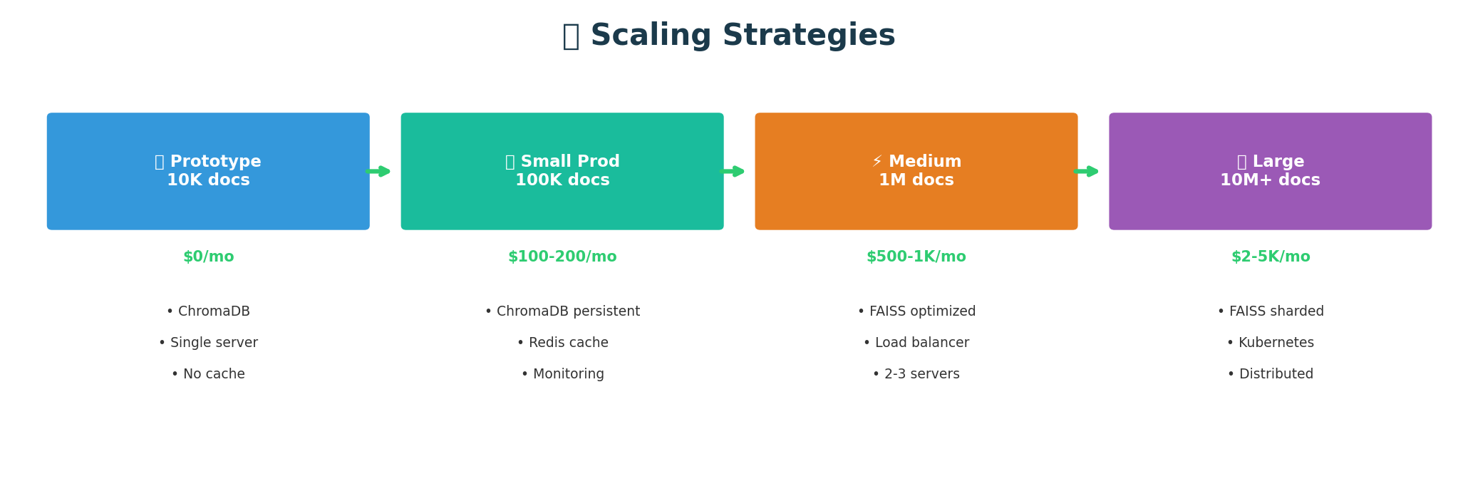
📈 Scaling Strategies — Prototype to Production
Start small, scale as needed! Prototype ($0) → Small ($100-200) → Medium ($500-1K) → Large ($2-5K/mo)
B3

