Slide 1
Scan (aps format)
16 x 512 x 660
JPG
16 Images
TFRECORD
16 buffers
Train Object Detection
Hand Label
Head, Hands, Groin, Threats
Use Pre-trained model

Slide 2
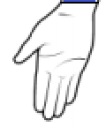
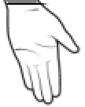
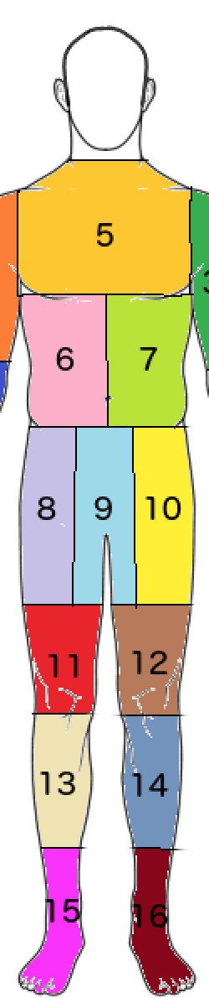
2
4
1
3
Bounding Box

Slide 3
Scan
16 (512 x 660) arrays.
JPG
16 Images
TF Record
16 frames
Object Detection
Zone Prediciton
Final Predcition
Bounding boxes for Head/Hands/Groin/Threats for 16 frames.
For each threat in each of the frames predict body zone.
Probability for each body zone.

Slide 7
Training
Training Scans
Subset of Training Scans
Bounding boxes for Head/Hands/Groin and Threats
Head box Hands box Groin box Threats box Body Zone
Zone Prediction Training XGBOOST
Hand Label Images
Object Detection Training
Object Detection Model
Subset of Training Labels
Pre-Trained Model
Custom Zone Predictor
XGBOOST Model to predict zones
Training Labels
Inference
XGBOOST Model to predict zones
Results 1
Object Detection Model
Bounding boxes for Head/Hands/Groin and Threats
Test Scans
Custom Zone Predictor
Results 2

