Slide 1
Scan (aps format)
16 x 512 x 660
JPG
16 Images
TFRECORD
16 buffers
Train Object Detection
Hand Label
Head, Hands, Groin, Threats
Use Pre-trained model

Slide 2
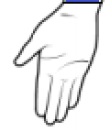
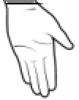
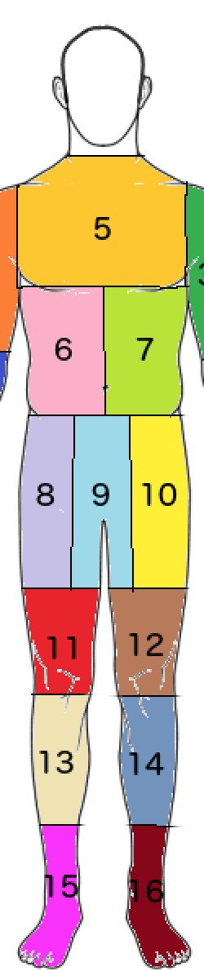
2
4
1
3
Bounding Box

Slide 3
Scan
16 (512 x 660) arrays.
JPG
16 Images
TF Record
16 frames
Object Detection
Zone Prediciton
Final Predcition
Bounding boxes for Head/Hands/Groin/Threats for 16 frames.
For each threat in each of the frames predict body zone.
Probability for each body zone.

