Slide 1




Distributed Machine Learning and Graph Processing with Sparse Matrices
Shivaram Venkataraman*, Erik Bodzsar#
Indrajit Roy⁺, Alvin AuYoung⁺, Rob Schreiber⁺
*UC Berkeley, #U Chicago, ⁺HP Labs

Slide 2






Big Data, Complex Algorithms
PageRank (Dominant eigenvector)
Recommendations (Matrix factorization)
Anomaly detection (Top-K eigenvalues)
User Importance (Vertex Centrality)
Machine learning + Graph algorithms
Notes:
Two major trends in industry - big data, complex algorithms used to analyze data – PageRank

Slide 3
Large-Scale Processing Frameworks
Data-parallel frameworks – MapReduce/Dryad (2004)
Process each record in parallel
Use case: Computing sufficient statistics, analytics queries
Graph-centric frameworks – Pregel/GraphLab (2010)
Process each vertex in parallel
Use case: Graphical models
Array-based frameworks – MadLINQ (2012)
Process blocks of array in parallel
Use case: Linear Algebra Operations

Slide 4
PageRank using Matrices
Simplified algorithm repeat { p = M*p }
Linear Algebra Operations on Sparse Matrices
p
M
p
Power Method
Dominant eigenvector
M = web graph matrix
p = PageRank vector

Slide 5
Presto
Large-scale machine learning and
graph processing on sparse matrices
Extend R – make it scalable, distributed

Slide 6
Challenge 1 – Sparse Matrices

Slide 7
Challenge 1 – Sparse Matrices
1000x more data → Computation imbalance
Notes:
MapReduce based systems where mappers scan any of the equal-size data partitions

Slide 8
Challenge 2 – Data Sharing
Sparse matrices →
Communication overhead
Server 1
Process
Process
data
copy of data
Sharing data through pipes/network
local copy
network
copy
network
copy
Time-inefficient (sending copies)
Space-inefficient (extra copies)
Process
Process
copy of data
copy of data
Server 2

Slide 9
Outline
Motivation
Programming model
Design
Applications and Results

Slide 10
darray

Slide 11
foreach
f (x)

Slide 12
PageRank Using Presto
P₁
P₂
P_{N/s}
M
p
M ← darray(dim=c(N,N),blocks=(s,N))
P ← darray(dim=c(N,1),blocks=(s,1))
while(..){
foreach(i,1:len,
calculate(m=splits(M,i),
x=splits(P), p=splits(P,i)) {
p ← m*x
}
)}
Create Distributed Array

Slide 13
PageRank Using Presto
P₁
P₂
P_{N/s}
M
p
M ← darray(dim=c(N,N),blocks=(s,N))
P ← darray(dim=c(N,1),blocks=(s,1))
while(..){
foreach(i,1:len,
calculate(m=splits(M,i),
x=splits(P), p=splits(P,i)) {
p ← m*x
}
)}
Execute function in a cluster
Pass array partitions

Slide 14
Presto Architecture
Master
Worker
Worker
R instance
R instance
R instance
R instance
R instance
R instance
DRAM
DRAM

Slide 15
Repartitioning Matrices
Profile execution
Repartition
Partition if $\frac{max⁡(t)}{median (t)}> δ$

Slide 16
Maintaining Size Invariants
invariant(mat,vec, type=ROW)

Slide 17
Sharing Distributed Arrays
Goal: Zero-copy sharing across cores
Immutable partitions → Safe sharing
Versioned distributed arrays

Slide 18
Data Sharing Challenges
1. Garbage collection
2. Header conflicts
R instance
R instance
Write
Write
Read
Garbage collect
R object header
R object data part
Corrupt header

Slide 19
Overriding R’s allocator
Allocate process-local headers. Map data in shared memory
page
Local R object header
Shared R object data part
page boundary
page boundary

Slide 20
Outline
Motivation
Programming model
Design
Applications and Results

Slide 21
demo
demo
demo
demo
5 node cluster
8 cores per node
PageRank on 1.5B edge Twitter data

Slide 22
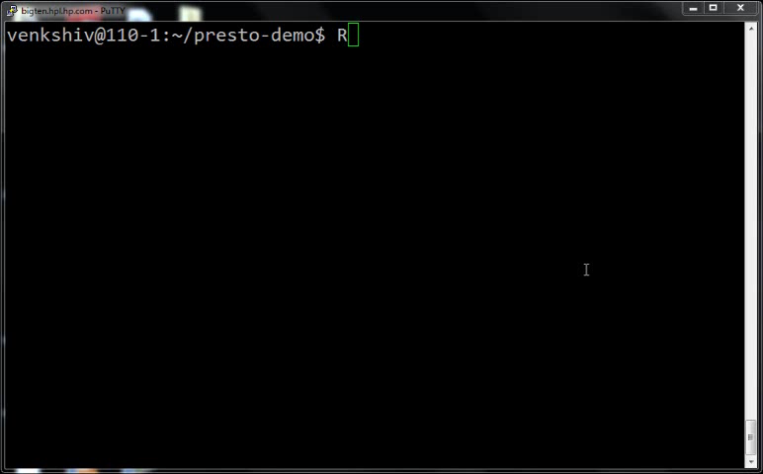

Slide 23
Applications Implemented in Presto
Application | Algorithm | Presto LOC
PageRank | Eigenvector calculation | 41
Triangle counting | Top-K eigenvalues | 121
Netflix recommendation | Matrix factorization | 130
Centrality measure | Graph algorithm | 132
k-path connectivity | Graph algorithm | 30
k-means | Clustering | 71
Sequence alignment | Smith-Waterman | 64
Fewer than 140 lines of code

Slide 24
Evaluation Overview
Evaluation Setup
- 25 machine cluster
- Machine: 24 cores, 96GB RAM, 10Gbps network
Data-sharing benefits – 1.5B edge Twitter graph
Repartitioning analysis – 6B edge Web-graph
Faster than Spark and Hadoop using in-memory data
Collaborative Filtering using Netflix dataset

Slide 25
Data sharing benefits
No sharing
Sharing

Slide 26
Repartitioning Progress
Notes:
130G in plain text files. 1000 partitions.

Slide 27
Repartitioning benefits
No Repartition
Repartition

Slide 28
Related Work
Large scale data processing frameworks
– MapReduce, Dryad, Spark, GraphLab
Matrix Computations – Ricardo, MadLINQ
HPC systems – ARPACK, Combinatorial BLAS
Multi-core R packages – doMC, snow, Rmpi

Slide 29
Presto
Locality-based
scheduling
Caching
partitions
Co-partitioning
matrices

Slide 30
Conclusion
Presto: Large scale array-based framework extends R
Challenges with Sparse matrices
Repartitioning, sharing versioned arrays

Slide 31
Backup Slides

Slide 32
Netflix Collaborative Filtering
Notes:
MadLINQ reported 48 machines 840s on different hardware

Slide 33
Repartitioning benefits

