Slide 1
Traffitizer - An emergency response system
Internal guide:
Mrs.Jayashree S Patil
Associate Professor
N.Lakshmi Vyshnavi 16251A05G0
Simrah Hussain 16251A05H1
Gorantala Niharika 17255A0526

Slide 2
Contents
Introduction
Existing System
Traffitizer
Objectives
Technologies Used
Presence of an ambulance
Absence of ambulance
Conclusions

Slide 3
Introduction
India is the second most populous country in the world and faces terrible road congestion problem in the cities.
Automatic traffic monitoring and surveillance are important for road usage and management.
A model is proposed for controlling the traffic light by image processing.
Traffitizer-An Emergency Response System aims to detect and identify any types of ambulances and to give green signal in the traffic jam.

Slide 4
Existing System
The current traffic control system (TCS) in the metro cities of India is inefficient due to randomness in the traffic density pattern throughout the day.
The traffic signal timers have a fixed time period to switch traffic between different directions.
Due to this, the vehicles have to wait for a long-time span even if the traffic density is very less.

Slide 5
Traffitizer
Traffitizer is a prototype in which if connected to camera, detects an ambulance waiting at a traffic signal, the respective signal changes from red to green, clearing way for the ambulance to reach its destination on time.
The proposed system is based on the Internet of Things (IoT) and image processing, which will help to take proactive and preventive actions to minimize the loss of patient’s lives due to traffic congestion.
Once the ambulance crosses the signal, the signals will act accordingly.

Slide 6
Objectives
To prevent the ambulance from getting stuck in traffic congestion.
It is a prototype of an intelligent traffic management system that can clear the traffic on the lane where the ambulance is present.
Automatic conversion of signals in other lanes to avoid traffic collision.

Slide 7
Technologies Used
Arduino IDE
It is used to write and upload programs to Arduino compatible boards.
Data is transferred from Arduino board to Python code to view the results.
Cascade GUI Trainer
Haar cascading is a Machine Learning based approach, to detect objects.
Cascade GUI Trainer is used to train models.
Python
Python is used for Object Detection purpose.
OpenCV is a library used for image processing to read and write images.
If an ambulance is detected, LED glows, representing it’s presence.

Slide 8
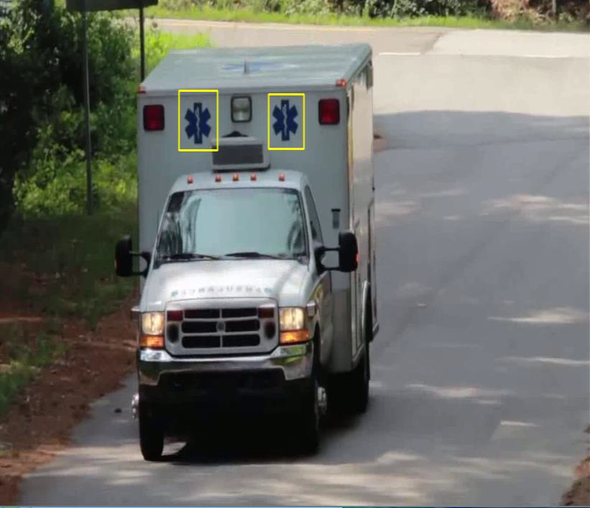
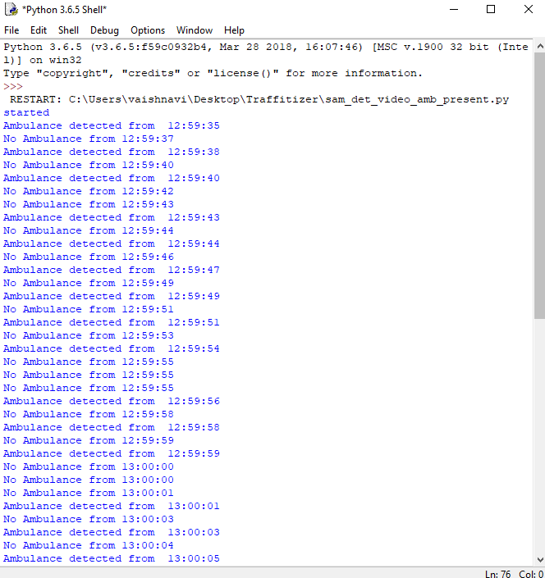
Presence of an ambulance

Slide 9
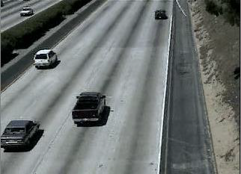
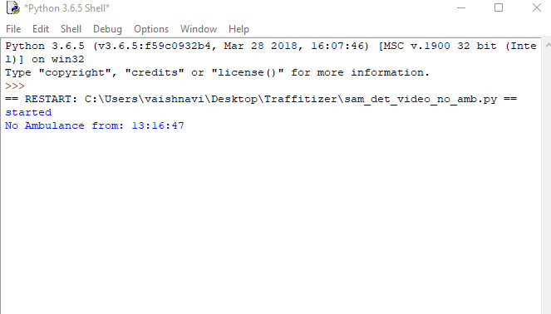
Absence of ambulance

Slide 10
Conclusion
The proposed system helps to solve the problem of traffic congestion during emergency.
The timing of each signal can be automatically adjusted according to the presence of an ambulance clearing the path for the ambulance in emergency cases.
It will help patients in taking decisions for reaching their destination in time.

