Slide 1
IRIS Data Analysis Report
Shivaram Andiappan Selvaraj
Notes:
Welcome the participants to the program.
Introduce yourself and briefly summarize your experience at EY and your interest in presenting at Welcome to EY.
Have co-facilitators, if present, introduce themselves and provide background information.
State the following to help participants understand the context of Welcome to EY:
This course was designed for all ranks around the globe. It provides you with foundational knowledge that will help to explain our culture, our processes and how we go to market.
However, your service line will provide the specifics about your role and your job.
As an organization, we want to invest in you, give you consistent content globally, let you meet other new hires across service lines and meet some of our leaders.

Slide 2
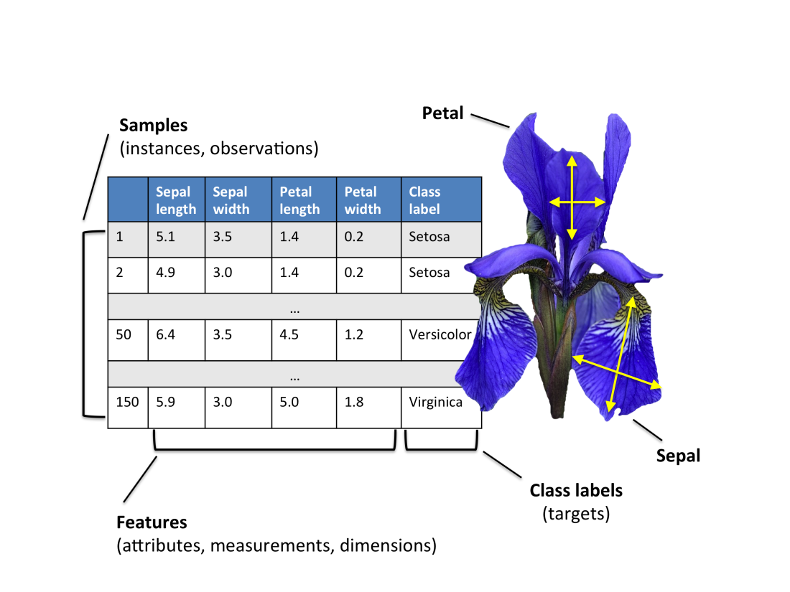
Problem Description
To build a tool which would retrieve records of the most similar Iris flowers in the garden for any input Iris flower from the user
Notes:
Make the following points:
Here you see our four Areas. Across our geographies we operate in approximately 150 countries, offering us worldwide reach. EY has over 190,000 people across the globe.
Our services are provided within four service lines:
Assurance
Advisory
Tax
Transaction Advisory Services (TAS)
Explain that these will be covered in more detail a bit later.

Slide 3
Overview
Language used | R programming
Data | Iris data from URL (https://archive.ics.uci.edu/ml/datasets/Iris)
Quality assesments | Missing Value, Duplicate value removal, Negative value removal, Extreme value removal
Scope | Reteive the most similar 10 other flowers from dataset
Visualization | Scatterplot using ggplot2
Notes:
We are organized into four Areas, so that we can:
We can better serve our clients Our Priority and Core Accounts want confidence we can bring together the best and most experienced teams wherever our clients do business. They want to work with market leading advisors, in terms of scale, services and experience. And they want evidence that we can respond to market developments swiftly and effectively.
It strengthens our brand A combined presence in EMEIA allows us to go to market as a more integrated and connected organization than any of our competitors. This differentiates us, and provides a powerful demonstration to clients, the market and our people about the strength of our commitment to provide seamless, consistent, high-quality client service, worldwide.
We drive consistent quality and risk management
Our quality and risk management procedures are already enhancing our client service, protecting our brand and strengthening our reputation. By coordinating across EMEIA, we can more readily drive consistency, share best practice and demonstrate to our clients and regulators the breadth and depth of our approach.
We build financial strength We are better able to converge our business model, and achieve appropriate sharing of costs, investments and rewards. This breaks down artificial silos and allows us to better leverage our investments. It will also give us greater scope to invest in the critical new services we believe our clients will demand in the future.
We drive operational effectiveness Removing duplication and overlap at the country level means significant reductions in finance, IT, HR, and tax infrastructure.

Slide 4
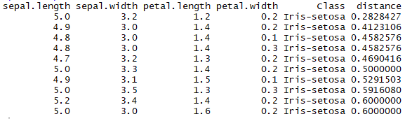
Euclidean Distance
Formula : d(a,b) = sqrt( (a1-b1)^2 + (a2-b2)^2 + (a3-b3)^2 + (a4-b4)^2 )
Input : a = {a1, a2, a3, a4}
b = {b1, b2, b3, b4}
Given input
Sepal.length - 5
Sepal.width - 3
Petal.length - 1
Petal.width - 0.2

Slide 5
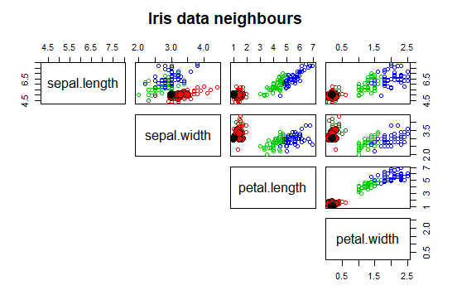
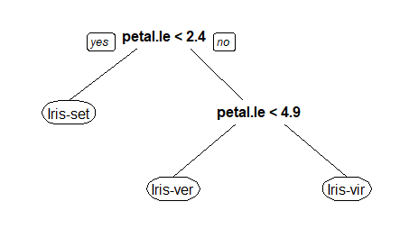
Visualization and Findings
Scatterplot visualizing all possible 2 dimenssional views for the 4 input variables
Legend
Black dot represents user input
Red dots represents class Iris-Setosa
Blue dots represents Iris-Virginica
Green dots represents Iris-Versicolor
Findings using Decision Tree
If petal.length is < 2.4, then the flower is Iris Setosa
If petal.length is between 2.3 and 4.9, then the flower is Iris-Versicolor
If petal.length is >=4.9, then the flower is Iris-Virginica

Slide 6
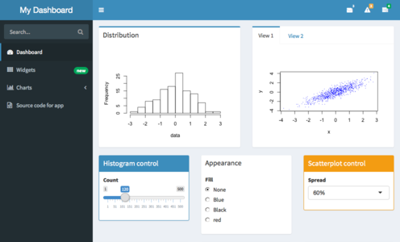
Future Expansion
A Shiny Dashboard for selection of parameters ands visualization
Other distance measure like Manhattan can be used

Slide 7
Thank you!

