Slide 1
AMP®-Parkinson's Disease Progression Prediction

Slide 2
Agenda
Introduction
Data Background
Data Preprocessing + EDA
Results
Methodology

Slide 3
Introduction
Data Source: https://www.kaggle.com/competitions/amp-parkinsons-disease-progression-prediction/overview
Problem Statement:
Parkinson’s disease (PD) is a disabling brain disorder that affects movements, cognition, sleep, and other normal functions
Research indicates that protein or peptide abnormalities play a key role in the onset and worsening of this disease
Goal: predict MDS-UPDR scores (from updrs 1 to 4), which measure progression in patients with Parkinson's disease

Slide 4
Data Background
Available data:
Training data:
train_peptides.csv Mass spectrometry data at the peptide level.
train_proteins.csv Protein expression frequencies aggregated from the peptide level data.
train_clinical_data.csv (include patient’s score per PD rating scale)
Testing data:
test_peptides.csv
test_proteins.csv
test.csv
Data overview:
Input features: visit_month, NPX, PeptideAbundance
Potential target variable(s): updrs_1, updrs_2, updrs_3, updrs_4
Notes:
NPX - The frequency of the protein's occurrence
PeptideAbundance - The frequency of the amino acid

Slide 5
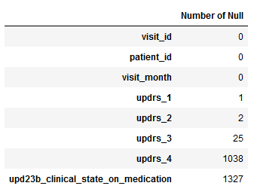


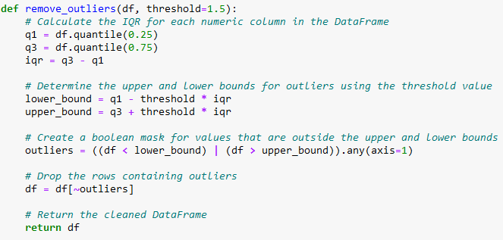
Data Preprocessing + EDA
Missing values:
For numerical data: replacing missing values with their corresponding column arithmetic average
For non-numerical data: replacing missing values with the column mode
Outliers removal: defined first and third quantiles, and removed any data points that are outside of the upper and lower bounds of the threshold
Notes:
Missing values are data points that are not recorded or available for some reason. They can be due to human errors, technical issues, or intentional omissions.
Outliers are data points that are significantly different from the rest of the data. They can be due to measurement errors, natural variations, or anomalies.
To identify missing values and outliers in your data sets, you can use descriptive statistics, such as mean, median, mode, standard deviation, range, or interquartile range. You can also use graphical methods, such as histograms, box plots, scatter plots, or heat maps.
For numerical data, one common method for replacing missing values is using their corresponding column arithmetic average. This means calculating the mean of all the available values in the same column and using it as a substitute for the missing values.
This method is simple and easy to implement, but it has some drawbacks. It can reduce the variability of the data, introduce biases, or affect the distribution of the data.
Another method for replacing missing values for numerical data is using regression or interpolation techniques. These methods use the relationship between variables to estimate the missing values based on other available values.
These methods are more complex and require more assumptions, but they can preserve the variability and distribution of the data better than using the arithmetic average.

Slide 6
Data Preprocessing + EDA (Cont.)
Feature Selection: dropping columns like “visit_id”, “upd23b_clinical_state_on_medication”, “UniProt”, and “Peptide”
Merging:
Inner join between “train_peptides” and “train_proteins” dataset on “visit_month”, “UniProt” and “patient_id” columns as “train”
Inner join between “train” and “train_clincal_data” dataset on “visit_id” and “patient_id” columns

Slide 7
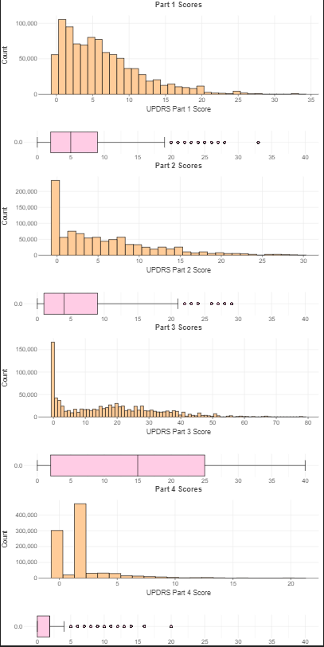
Data Preprocessing + EDA (Cont.)
All UPDRS scores are left skewed with outliers mostly centered on the right
This may show that the most of the patients are not in the severe impairment level

Slide 8
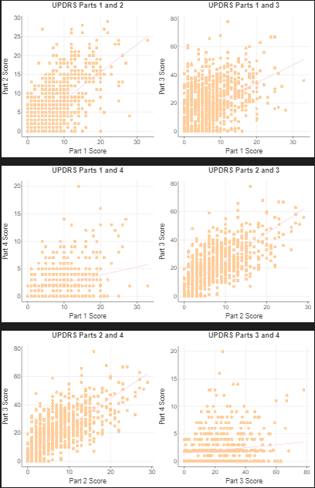
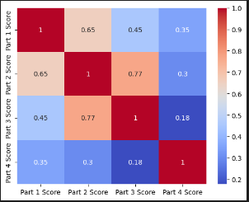
Data Preprocessing + EDA (Cont.)
Highest correlation score is between UPDRS_2 and UPDRS_3
Lowest correlation score is between UPDRS_4 and UPDRS_3

Slide 9
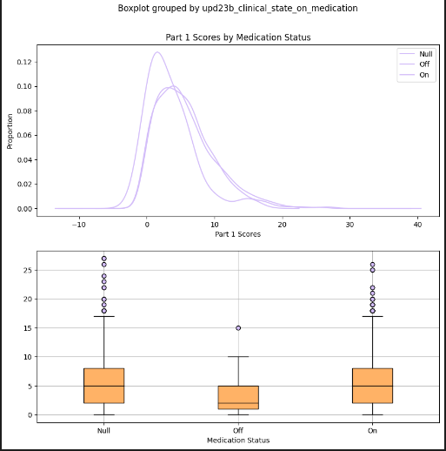
Data Preprocessing + EDA (Cont.)
UPDRS scores with medication status has shown that the ones without missing record are similarly distributed
UPDRS scores with medication status has shown that the ones with missing record (or Null values) are centered to the far left.

Slide 10
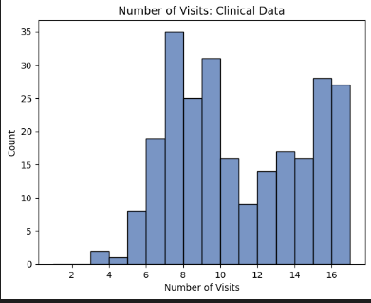
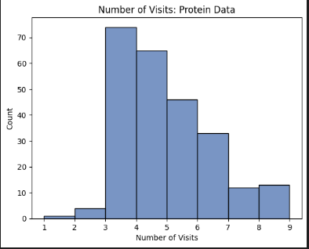
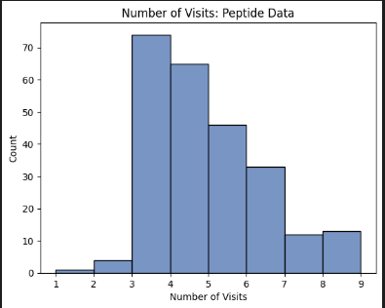
Data Preprocessing + EDA (Cont.)
Histograms shows that number of visits are different from all 3 datasets clinical, petite, and protein.
This needs to be considered while performing merging

Slide 11
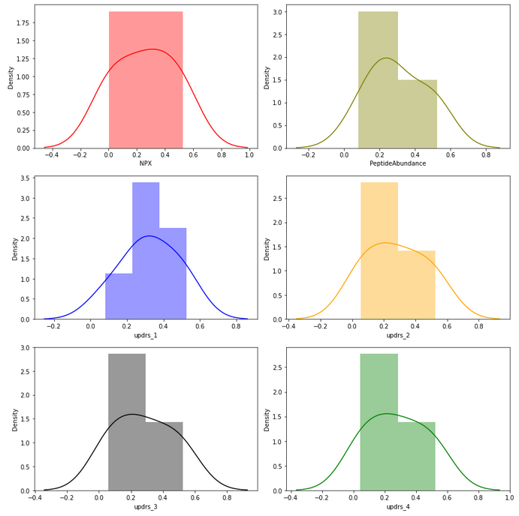
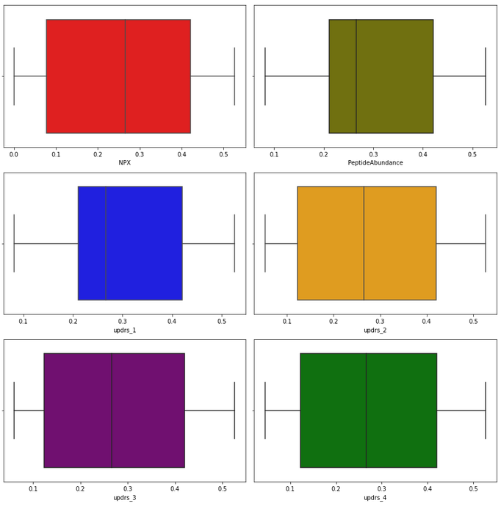
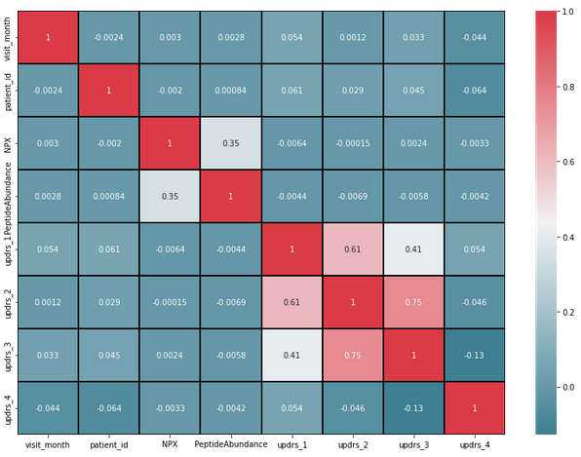
Data Preprocessing + EDA (Cont.)
Plotting distribution plots + boxplots + correlation matrix after removing outliers

Slide 12
Methodology
LSTM Model:
We used an LSTM model to predict MDS-UPDR scores based on the preprocessed data. The LSTM model was trained on sequential data, where each patient's previous MDS-UPDR scores were used to predict the next score. We used a sliding window approach to create sequences of fixed length from the data.
LightGBM Model:
We then used a LightGBM model to further refine the LSTM predictions. The LightGBM model was trained on the same data used for the LSTM model, along with other relevant patient features. This allowed us to capture additional patterns and relationships in the data that the LSTM model may have missed.
M5 Prime:
Regression tree built on M5 Algorithm developed by Quinlan (1992). Each leaf node is used to generated a linear regression model. Steps include: Splitting criterion, pruning, smoothing. It has been known to perform well in predicting nonlinear and noisy datasets.
Notes:
The M5 prime model is a type of regression tree that can be used to model complex relationships between input and output variables. It is based on the M5 algorithm developed by Quinlan (1992), but with some modifications to improve its accuracy and simplicity. The M5 prime model consists of two steps: first, it builds a decision tree that splits the data into subsets based on the values of the input variables; second, it generates a linear regression model for each leaf node of the tree that predicts the output variable based on a weighted combination of the input variables12.
The methodology of the M5 prime model involves the following steps12:
Splitting criterion: The M5 prime model uses the standard deviation reduction (SDR) as the splitting criterion to select the best attribute and value for splitting a node. The SDR measures how much the standard deviation of the output variable is reduced after splitting a node into two branches. The attribute and value that maximize the SDR are chosen as the splitting point.
Pruning: The M5 prime model uses a pruning technique to reduce the size and complexity of the decision tree. Pruning involves removing some branches or nodes of the tree that do not contribute much to the accuracy of the model. The pruning process starts from the bottom of the tree and moves upwards, comparing the error of each node with its parent node. If the error of a node is not significantly higher than its parent node, then the node is pruned and replaced by its parent node.
Smoothing: The M5 prime model uses a smoothing technique to improve the accuracy and generalization ability of the linear regression models at each leaf node. Smoothing involves adjusting the coefficients of the regression models based on their neighboring models in the tree. The smoothing process starts from the top of the tree and moves downwards, updating the coefficients of each model by taking a weighted average of its own coefficients and those of its parent model.
The M5 prime model has been applied to various domains such as engineering, hydrology, ecology, and economics. It has been shown to perform well in predicting nonlinear and noisy data sets12345.

Slide 13
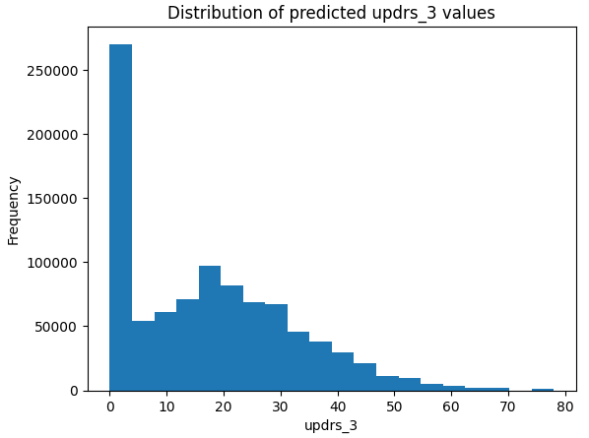
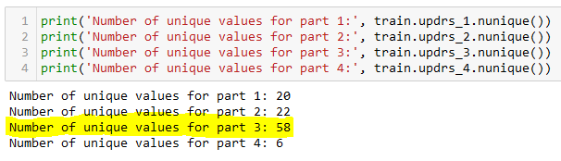
Results
We chose UPDRS3 as the target variable due to its highest number of unique values (58) among the UPDRS scores.
We trained the data using LSTM, LightGBM, and M5 Prime models.

Slide 14
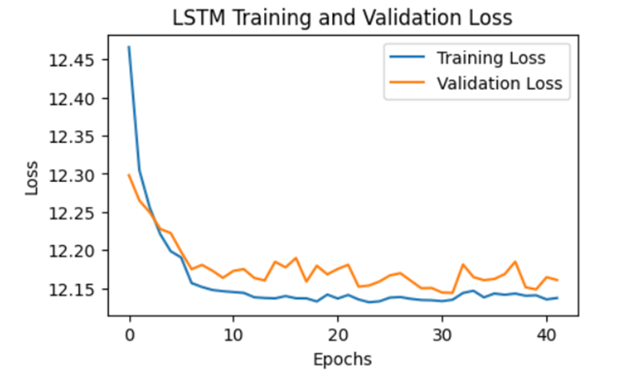
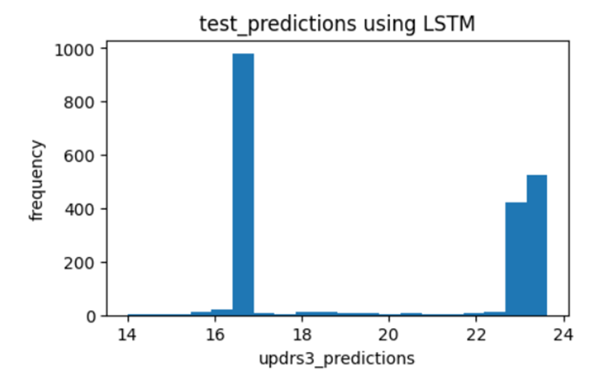
LSTM_Model performance
Train_time = approximately 8 hours
RMSE = 14.75
MAE = 12.11
r2_score = 0.0289
Validation loss on train data Predictions on test data

Slide 15
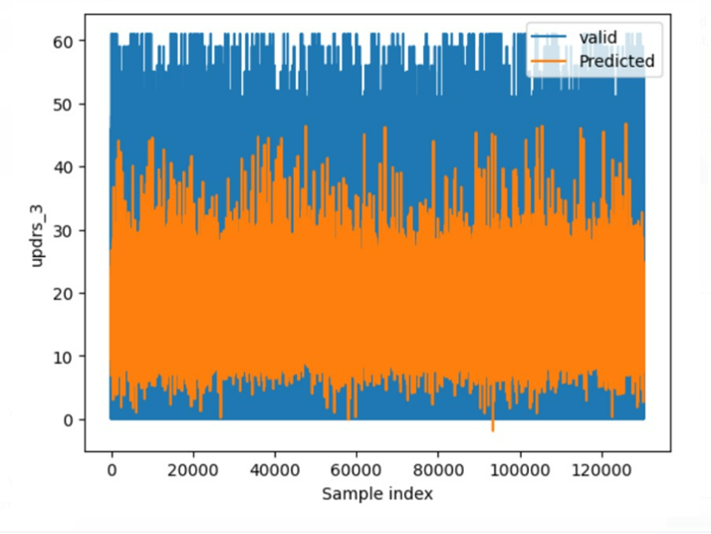
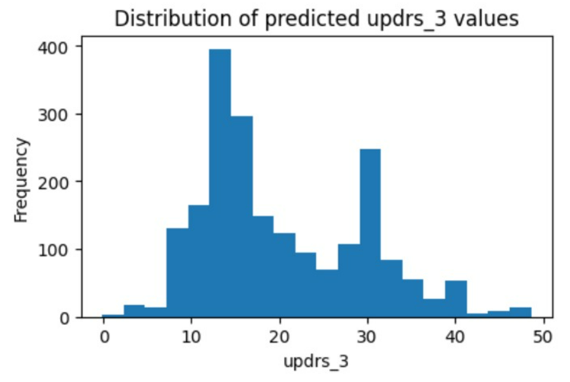
LightGB Model performance
Train_time = 2mins
RMSE = 13.4
MAE = 11.29
r2_score = 0.0719
Predictions on train data Predictions on test data

Slide 16
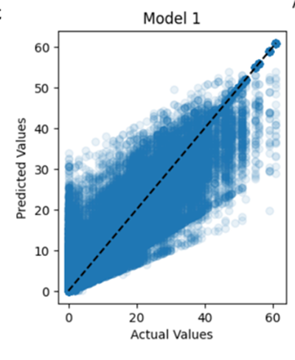
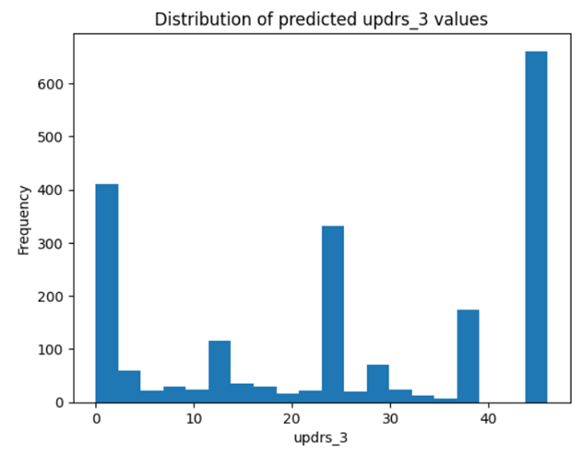
M5 Prime Model performance
Train_time = 48mins
MSE = 15.18
r2_score = 0.92
Predictions on train data
Predictions on test data

Slide 17
Conclusions
Based on the given performance metrics, it appears that the M5 Prime model has the best overall performance, with the highest r2_score of 0.92, indicating that it explains 92% of the variance in the data. The LightGB model has the next best performance with an r2_score of 0.0719, while the LSTM model performs the worst with an r2_score of 0.0289.
It is also worth noting that the LightGB model has a significantly faster training time (2 minutes) compared to the LSTM model (approximately 8 hours), which may be an important consideration depending on the specific use case and available computational resources.
In conclusion, based on the provided metrics, the M5 Prime model is the best-performing model, followed by the LightGB model, and the LSTM model performs the worst.

Slide 18
THANK YOU!!!

